Slide 1
Telescopes
Portals of Discovery

Slide 2
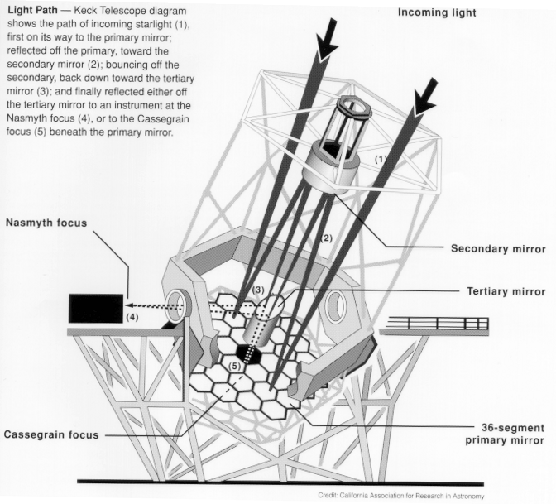
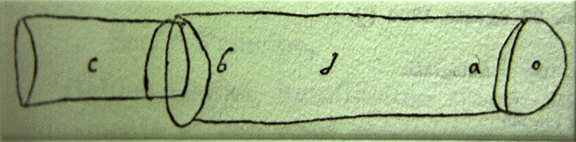
Telescopes Portals of Discovery
Notes:
2

Slide 3
6.1 Eyes and Cameras: Everyday Light Sensors
Our goals for learning:
  How do eyes and cameras work?

Slide 4
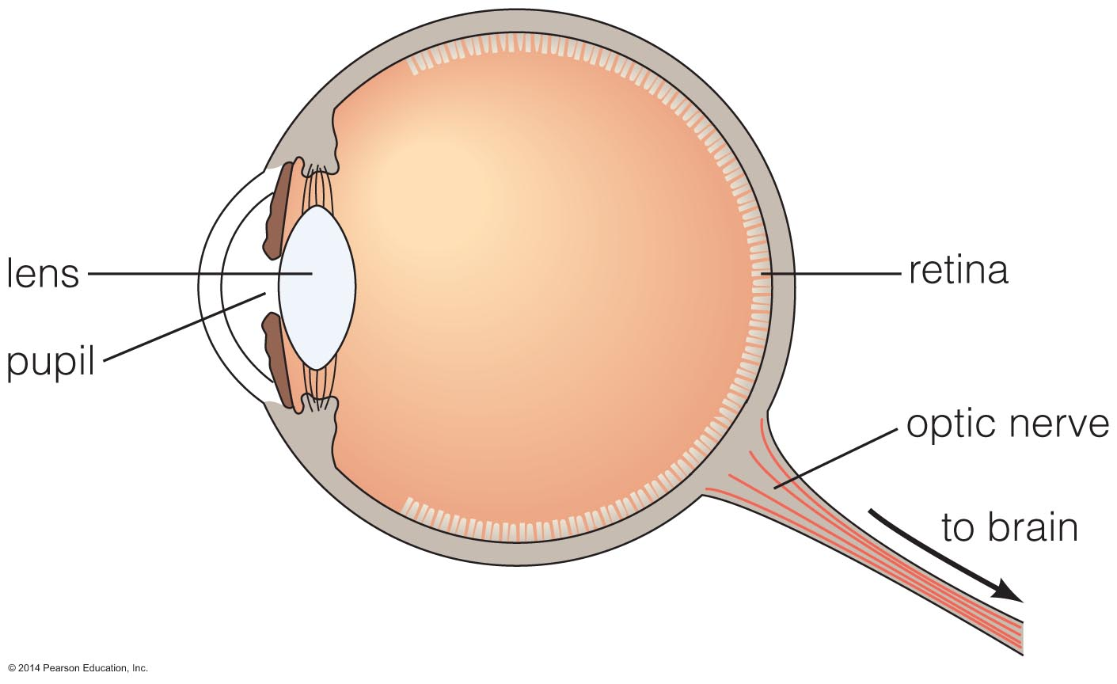
The Eye

Slide 5
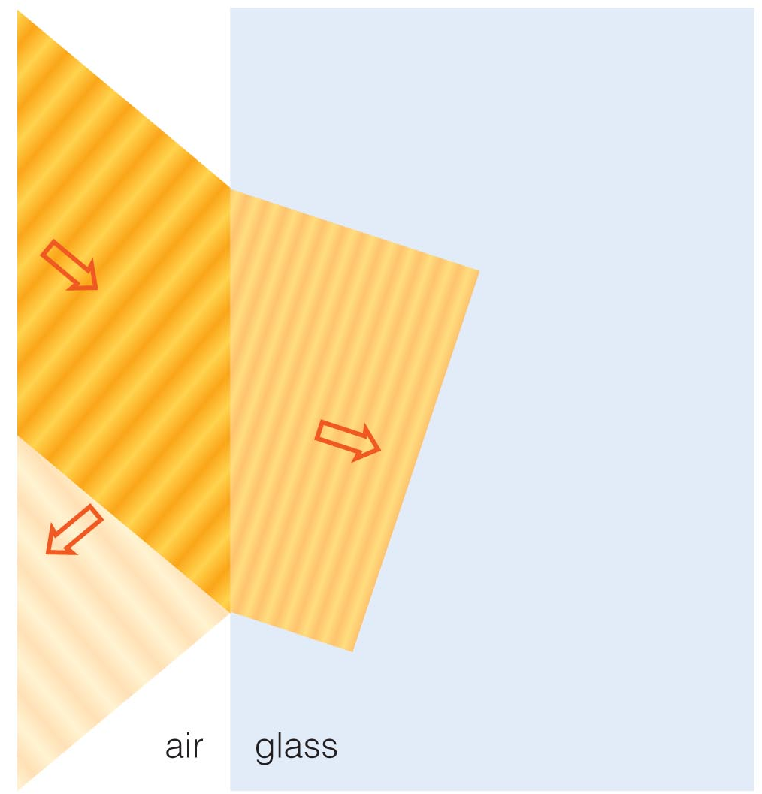
Refraction
Refraction is the bending of light when it passes from one substance into another.
Your eye uses refraction to focus light.

Slide 6
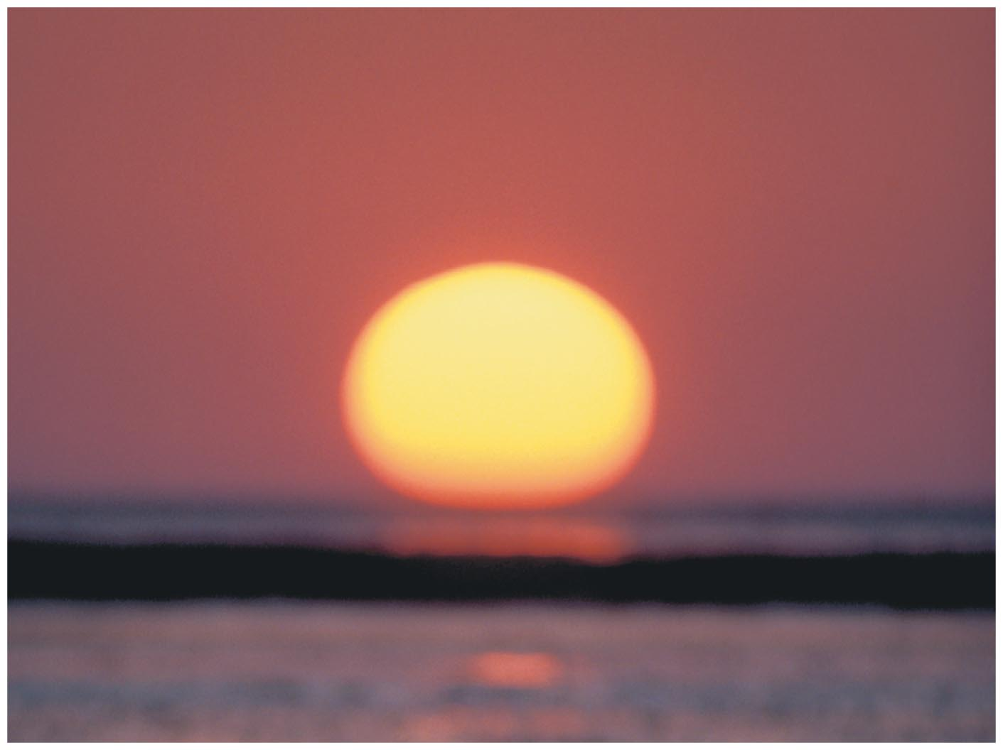
Example: Refraction at Sunset
Sun appears distorted at sunset because of how light bends in Earth's atmosphere.

Slide 7
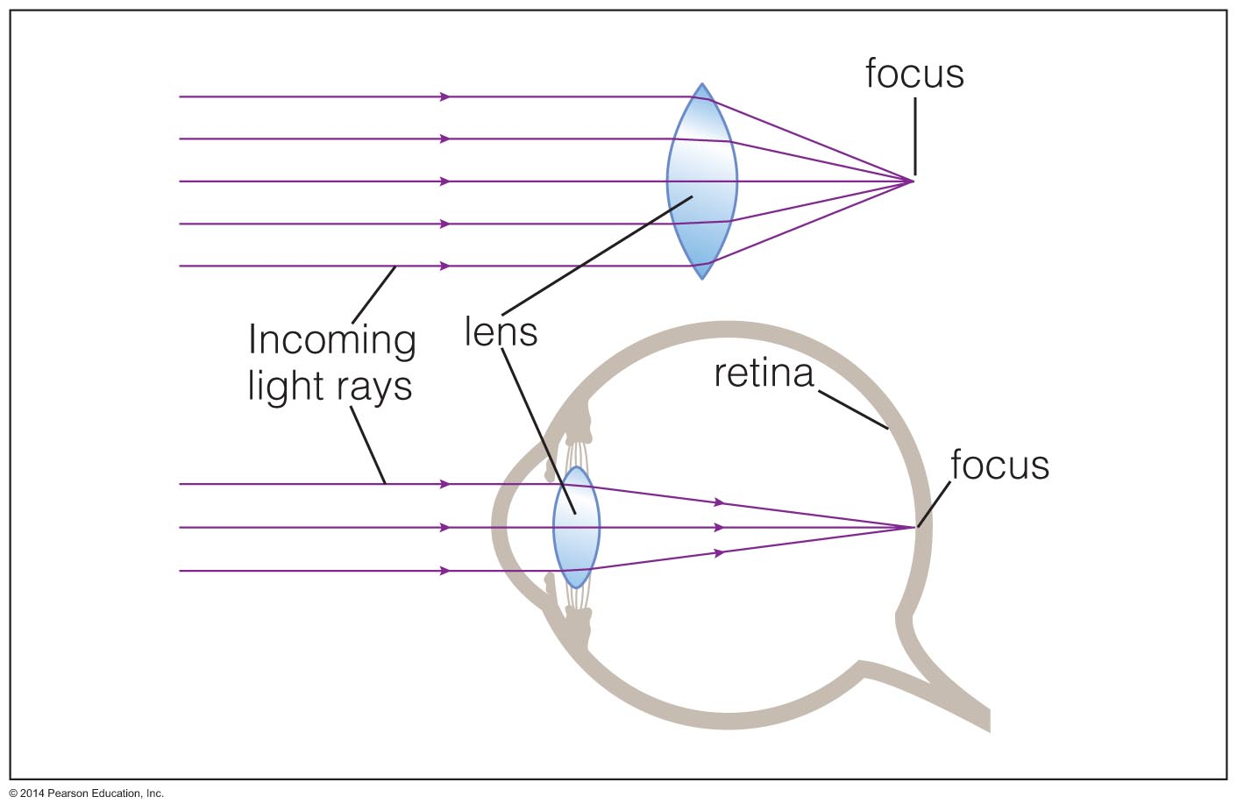
Focusing Light
Refraction can cause parallel light rays to converge to a focus.

Slide 8
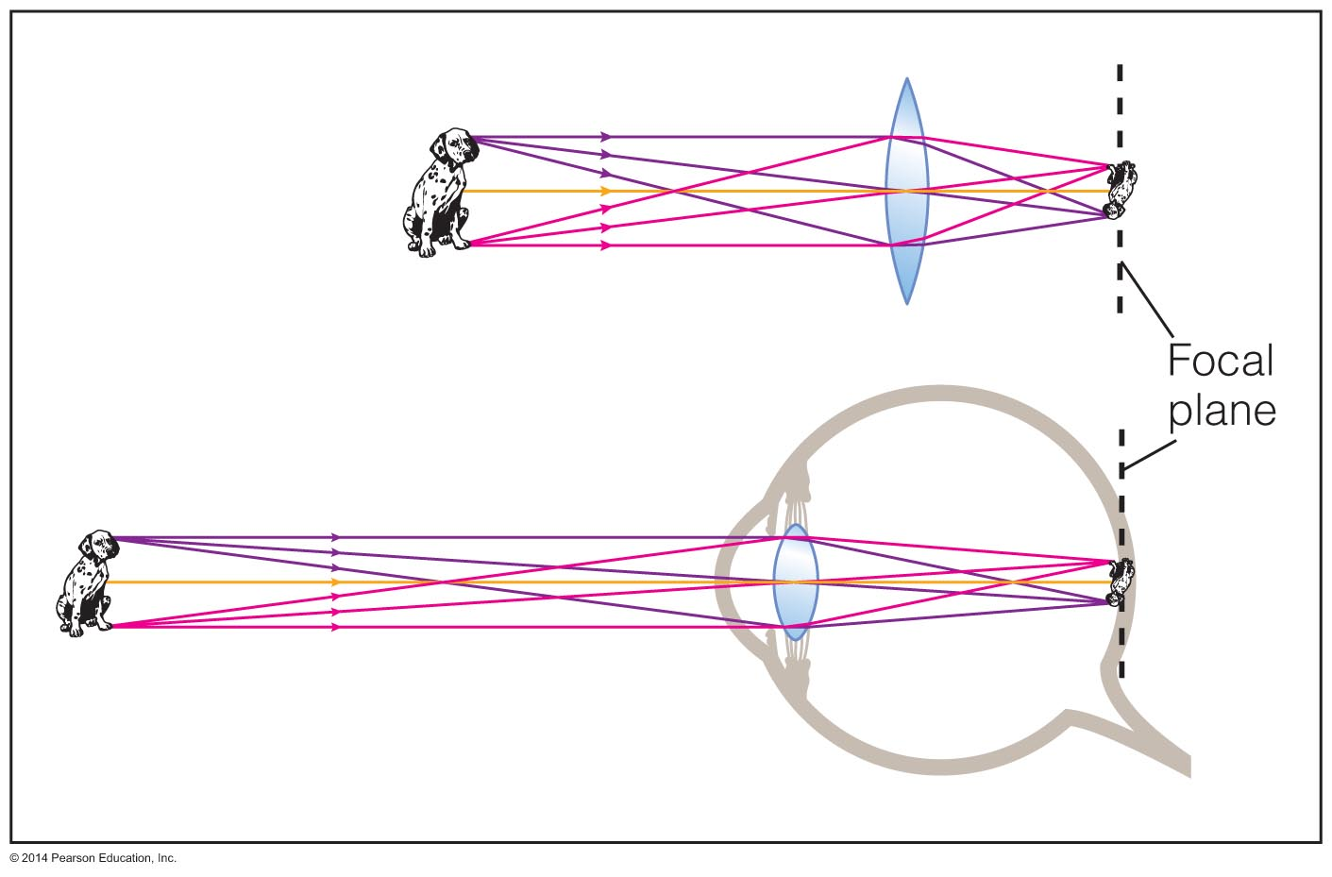
Image Formation
The focal plane is where light from different directions comes into focus.
The image behind a single (convex) lens is actually upside-down!

Slide 9
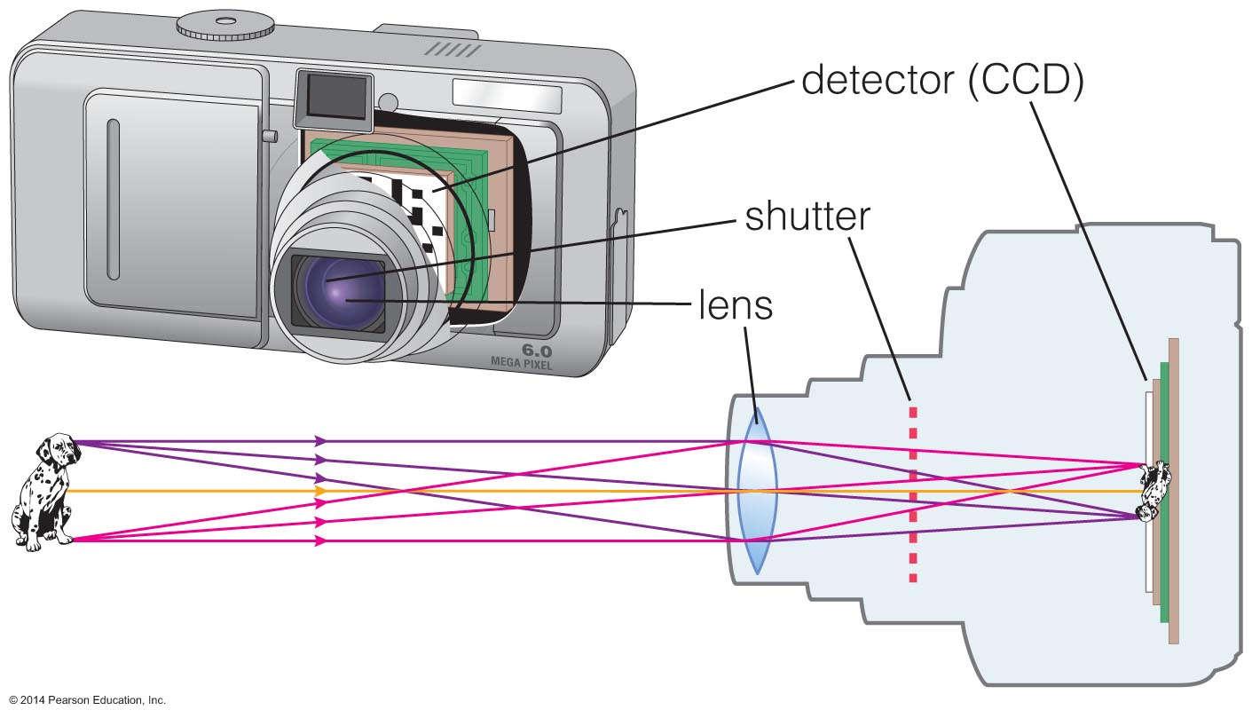
Recording Images
Digital cameras detect light with charge-coupled devices (CCDs).
A camera focuses light like an eye and captures the image with a detector.
The CCD detectors in digital cameras are similar to those used in modern telescopes.
Notes:
Note that the text in the book does not mention CCDs, though figure 6.6 still makes reference to them. This should be mentioned to students.

Slide 10
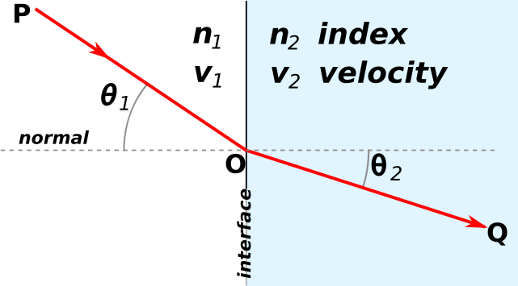
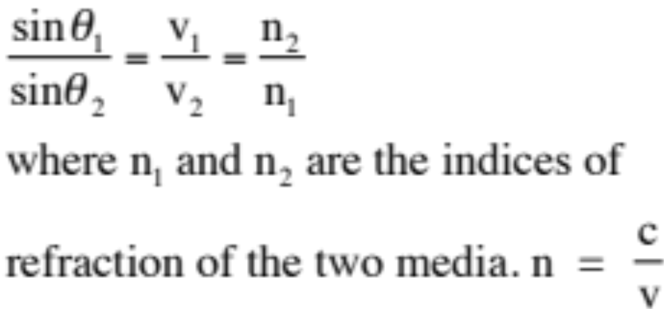
Refraction
To understand telescopes we need to discuss refraction.
Refraction is the change in direction of light due to a change in its speed. This usually happens when light goes from one type of medium to another.
Refraction is described by Snell's law, which states that the angle of incidence θ₁ is related to the angle of refraction θ₂ by:

Slide 11
What have we learned?
How do eyes and cameras work?
  Eyes use refraction to bend parallel light rays so that they form an image.
  The image is in focus if the focal plane is at the retina.
  Cameras focus light like your eye and record the image with a detector.

Slide 12
6.2 Telescopes: Giant Eyes
Our goals for learning:
  What are the two most important properties of a telescope?
  What are the two basic designs of telescopes?
  What do astronomers do with telescopes?

Slide 13
What are the two most important properties of a telescope?
Light-collecting area: Telescopes with a larger collecting area can gather a greater amount of light in a shorter time.
Angular resolution: Angular Resolution is the angular size of the smallest feature that can be distinguished. Telescopes that are larger are capable of taking images with greater detail.

Slide 14
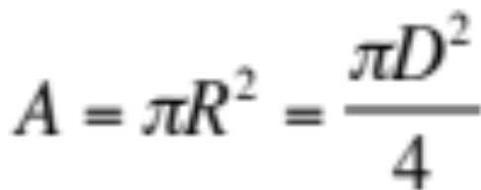
Light-Collecting Area
The light-collecting area of a telescope is proportional to the area of the telescopes objective lens or mirror:
where, D is the lens or mirror diameter.
Example: Each of the two Keck telescopes on Mauna Kea in Hawaii uses a concave mirror 10 m in diameter to bring starlight to a focus.
Question: How many times greater is the light-collecting area of either Keck telescope compared to that of the human eye? Assume a human eye has a pupil diameter of about 5 mm.

Slide 15
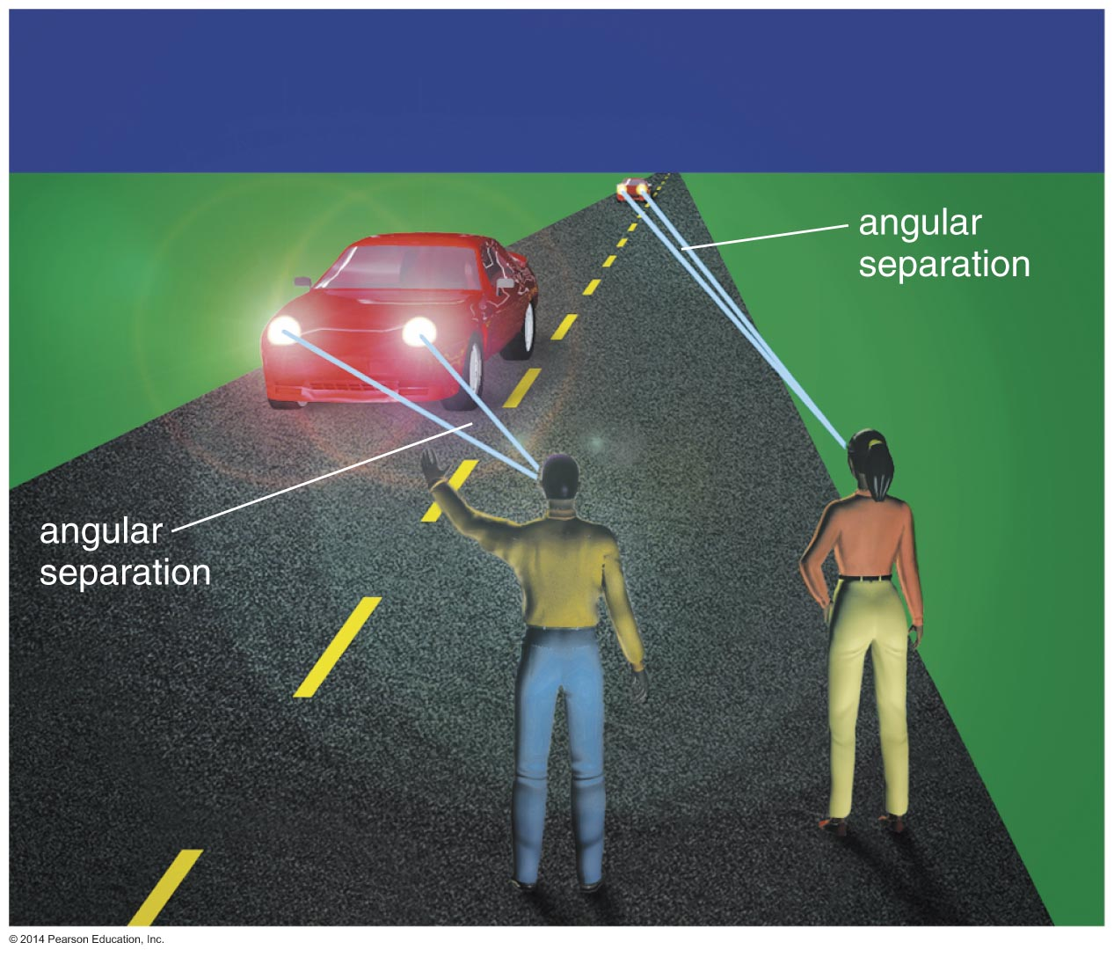
Angular Resolution
The minimum
angular
separation that
the telescope
can distinguish
Notes:
Emphasize that at a great distance the lights would look like one light rather than two --- but we could still see them. (Students sometimes think that below a particular angular resolution we see nothing at all.)

Slide 16
Angular Resolution
An important property of a telescope is its angular resolution.
Angular resolution of a telescope is the angular size of the smallest feature that can be distinguished.
The angular resolution of your eye (for 20/20 vision) is about 1 arcmin. The planets have angular sizes of less than 1 arcmin and this is why they appear as points.
The angular resolution will depend on:
the quality of the mirrors, mirror design
diffraction
atmospheric turbulence (seeing)
Notes:
Emphasize that at a great distance the lights would look like one light rather than two --- but we could still see them. (Students sometimes think that below a particular angular resolution we see nothing at all.)

Slide 17
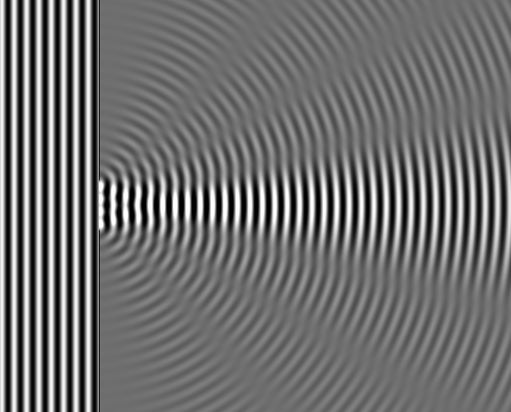
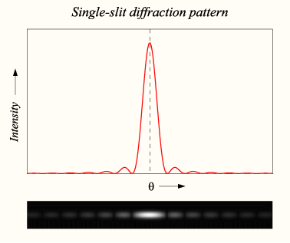
Diffraction
Diffraction is the apparent bending of waves around small obstacles and the spreading out of waves past small openings.

Slide 18
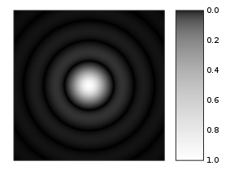
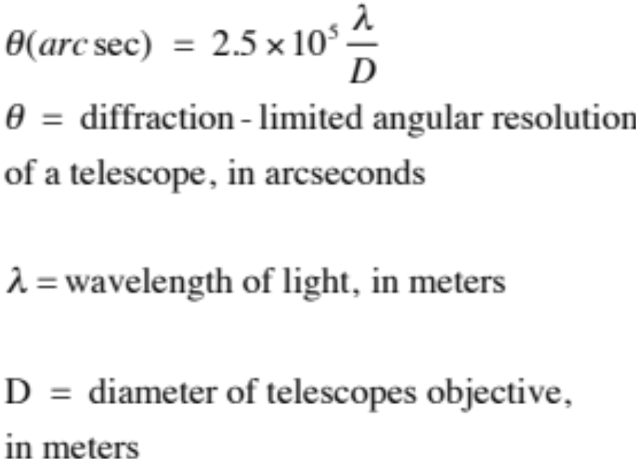
Diffraction
The light collected by a telescope at the focal point is not focused to a point but forms a diffraction pattern having a central peak with a angular size between the peak and the first null:
Diffraction by a circular aperture. Notice the variation of intensity with angle.
Question: What is the diffraction limited angular resolution of
the human eye (D = 5 mm)
The Keck telescope (D = 10 m)
at H_{α}.

Slide 19
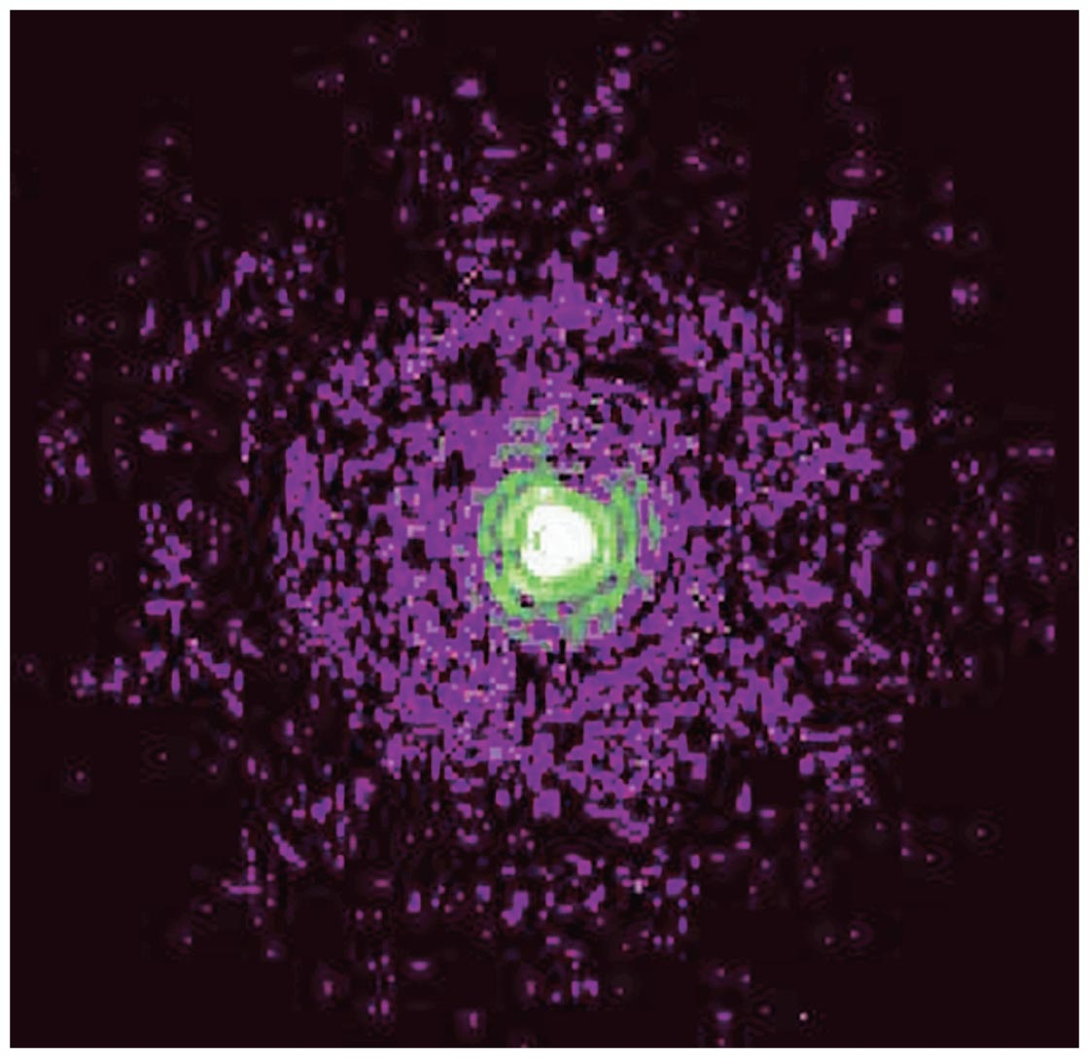
Angular Resolution
The rings in this image of a star come from diffraction of light waves.
This limit on angular resolution is known as the diffraction limit.
Close-up of a star from the Hubble
Space Telescope

Slide 20
Seeing Disk
Turbulence in the atmosphere will blur an image. Even through the largest telescopes that are not limited by diffraction a point source looks like a blob.
The angular size by which a stars size is broadened due to the atmosphere is called the seeing disk.
The size of the seeing disk depends on the location of the observations. For example, on Kitt Peak in Arizona and Cerro Tololo in Chile, the seeing disk is typically around 1 arcsec.

Slide 21
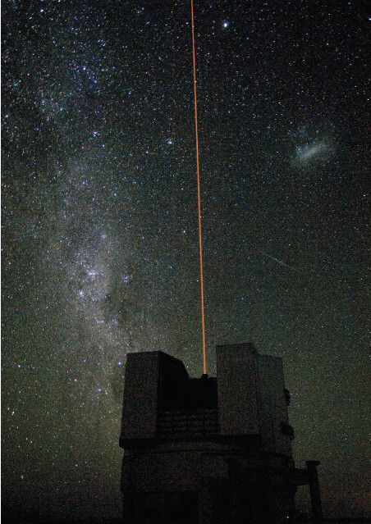
Correcting for Turbulence: Adaptive Optics
The goal of adaptive optics is to compensate for atmospheric turbulence.
In an adaptive optics system, sensors monitor the dancing motion of a star due to turbulence 10 to 100 times per second, and a powerful computer rapidly calculates the mirror shape needed to compensate.
If a bright star is not near the field of view
a laser beam is used. The beam strikes sodium atoms in the sky, causing them to glow and make an artificial “star.” Tracking the twinkling of this “star” makes it possible to undo the effects of atmospheric turbulence on telescope images.

Slide 22
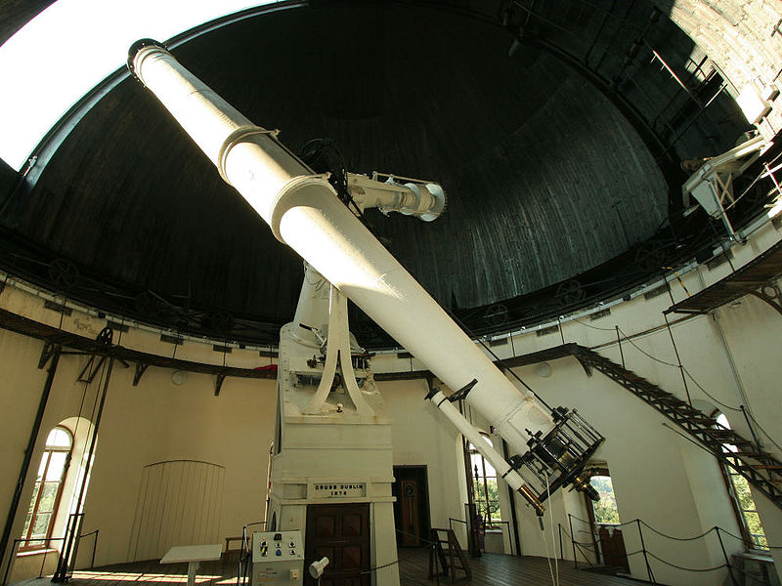
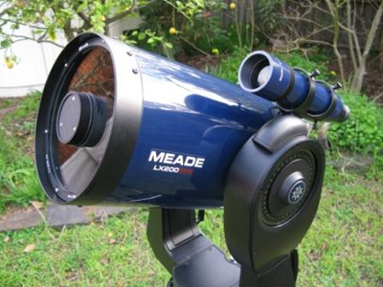
What are the two basic designs of telescopes?
Refracting telescope: focuses light with lenses
Reflecting telescope: focuses light with mirrors
The 68 cm refractor at the Vienna University Observatory.
The 8 in reflecting telescope MEADE LX 200.

Slide 23
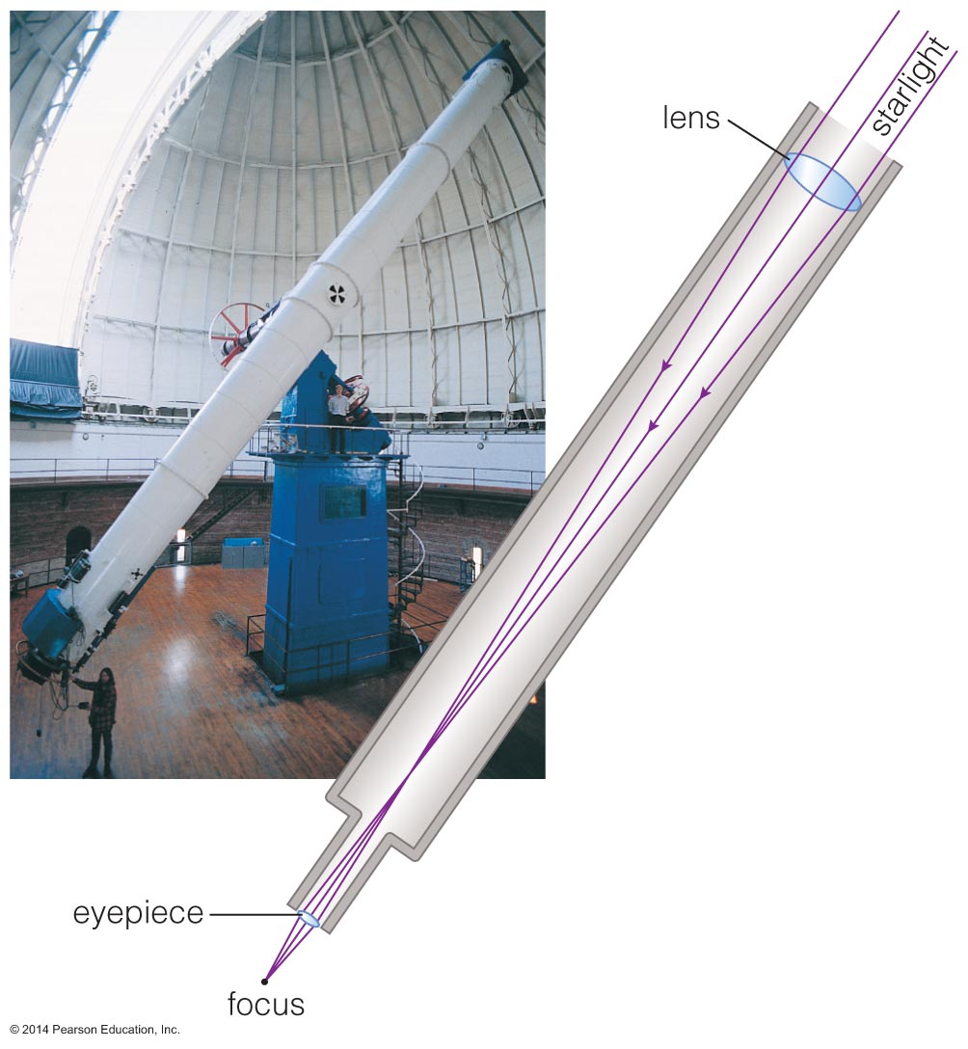
Refracting Telescope
Refracting telescopes need to be
very long,
with large, heavy lenses.

Slide 24
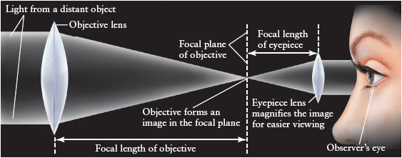
Refracting Telescope
A refracting telescope consists of a large-diameter objective lens (convex lens) with a long focal length and a small eyepiece lens of short focal length. The eyepiece lens magnifies the image formed by the objective lens in its focal plane (shown as a dashed line).

Slide 25
Refracting Telescope
The magnification (M) provided by a refracting telescope is the ratio of the focal length of the objective (f₁) to the focal length of the eyepiece (f₂). M= f₁/f₂
Assume a crater on the moon has an angular size of about 0.01°. A telescope with a magnification of 20× will make it appear to have an angular size of 20×0.01° = 0.2°

Slide 26
Refracting Telescope
Example: A small refracting telescope has an objective of focal length 1 m. If the eyepiece has a focal length of 4.0 cm, what is the magnification of the telescope?

Slide 27
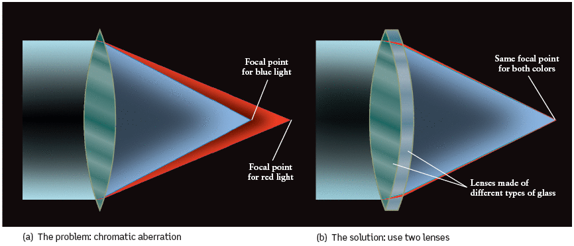
Chromatic Aberration of Refractors
A single lens suffers from a defect called chromatic aberration,
in which different colors of light are brought to a focus at different
distances from the lens. (b) This problem can be corrected by
adding a second lens made from a different kind of glass.

Slide 28
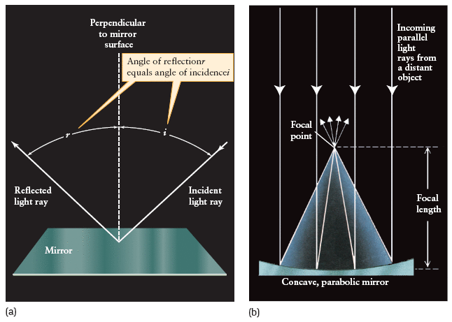
Reflecting Telescope
Almost all modern day telescopes are reflecting telescopes.
Some properties of reflection:
(a) The angle of incidence (i), is always equal to the angle the angle of reflection (r).
(b) A parabolic mirror causes parallel light rays to converge to a focus at the focal point. The distance between the mirror and the focal point is the focal length of the mirror.

Slide 29
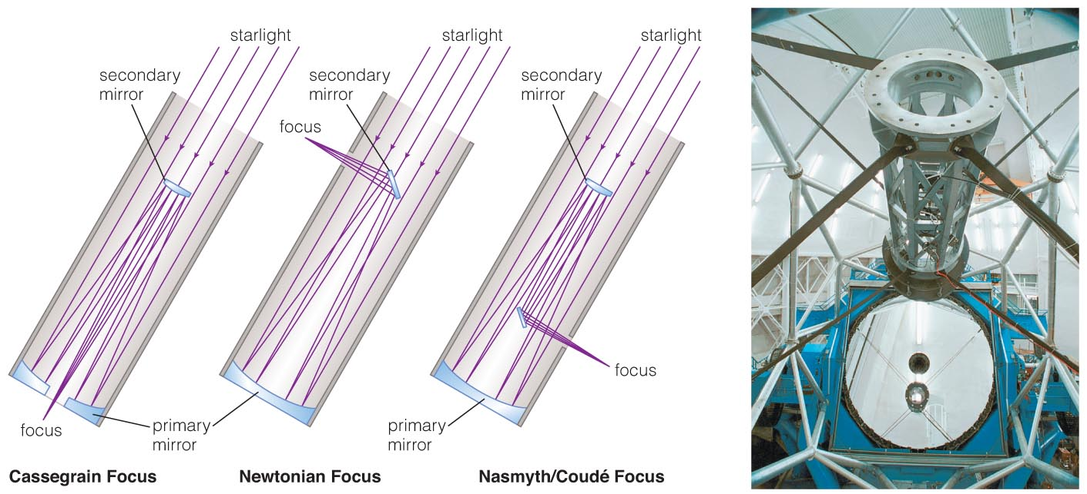
Reflecting Telescope
Reflecting telescopes can have much greater diameters.
Most modern telescopes are reflectors.

Slide 30
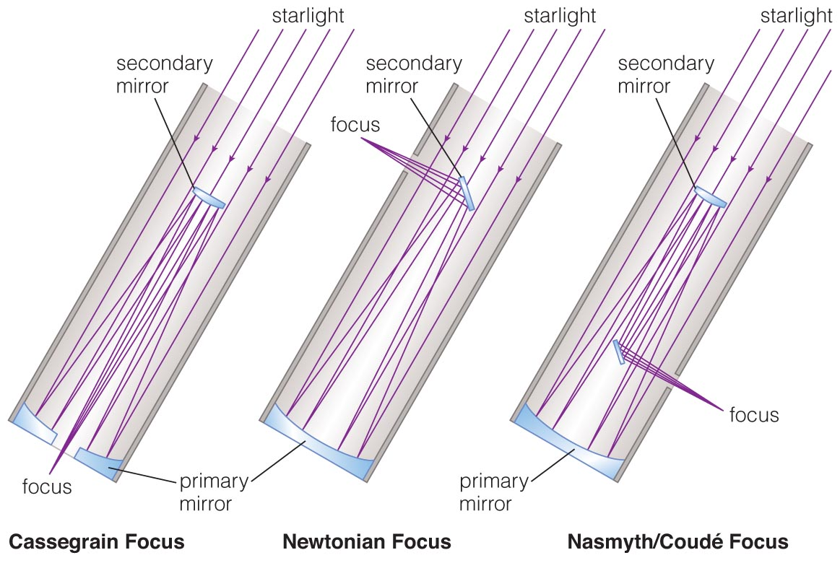
Designs for Reflecting Telescopes
The magnification of Newtonian and Cassegrain telescopes is the ratio of the focal length of the objective to the focal length of the eyepiece: M = f1/f2

Slide 31
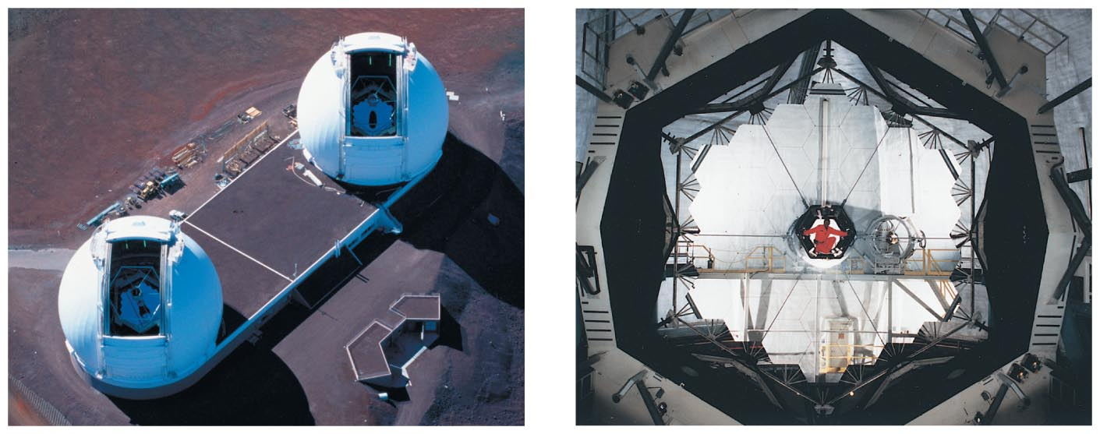
Mirrors in Reflecting Telescopes
Pick-up images.
Twin Keck telescopes on
Mauna Kea in Hawaii
Segmented 10-meter mirror of a Keck telescope
Notes:
Point students' attention to the human in the middle of the Keck mirror!

Slide 32
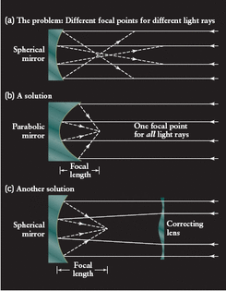
Spherical Aberration of Reflectors
Different parts of a spherically concave mirror reflect light to slightly different focal points. This effect, called spherical aberration, causes image blurring.
Spherical aberration can be corrected by using :
- a parabolic objective mirror
- or using a correcting mirror

Slide 33
What do astronomers do with telescopes?
Imaging: taking pictures of the sky
Spectroscopy: breaking light into spectra
Time Monitoring: measuring how light output varies with time

Slide 34
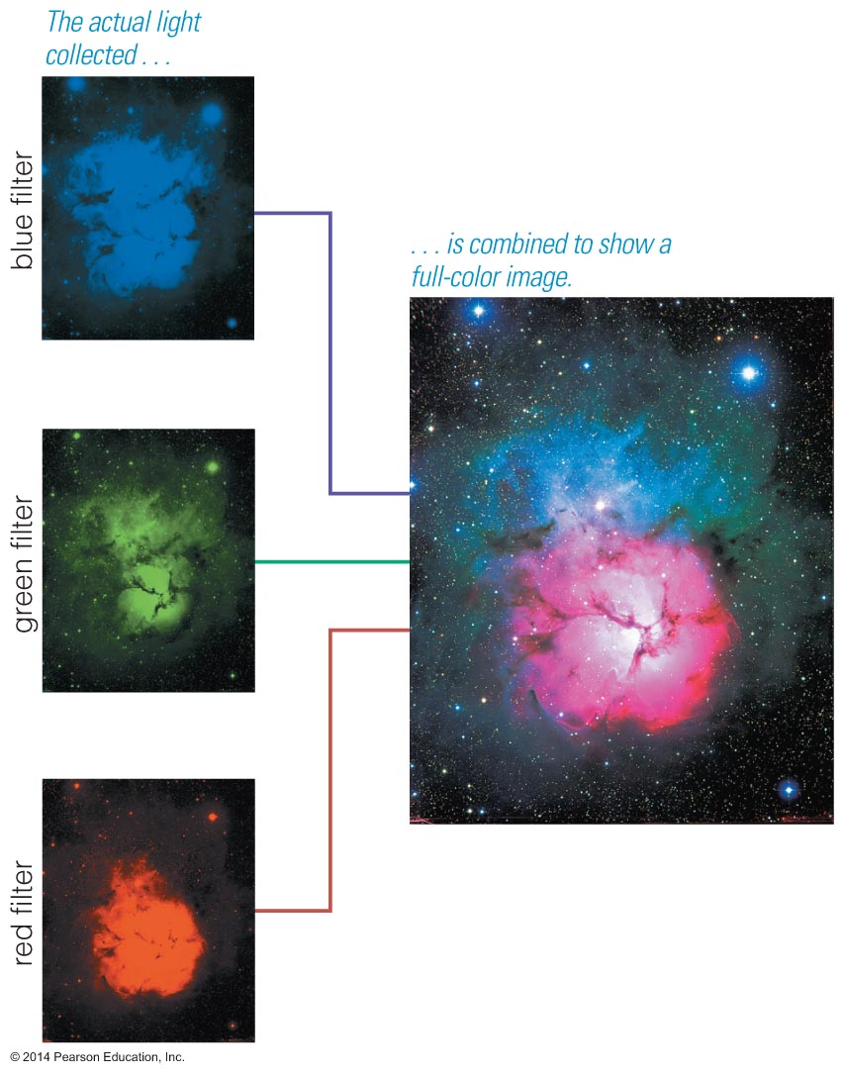

Imaging
Astronomical detectors generally record only one color of light at a time.
Several images must be combined to make full-color pictures.

Slide 35
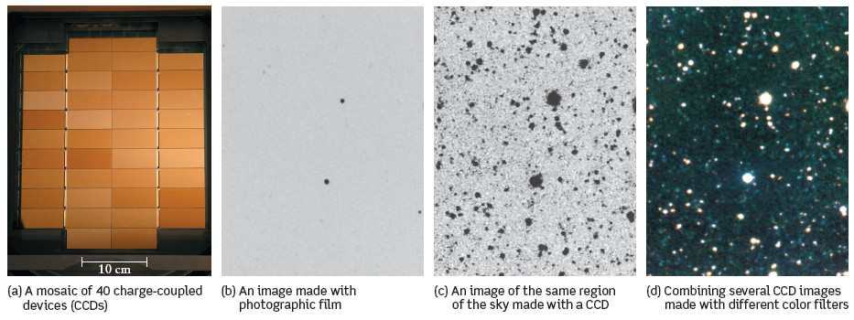
Imaging instruments used in astronomy
Telescopes can provide detailed pictures of distant objects. These images are usually recorded on charge-coupled devices (CCDs).
Each one of the 40 CCDs used on the Canada-France-Hawaii Telescope (panel a) has 9.4 million pixels arranged in 2048 rows by 4608 columns.

Slide 36
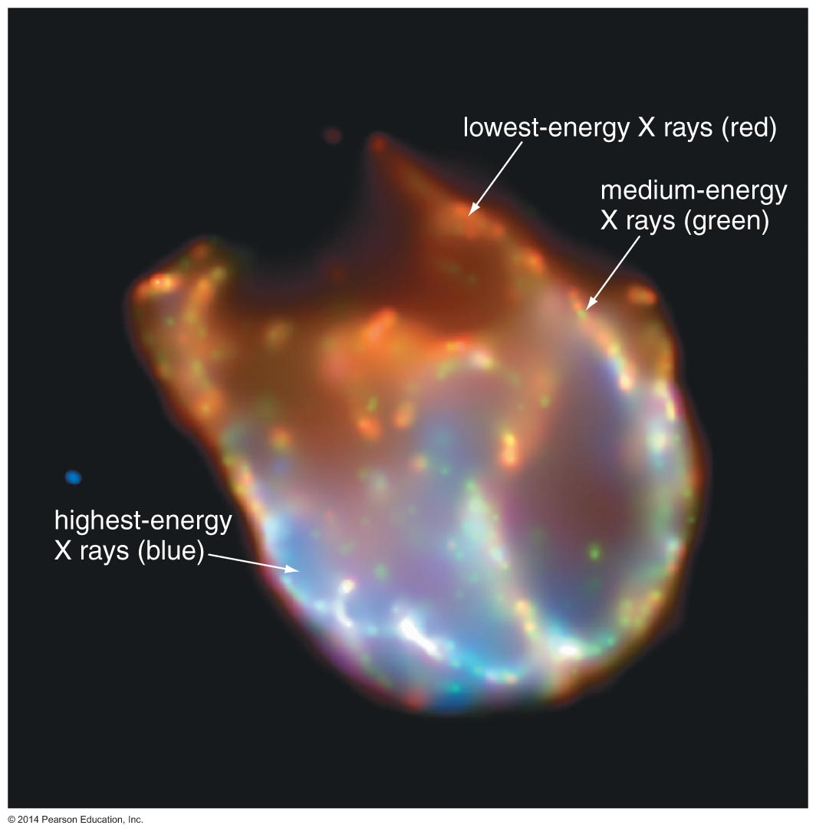
Imaging
Astronomical detectors can record forms
of light our
eyes can't see.
Color is sometimes used to represent different energies of non-visible light.

Slide 37
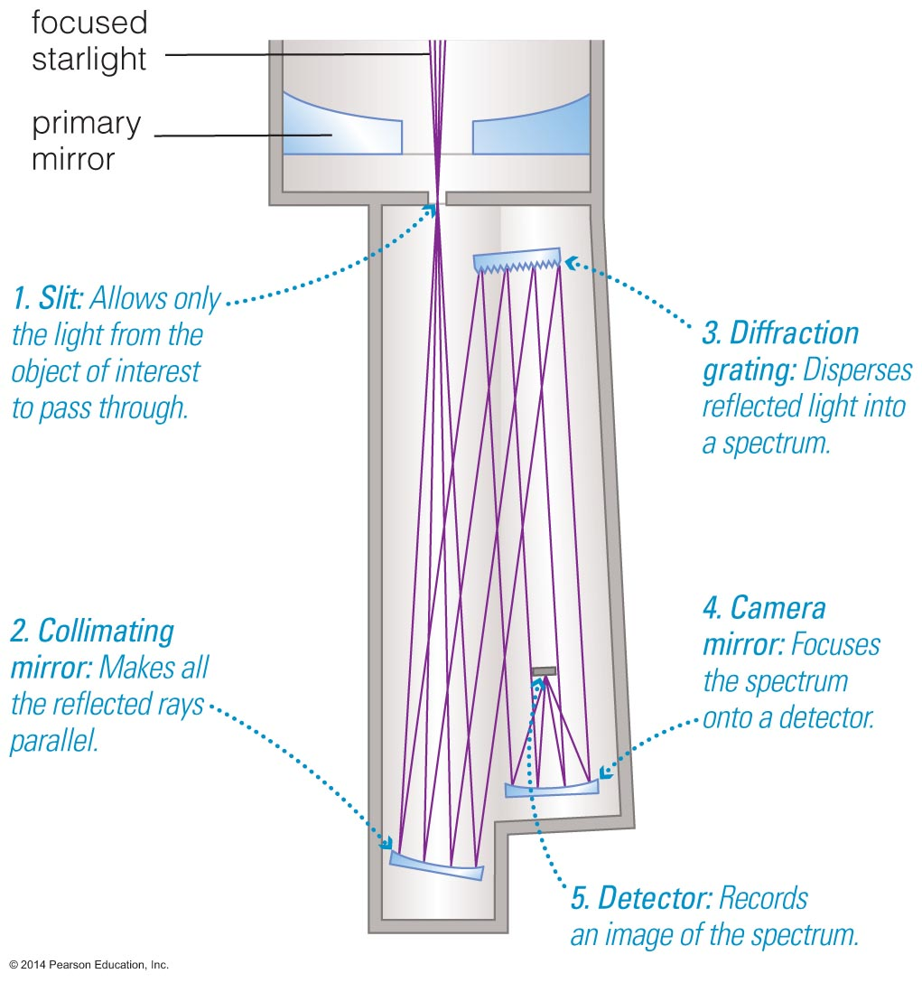
Spectroscopy
A spectrograph separates the different wavelengths of light before they hit the detector.

Slide 38
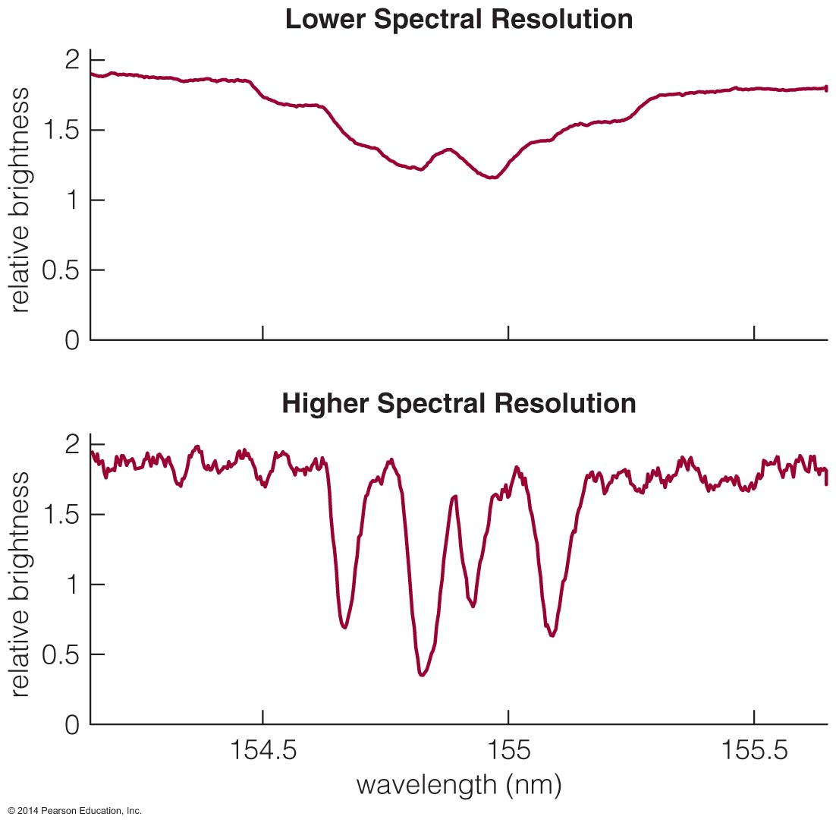
Spectroscopy
Graphing relative brightness of light at each wavelength shows the details in a spectrum.

Slide 39
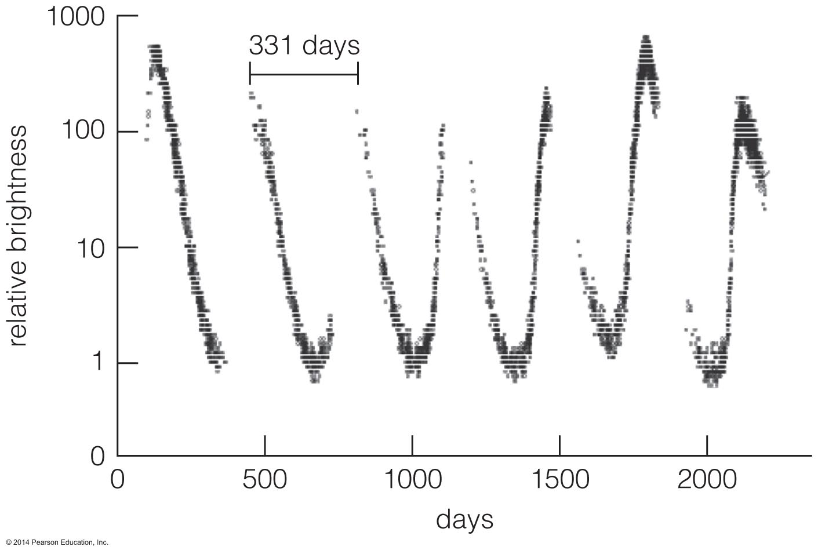
Time Monitoring
A light curve represents a series of brightness measurements made over a period of time.

Slide 40
What have we learned?
What are the two most important properties of a telescope?
  Collecting area determines how much light a telescope can gather.
  Angular resolution is the minimum angular separation a telescope can distinguish.
What are the two basic designs of telescopes?
  Refracting telescopes focus light with lenses.
  Reflecting telescopes focus light with mirrors.
  The vast majority of professional telescopes are reflectors.

Slide 41
What have we learned?
What do astronomers do with telescopes?
  Imaging
  Spectroscopy
  Time Monitoring

Slide 42
6.3 Telescopes and the Atmosphere
Our goals for learning:
  How does Earth's atmosphere affect ground-based observations?
  Why do we put telescopes into space?

Slide 43
How does Earth's atmosphere affect ground-based observations?
The best ground-based sites for astronomical observing are:
  calm (not too windy)
  high (less atmosphere to see through)
  dark (far from city lights)
  dry (few cloudy nights)

Slide 44
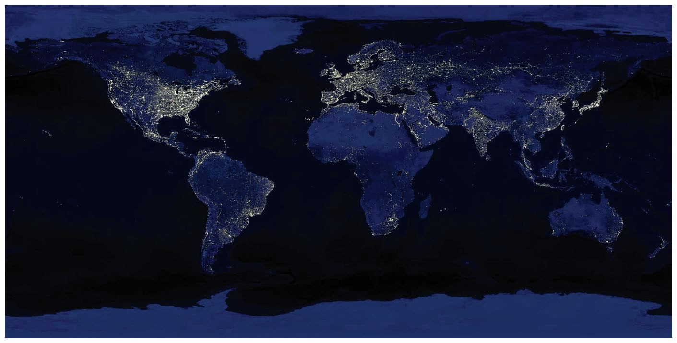
Light Pollution
Scattering of human-made light in the atmosphere is a growing problem for astronomy.

Slide 45
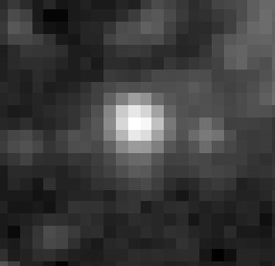
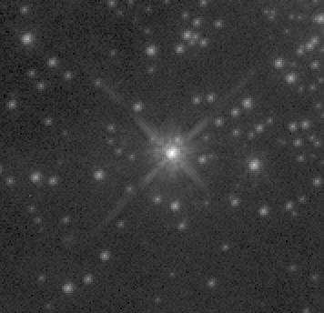
Twinkling and Turbulence
Bright star viewed with ground-based telescope
Same star viewed with Hubble Space Telescope
Turbulent air flow in Earth's atmosphere distorts our view, causing stars to appear to twinkle.

Slide 46
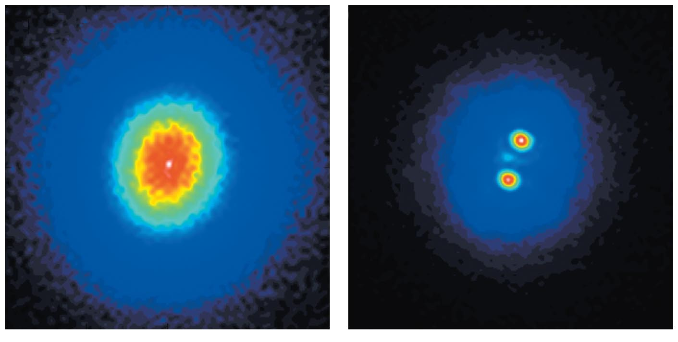
Adaptive Optics
Without adaptive optics
With adaptive optics
Rapidly changing the shape of a telescope's mirror compensates for some of the effects of turbulence.

Slide 47
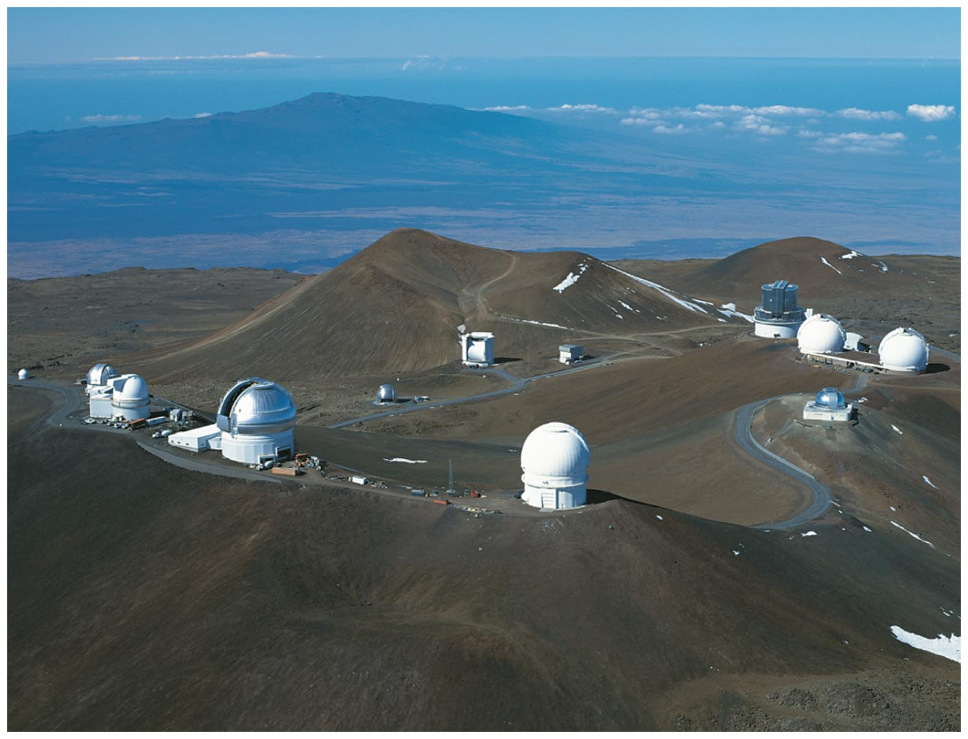
Calm, High, Dark, Dry
The best observing sites are atop remote mountains.
Summit of Mauna Kea, Hawaii

Slide 48
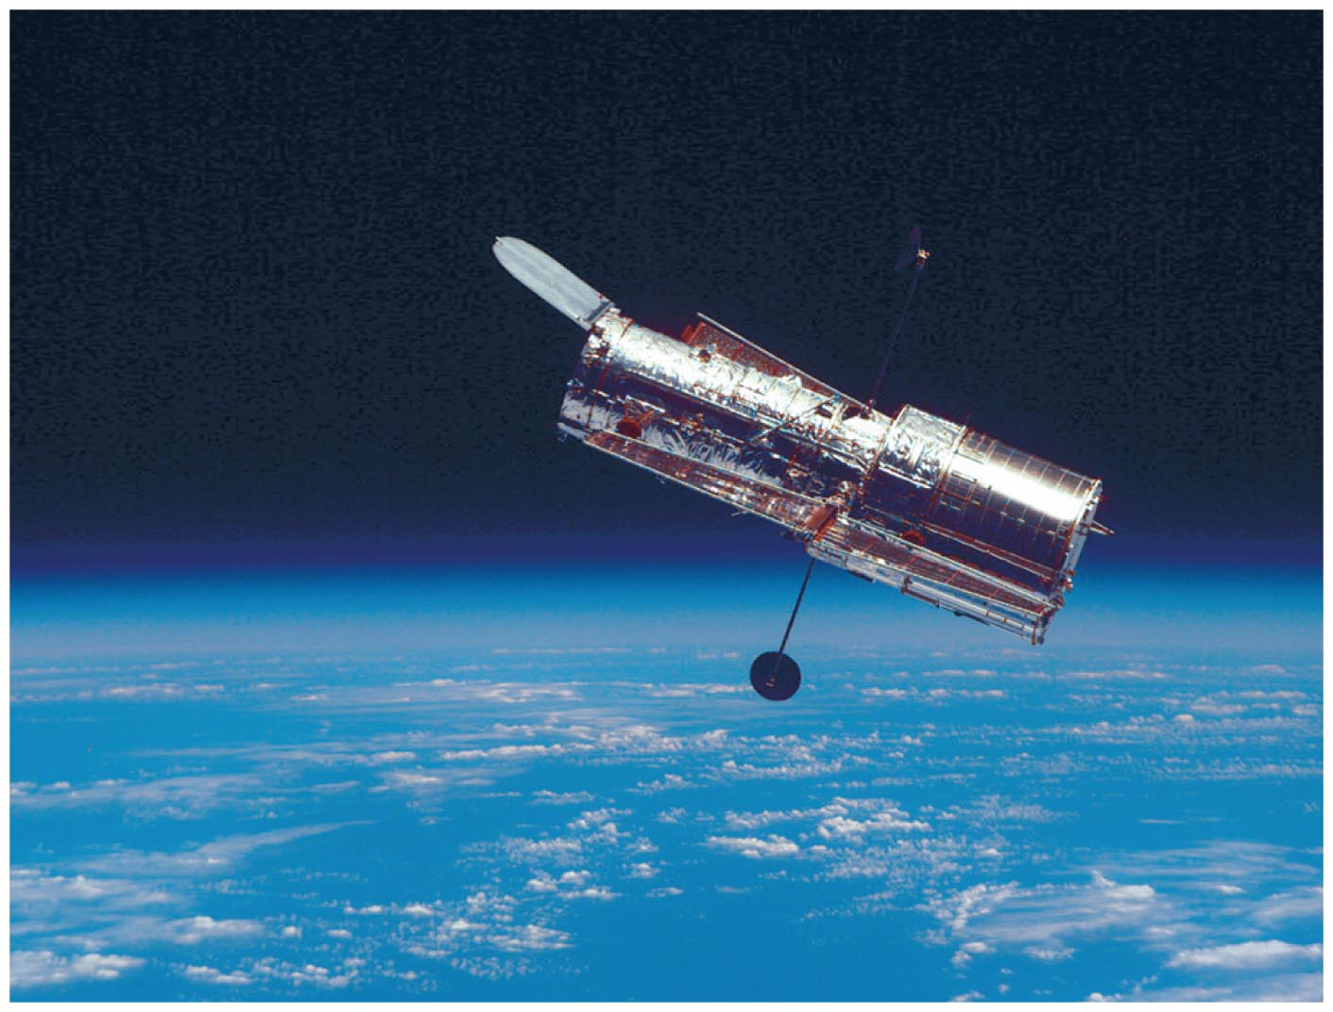
Why do we put telescopes into space?

Slide 49
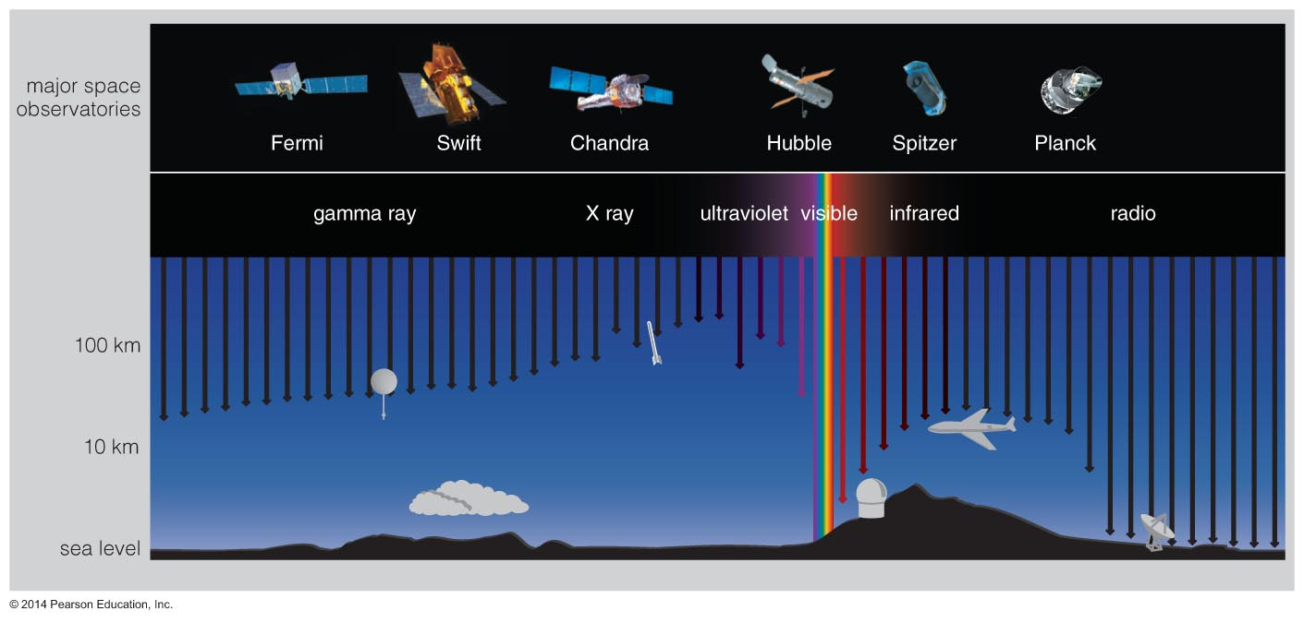
Transmission in Atmosphere
Only radio and visible light pass easily through Earth's atmosphere.
We need telescopes in space to observe other forms.

Slide 50
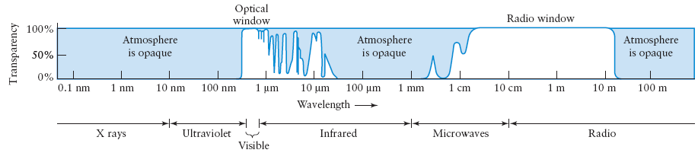
Transmission in Atmosphere
This graph shows the percentage of radiation that can penetrate the Earth’s atmosphere at different wavelengths.
At wavelengths less than about 290 nm photons are absorbed by atmospheric oxygen and nitrogen.
Between the optical and radio windows photons are absorbed by water vapor and carbon dioxide.
At wavelengths longer than about 20 m, photons are reflected back into space by ionized gases in the upper atmosphere.

Slide 51
What have learned?
How does Earth's atmosphere affect ground-based observations?
  Telescope sites are chosen to minimize the problems of light pollution, atmospheric turbulence, and bad weather.
Why do we put telescopes into space?
  Forms of light other than radio and visible do not pass through Earth's atmosphere.
  Also, much sharper images are possible because there is no turbulence.

Slide 52
6.4 Telescopes and Technology
Our goals for learning:
  How can we observe invisible light?
  How can multiple telescopes work together?

Slide 53
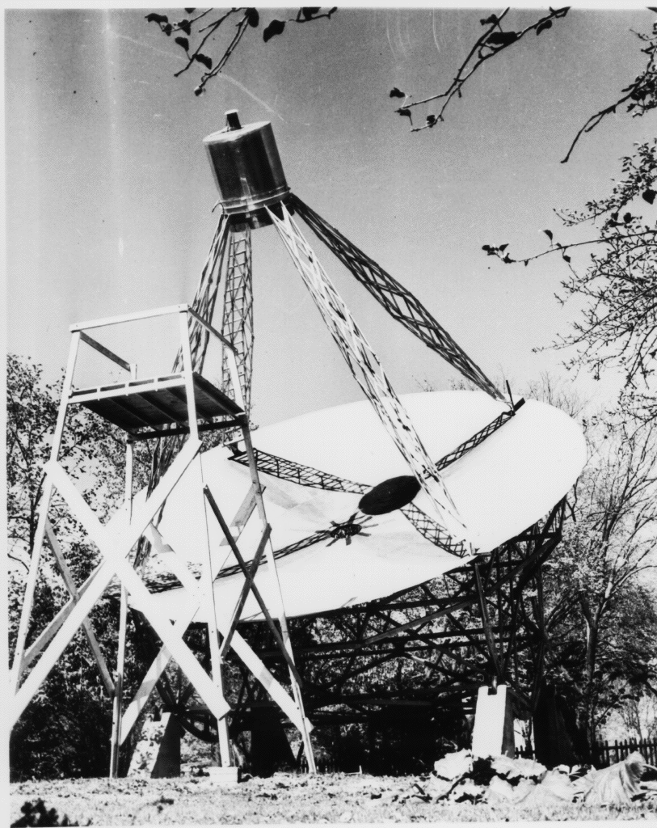
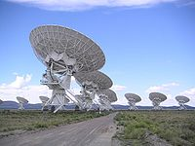
Radio Astronomy
The first radio waves of an astronomical origin were discovered by Karl Jansky in the early 1930s.
Jansky was trying to figure out what was causing interference at 20 MHz with a trans-atlantic radio link. He built a steerable radio antenna to search for the source of the noise.
He concluded that an astronomical object in the direction of the constellation Sagittarius must be causing the radio interference.
In 1936 Grote Reber built the first parabolic "dish" radio telescope and conducted the first sky survey in the radio frequencies.
Reber’s radio telescope
VLA in New Mexico

Slide 54
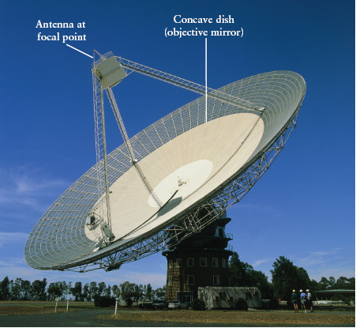
Radio Telescopes
A modern ratio telescope consists of :
a parabolic dish
- an antenna tuned to the desired frequency located at the focus.
The signal picked up by the antenna is relayed to an amplifier and recording instruments usually located at the base of the telescope pier.
Questions:
1) What frequency does 64 m correspond to?
2) Why can’t microwaves at
ν = 2.45 GHz leak through a microwave door?
PARKES, NSW, Australia
(64 m diameter)

Slide 55
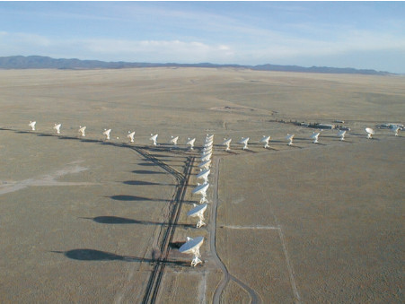
Radio Telescopes: Dealing with Diffraction
The diffraction limited angular resolution of a 25 m radio dish at λ = 21-cm is θ ~ 2.5×10⁵ ×(21 cm /25 m) = 2100 arcsec
To improve the angular resolution of radio telescopes astronomers use the interferometry technique.
The Very Large Array (VLA) consists of 27 parabolic dishes, each 25 m in diameter. By pointing all 27 telescopes at the same object and combining the 27 radio signals, the VLA can produce radio views of the sky with an angular resolution as small as 0.05 arcsec.

Slide 56
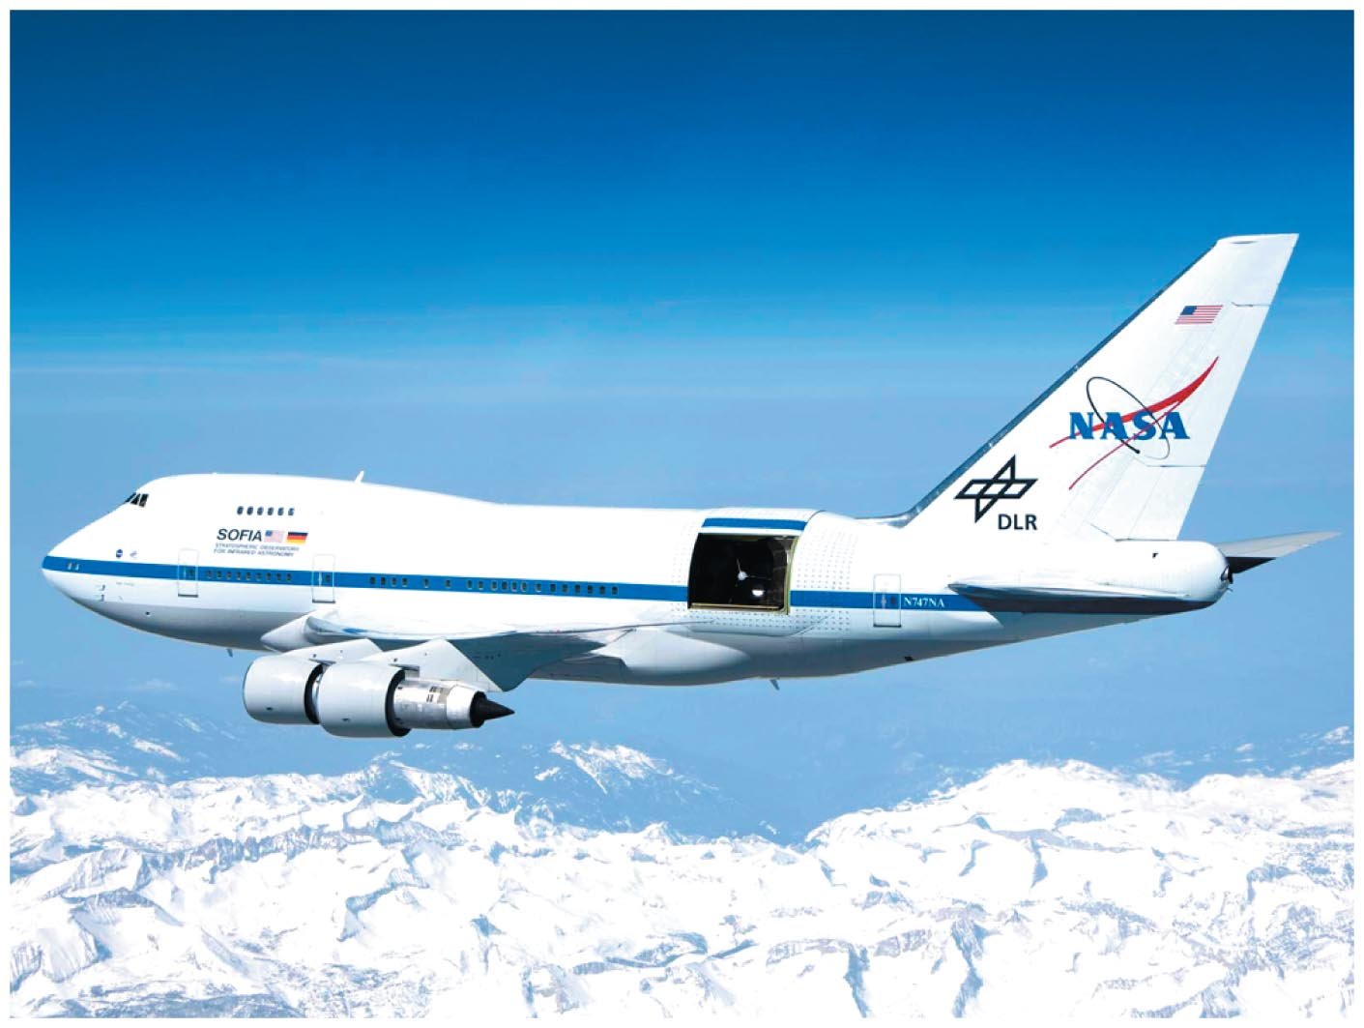
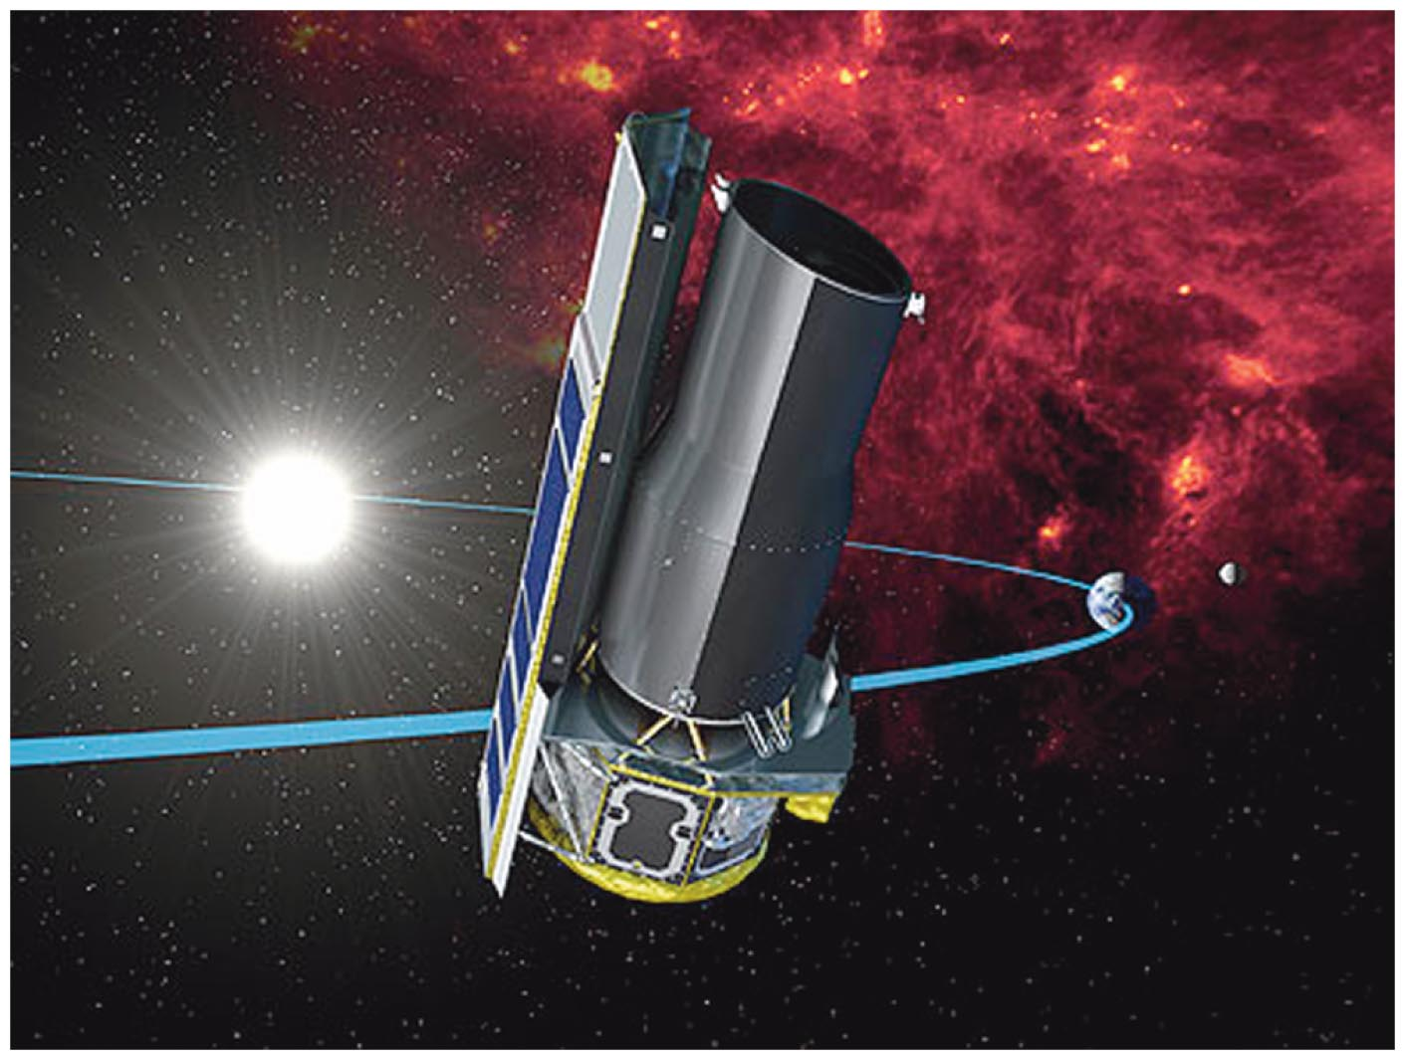
Infrared and Ultraviolet Telescopes
SOFIA
Spitzer
Infrared and ultraviolet light telescopes operate like visible-light telescopes but need to be above atmosphere to see all wavelengths.

Slide 57
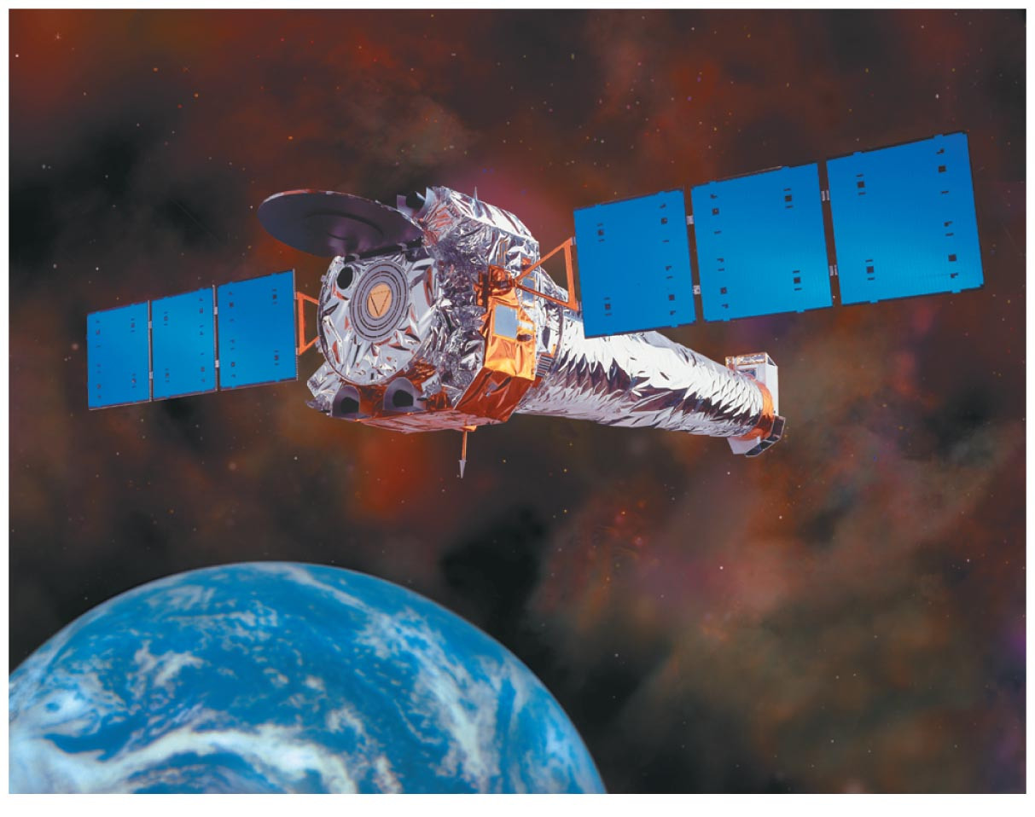
X-Ray Telescopes
X-ray telescopes also need to be above the atmosphere.
Chandra X-Ray Observatory

Slide 58
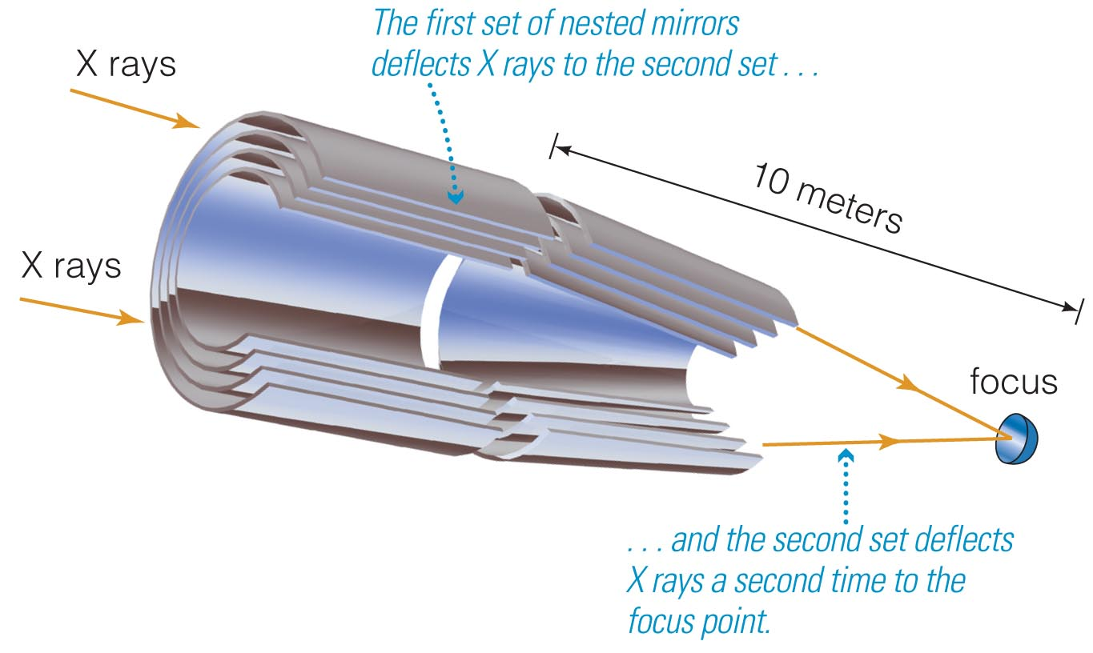
X-Ray Telescopes
Focusing of X-rays requires special mirrors.
Mirrors are arranged to focus X-ray photons through grazing bounces off the surface.

Slide 59

Gamma-Ray Telescopes
Gamma-ray telescopes also need to be in space.
Focusing gamma rays is extremely difficult.
Fermi Gamma-Ray Observatory

Slide 60
What have learned?
How can we observe invisible light?
  Telescopes for invisible light are usually modified versions of reflecting telescopes.
  Many of the telescopes used for observing invisible light are in space.
How can multiple telescopes work together?
  Linking multiple telescopes using interferometry enables them to produce the angular resolution of a much larger telescope.
Notes:
60

