Slide 1
Star Birth

Slide 2
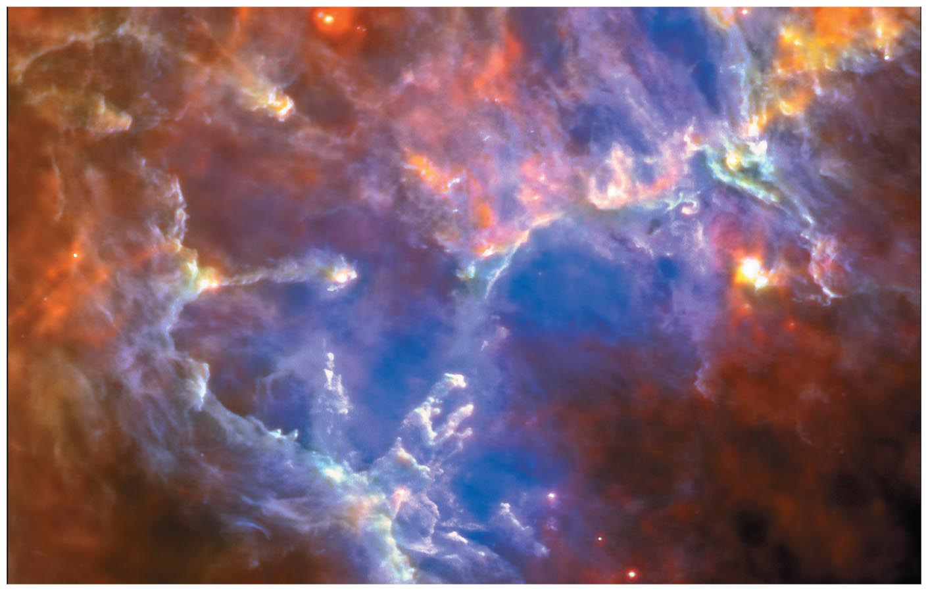
Star Birth
The dust and gas between the star in our galaxy is referred to as the Interstellar medium (ISM).

Slide 3
16.1 Stellar Nurseries
Our goals for learning:
  Where do stars form?
  Why do stars form?
Notes:
3

Slide 4
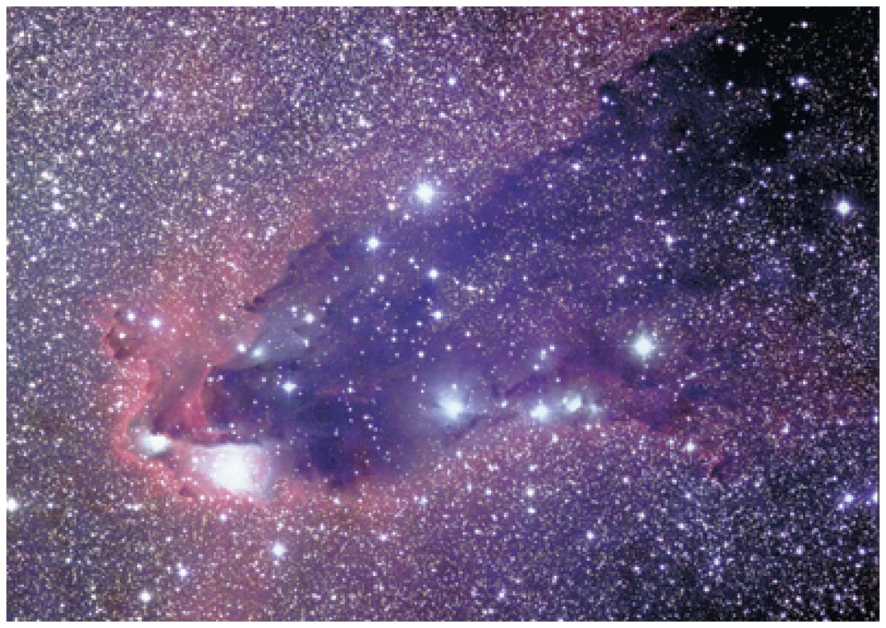
Where do stars form?
Stars form in dark clouds of dusty gas in the interstellar medium.

Slide 5
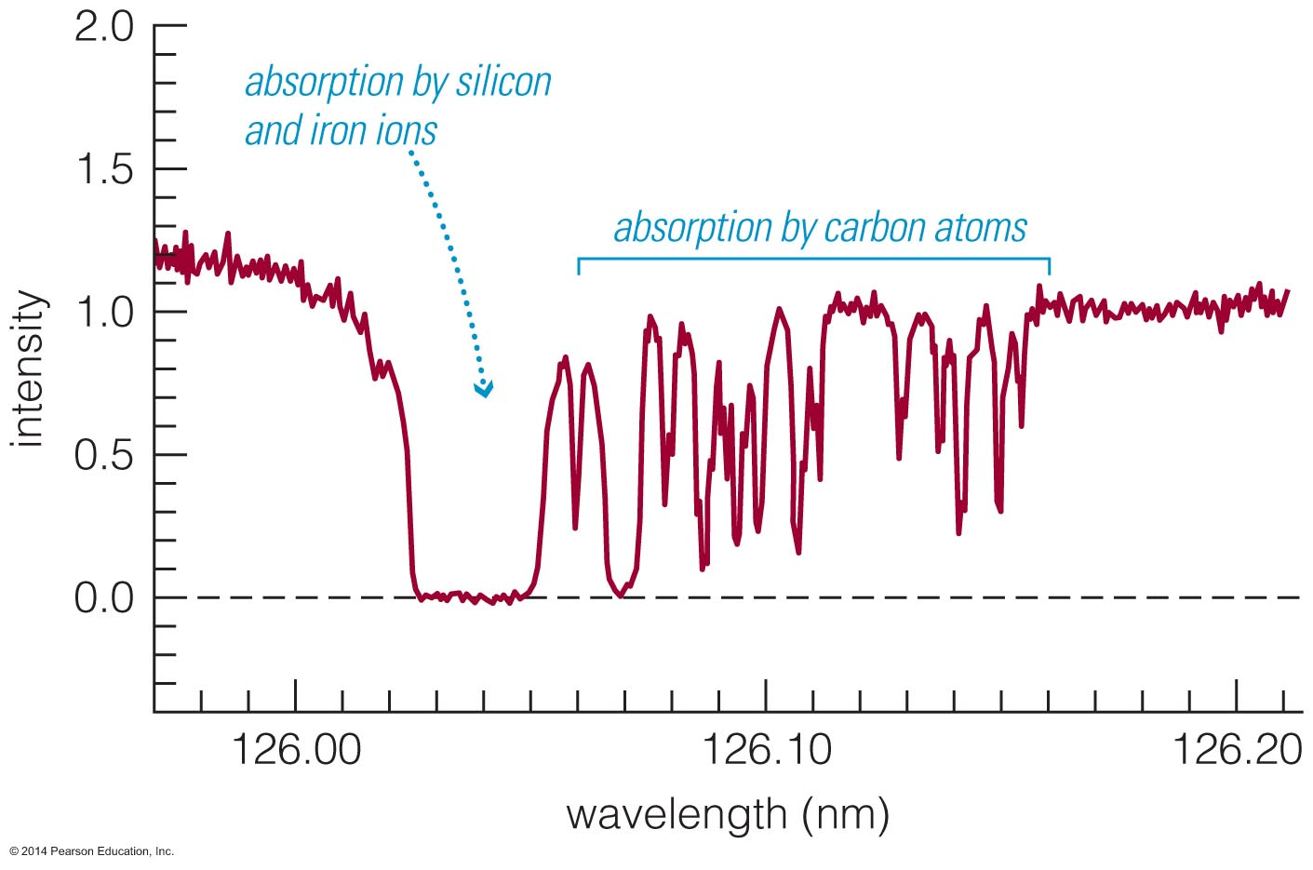
Composition of Clouds
We can determine the composition of interstellar gas from its absorption lines in the spectra of stars.
70% H, 28% He, 2% heavier elements in our region of Milky Way
The chemical composition of the ISM is similar through out the Milky Way, however, the temperature and density of ISM clouds change through out the Milky Way.

Slide 6
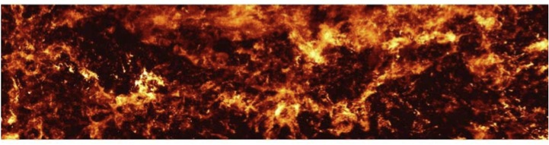
Molecular Clouds
Stars are born in interstellar clouds that are cold and dense. These clouds are called molecular clouds because their low temperature and high density allows for the formation of molecules (H₂, CO, etc.).
These molecular clouds have a temperature of 10–30 K and a density of about 300 molecules per cubic centimeter.

Slide 7
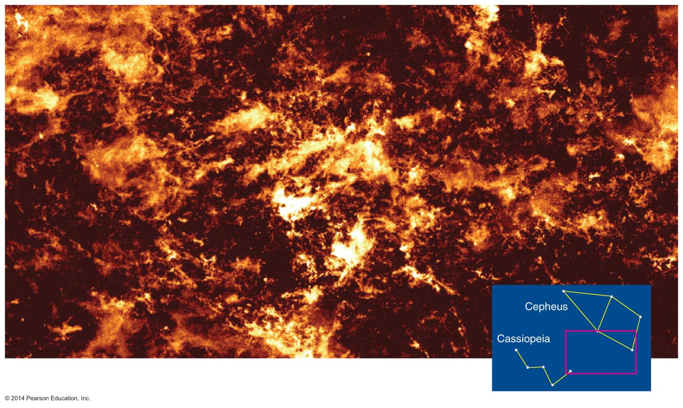
Molecular Clouds
The most common molecule in molecular clouds is H₂. Emission from hydrogen molecules in the mm band is very weak (symmetric molecule) while mm emission from CO molecules is much stronger.
In interstellar space for every CO molecule there are about a 10,000 H₂ molecules so one can use the CO as a tracer for H₂.

Slide 8
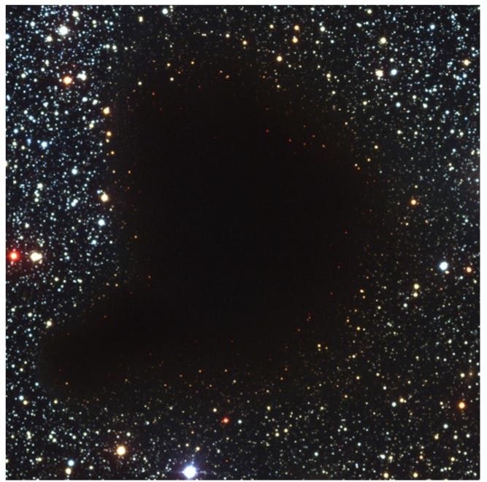
Interstellar Dust
Tiny solid particles of interstellar dust block our view of stars on the other side of a cloud.
Particles are < 1 micrometer in size and made of elements like C, O, Si, and Fe.
70% of the ISM is H, 28% is He and 2% is heavier elements. Out of those 2% half the heavier elements are found in tiny solid grains of interstellar dust.

Slide 9
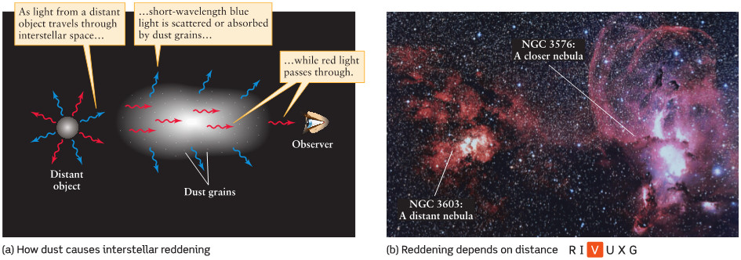
Interstellar Extinction and Reddening
Interstellar extinction is the dimming of light as it passes through the interstellar medium.
If you look at a source through a cloud of dust grains more blue than red light will be scattered out of your line of sight. Such sources as said to be reddened.

Slide 10
Interstellar Reddening
Stars viewed through the edges of the cloud look redder because dust blocks (shorter-wavelength) blue light more effectively than (longer-wavelength) red light.

Slide 11
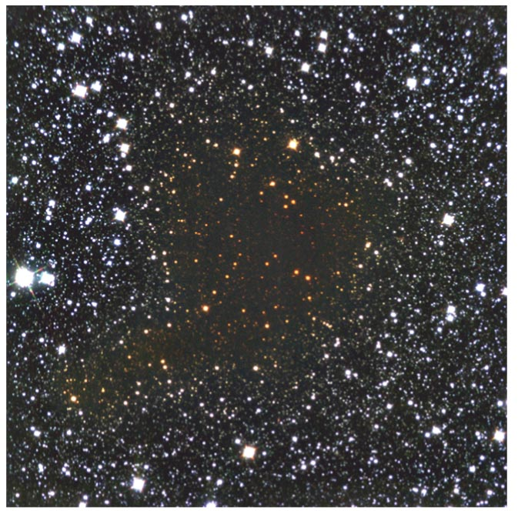
Interstellar Reddening
Long-wavelength infrared light passes through a cloud more easily than visible light.
Observations of infrared light reveal stars on the other side of the cloud.

Slide 12
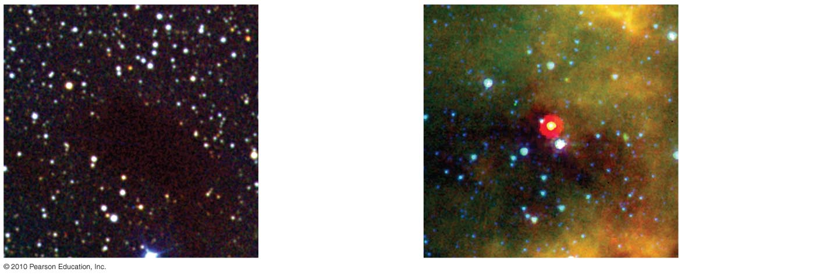
Observing Newborn Stars
Visible light from a newborn star is often trapped within the dark, dusty gas clouds where the star formed.

Slide 13
Observing Newborn Stars
Newborn stars within a cloud are not observable with visible light because it is absorbed by the surrounding dust.
When the surrounding dust grains absorb visible light they become heated and emit in the IR and microwave bands.
The dust surrounding a newborn star can be detected with observations in the IR of microwave.

Slide 14
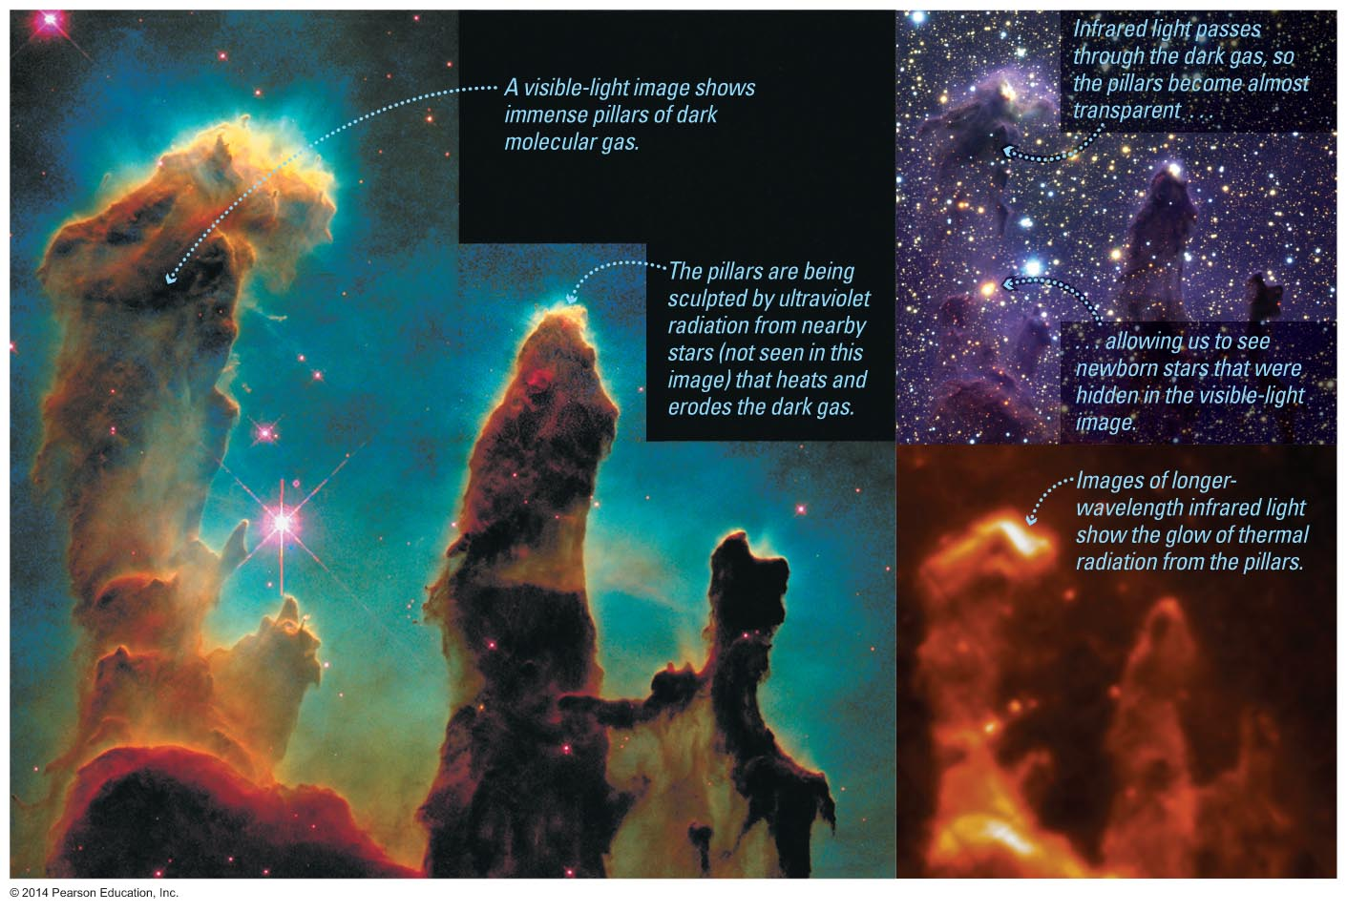
Observing Newborn Stars

Slide 15
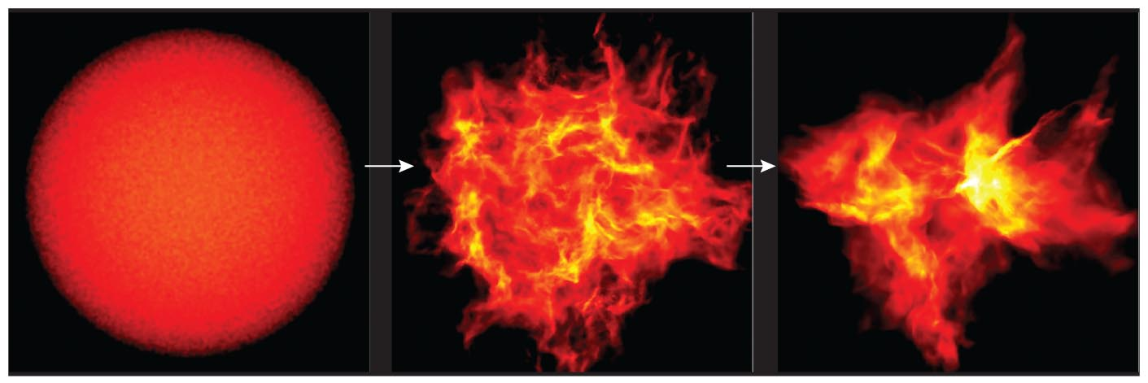
How do stars form?
Stars form when gravity causes a molecular cloud to contract and fragment. The collapse continues until the central object gets hot enough to sustain nuclear fusion in its core.
A star remains stable because of a balance between the outward gas pressure and the inward pull of gravity.

Slide 16
Pressure of a Gas
The pressure of a gas is related to its temperature and density.
PV = NkT (ideal gas law)
Where P = pressure, V = volume, N = number of molecules, T = temperature,
k_{B} = 1.3810⁻²³ J/K
There are other types of pressure: degeneracy pressure from electrons and neutrons, radiation pressure, and magnetic pressure. To distinguish between these we refer to the pressure of a gas that depends on density and temperature as its thermal pressure.

Slide 17
Gravity versus Pressure in Molecular Clouds
A typical molecular cloud (T~ 30 K, n ~ 300 particles/cm³) must contain at least ~100 M for gravity to overcome pressure.
In many molecular clouds gravity is stronger than thermal pressure because of their low temperature. Their high density results in a significant increase in the gravitational force.
Events that can start the collapse of a molecular cloud (trigger the collapse) are a wind from a nearby star or the shock wave from a nearby supernova explosion.

Slide 18
Preventing a Pressure Buildup During Collapse
As gravity makes a molecular cloud collapse gravitational energy is converted to kinetic energy and the gas heats up leading to an increase in the outward pressure.
If the heat does not escape the cloud the pressure would build up and prevent the cloud from collapsing.
Molecular clouds get rid of the pressure build up by radiating. Molecules such as CO can radiate in the IR and radio thus lose kinetic energy and reduce the pressure of the gas.

Slide 19
Resistance to Gravity
Question: Many molecular clouds exist with masses ~1000’s M_{solar}. How do they resist gravity long enough to grow to such large masses?
Answer: Turbulence and magnetic fields can hinder the collapse of a molecular cloud.

Slide 20
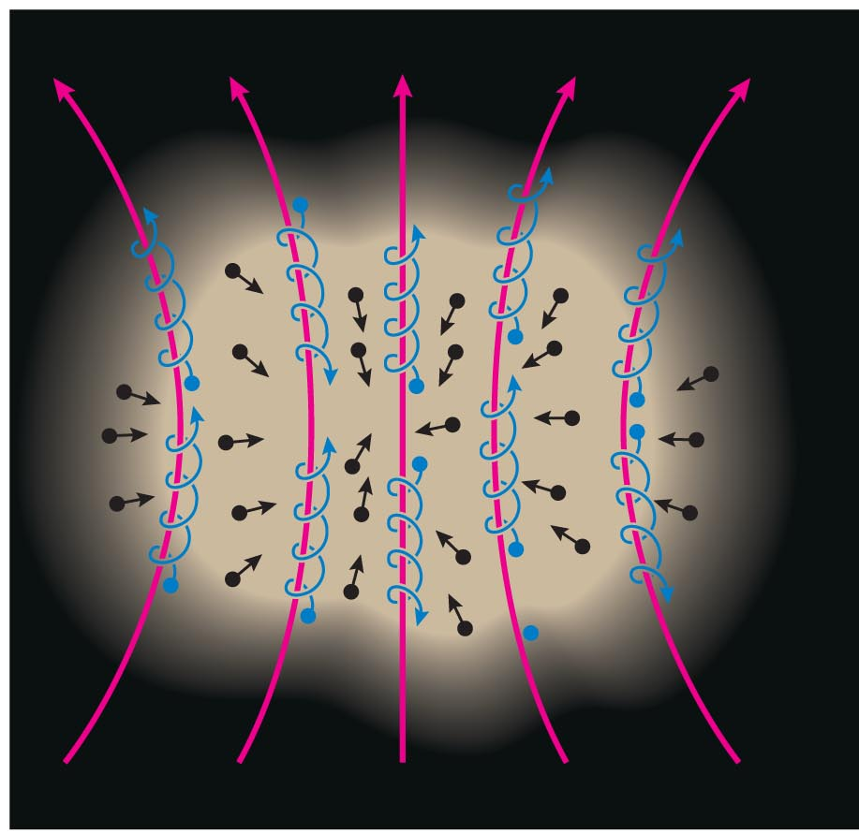
Resistance to Gravity
A cloud must have even more mass to begin contracting if there are additional forces opposing gravity.
Both magnetic fields and turbulent gas motions increase resistance to gravity.

Slide 21
Fragmentation of a Cloud
Question: Why does a large molecular cloud not collapse to a single massive star but collapses and fragments to form many smaller stars?
Answer: Molecular clouds are lumpy and turbulent. Within each clump the force of gravity can overcome the pressure of the clump even if the condition is not satisfied over the entire molecular cloud. Thus the gas within relatively small clumps will be compressed first.

Slide 22
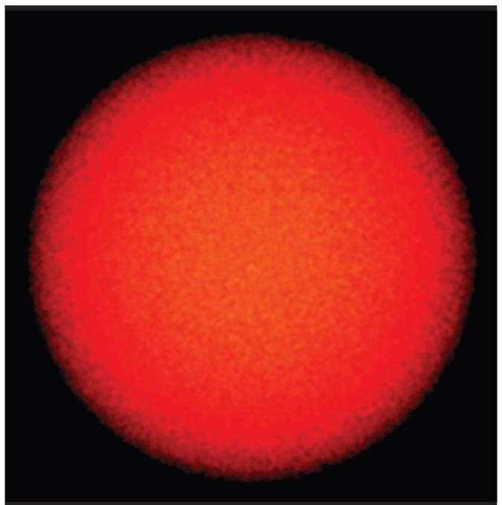
Fragmentation of a Cloud
This simulation begins with a turbulent cloud containing 50 solar masses of gas.

Slide 23
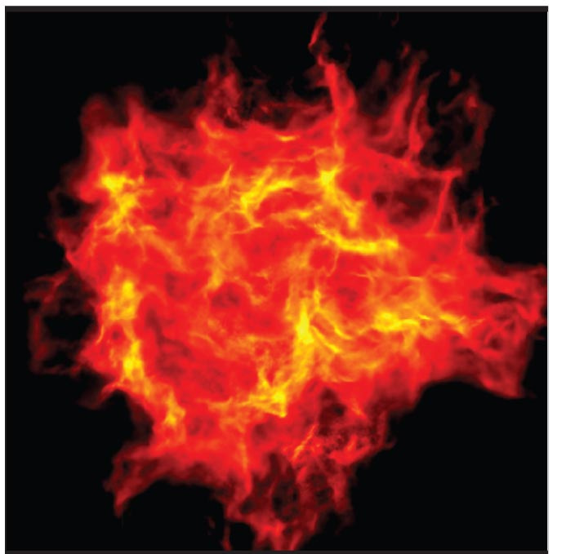
Fragmentation of a Cloud
The random motions of different sections of the cloud cause it to become lumpy.

Slide 24
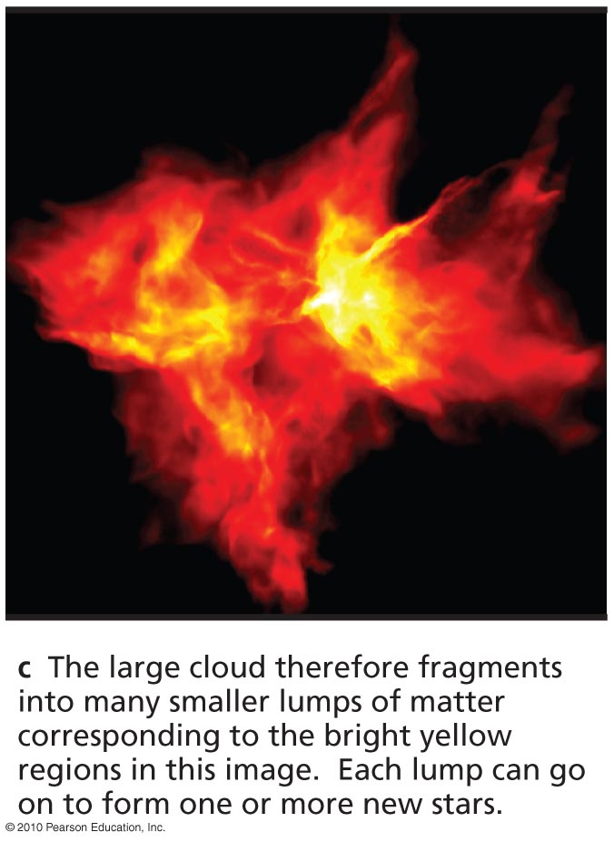
Fragmentation of a Cloud
Each lump of the cloud in which gravity can overcome pressure can go on to become a star.
A large cloud can make a whole cluster of stars.

Slide 25
Thought Question
What would happen to a contracting cloud fragment if it were not able to radiate away its thermal energy?
It would continue contracting, but its temperature would not change.
Its mass would increase.
Its internal pressure would increase.

Slide 26
Thought Question
What would happen to a contracting cloud fragment if it were not able to radiate away its thermal energy?
It would continue contracting, but its temperature would not change.
Its mass would increase.
Its internal pressure would increase.

Slide 27
The First Stars
Elements like carbon and oxygen had not yet been made when the first stars formed.
Without CO molecules to provide cooling, the clouds that formed the first stars had to be considerably warmer than today's molecular clouds. (H₂ can radiate at temperatures > 100 K)
The first stars must therefore have been more massive than most of today's stars, for gravity to overcome pressure.

Slide 28
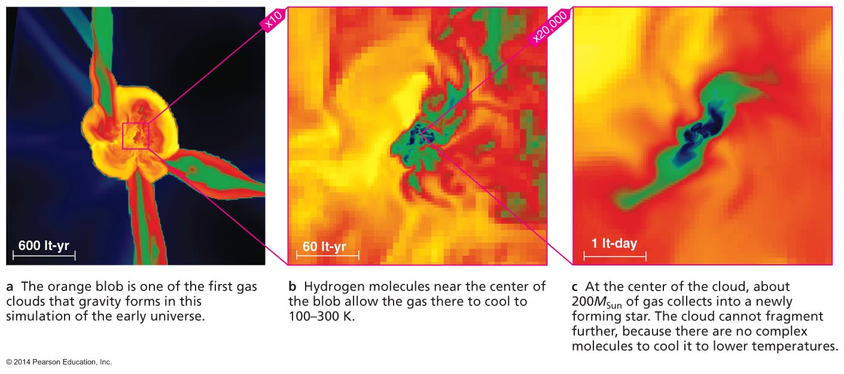
Simulation of the First Star
Simulations of early star formation suggest the first molecular clouds never cooled below 100 K, making stars of ~100M_{Sun}.

Slide 29
What have we learned?
Where do stars form?
  Stars form in dark, dusty clouds of molecular gas with temperatures of 10–30 K.
  These clouds are made mostly of molecular hydrogen (H₂) but stay cool because of emission by carbon monoxide (CO).
Why do stars form?
  Stars form in clouds that are massive enough for gravity to overcome thermal pressure (and any other forms of resistance).
  Such a cloud contracts and breaks up into pieces that go on to form stars.

Slide 30
16.2 Stages of Star Birth
Our goals for learning:
  What slows the contraction of a star-forming cloud?
  What is the role of rotation in star birth?
  How does nuclear fusion begin in a newborn star?

Slide 31
What slows the contraction of a star-forming cloud?
As contraction packs the molecules and dust particles of a cloud fragment closer together, it becomes harder for infrared and radio photons to escape.
The difficultly arises because the IR photon emitted by a molecule will likely be absorbed by a nearby molecule if the density is too high.

Slide 32
Trapping of Thermal Energy and Formation of a Protostar
Thermal energy then begins to build up inside, increasing the internal pressure.
Contraction slows down, and the center of the cloud fragment becomes a protostar.

Slide 33
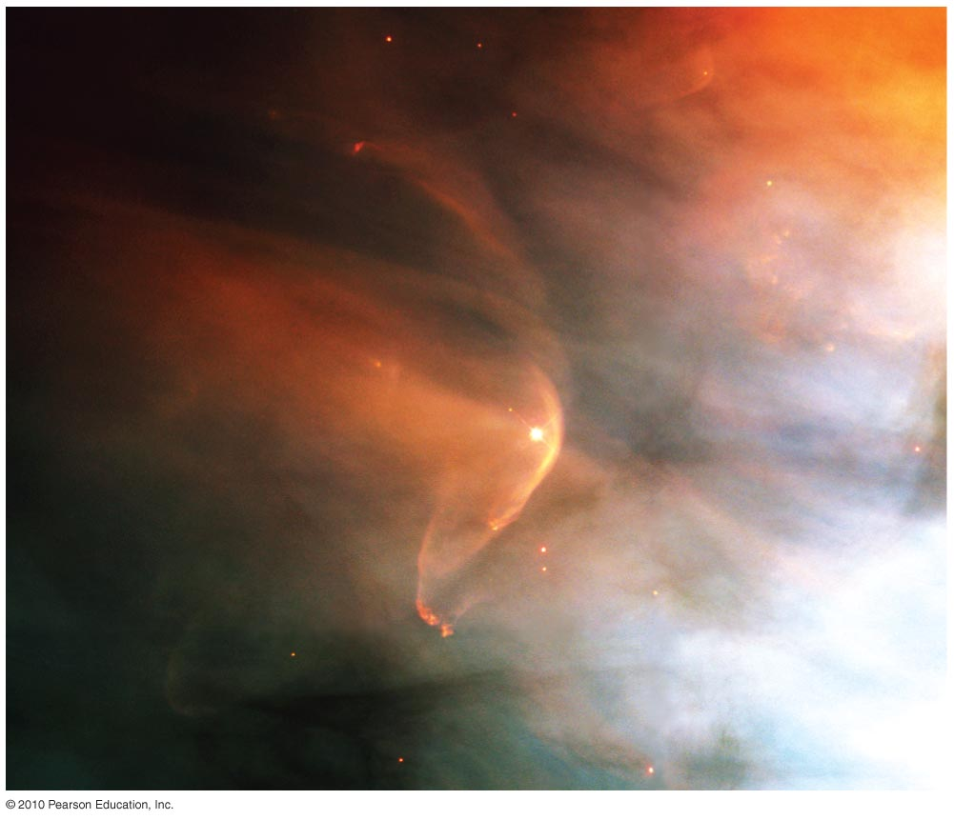
Growth of a Protostar
Matter from the cloud continues to fall onto the protostar until either the protostar or a neighboring star blows the surrounding gas away.

Slide 34
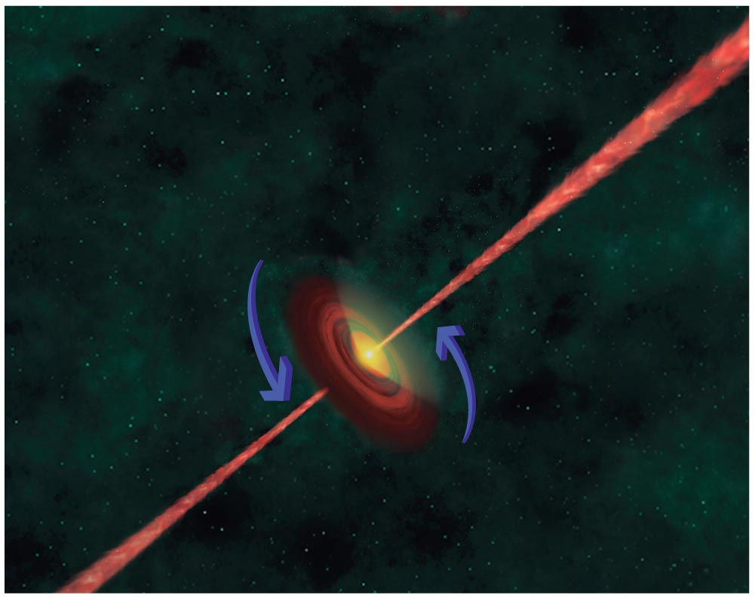
What is the role of rotation in star birth?

Slide 35
What is the role of rotation in star birth?
Rotation leads to the:
Formation of a protostellar disk
Formation of jets
Formation of binary protostars

Slide 36
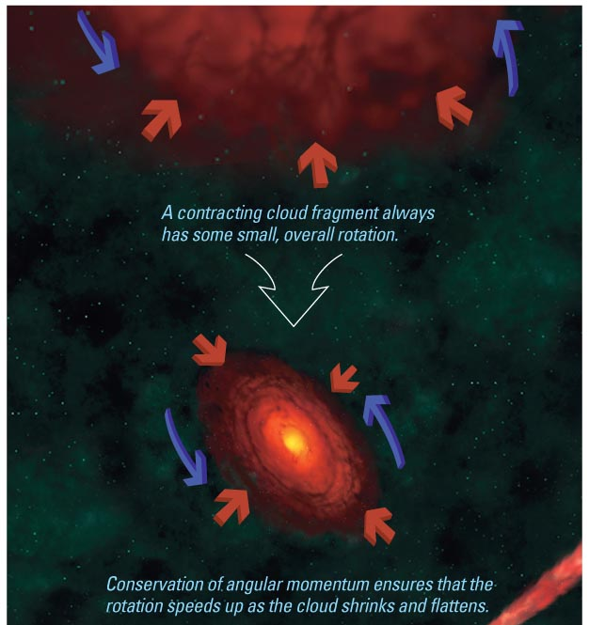
Formation of a Protostellar Disk
As the molecular cloud collapses any small amounts of rotation will increase because of conservation of angular momentum.
Conservation of angular momentum prevents the material from falling directly onto the protostar.
Material can move along the axis of rotation and collisions lead to the formation of a flattened protostellar disk around the protostar.

Slide 37
Accretion onto Protostar
Material at different radii rotates at different velocities. Friction between neighboring particles leads to loss of energy and particles fall towards to protostar.
The protostar gradually accretes material to become more massive.

Slide 38
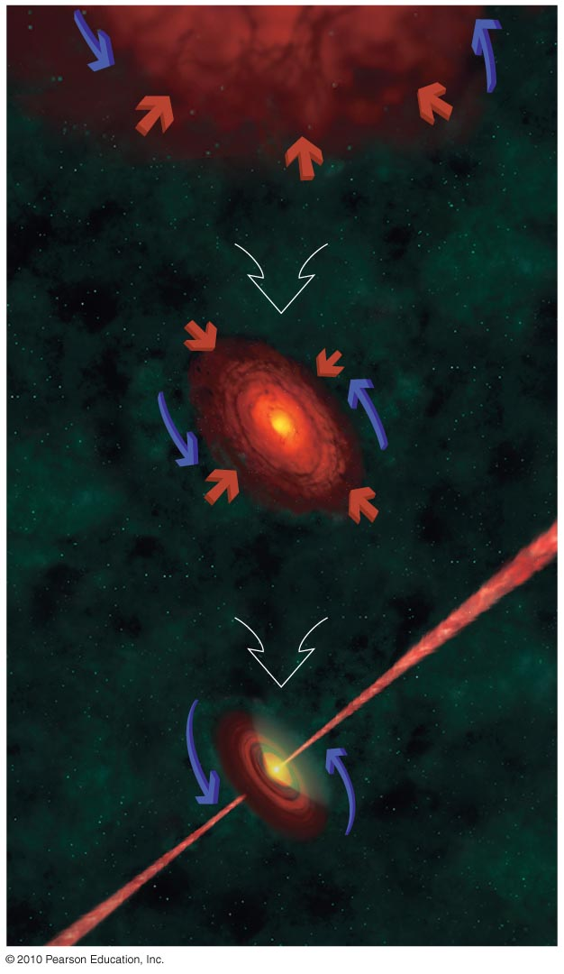
Formation of Jets
Many protostars are observed to launch jets of material that is highly collimated along the rotation axis.
These jets occasionally collide with clumps of interstellar gas to form hot spots on either end of these jets( Herbig - Haro Objects).
Jets are thought to be formed by the twisting of magnetic filed lines that thread the protostellar disk. The spinning protostellar disk twists the magnetic field lines to channel jets of charged particles along the rotation axis.

Slide 39
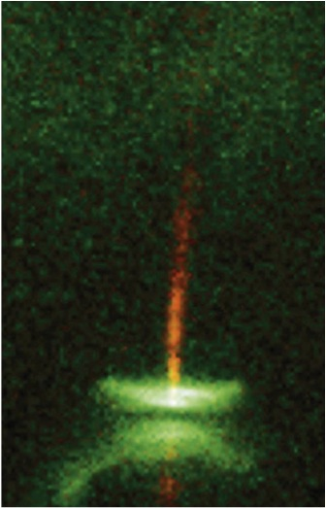
Jets are observed coming from the centers of disks around protostars.

Slide 40
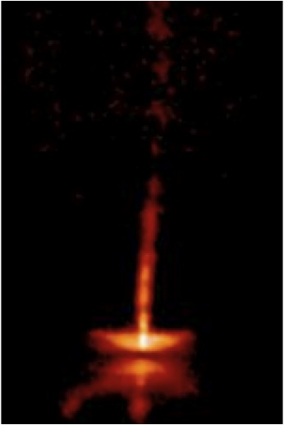
Notes:
2000-32-b-animated.gif

Slide 41
Thought Question
What would happen to a protostar that formed without any rotation at all?
Its jets would go in multiple directions.
It would not have planets.
It would be very bright in infrared light.
It would not be round.

Slide 42
Thought Question
What would happen to a protostar that formed without any rotation at all?
Its jets would go in multiple directions.
It would not have planets.
It would be very bright in infrared light.
It would not be round.

Slide 43
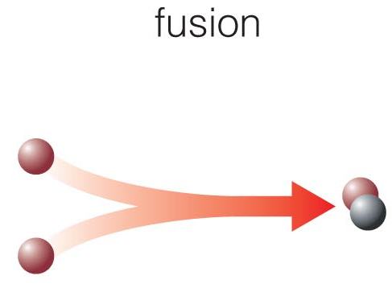
How does nuclear fusion begin in a newborn star?

Slide 44
From Protostar to Main Sequence
The central temperature of a newly formed protostar is about 1 million degrees. The protostar needs to contract to increase its temperature to about 10 million degrees before fusion may begin. How does it do this?
Answer: Thermal energy in the interior decreases by radiation emitted at the protostars surface. This decrease in thermal energy results in the further collapse and increase in the core temperature.
When the core temperature reaches 10 million degrees fusion of H to He begins.

Slide 45
From Protostar to Main Sequence
Contraction stops when the energy released by core fusion balances energy radiated from the surface—the star is now a main-sequence star.
The length of time needed to go from the formation of a protostar to the onset of fusion depends on the mass of the protostar. Massive protostars evolve faster.
A protostar with the mass of our sun would take about 30 million years to contract to the point of reaching fusion temperatures in the core.

Slide 46
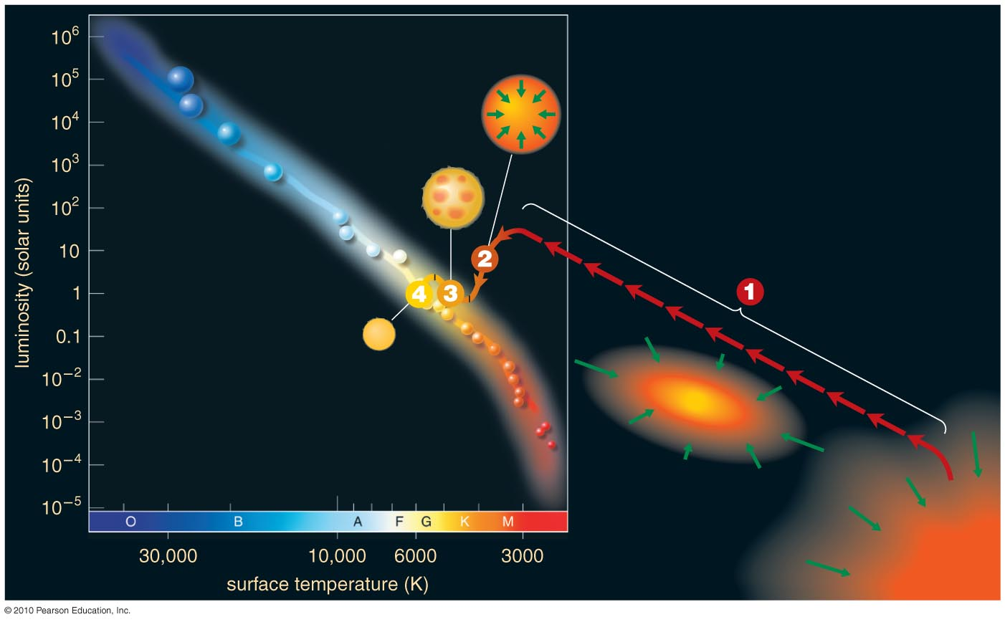

Birth Stages on a Life Track
A life track illustrates a star's surface temperature and luminosity at different moments in time.

Slide 47
Assembly of a Protostar
Luminosity and temperature grow as matter collects into a protostar.

Slide 48
Convective Contraction
Surface temperature remains near 3000 K while convection is main energy transport mechanism.

Slide 49
Radiative Contraction
Luminosity remains nearly constant during late stages of contraction, while radiation transports energy through star.

Slide 50
Self-Sustaining Fusion
Core temperature continues to rise until star begins fusion and arrives on the main sequence.

Slide 51
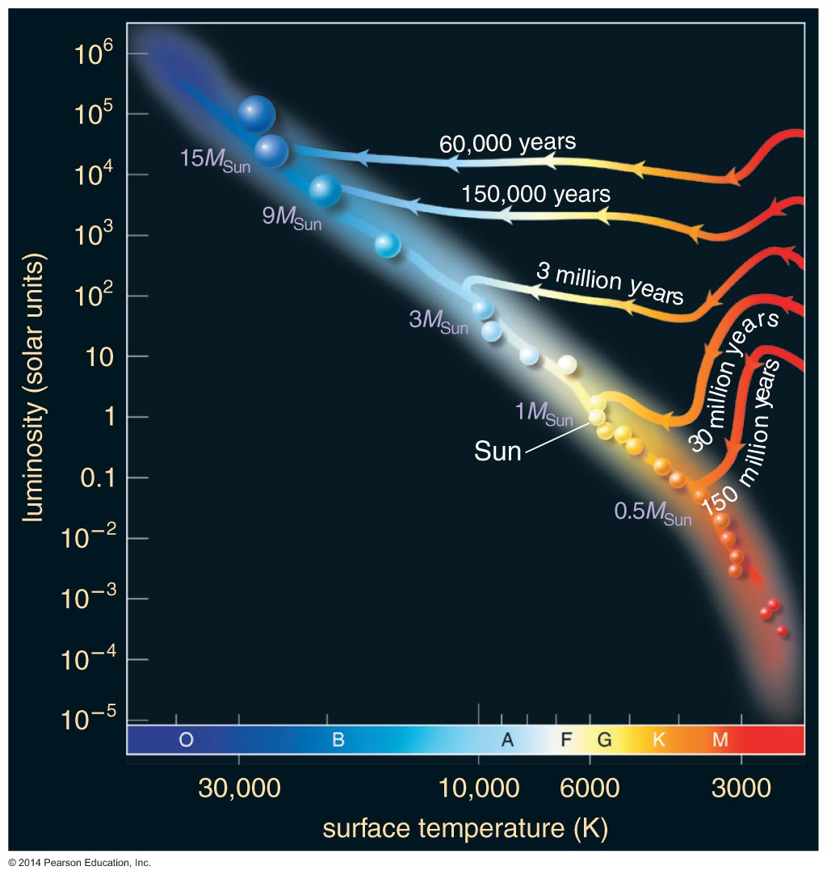
Life Tracks for Different Masses
Models show that Sun required about 30 million years to go from protostar to main sequence.
Higher-mass stars form faster.
Lower-mass stars form more slowly.

Slide 52
What have we learned?
What slows the contraction of a star-forming cloud?
  The contraction of a cloud fragment slows when thermal pressure builds up because infrared and radio photons can no longer escape.
What is the role of rotation in star birth?
  Conservation of angular momentum leads to the formation of disks around protostars.

Slide 53
What have we learned?
How does nuclear fusion begin in a newborn star?
  Nuclear fusion begins when contraction causes the star's core to grow hot enough for fusion.

Slide 54
16.3 Masses of Newborn Stars
Our goals for learning:
  What is the smallest mass a newborn star can have?
  What is the greatest mass a newborn star can have?
  What are the typical masses of newborn stars?

Slide 55
16.3 Masses of Newborn Stars
Astronomers observe that the masses of stars range between 0.08 M to 150 M
Why this mass range limit?

Slide 56
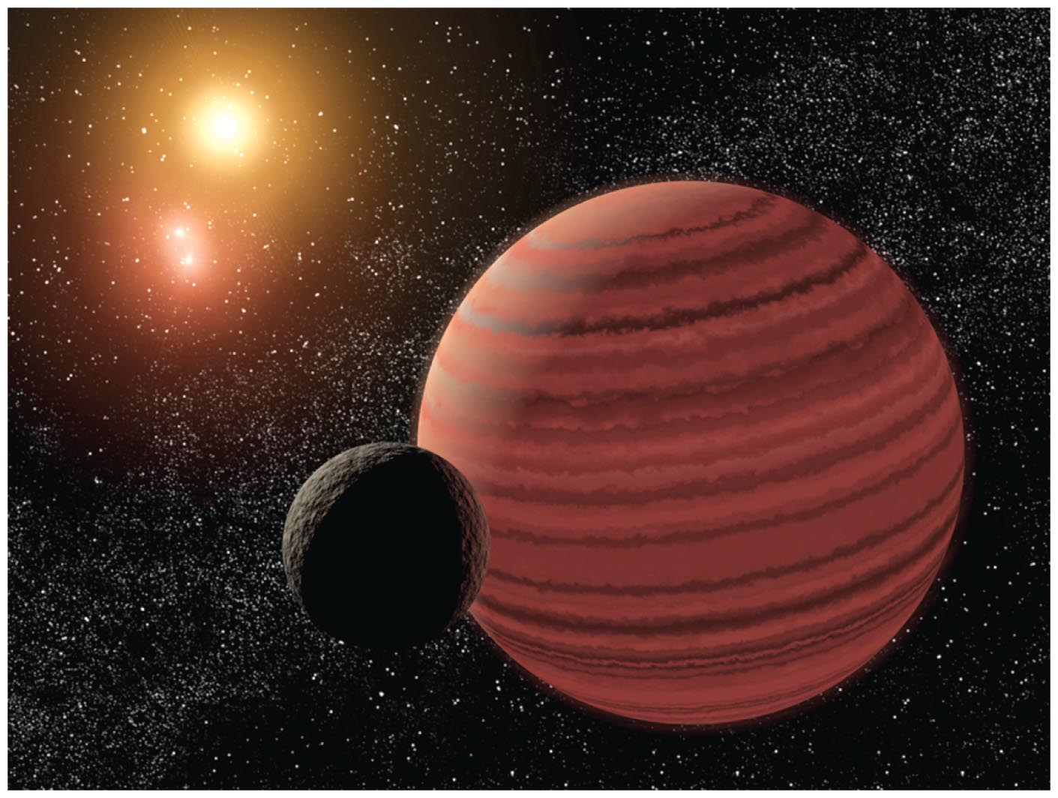
What is the smallest mass a newborn star can have?
Stars cannot have masses less than ~ 0.08 M.The reason for this limit is that degeneracy pressure of electrons prevents protostars with a mass of less than 0.08 M to collapse.
Thermal pressure depends on density and temperature.
Degeneracy pressure depends on density but not on Temperature

Slide 57
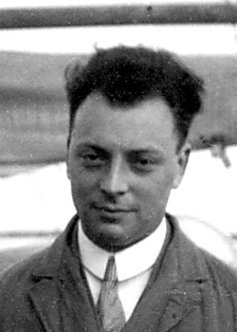
Degeneracy Pressure
Closely packed electrons resist compression. The reason for this is that no two electrons too close to each other can have the same four quantum numbers n, l, m_{l}, m_{s} (The Pauli exclusion principle).
The pressure of the electrons resisting compression is called degeneracy pressure.
Wolfgang Pauli

Slide 58
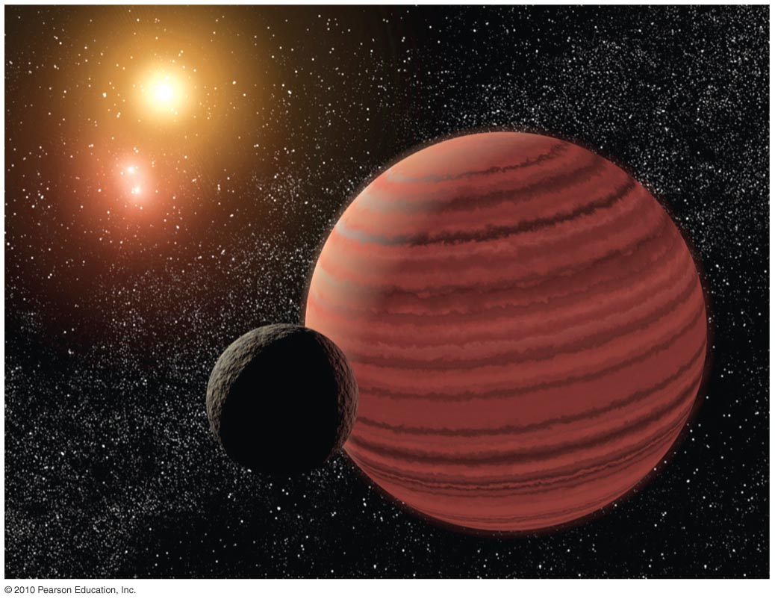
Brown Dwarfs
Degeneracy pressure halts the contraction of objects with < 0.08M before core temperature becomes hot enough for fusion.
Starlike objects not massive enough to start fusion (M< 0.08M) are called brown dwarfs.

Slide 59
Brown Dwarfs
A brown dwarf emits infrared light because of heat left over from contraction.
Its luminosity gradually declines with time as it loses thermal energy.

Slide 60
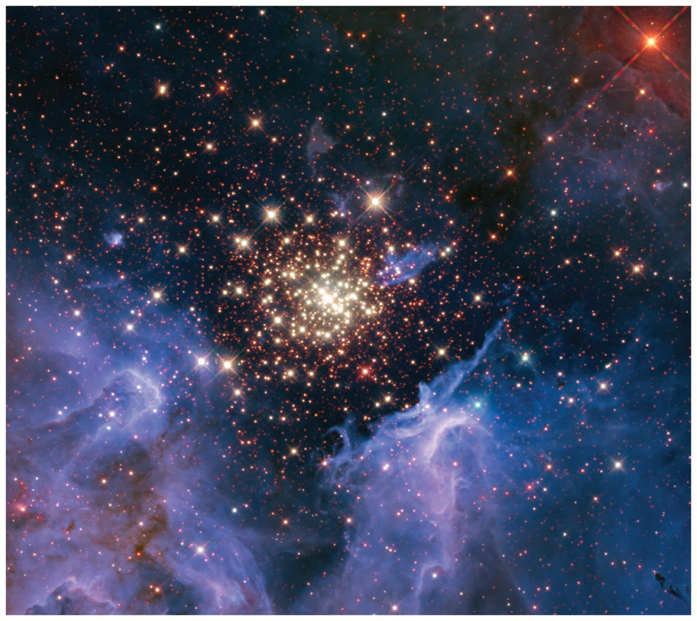
What is the greatest mass a newborn star can have?

Slide 61
Radiation Pressure
Photons exert pressure when they strike matter (radiation pressure).
Very massive stars (M>150M) are so luminous that their radiation pressure can blow apart the star.

Slide 62
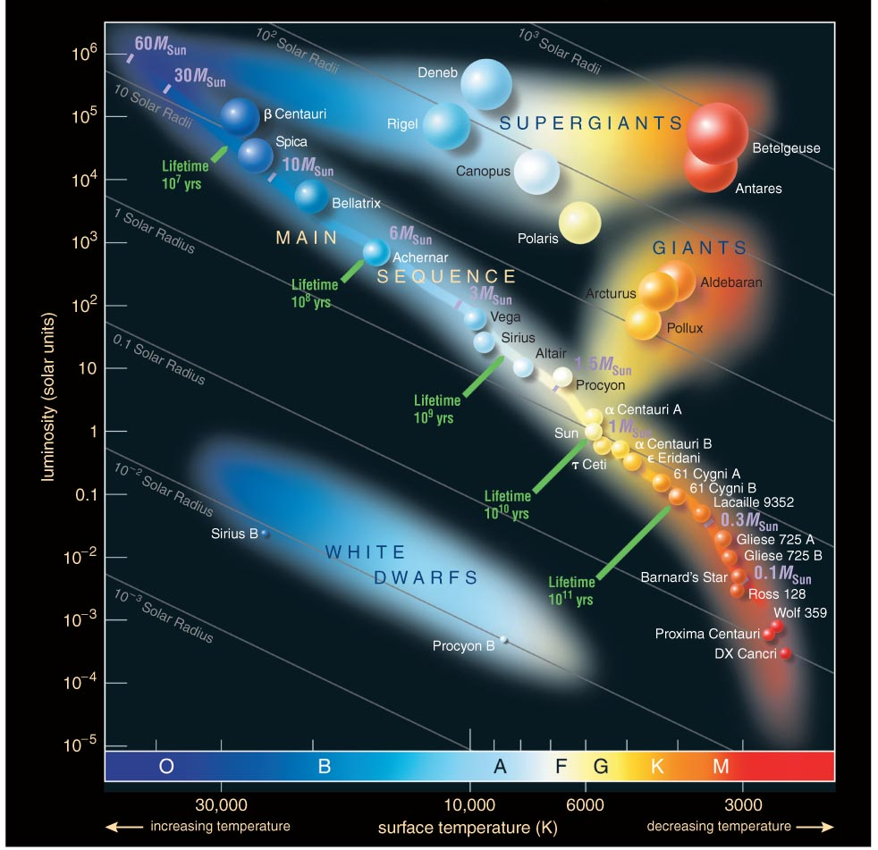
Stars more massive than
150M_{Sun} would blow apart.
Stars less massive than
0.08M_{Sun} can't sustain fusion.
Luminosity
Temperature

Slide 63
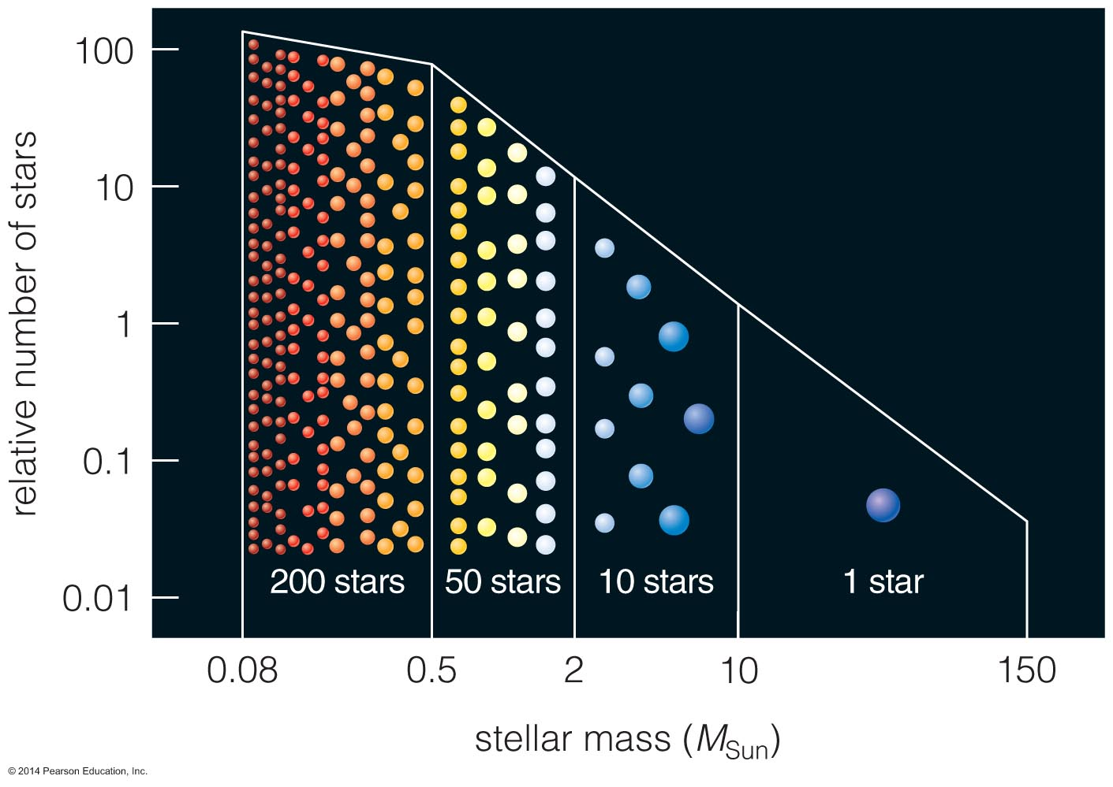
What are the typical masses of newborn stars?

Slide 64
Demographics of Stars
By studying stars in clusters astronomers have inferred the distribution of the masses of stars. Most stars have masses smaller than that of the sun and it is rare to find stars with masses larger than our sun.
The distribution of stellar masses found in a star cluster depends on the age of the star cluster. In older star clusters the more massive stars will have evolved off the main sequence and there will be much less of them.

Slide 65
What have we learned?
What is the smallest mass a newborn star can have?
  Degeneracy pressure stops the contraction of objects <0.08M_{Sun} before fusion starts.
What is the greatest mass a newborn star can have?
  Stars greater than about 150M_{Sun} would be so luminous that radiation pressure would blow them apart.
  New observations may require raising this limit.

Slide 66
What have we learned?
What are the typical masses of newborn stars?
  Star formation makes many more low-mass stars than high-mass stars.

