Slide 1
Star Stuff

Slide 2
17.1 Lives in the Balance
Our goals for learning:
  How does a star's mass affect nuclear fusion?

Slide 3
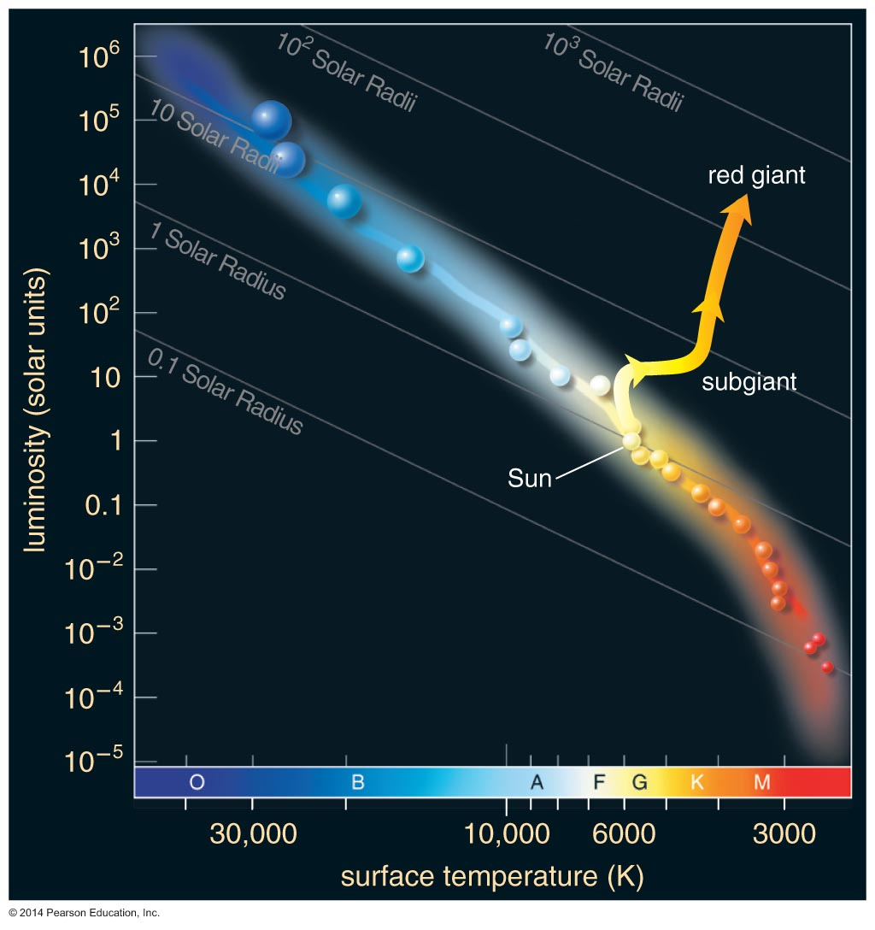
How does a star's mass affect nuclear fusion?

Slide 4
Stellar Mass and Fusion
The mass of a main-sequence star determines its core pressure and temperature.
Stars of higher mass have higher core temperature and more rapid fusion, making those stars both more luminous and shorter-lived.
Stars of lower mass have cooler cores and slower fusion rates, giving them smaller luminosities and longer lifetimes.

Slide 5
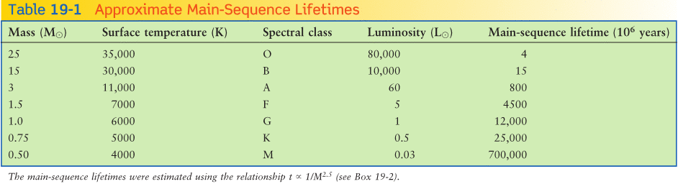
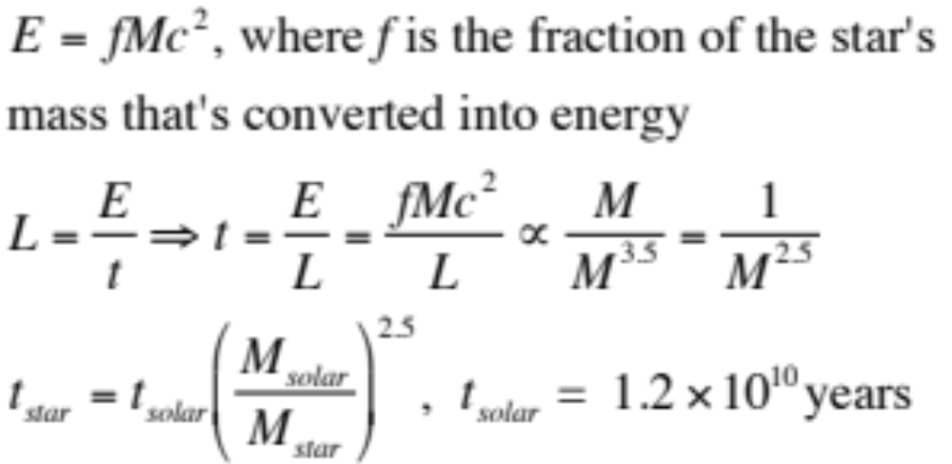
Stellar Evolution: On and Off the Main Sequence
How long will a star remain on the main sequence?

Slide 6
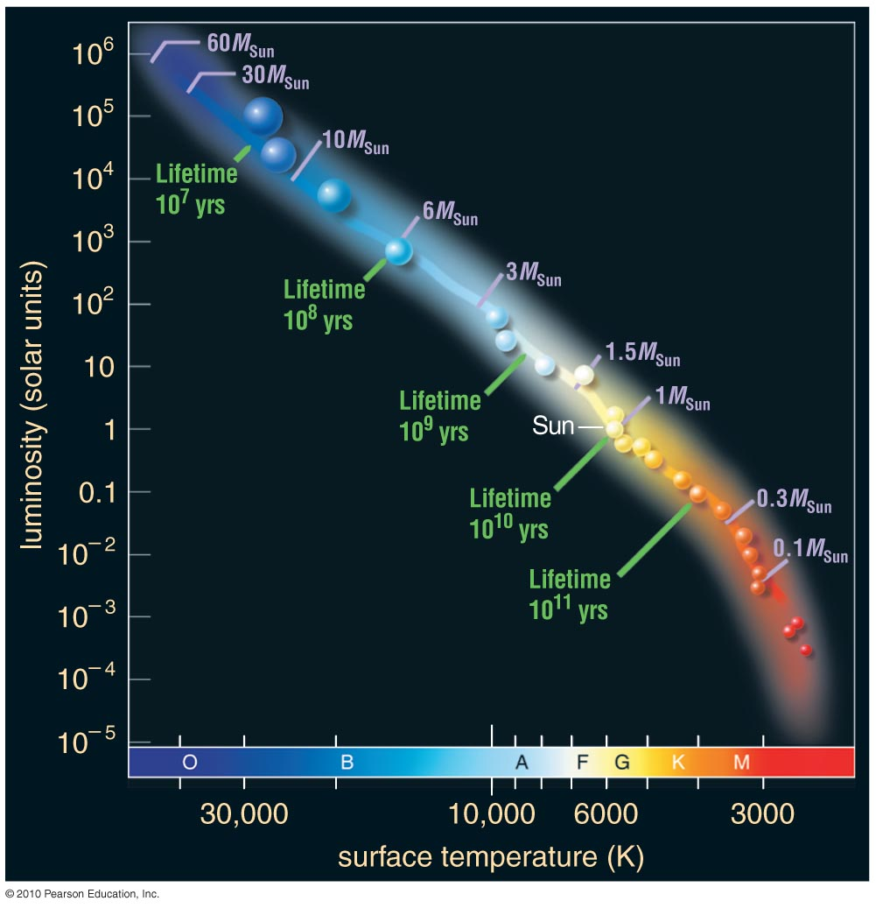
High-Mass Stars
> 8M_{Sun}
Intermediate-Mass Stars
Low-Mass Stars
< 2M_{Sun}
Brown Dwarfs

Slide 7
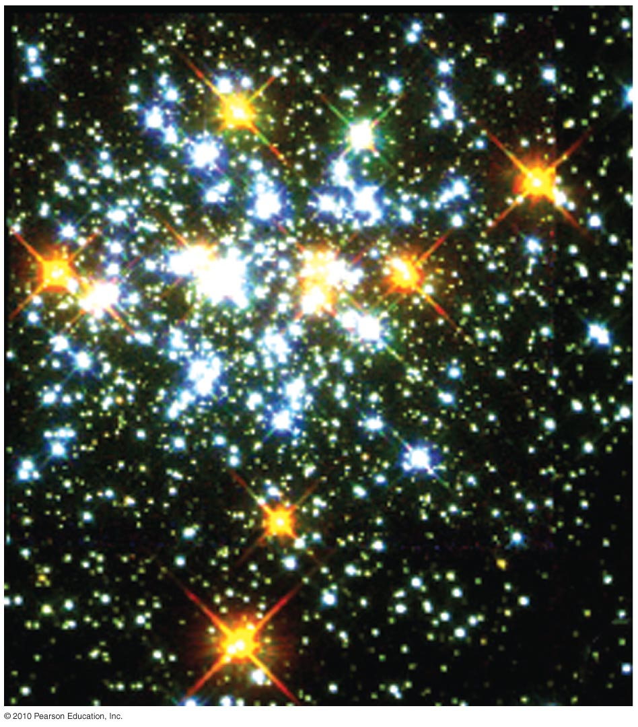
Star Clusters and Stellar Lives
Our knowledge of the life stories of stars comes from comparing mathematical models of stars with observations.
Star clusters are particularly useful because they contain stars of different mass that were born about the same time.

Slide 8
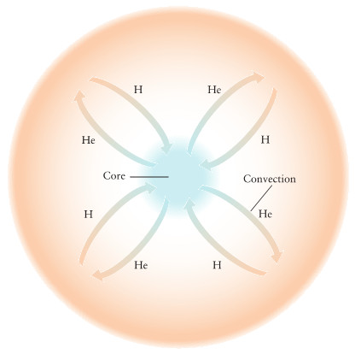
Stellar Evolution: On and Off the Main Sequence
Case of M_{star} < 0.4 M
These stars are called red dwarfs because they are
less massive than the sun
and they are red in color due to their low temperature.
85% of the stars in the Milky Way are M class red dwarfs. Energy in red dwarfs is transported by convection from the core to the outer layers and therefore they do not build up He only in the core as do stars with > 0.4 M.

Slide 9
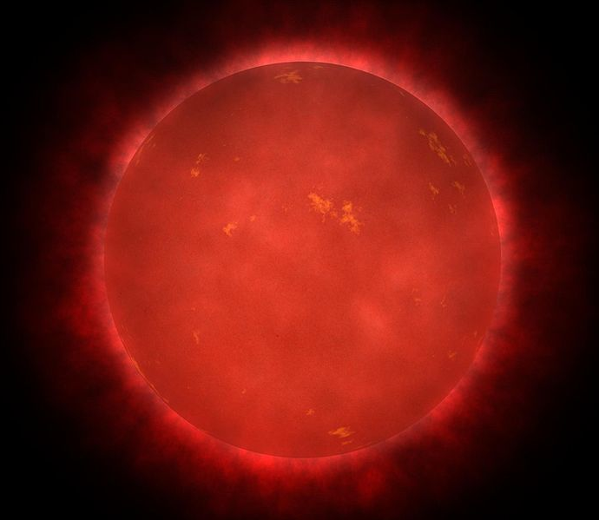
Stellar Evolution: On and Off the Main Sequence
Case of M_{star} < 0.4 M
Question: What happens when the H runs out?
Answer: In a red dwarf when the H runs out the temperature and density are not high enough to initiate fusion of He.
Artistic presentation of a red dwarf star.
After H fusion ends in a red dwarf it radiates its energy away, slowly cools and shrinks in size.
Calculations indicate that it takes ~ 100 billion years for a red dwarf to convert all of its H to He.

Slide 10
Stellar Evolution: On and Off the Main Sequence
Case of 4 M> M_{star} > 0.4 M
Question: What happens when the H runs out?
Answer: When H runs out in the core H fusion continues in a shell around the core.
The core cannot support the material above it so it begins to shrink and is compressed from the weight of the outer layers. When the gas in the core becomes compressed its temperature again begins to rise.
The increase in temperature increases the rate of H fusion reactions in the thin H shell that surrounds the shell while there in no core H fusion.

Slide 11
Stellar Evolution: On and Off the Main Sequence
Case of 4 M> M_{star} > 0.4 M
Answer continued: The increase in core temperature increases the rate of H fusion reactions in the thin H shell that surrounds the shell while there is no core H fusion.
The outer layers expand by the increased luminosity of the H burning shell. As the external layers of gas expand the surface temperature of the star decreases.
When the temperature of the external layers drops to ~ 3,500 K the star appears reddish at which point is has become a red giant.

Slide 12
Stellar Evolution: On and Off the Main Sequence
Case of 4 M> M_{star} > 0.4 M
A star leaves the main sequence when hydrogen fusion ends in the core. The star becomes a red giant.

Slide 13
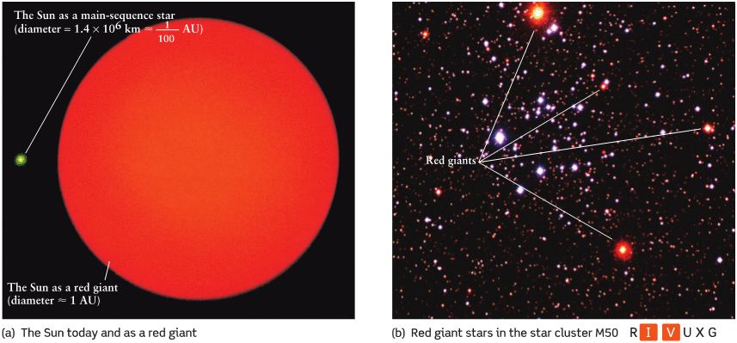
Stellar Evolution: On and Off the Main Sequence
When the sun becomes a red giant its diameter will increase from ~ 0.01 AU to ~2 AU.

Slide 14
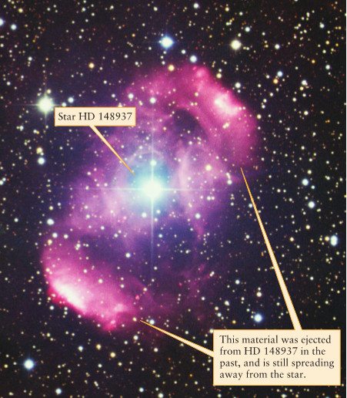
Stellar Evolution: On and Off the Main Sequence
Red giants lose a substantial amount of gas from the outer layers.
The reason for this is that the outer layers have expanded far from the center and since force is proportional to 1/R² the force keeping the gas bound is substantially weaker.
Mass loss from red giants is detected from blue-shifted emission lines
that imply wind velocities of 10 km/s.
A red giant may lose ~ 10⁻⁷ M per year (the sun loses ~ 10⁻¹⁴ M per year).
Winds from red giant HD 148937

Slide 15
The Sun’s Fate
While still on the main sequence the Sun’s luminosity will continue to increase. In about 3.5 billion years the average temperature on Earth will be > 100 °C and the water on the surface will boil away.
H fusion reactions in the core are expected to cease in about 7.5 billion years from now!
At about ~7.7 billion years from now the Sun will have expanded to a diameter of about 1 AU.

Slide 16
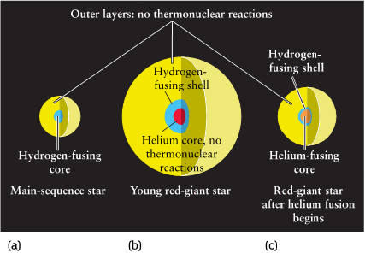
Stellar Evolution: On and Off the Main Sequence

Slide 17
Thought Question
What happens when a star can no longer fuse hydrogen to helium in its core?
The core cools off.
The core shrinks and heats up.
The core expands and heats up.
Helium fusion immediately begins.

Slide 18
Thought Question
What happens when a star can no longer fuse hydrogen to helium in its core?
The core cools off.
The core shrinks and heats up.
The core expands and heats up.
Helium fusion immediately begins.

Slide 19
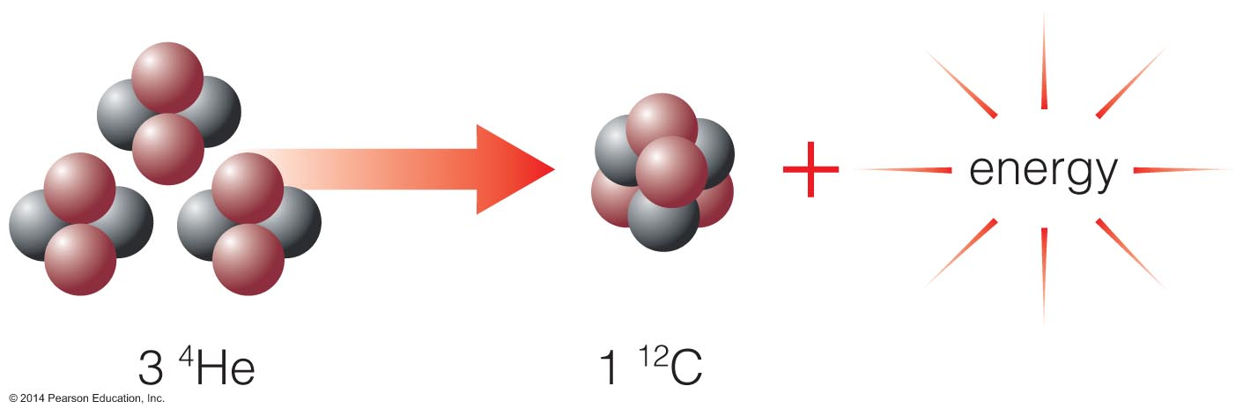
Helium fusion does not begin right away because it requires higher temperatures than hydrogen fusion—larger charge leads to greater repulsion.
Fusion of two helium nuclei doesn't work, so helium fusion must combine three helium nuclei to make carbon.

Slide 20
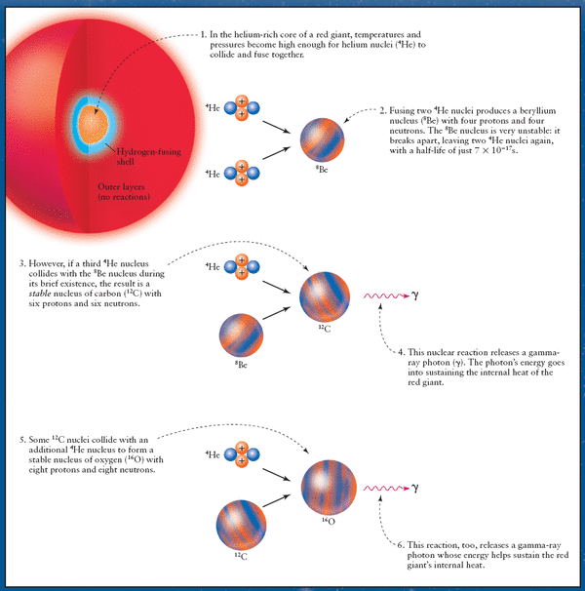
Core Helium Fusion: The Triple Alpha Process

Slide 21
Core He Fusion
The way He fusion begins in the core of a star depends on its mass.
for 0.4 M < M_{star} < 2-3 M Helium flash
M_{star} > 2-3 M we have gradual ignition of He

Slide 22
Safety Valve
In most cases the gases of a star obey the law: VT^{γ-1} = constant, where V=volume, T=temperature and γ is the adiabatic index that depends on the type of gas (γ= 1.4 for diatomic gas). When the gas expands the temperature goes down.
When the rate of fusion reactions increases, the outward radiation pressure also increases and expands the core. This expansion results in a decrease in temperature and the reaction rate goes down. This provides a safety valve for the star.
Conversely, a decrease in the reaction rate causes a compression of the gas resulting in an increase of the core temperature and the reaction rate goes up.

Slide 23

Degeneracy Pressure
Closely packed electrons resist compression. The reason for this is that no two electrons too close to each other can have the same four quantum numbers n, l, m_{l}, m_{s} (The Pauli exclusion principle).
The pressure of the electrons resisting compression is called degeneracy pressure.
In a red giant with 0.4 M < M_{star} < 2-3M the core must be compressed tremendously in order to become hot enough for helium fusion to begin.
Electron degeneracy pressure prevents a low mass red giant from compressing any further.
Wolfgang Pauli

Slide 24
Helium Flash
Helium flash is the sudden beginning of helium fusion in the core of intermediate mass stars of less than about 2.25 solar masses. The core is held up mostly by degeneracy pressure.
The cores of 0.4 M_{solar} < M_{star} < 2-3 M_{solar} red giant stars are degenerate. A helium flash occurs when fusion begins in a degenerate gas.
The cores of M_{star} > 2-3 M_{solar} red giant stars are not degenerate. In these stars He fusion begins gradually with no flash.

Slide 25
Thought Question
What happens in a low-mass star when the core temperature rises enough for helium fusion to begin?
Helium fusion slowly starts.
Hydrogen fusion stops.
Helium fusion rises very sharply.
Hint: Degeneracy pressure is the main form of pressure in the inert helium core.

Slide 26
Thought Question
What happens in a low-mass star when the core temperature rises enough for helium fusion to begin?
Helium fusion slowly starts.
Hydrogen fusion stops.
Helium fusion rises very sharply.
Hint: Degeneracy pressure is the main form of pressure in the inert helium core.

Slide 27
Helium Flash
Core temperature in a low-mass red giant rises rapidly when helium fusion begins.
Helium fusion rate skyrockets until thermal pressure takes over and expands the core again.

Slide 28
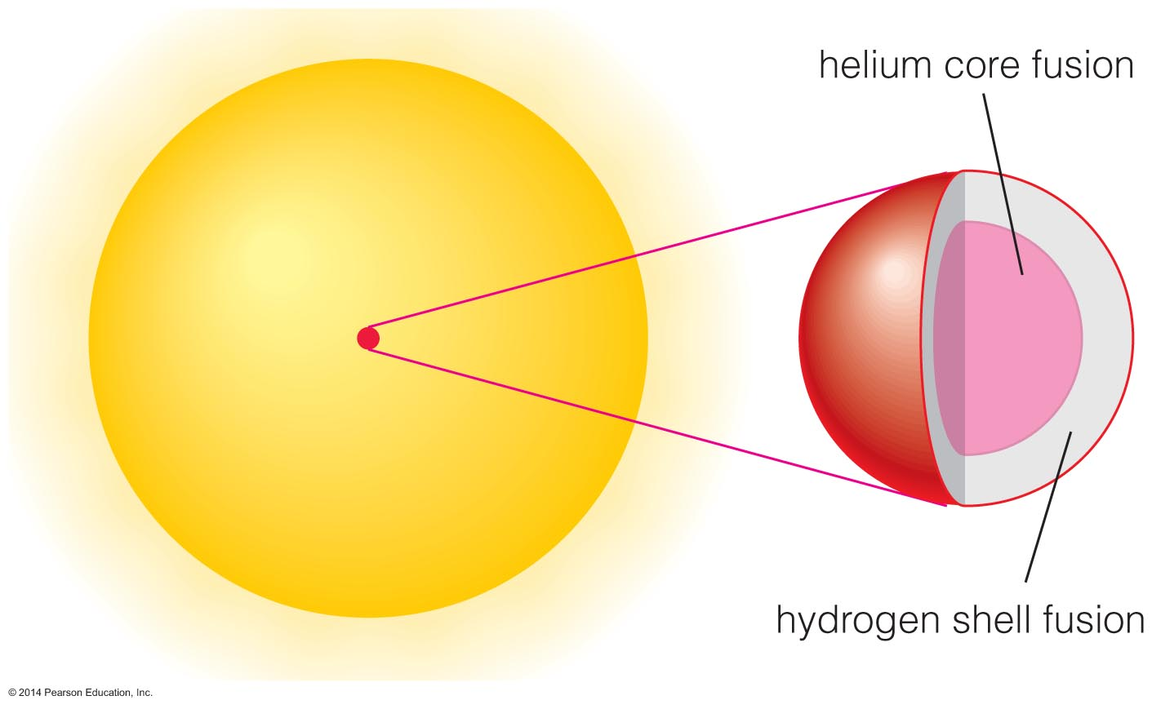
Helium-burning stars neither shrink nor grow because core thermostat is temporarily fixed.

Slide 29
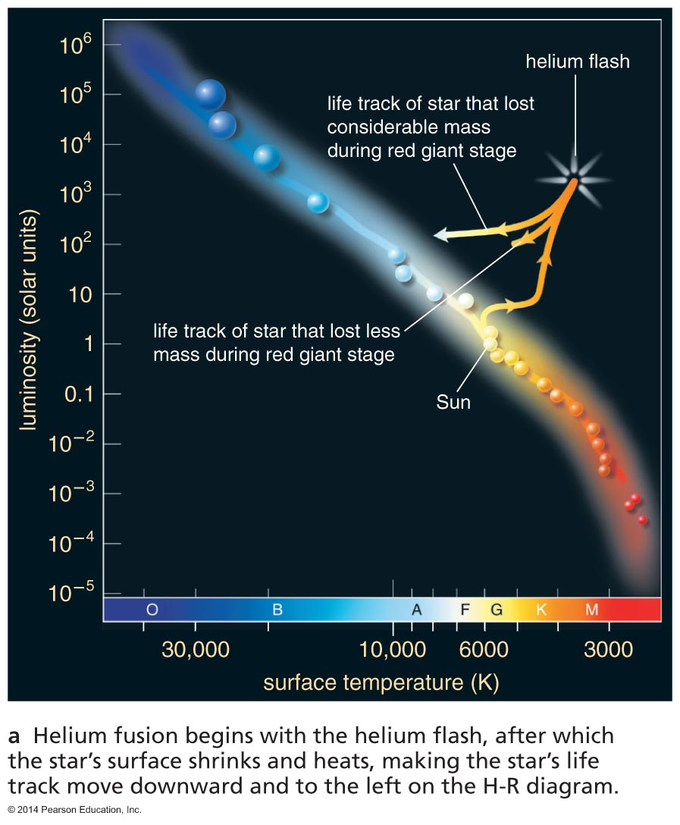
Life Track after Helium Flash
Models show that a red giant should shrink and become less luminous after helium fusion begins in the core.

Slide 30
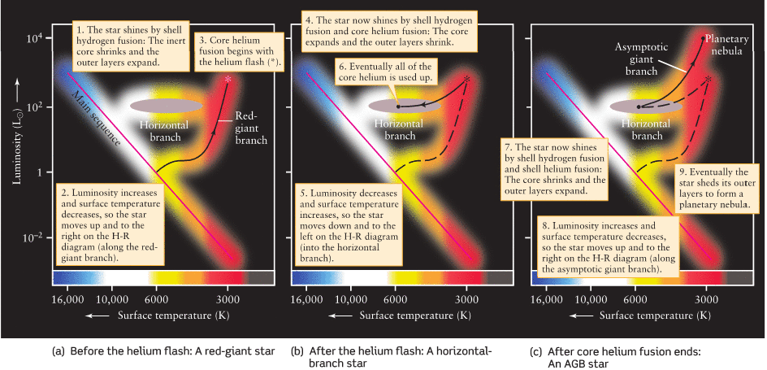
The Death of Low Mass Stars

Slide 31
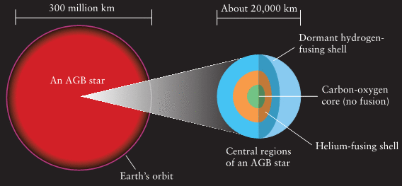
The Death of Low Mass Stars
He fusion produces O and C in the core. In a 1 M star He fusion will last for about 10⁸ years.
When He runs out, the core will collapse again resulting in an increase in the core temperature (T). This increase in T results in an increase in the reaction rate in the He shell that leads to the expansion of the outer layers for a second time. The resulting star is called an asymptotic giant branch (AGB) star.

Slide 32
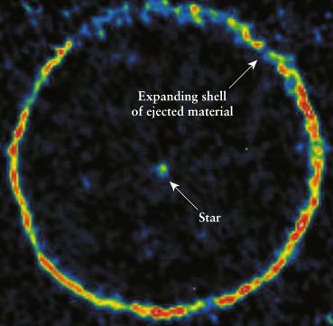
The Death of Low Mass Stars
The convection zone can grow significantly during the AGB phase of a M < 4M star.
This broadening of the convection zone drudges-up heavier elements ( ie. C, N and O) from the core to the surface.
The drudged-up carbon produces strong absorption lines in the spectra of some AGB stars. These are called carbon stars.
Carbon AGB star TT Cygni showing radio emission from CO in the ejected shell. AGB stars have very powerful winds with outflow rates of 10⁻⁴ M per year. A red giant’s outflow is ~10⁻⁷ M per year and the sun’s is ~10⁻¹⁴ M per year.

Slide 33
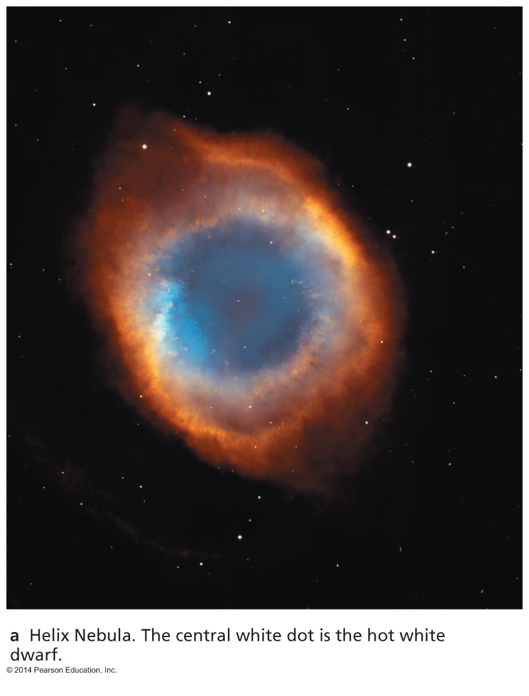
How does a low-mass star die?

Slide 34
Thought Question
What happens when the star's core runs out of helium?
The star explodes.
Carbon fusion begins.
The core cools off.
Helium fuses in a shell around the core.

Slide 35
Thought Question
What happens when the star's core runs out of helium?
The star explodes.
Carbon fusion begins.
The core cools off.
Helium fuses in a shell around the core.

Slide 36
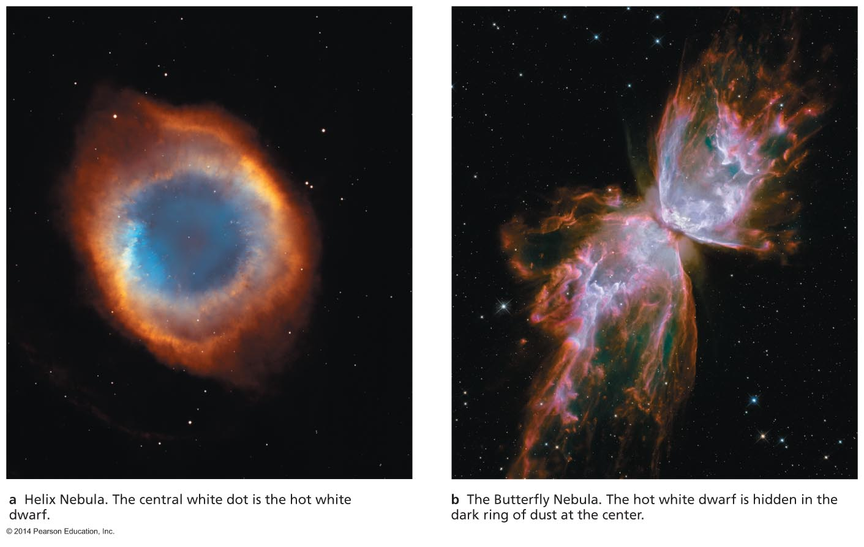
Planetary Nebulae
Double shell burning ends with a pulse that ejects the H and He into space as a planetary nebula.
The core left behind becomes a white dwarf.

Slide 37
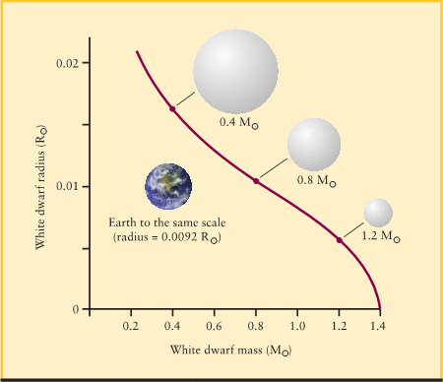
White Dwarfs
One unusual property of white dwarfs is the larger the mass the smaller the radius.
There is a limit however as to how much mass a white dwarf can have. Above this limit degeneracy pressure cannot overcome gravity. The limit is 1.4 M and was first derived by Indian astronomer Chandrasekhar.
When a white dwarf is initially formed it consists of ionized carbon and oxygen atoms floating in a sea of degenerate electrons.
As the white dwarf cools the motion of the C and O reduces to the point where the atoms form a crystal lattice.
A cool carbon-oxygen white dwarf resembles a huge diamond.
The mass-radius relation for a white dwarf. The maximum mass of a white dwarf, called the Chandrasekhar limit, is 1.4 M.

Slide 38
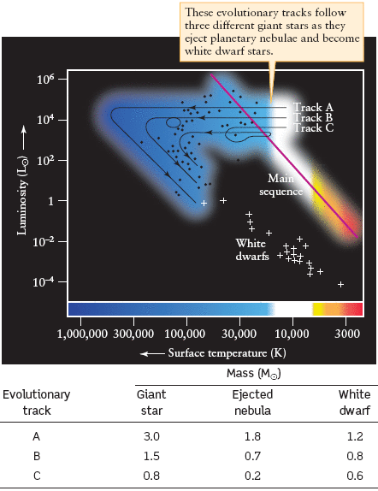
White Dwarfs
During the asymptotic giant branch a star ejects its outer layers exposing the burned-out core.
Once all the outer layers are ejected and the planetary nebula fades away the core continues to cool down and its luminosity decreases. A white dwarf’s size does not change because it is supported by degeneracy pressure.
The fraction of material ejected will depend on the mass of the giant star.
Evolution from Giants to White dwarf

Slide 39
End of Fusion
Fusion progresses no further in a low-mass star because the core temperature never grows hot enough for fusion of heavier elements (some helium fuses to carbon to make oxygen).
Degeneracy pressure supports the white dwarf against gravity.

Slide 40
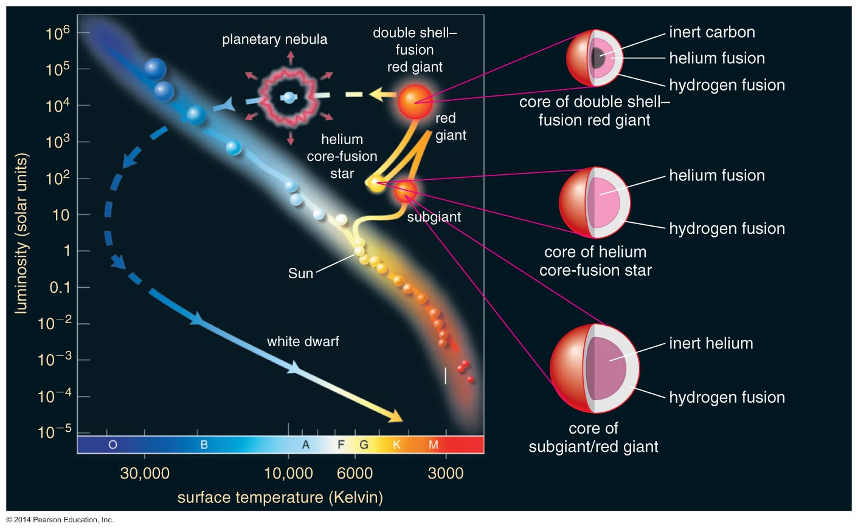
Life Track of a Sun-like Star

Slide 41
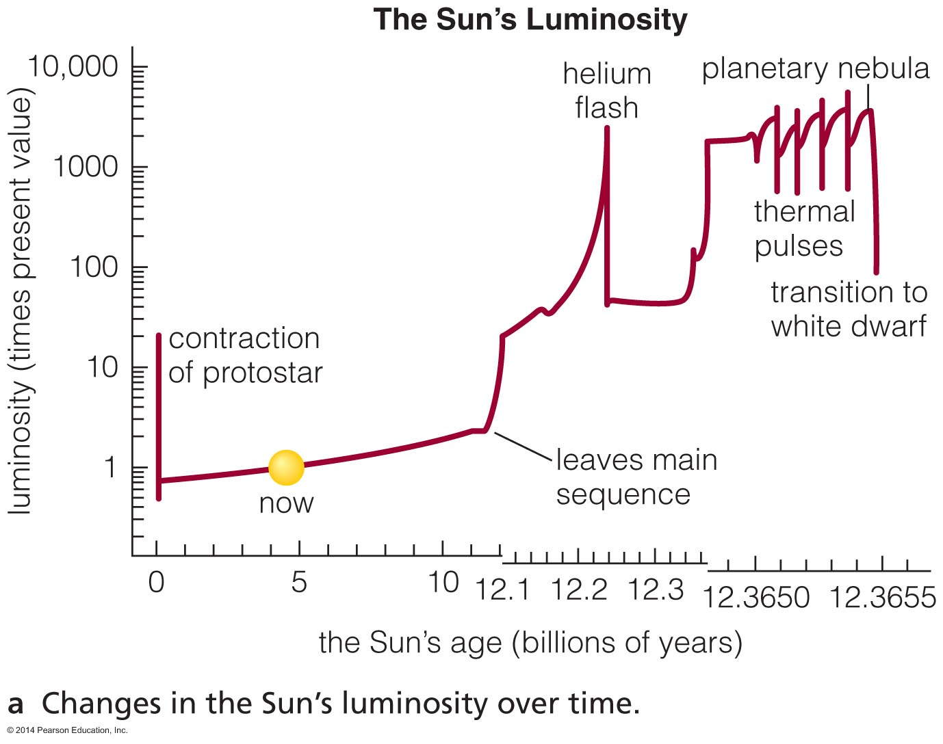
Earth's Fate
The Sun's luminosity will rise to 1000 times its current level—too hot for life on Earth.

Slide 42
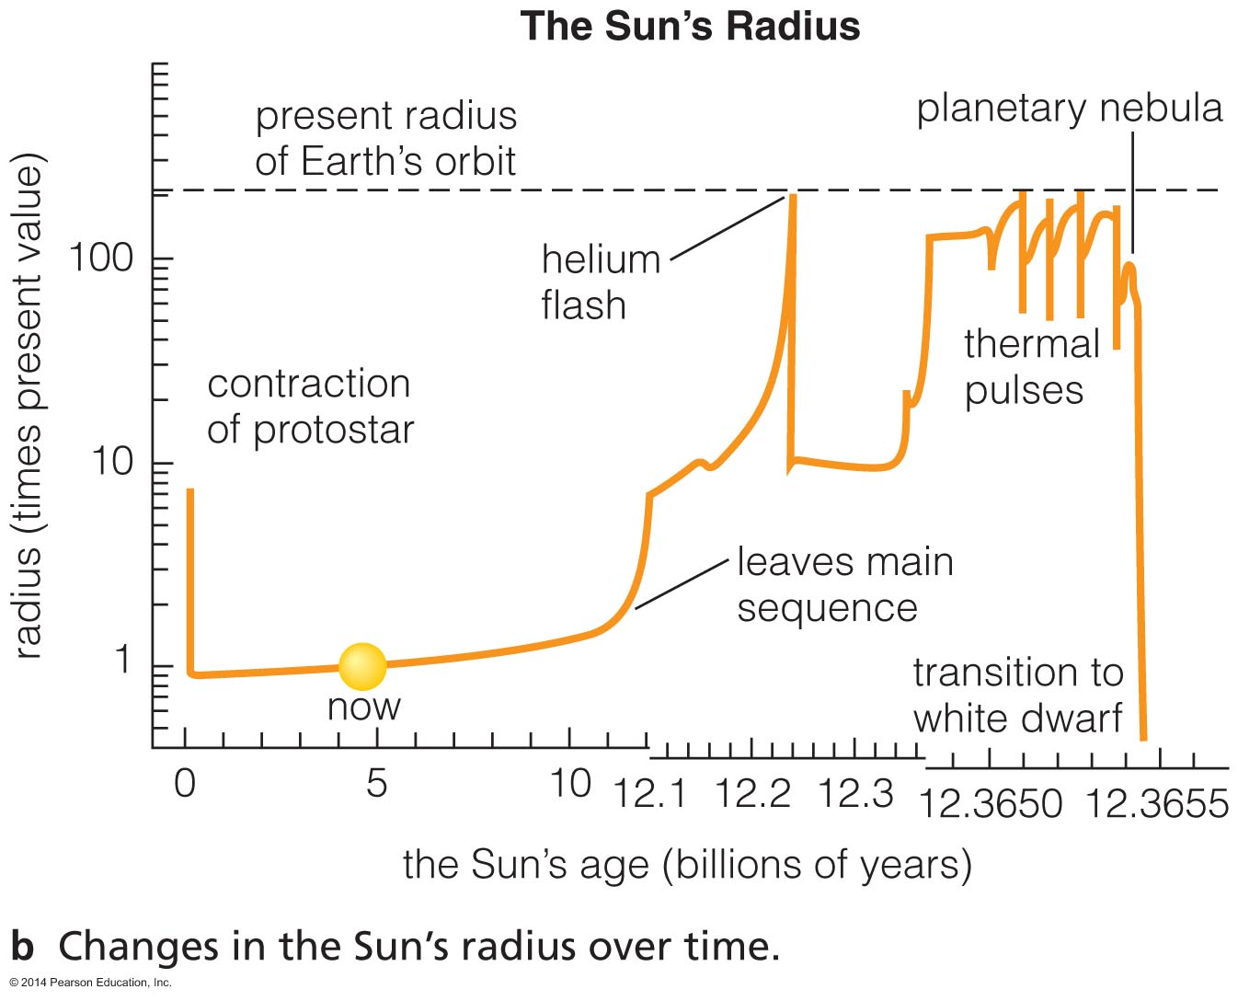
Earth's Fate
The Sun's radius will grow to near current radius of Earth's orbit.

Slide 43
What have we learned?
What are the life stages of a low-mass star?
  Hydrogen fusion in core (main sequence)
  Hydrogen fusion in shell around contracting core (red giant)
  Helium fusion in core (horizontal branch)
  Double shell burning (red giant)
How does a low-mass star die?
  Ejection of hydrogen and helium in a planetary nebula leaves behind an inert white dwarf.

Slide 44
17.3 Life as a High-Mass Star
Our goals for learning:
  What are the life stages of a high-mass star?
  How do high-mass stars make the elements necessary for life?
  How does a high-mass star die?

Slide 45
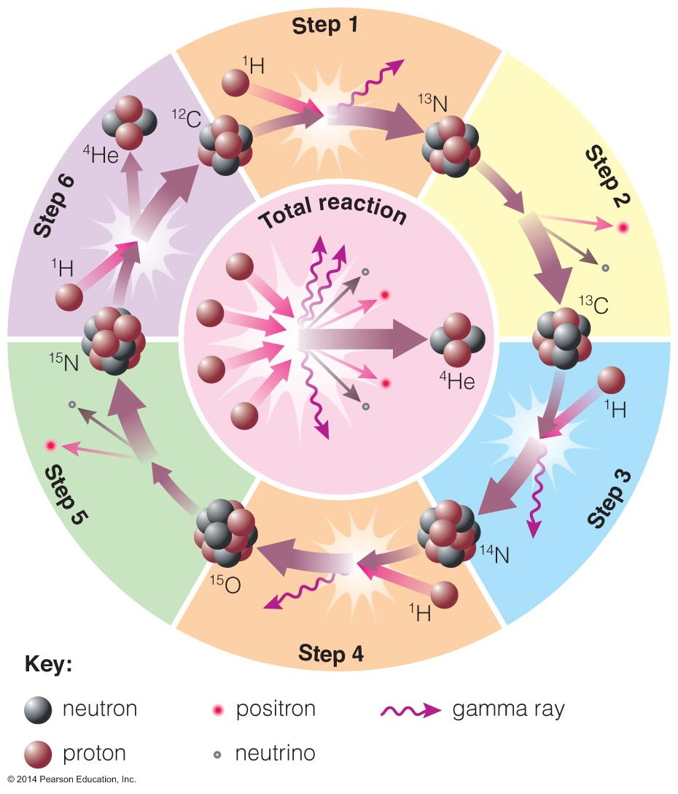
CNO Cycle
High-mass main-sequence stars fuse H to He at a higher rate using carbon, nitrogen, and oxygen as catalysts.
Greater core temperature enables hydrogen nuclei to overcome greater repulsion.

Slide 46
Life Stages of High-Mass Stars
Late life stages of high-mass stars are similar to those of low-mass stars:
  Hydrogen core fusion (main sequence)
  Hydrogen shell burning (supergiant)
  Helium core fusion (supergiant)

Slide 47
Life Stages of High-Mass Stars
The reason why high densities and temperatures are required to fuse elements heavier than He is that heavy nuclei have large charges and therefore large electric forces that tend to keep the nuclei apart.
When a star with initial mass M > 4M runs out of He in its core the core begins to contract and the outer layers of the star expand.
Because the mass of the core of a star with M > 4M is more than the Chandrasekhar limit of 1.4 M, degeneracy pressure cannot prevent the collapse of the star. The temperature continues to rise and when it reaches 600 million K carbon fusion begins.

Slide 48
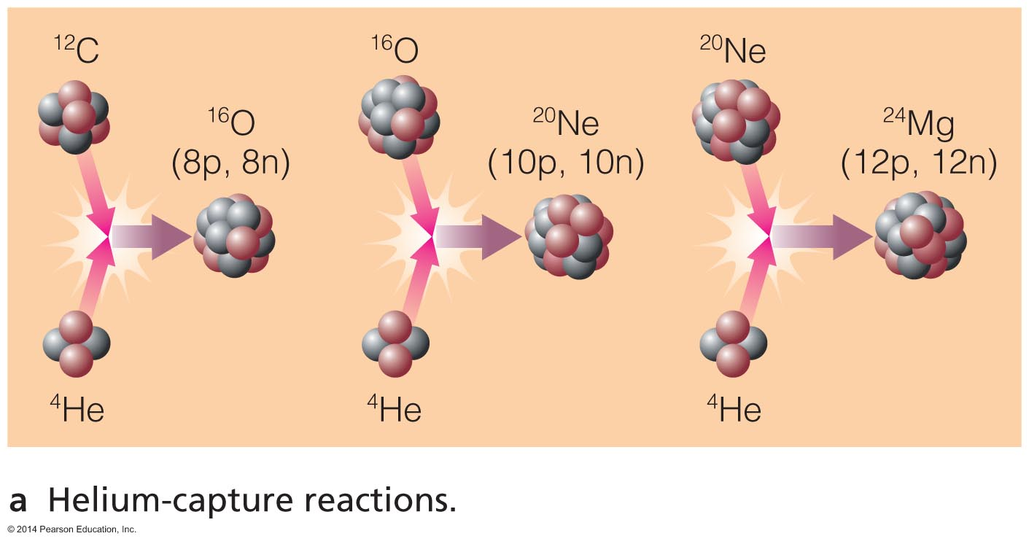
How do high-mass stars make the elements necessary for life?

Slide 49
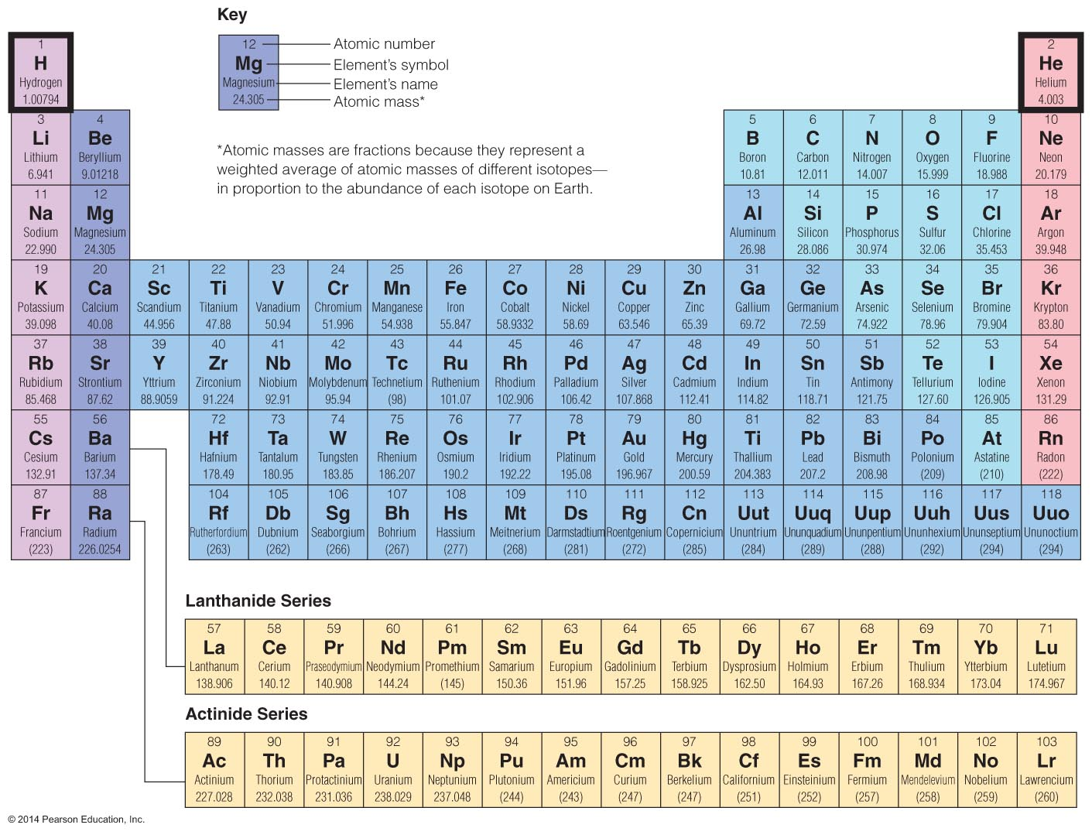
Big Bang made 75% H, 25% He; stars make everything else.

Slide 50
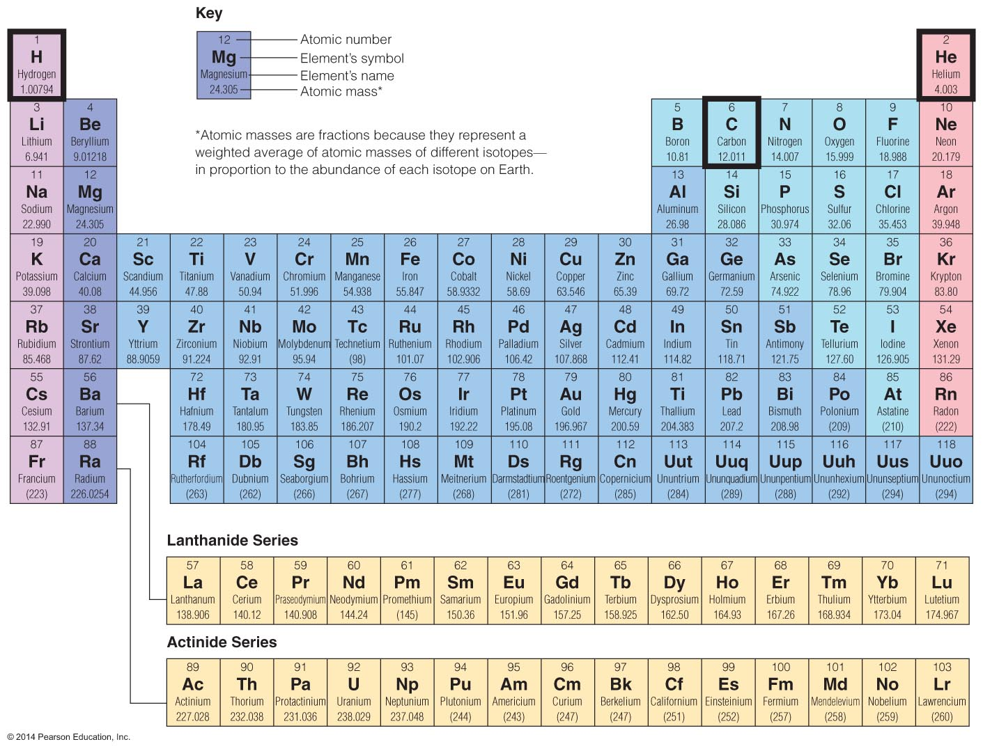
Helium fusion can make carbon in low-mass stars.

Slide 51
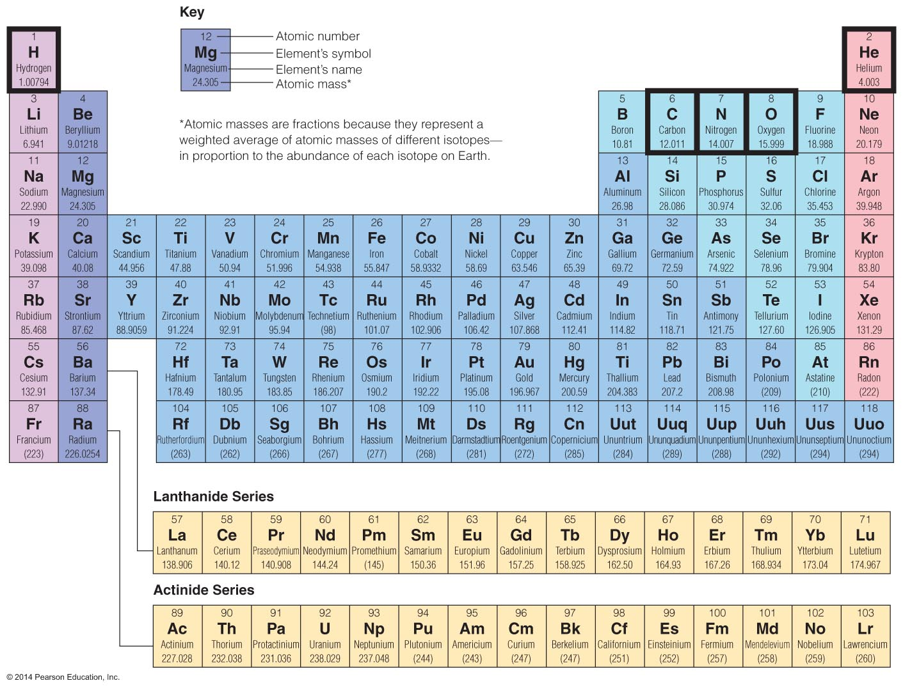
CNO cycle can change carbon into nitrogen and oxygen.

Slide 52
Helium Capture
High core temperatures allow helium to fuse with heavier elements.

Slide 53
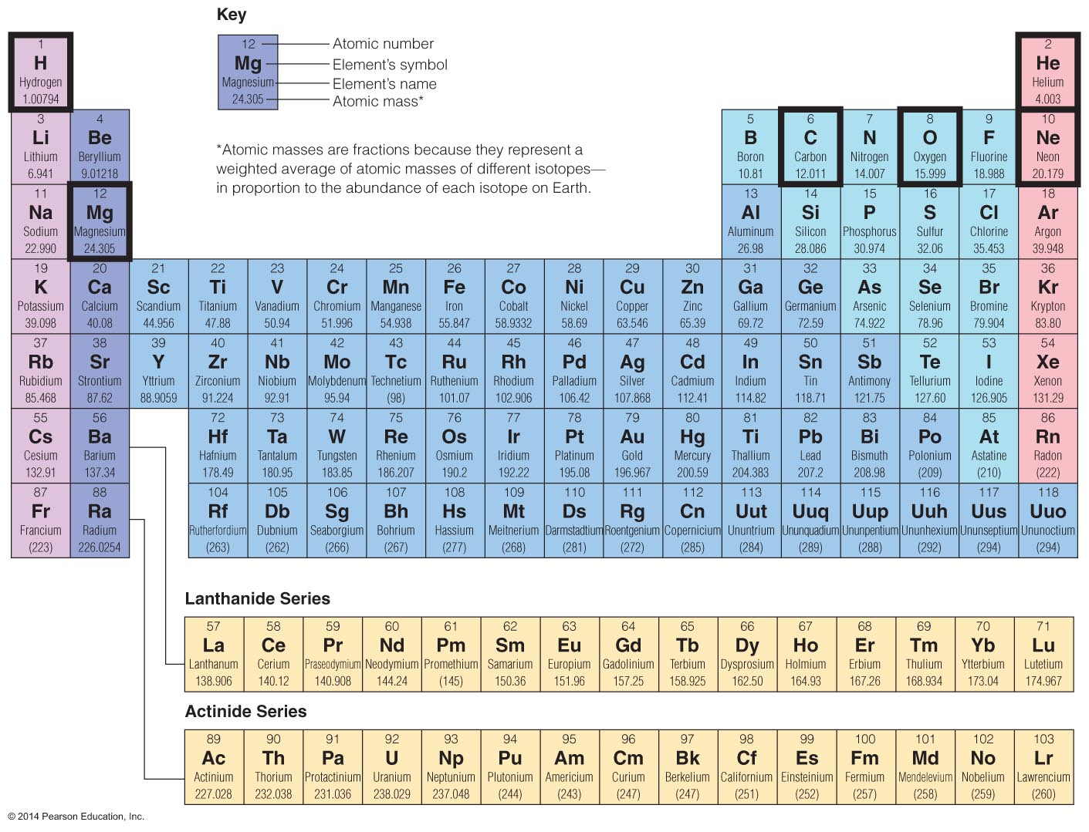
Helium capture builds carbon into oxygen, neon, magnesium, and other elements.

Slide 54
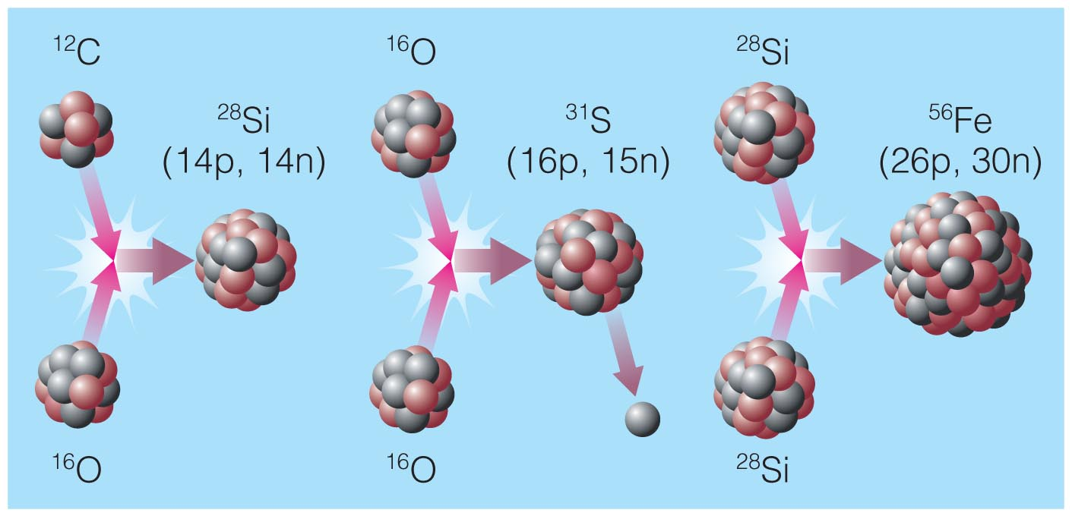
Advanced Nuclear Burning
Core temperatures in stars with >8M_{Sun} allow fusion of elements as heavy as iron.

Slide 55
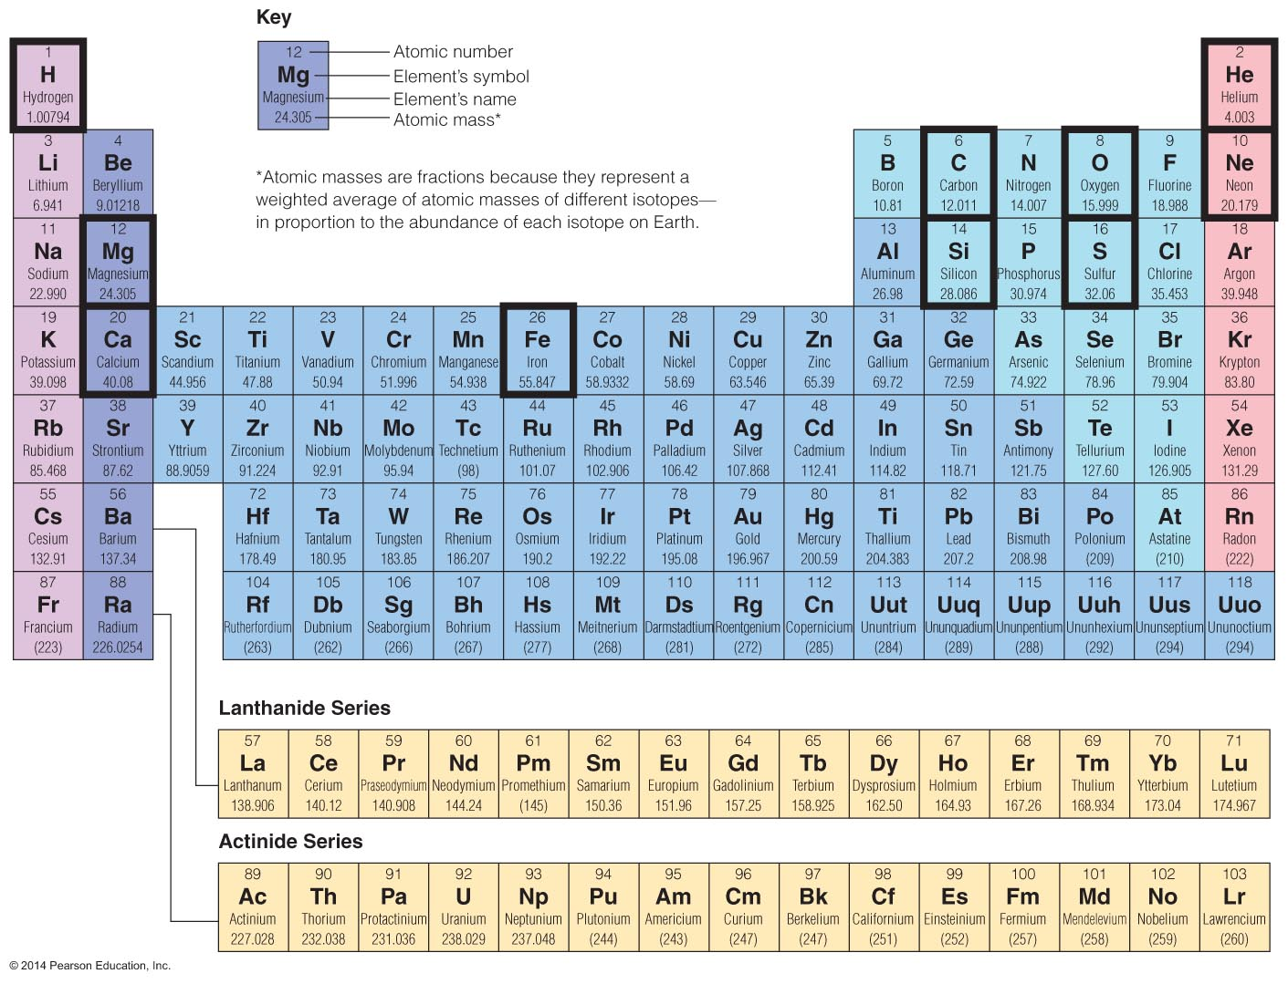
Advanced reactions in stars make elements like Si, S, Ca, Fe.

Slide 56
Stellar Evolution of Massive Stars
Carbon fusion: T_{Fusion} = 600 ×10⁶ K
Products = oxygen (O), neon (Ne), sodium (Na), magnesium (Mg)
If the star has M >8M additional reactions can occur:
Neon fusion: T_{Fusion} = 10⁹ K
Products = oxygen (O), magnesium (Mg)
Oxygen fusion: T_{Fusion}= 1.5 ×10⁹ K
Product = silicon (Si), magnesium (Mg), phosphorus (P), sulfur(S)
Silicon fusion: T_{Fusion} = 2.7 ×10⁹ K
Products = Sulfur (S), Iron (Fe), Nickel (Ni)

Slide 57
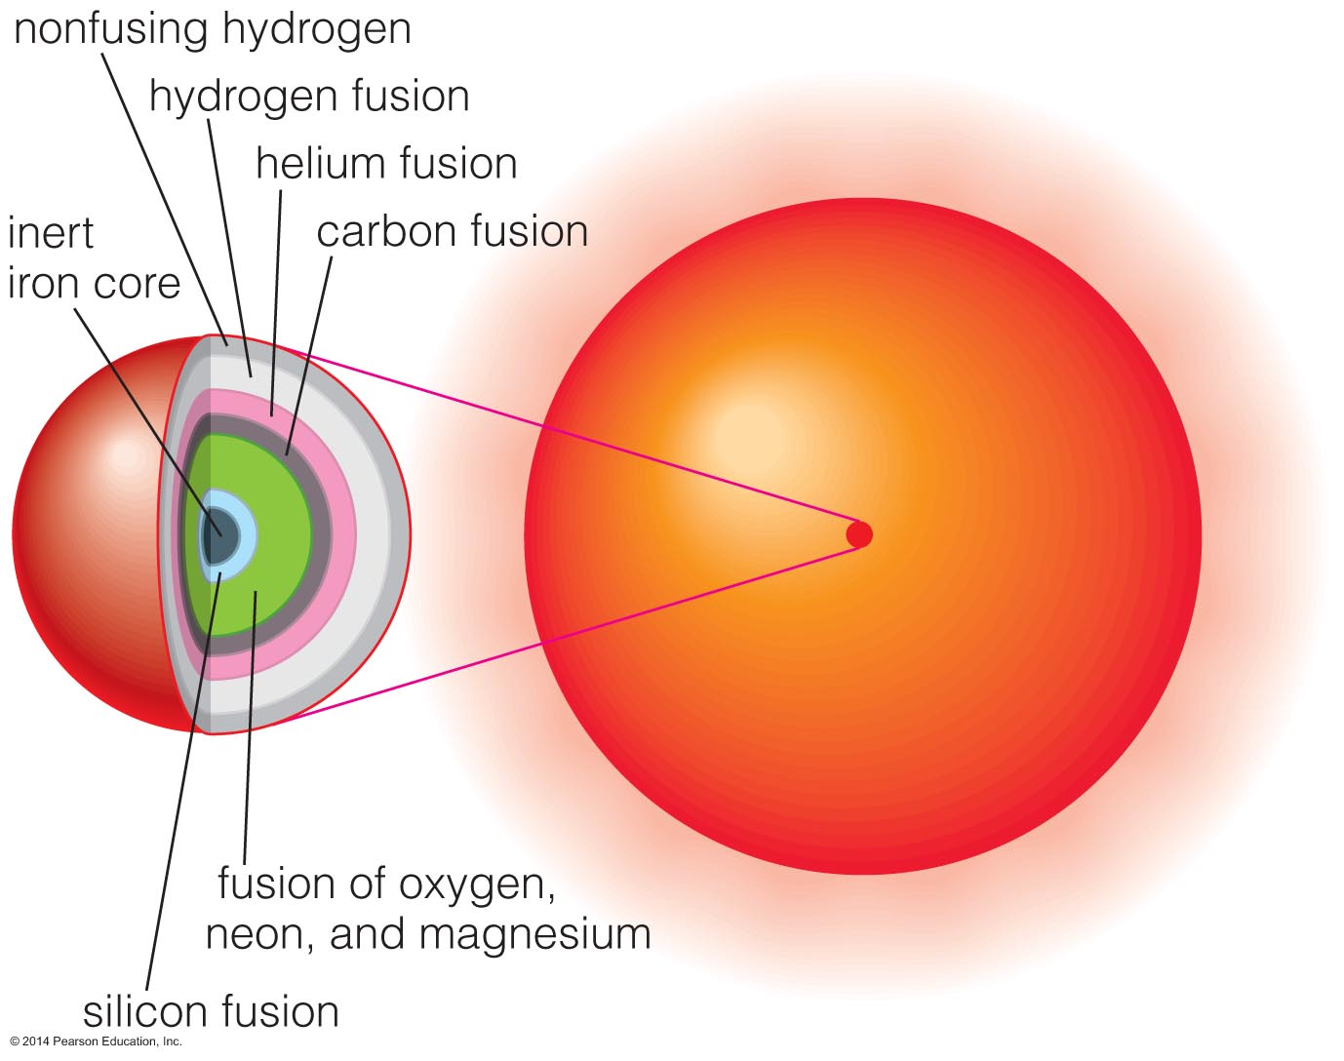
Multiple Shell Burning
Advanced nuclear burning proceeds in a series of nested shells.

Slide 58
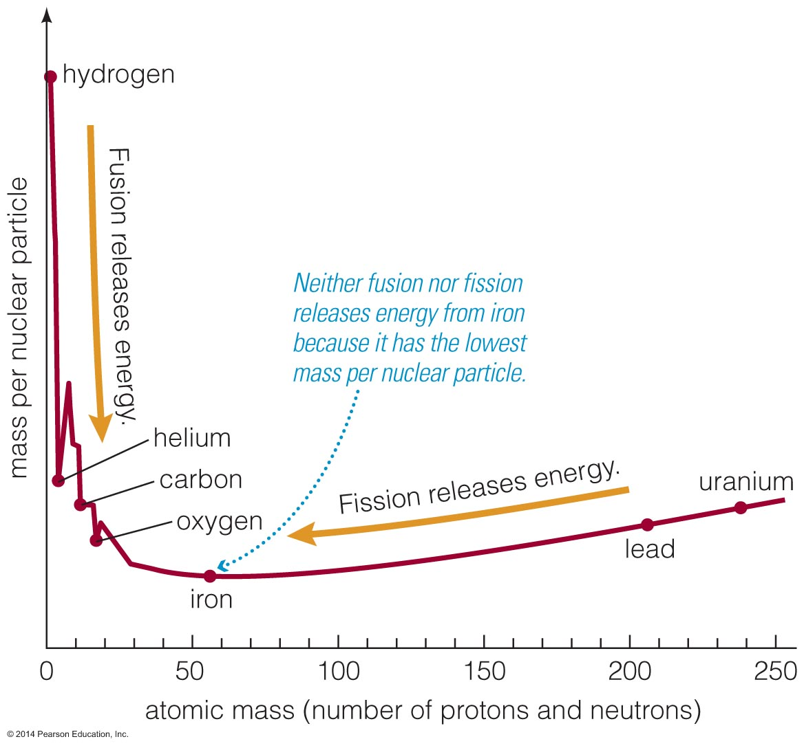
Iron is a dead end for fusion because nuclear reactions involving iron do not release energy.
(This is because iron has lowest mass per nuclear particle.)

Slide 59
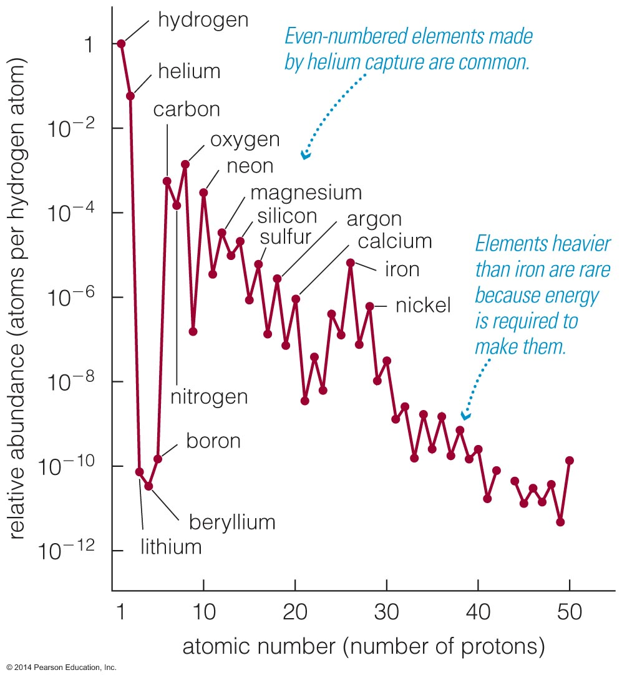
Evidence for helium capture:
Higher abundances of elements with even numbers of protons

Slide 60
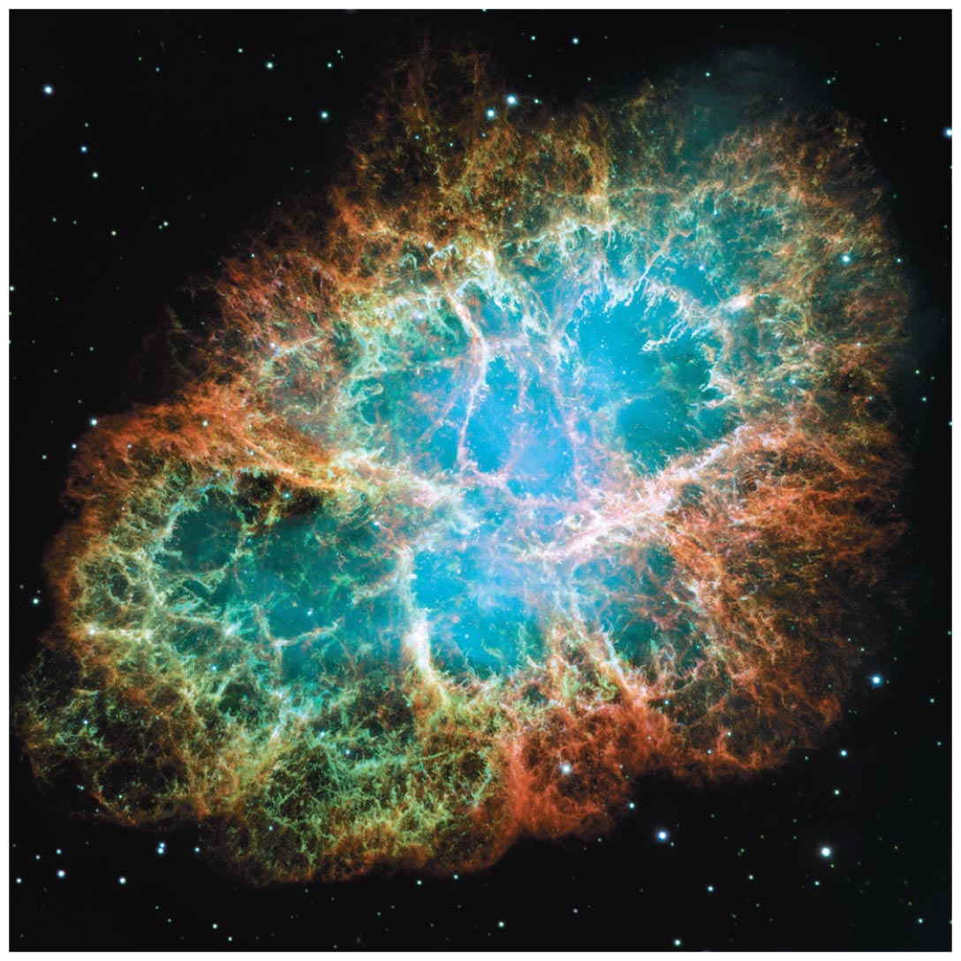
How does a high-mass star die?

Slide 61
Core Collapse
A massive star with M > 8M will eventually reach the point of fusing Si into Fe. Fusion of Fe does not produce energy (endothermic) so the core cannot generate heat from fusion but instead begins to collapse and heat up.
The gamma rays emitted from the hot core have very large energies that break the iron into helium nuclei and free neutrons. This process is called photodisintegration.
Because of the high density electrons combine with protons to form neutrons and neutrinos: e⁻ + p⁺ → n + ν
The escape of the neutrinos cools down the core and leads to more compression. Seconds after the contraction began the density reaches the nuclear density value of ~ 4×10¹⁷kg m⁻³.

Slide 62
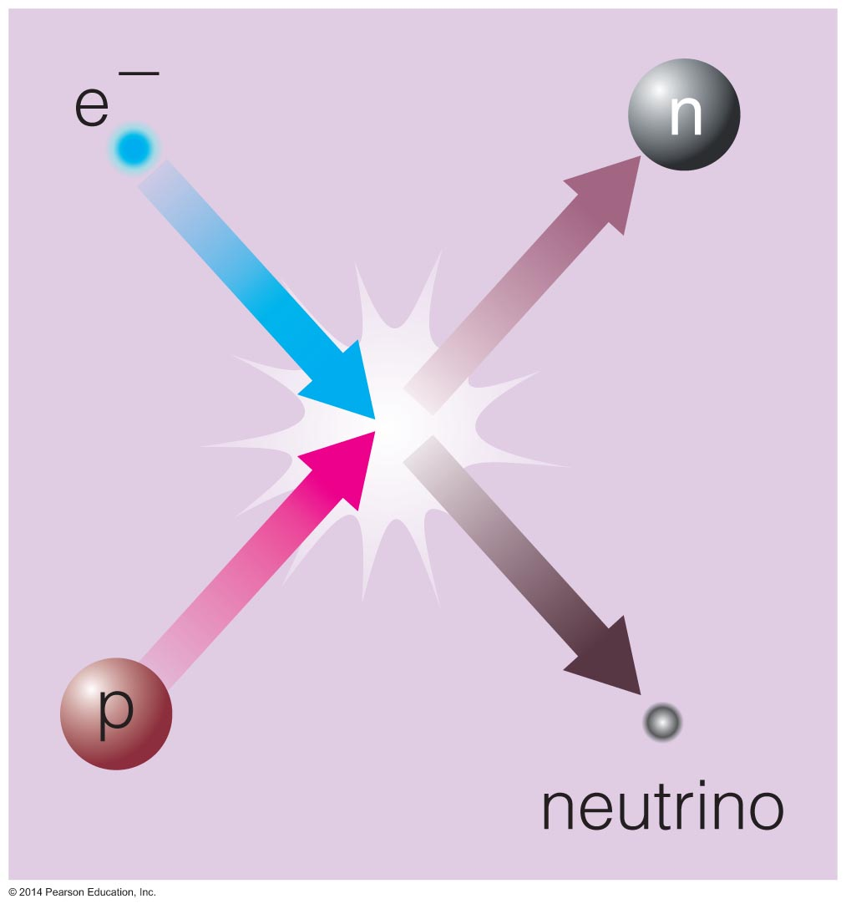
Core Collapse
Electron degeneracy pressure goes away because electrons combine with protons, making neutrons and neutrinos.
Neutrons collapse to the center, forming a neutron star.

Slide 63
Core Bounce
The core becomes very rigid at nuclear density and further compression results in the innermost part of the core bouncing back and sending out a pressure wave.
There isn’t enough radiation pressure to hold the outer layers up against gravity, and the material from the outer layers plunges inward at speeds of up to 20% of the speed of light.
When the infalling material encounters the outward moving pressure wave it changes direction and starts moving outward reaching supersonic speeds. The outflowing neutrinos are thought to contribute to the outward shock wave.
It takes a few hours for the shock wave to reach the surface and lift away the outer layers of the star.

Slide 64
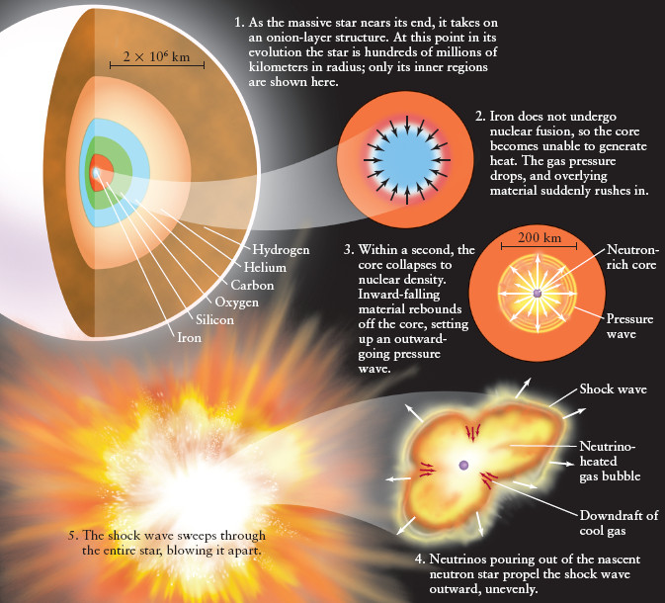
Supernova Explosions

Slide 65
Energetics
The energy released in a core-collapse supernova explosion is extremely large at ~ 10⁴⁴ Joules!
The energy released in a core-collapse supernova explosion comes from gravitational energy released by the collapse of the core and the infall of the outer layers of the star.
The gravitational energy released by the collapse of the core is mostly converted into a burst of neutrinos.

Slide 66
Heavy Elements Produced During Supernova Exposions
Material ejected from a massive star during a core-collapse supernova is compressed by the outward shock wave and
thermonuclear reactions occur in the gas that produce elements that are even heavier than iron, such as zinc (Zn), silver(Ag), tin(Sn), gold(Au), mercury(Hg), lead(Pb), and uranium(U).
Since we find these heavy elements on Earth it has been suggested that they were produced long ago by a star that went through a core-collapse supernova.

Slide 67

Energy and neutrons released in supernova explosion enable elements heavier than iron to form, including gold and uranium.

Slide 68
Supernova Remnant
Energy released by the collapse of the core drives the star's outer layers into space.
The Crab Nebula is the remnant of the supernova seen in A.D. 1054.

Slide 69
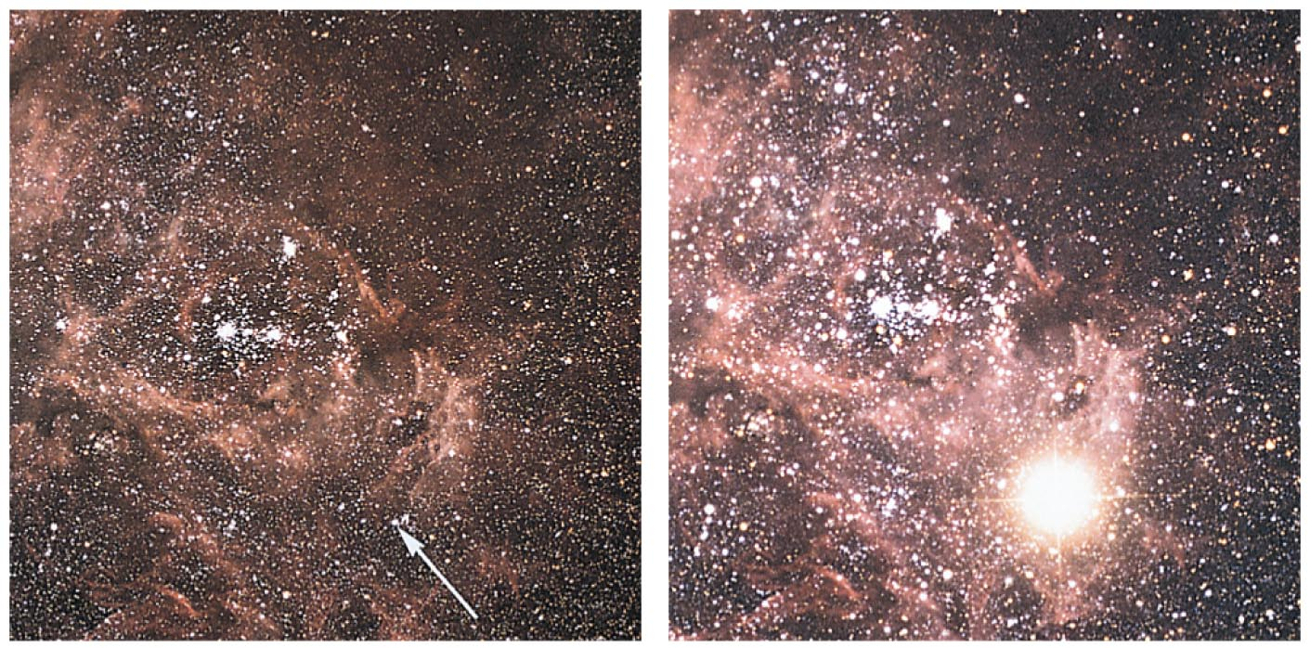
Supernova 1987A
The closest supernova in the last four centuries was seen in 1987.

Slide 70
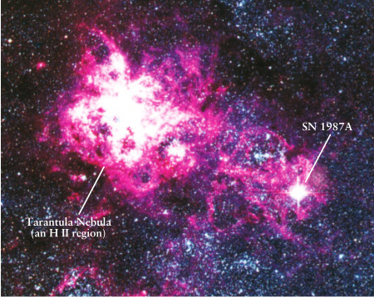
Supernova 1987A
Light from SN 1987 A continues to arrive. It doesn't all come out at one short period.
For the first 20 days after the supernova the ejected outer layers were glowing from the heat deposited by the shock wave.
SN 1987 A is also emitting gamma rays from the decay of radioactive isotopes created during the supernova explosion.
On Feb 1987 a supernova was discovered in the Large Magellanic Cloud (~ 170,000 ly away). It was so bright it could be seen without a telescope in the southern hemisphere.
Five very bright supernovae have been observable without a telescope in the last 1000 years.

Slide 71
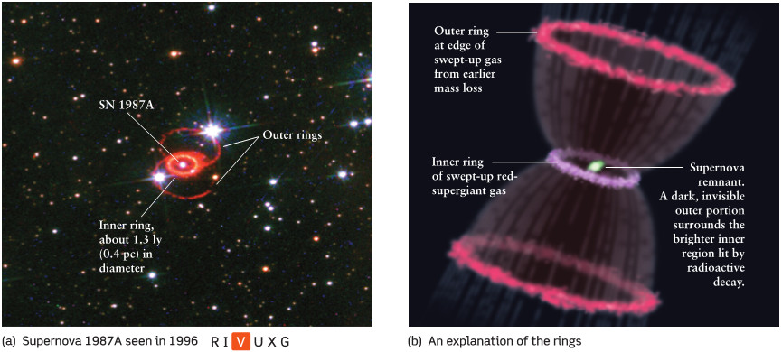
Rings around Supernova 1987A
Rings of SN 1987 A About 20,000 years before the explosion a shell of gas was ejected from the red giant and about 10,000 years before the explosion another shell of gas was ejected.
The UV flash of the supernova explosion ionized the ejected stellar material and caused it to glow.

Slide 72
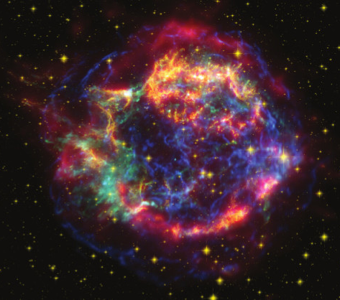
Rate of Supernovae in the Milky Way
From the frequency with which supernovae occur in distant galaxies, it is reasonable to suppose that a galaxy such as our own should have as many as five supernovae per century.
Where have they been?
A composite of observations of SNR Cassiopeia A at X-ray, visible, and infrared wavelengths.
Cas-A is about 11,000 ly away and the photons from the supernova explosion arrived ~300 years ago.

Slide 73
What have we learned?
What are the life stages of a high-mass star?
  They are similar to the life stages of a low-mass star.
How do high-mass stars make the elements necessary for life?
  Higher masses produce higher core temperatures that enable fusion of heavier elements.
How does a high-mass star die?
  Its iron core collapses, leading to a supernova.

Slide 74
17.4 The Roles of Mass and Mass Exchange
Our goals for learning:
  How does a star's mass determine its life story?
  How are the lives of stars with close companions different?

Slide 75
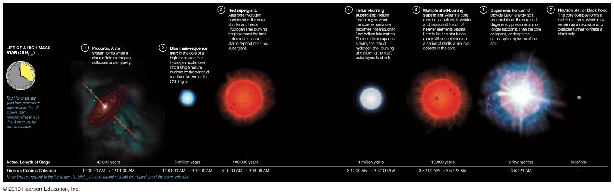
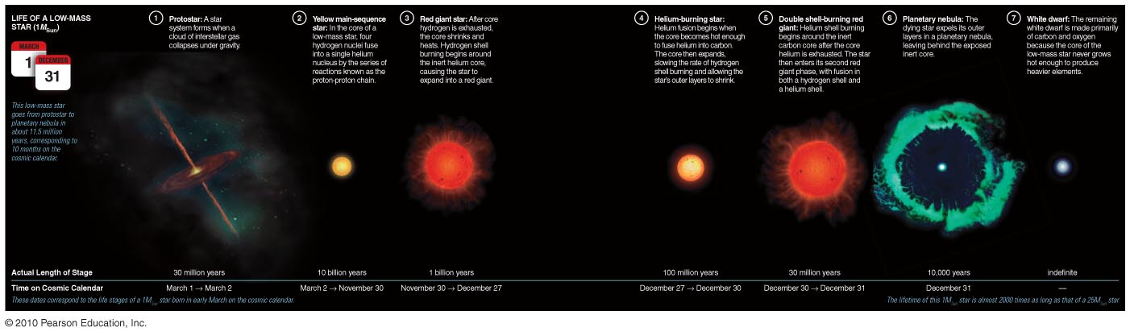
How does a star's mass determine its life story?

Slide 76
Role of Mass
A star's mass determines its entire life story because it determines its core temperature.
High-mass stars with > 8M_{Sun} have short lives, eventually becoming hot enough to make iron, and end in supernova explosions.
Low-mass stars with < 4M_{Sun} have long lives, never become hot enough to fuse carbon nuclei, and end as white dwarfs.
Intermediate-mass stars can make elements heavier than carbon but end as white dwarfs.

Slide 77
Low-Mass Star Summary
Main sequence: H fuses to He in core.
Red giant: H fuses to He in shell around He core.
Helium core burning: He fuses to C in core while H fuses to He in shell.
Double shell burning: H and He both fuse in shells.
Planetary nebula leaves white dwarf behind.

Slide 78
Life Stages of High-Mass Star
Main sequence: H fuses to He in core.
Red supergiant: H fuses to He in shell around He core.
Helium core burning:
He fuses to C in core while H fuses to He in shell.
Multiple shell burning:
Many elements fuse in shells.
Supernova leaves neutron star or black hole behind.

Slide 79
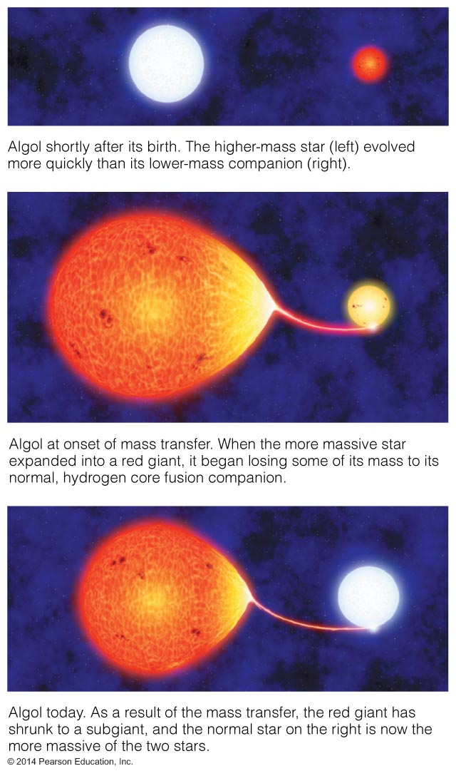
How are the lives of stars with close companions different?

Slide 80
Thought Question
The binary star Algol consists of a 3.7M_{Sun} main-sequence star and a 0.8M_{Sun} subgiant star.
What's strange about this pairing?
How did it come about?

Slide 81
Thought Question Answers
The stars in Algol are close enough that matter can flow from the subgiant onto the main-sequence star.

Slide 82
The star that is now a subgiant was originally more massive.
As it reached the end of its life and started to grow, it began to transfer mass to its companion (mass exchange).
Now the companion star is more massive.

Slide 83
What have we learned?
How does a star's mass determine its life story?
  Mass determines how high a star's core temperature can rise and therefore determines how quickly a star uses its fuel and what kinds of elements it can make.
How are the lives of stars with close companions different?
  Stars with close companions can exchange mass, altering the usual life stories of stars.

