Slide 1
Our Galaxy

Slide 2
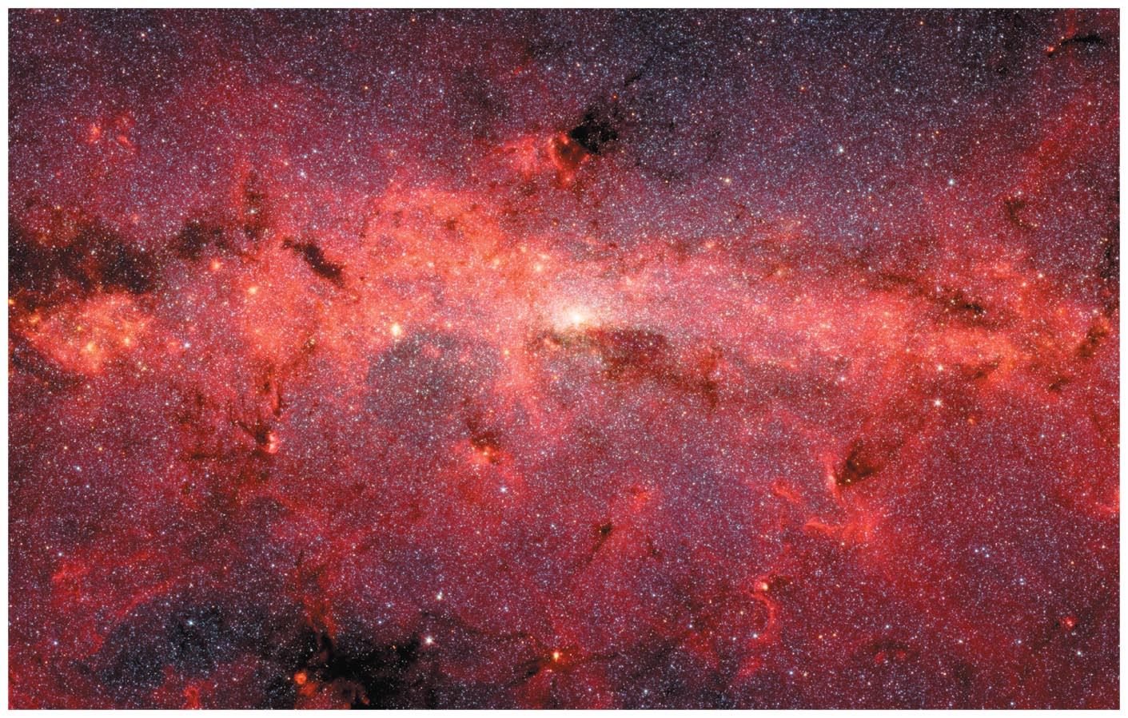
Our Galaxy

Slide 3
19.1 The Milky Way Revealed
Our goals for learning:
  Where are we located within our galaxy?
  What does our galaxy look like?
  How do stars orbit in our galaxy?

Slide 4
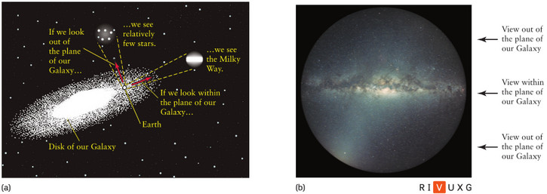
Our Galaxy
We are located in the disk of our galaxy and this is why the disk appears as a band of stars across the sky.
Early attempts to locate our solar system produced erroneous results. The main problem was that interstellar extinction allows one to only see the nearby stars
and makes distant objects appear dimmer.
The key to finding our location in the galaxy is locating bright objects out of the plane of the galaxy. Astronomers use globular clusters to locate the position of our solar system with respect to the Galaxy. We are ~ 26,000 ly from Galaxy center.

Slide 5
Interstellar Extinction in Our Galaxy
Interstellar extinction is roughly inversely proportional to wavelength. As a result we can see farther into the disk in radio and IR wavelengths than at visible wavelengths.
Starlight warms dust grains to temperatures of about 10K - 90K and thus they emit predominately at far-infrared wavelengths between 30 μm – 300 μm.
Far-infrared light from our galaxy traces interstellar dust.
- Near-infrared light from our galaxy traces mostly stars.

Slide 6
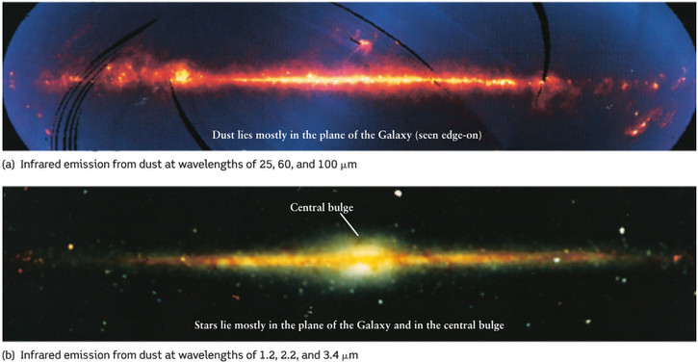
Our Galaxy
Far-infrared image of the Milky Way taken with the IRAS spacecraft. Interstellar dust, which is mostly confined to the plane of the Galaxy, is the principal source of radiation in this wavelength range.
(b) Near-infrared image of the Milky Way taken with the COBE observatory. We can see farther through interstellar dust by observing in near-infrared wavelengths than at visible ones. Light in the near infrared range comes mostly from stars in the plane of the Galaxy and in the bulge at the Galaxy’s center.

Slide 7
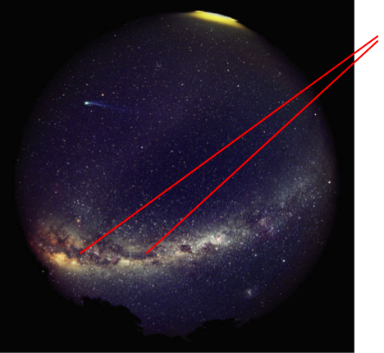
Dusty gas clouds obscure our view because they absorb visible light.
This is the interstellar medium that makes new star systems.

Slide 8
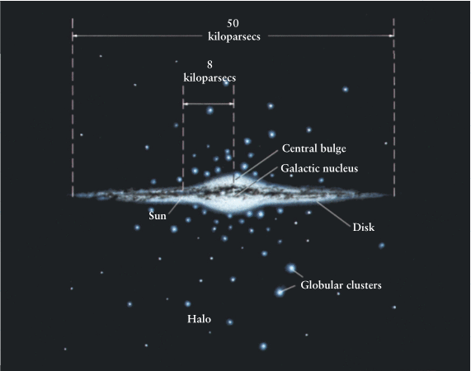
Our Galaxy
There are three major components of our Galaxy: a disk, a central bulge, and a halo. The disk contains gas and dust along with metal-rich (Population I) stars. The halo is composed almost exclusively of old, metal-poor (Population II) stars. The central bulge is a mixture of Population I and Population II stars.

Slide 9
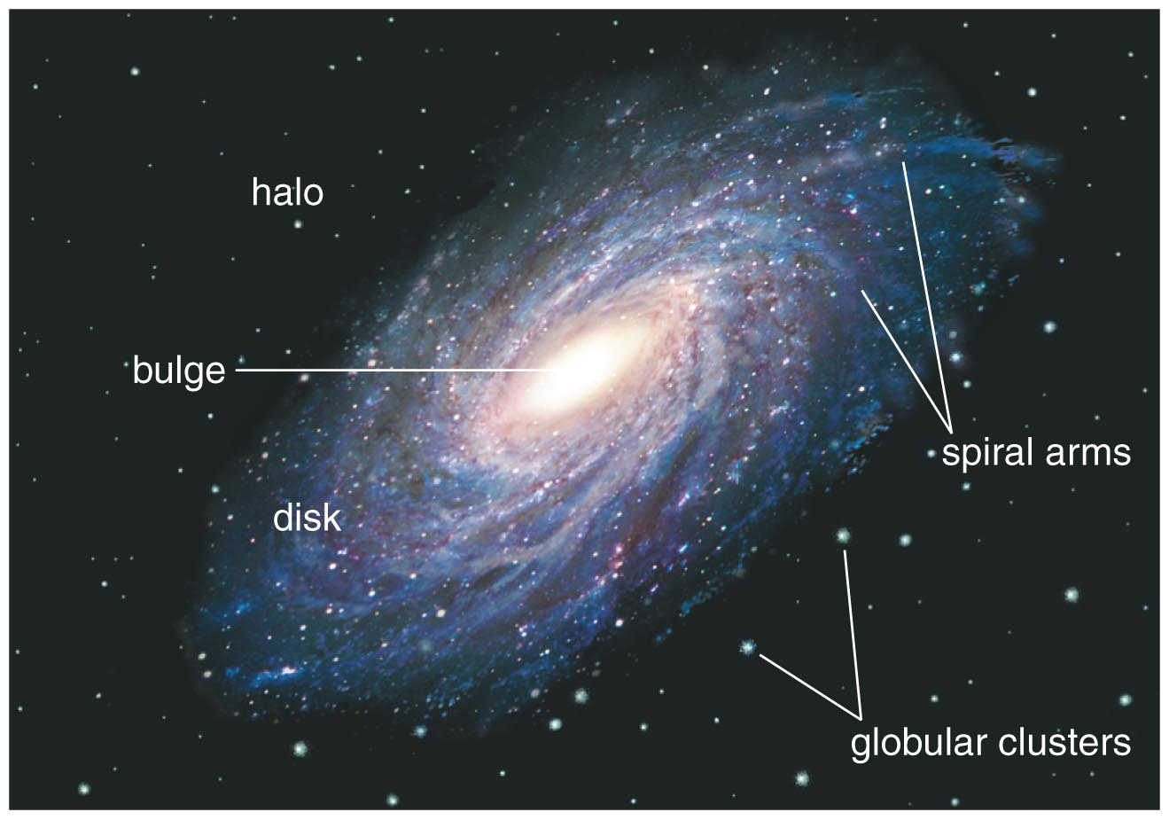
If we could view the Milky Way from above the disk, we would see its spiral arms.

Slide 10
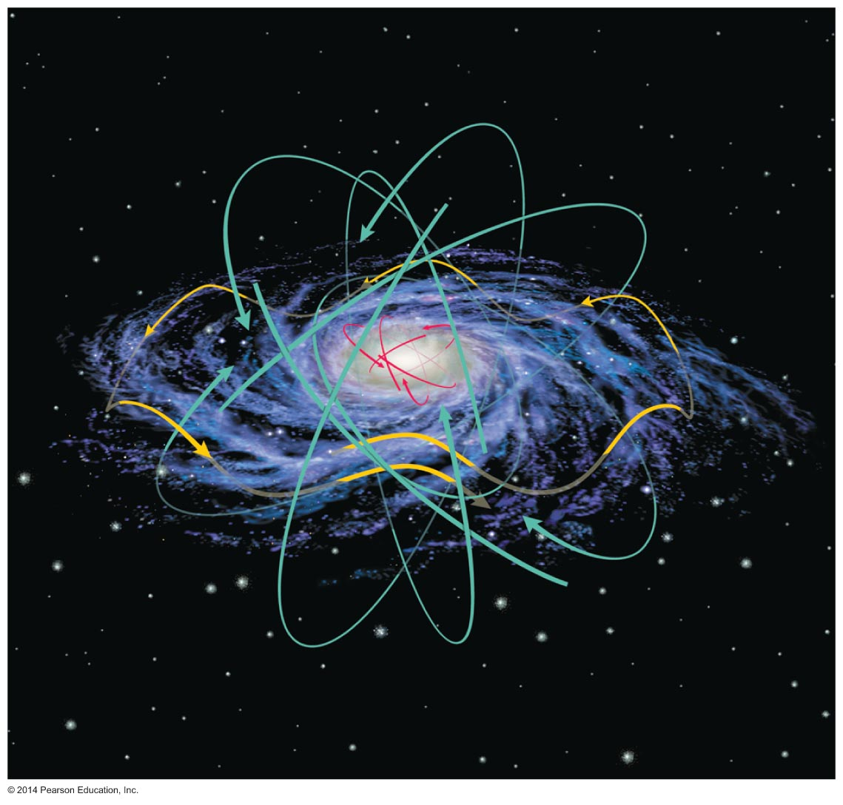
How do stars orbit in our galaxy?

Slide 11
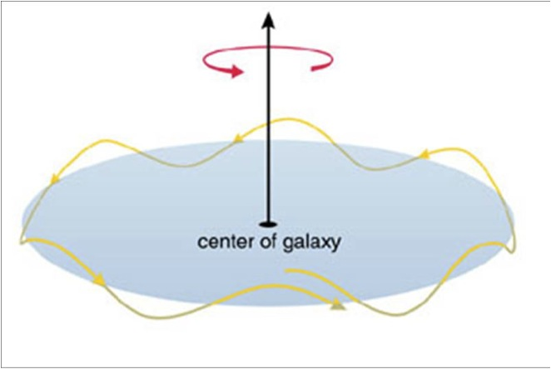
Stars in the disk all orbit in the same direction with a little up-and-down motion.

Slide 12
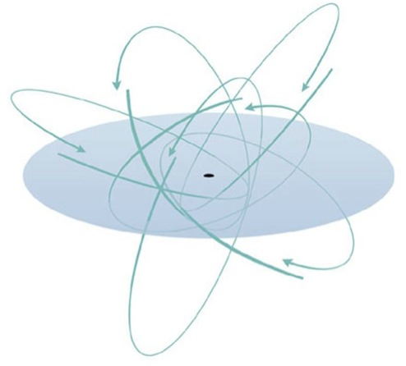
Orbits of stars in the bulge and halo have random orientations.

Slide 13
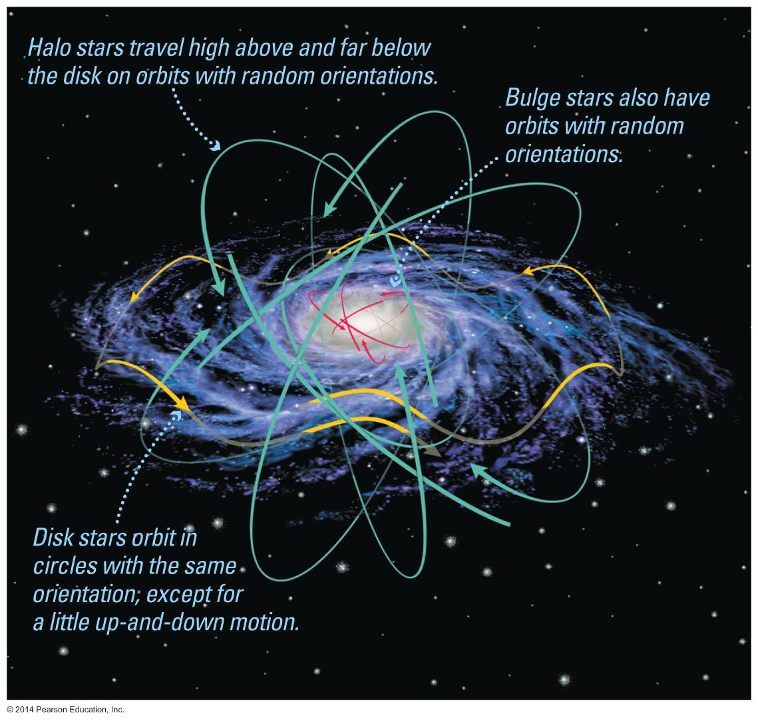

Slide 14
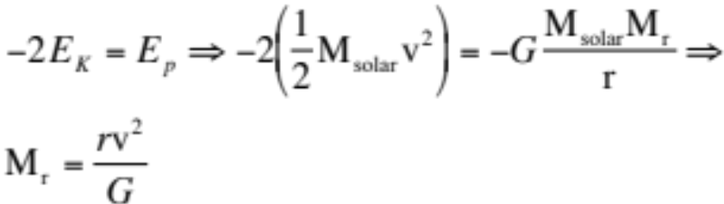
Orbital Velocity Law
r × v²
M_{r}
=
G
The orbital speed (v) and radius (r) of an object on a circular orbit around the galaxy tell us the mass (M_{r}) within that orbit.

Slide 15
The Sun's orbital motion (radius and velocity) tells us the mass within Sun's orbit:
1.0 × 10¹¹M_{Sun}
That is 1.9 × 10⁴¹kg!
Or, 190,000,000,000,000,000,000,000,000,000,000,000,000,000 kg.

Slide 16
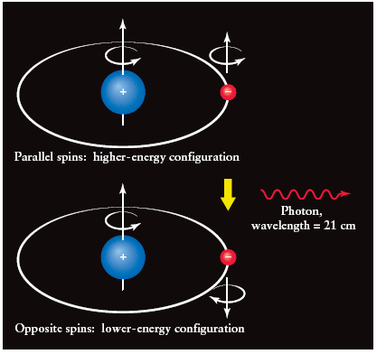
Mapping our Galaxy in Radio Wavelengths
A large fraction of the matter in the galaxy is made of hydrogen but most of it cannot be detected in the visible.
Radio wavelengths can penetrate the interstellar medium of our Galaxy easily and is ideal for mapping out cold atomic hydrogen (H I → not ionized).
A photon with a wavelength of 21 cm is emitted by a hydrogen atom when the electron flips its spin orientation.
Observations at 21 cm provide maps of the cold H in our Galaxy.
In the higher-energy configuration the electron has its spin in the same direction as the proton’s spin.

Slide 17
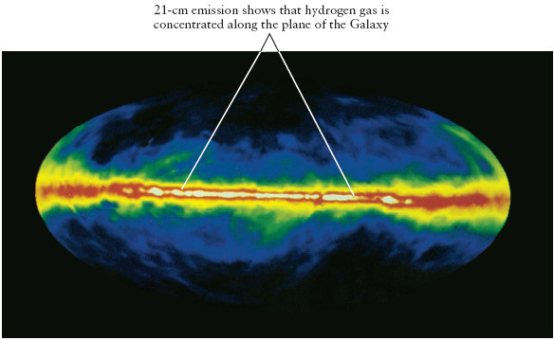
Mapping our Galaxy in Radio Wavelengths
The distribution of neutral H in the disk is not uniform but frothy. Our sun is located in a low density (10⁻³ cm⁻³) hot bubble of gas (local bubble) with a temperature of ~10⁶ K, possibly created by a supernova explosion ~ 300,000 years ago.

Slide 18
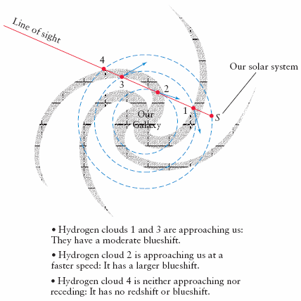
Mapping our Galaxy in Radio Wavelengths
The spirals of our galaxy were mapped out using Doppler shift measurements of the 21 cm emission originating from neutral H in the spiral arms.

Slide 19
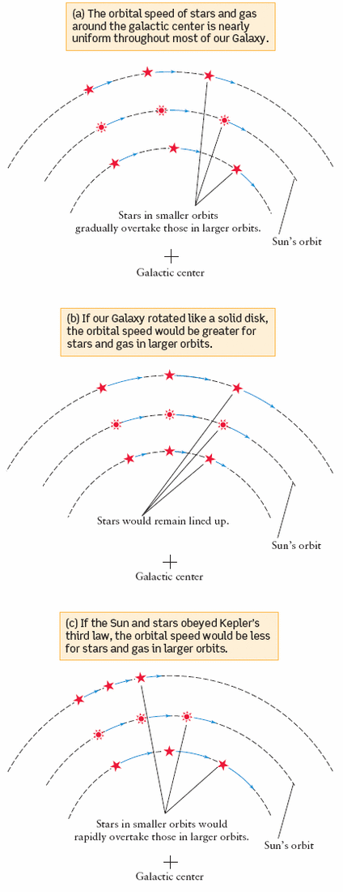
Rotation of the Disk
Constant speed
Doppler measurements indicate that the stars, gas and dust in the disk rotate around the galactic center with similar velocities.
The rotational speed is almost the same as a function of radius. This means that the disk does not move as a solid body.
One of the remarkable findings of the rotational measurement of our galaxy is that most of the mass of our galaxy is not visible but dark (dark matter) and we infer its presence from its gravitational effects.
Constant angular speed (Solid Disk)
Keplerian Rotation

Slide 20
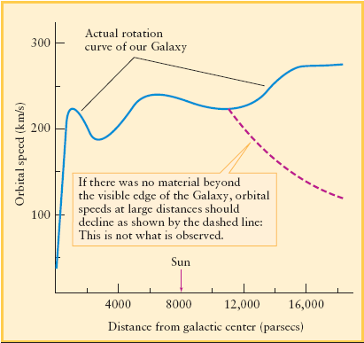
Rotation Curve of Galaxy
On the right is a plot of the rotational speed of stars in the galaxy as a function of radius. The orbital velocities were inferred from Doppler measurements and from the absolute measurement of the Sun’s velocity around the center.
One expects, based on Kepler's third law, that objects outside most of the mass to have orbital velocities that decline with distance.
The fact that the rotation curve does not decline beyond the visible edge of the galaxy implies the presence of dark matter.

Slide 21
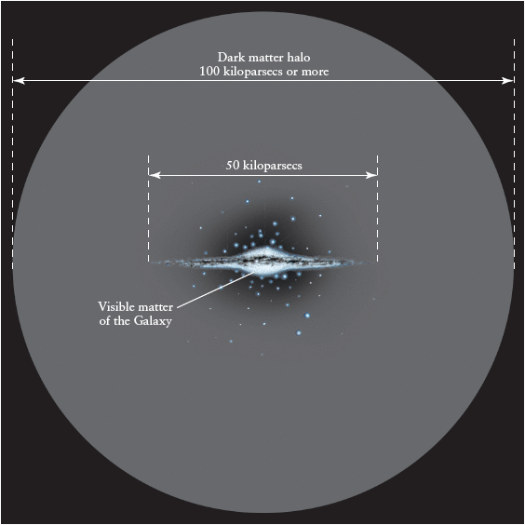
Dark Matter
Flat rotation curve implies dark matter in our Galaxy

Slide 22
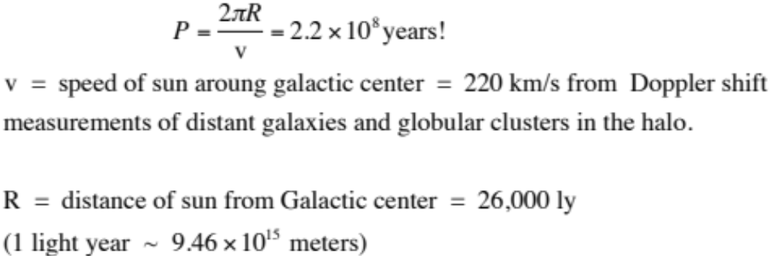
Our Galaxy
Example: Sun’s rotation period around the Galactic center
How many times has our Sun orbited our Galaxy?

Slide 23
What have we learned?
What does our galaxy look like?
  Our galaxy consists of a disk of stars and gas, with a bulge of stars at the center of the disk, surrounded by a large spherical halo and an even larger dark matter halo.
How do stars orbit in our galaxy?
  Stars in the disk orbit in circles going in the same direction with a little up-and-down motion.
  Orbits of halo and bulge stars have random orientations.

Slide 24
19.2 Galactic Recycling
Our goals for learning:
  How is gas recycled in our galaxy?
  Where do stars tend to form in our galaxy?

Slide 25
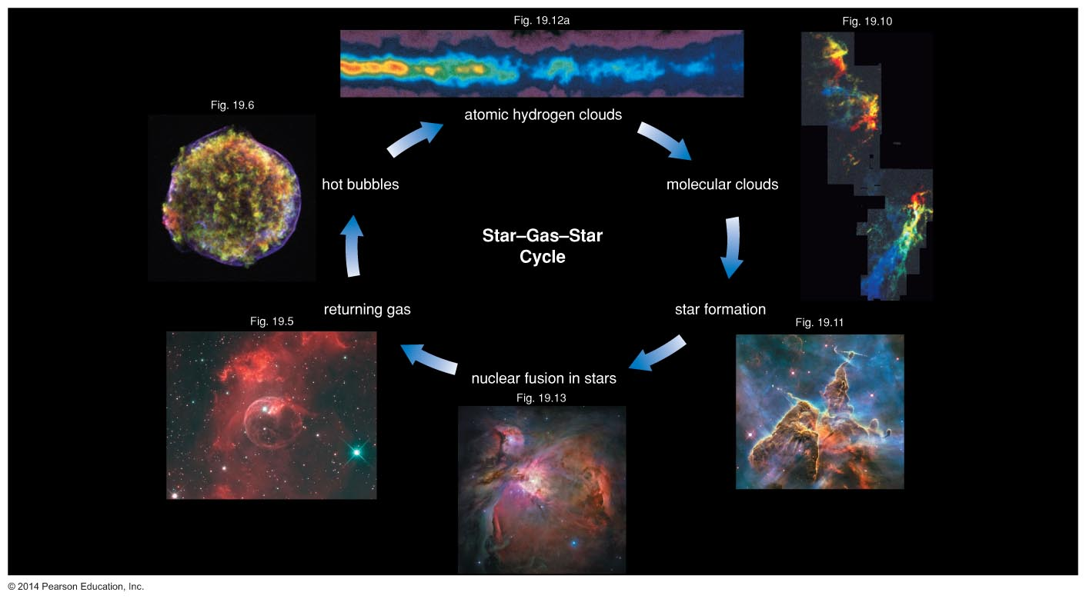
Star–gas–star cycle
Recycles gas from old stars into new star systems.

Slide 26
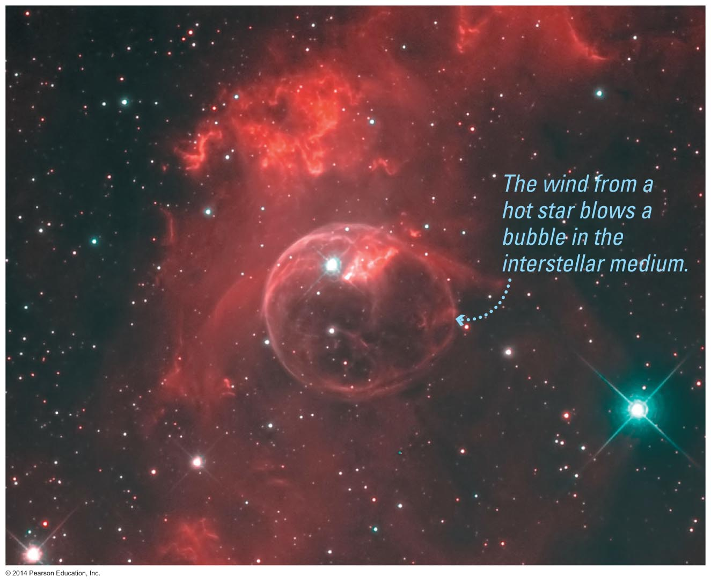
High-mass stars have strong stellar winds that blow bubbles of hot gas.

Slide 27
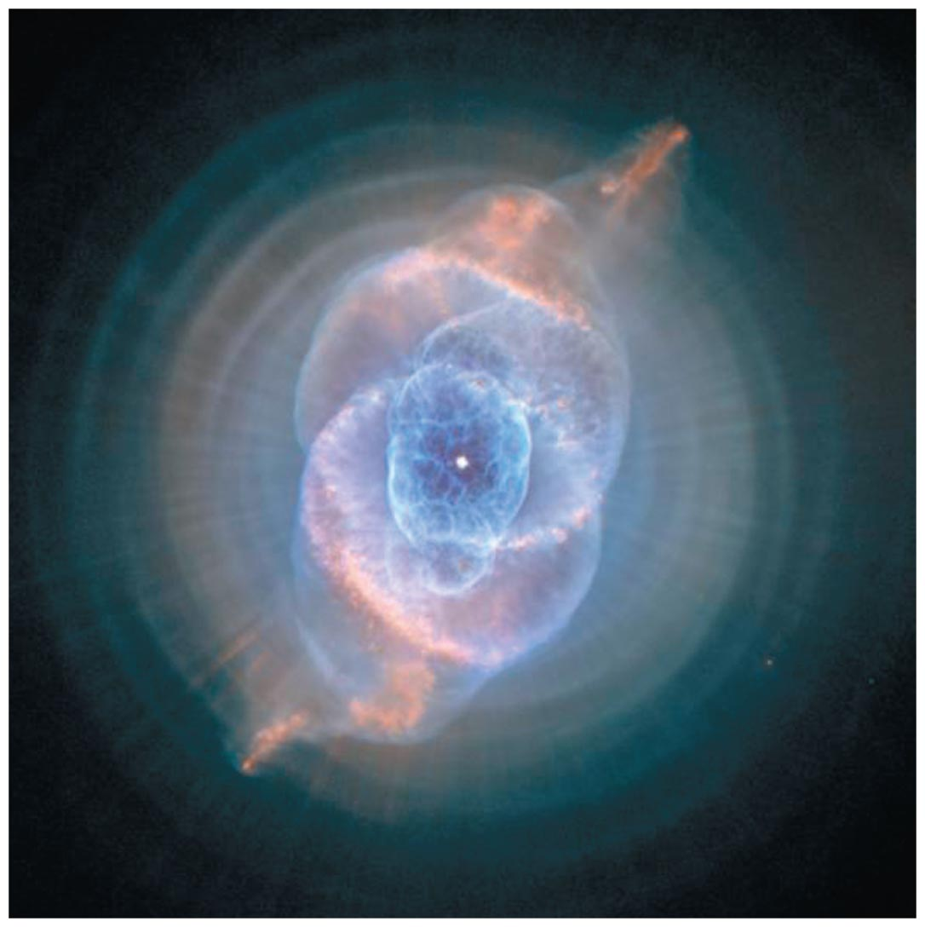
Lower mass stars return gas to interstellar space through stellar winds and planetary nebulae.

Slide 28
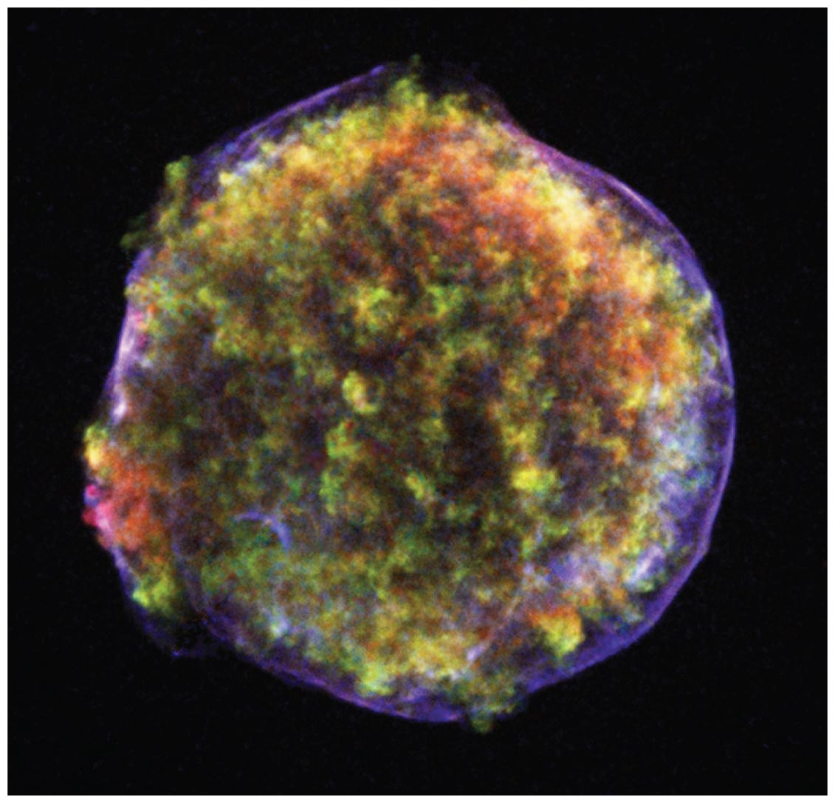
X rays from hot gas in supernova remnants reveal newly made heavy elements.
A supernova remnant cools and begins to emit visible light as it expands.
New elements made by a supernova mix into the interstellar medium.

Slide 29
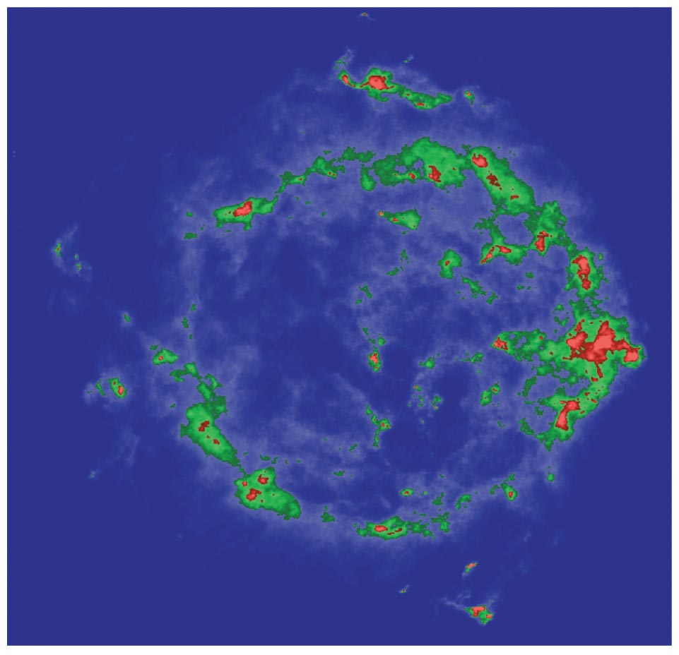
Radio emission in supernova remnants is from particles accelerated to near light speed.
Cosmic rays probably come from supernovae.

Slide 30
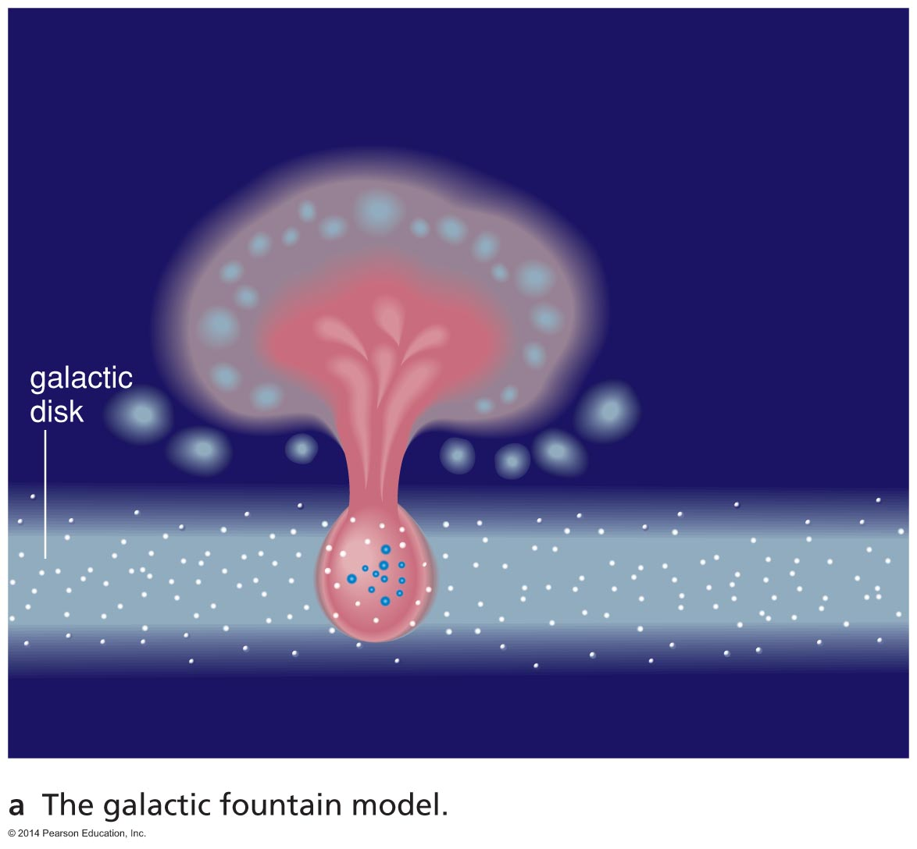
Multiple supernovae create huge hot bubbles that can blow out of the disk.
Gas clouds cooling in the halo can rain back down on the disk.

Slide 31
Atomic hydrogen gas forms as hot gas cools, allowing electrons to join with protons.
Molecular clouds form next, after gas cools enough to allow atoms to combine into molecules.

Slide 32
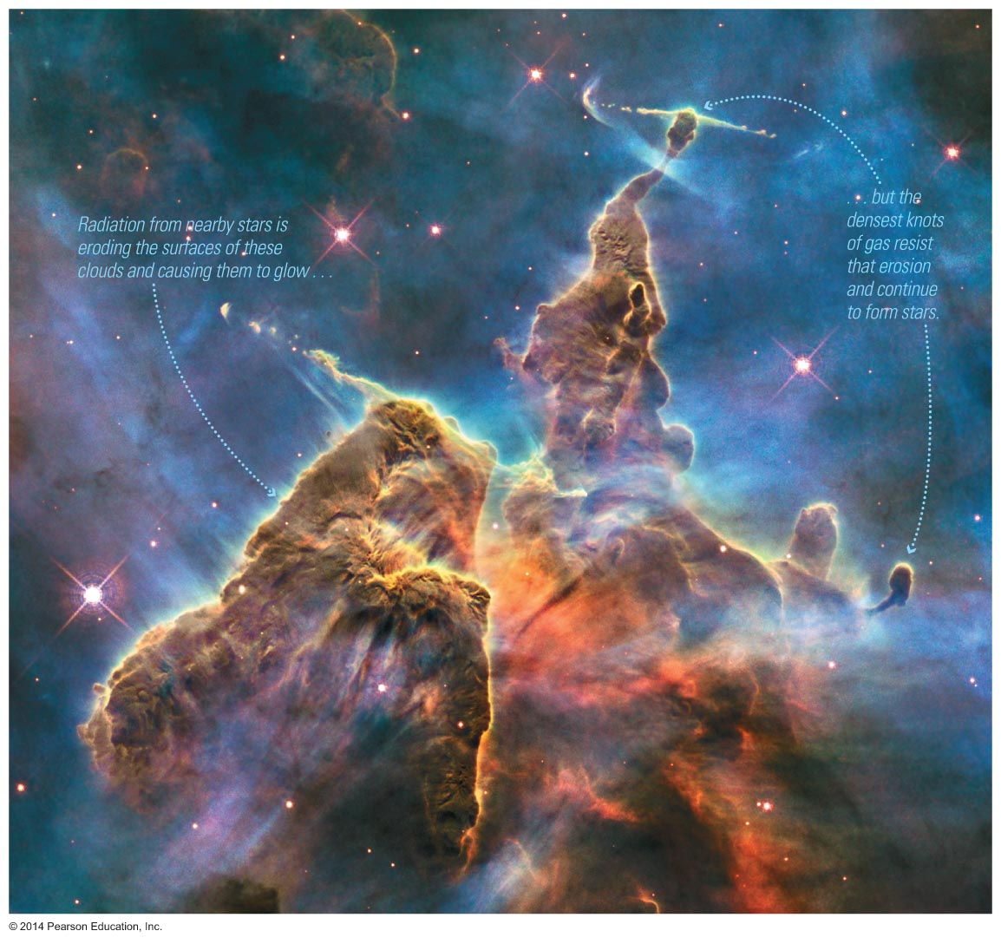
Gravity forms stars out of the gas in molecular clouds, completing the star–gas–star cycle.

Slide 33
Summary of Galactic Recycling
Stars make new elements by fusion.
Dying stars expel gas and new elements, producing hot bubbles (~10⁶ K).
Hot gas cools, allowing atomic hydrogen clouds to form (~100–10,000 K).
Further cooling permits molecules to form, making molecular clouds (~30 K).
Gravity forms new stars (and planets) in molecular clouds.
Gas Cools

Slide 34
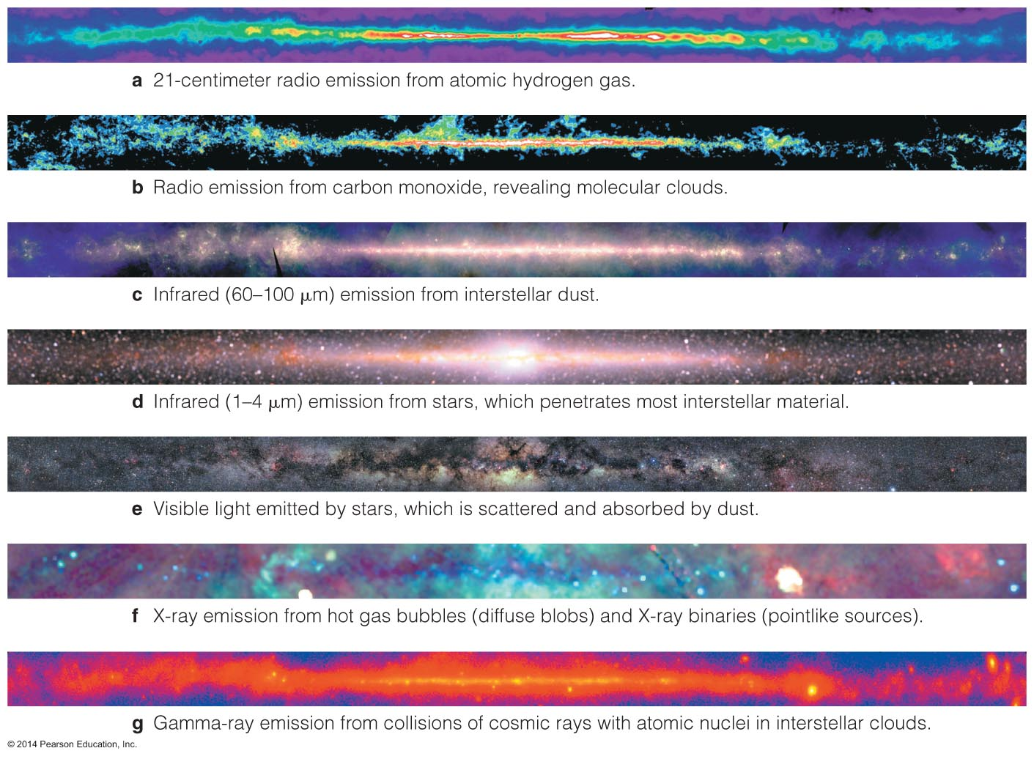
We observe the star–gas–star cycle operating in Milky Way's disk using many different wavelengths of light.

Slide 35
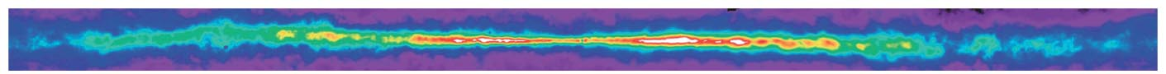
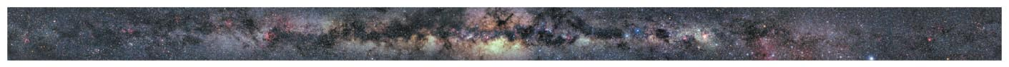
Radio (21 cm) (atomic hydrogen)
Visible
21-cm radio waves emitted by atomic hydrogen show where gas has cooled and settled into disk.

Slide 36

Radio (CO)
Visible
Radio waves from carbon monoxide (CO) show the locations of molecular clouds.

Slide 37
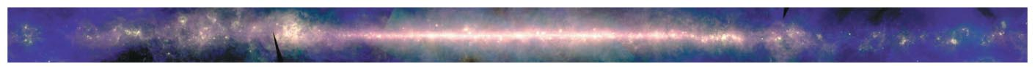
Far Infrared (dust)
Visible
Long-wavelength infrared emission shows where young stars are heating dust grains.

Slide 38
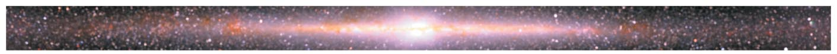
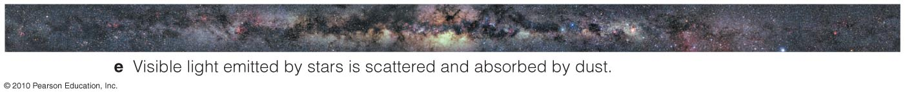
Near Infrared
Visible
Near Infrared light reveals stars whose visible light is blocked by gas clouds.

Slide 39
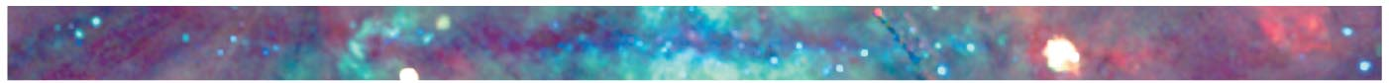
X-ray
Visible
X rays are observed from hot gas above and below the Milky Way's disk.

Slide 40
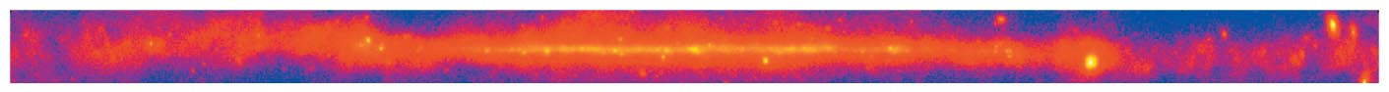
Gamma-ray
Visible
Gamma rays show where cosmic rays from supernovae collide with atomic nuclei in gas clouds.

Slide 41
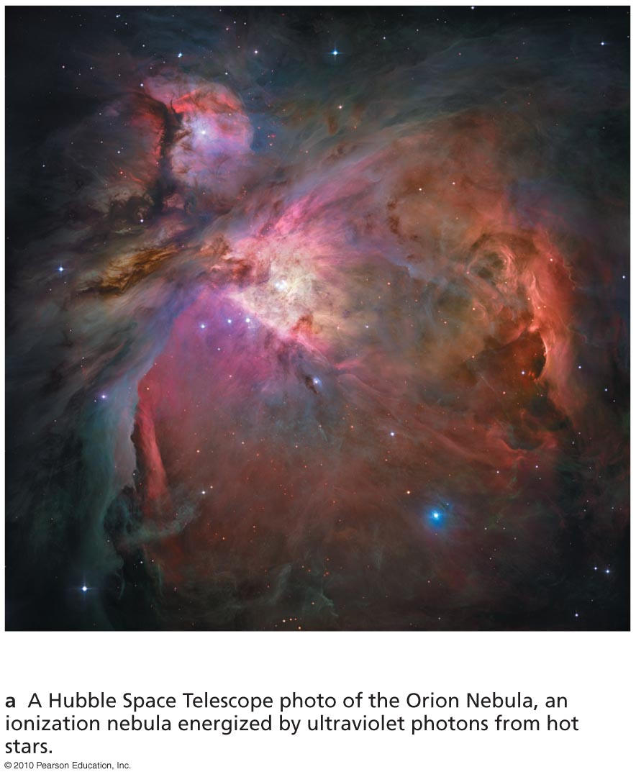
Where do stars tend to form in our galaxy?

Slide 42
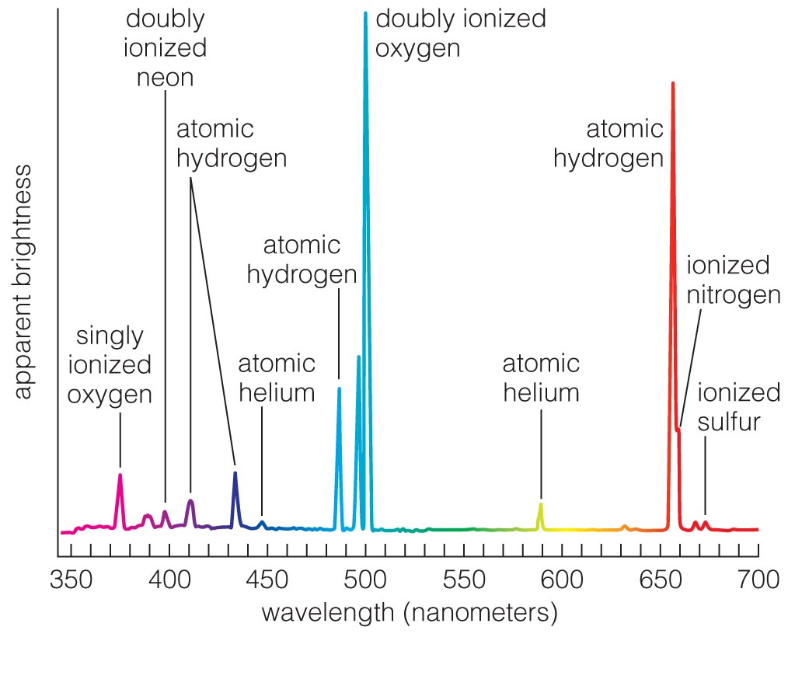

Ionization nebulae or Emission nebulae are found around short-lived high-mass stars, signifying active star formation.
Notes:
Orion nebula

Slide 43
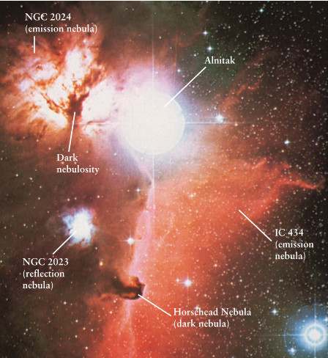
Emission Nebulae: HII Regions
An emission nebula is one that contains strong emission lines.
The total mass in an emission nebula ranges from 100-10,000 M scattered over a few light years. The gas in an emission nebula has a density ~ 1,000 H atoms cm⁻³.
Emission nebulae are found near hot O and B stars. Such stars emit copious amounts of UV that can easily ionize H atoms. Emission nebulae (HII regions) are composed primarily of ionized hydrogen (HII).
Emission, reflection and dark nebulae in Orion.

Slide 44
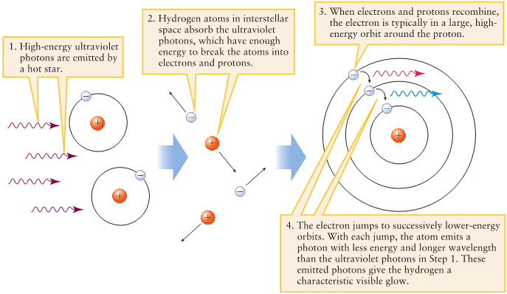
Emission Nebulae: HII Regions
UV photons can easily ionize Hydrogen. H II regions are clouds of glowing low density gas and plasma that contain a large amount of ionized H. Free electrons can recombine with protons and usually get captured in a high energy level. As the electron cascades downward through the atom’s energy levels toward the ground state, the atom emits photons with lower energy and longer wavelength than the photons that originally caused the ionization.

Slide 45
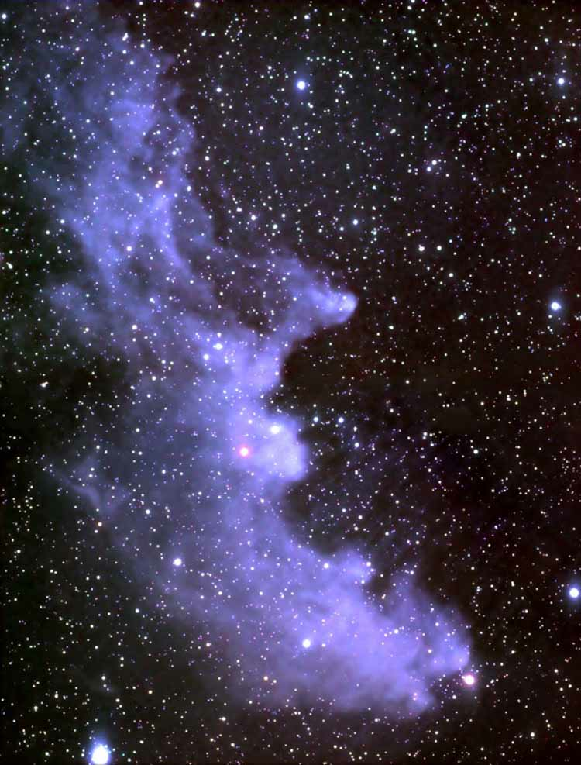
Reflection Nebulae
Reflection nebulae are clouds of dust that that do not emit their own light, but reflect and scatter the light of nearby stars.
Fine dust in the Witch Head Nebula nebula reflects the light from Rigel.
Dust grains reflect blue light more efficiently than red. A similar effects makes our sky look blue.
The Witch Head Nebula glows primarily by light reflected from Rigel, located just outside the top right corner of the image.

Slide 46
Halo: no ionization nebulae, no blue stars ⇒ no star formation
Disk: ionization nebulae, blue stars ⇒ star formation

Slide 47
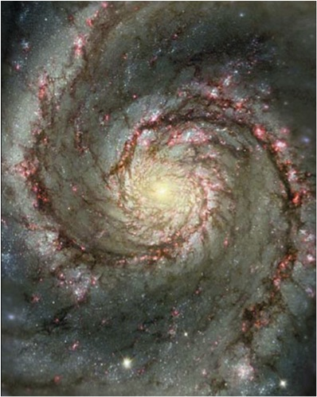
Much of the star formation in the disk happens in the spiral arms.
Whirlpool Galaxy

Slide 48
Much of the star formation in the disk happens in the spiral arms.
Whirlpool Galaxy
Ionization nebulae
Blue stars
Gas clouds

Slide 49
Density-Wave Model of Spiral Arms
Most of the stars, gas and dust in our Galaxy rotate around the center of the galaxy at almost the same speed. Any rigid pattern of stars could not persist after some time.
The density-wave model posits that the spirals are actually density-waves that travel around the disk just like ripples on water. These waves move around the galaxy more slowly than do stars, dust and gas.
A density wave compresses the gases in the interstellar medium and this leads eventually to star formation.

Slide 50
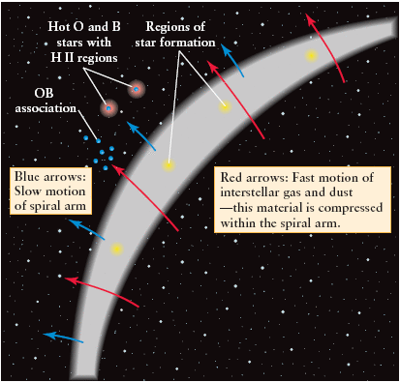
Density-Wave Model of Spiral Arms
A spiral arm is a region where the density of material is higher than in the surrounding parts of a galaxy.
Interstellar matter moves around the galactic center rapidly (shown by the red arrows) and is compressed as it passes through the slow-moving spiral arms (whose motion is shown by the blue arrows).
This compression triggers star formation in the interstellar matter, so that new stars appear on the “downstream” side of the densest part of the spiral arm.

Slide 51
What have we learned?
How is gas recycled in our galaxy?
  Gas from dying stars mixes new elements into the interstellar medium, which slowly cools, making the molecular clouds where stars form.
  Those stars will eventually return much of their matter to interstellar space.
Where do stars tend to form in our galaxy?
  Active star-forming regions contain molecular clouds, hot stars, and ionization nebulae.
  Much of the star formation in our galaxy happens in the spiral arms.

Slide 52
19.3 The History of the Milky Way
Our goals for learning:
  What clues to our galaxy's history do halo stars hold?
  How did our galaxy form?

Slide 53
What clues to our galaxy's history do halo stars hold?

Slide 54
Halo Stars:
0.02–0.2% heavy elements (O, Fe, …), only old stars
Halo stars formed first, then stopped.
Disk stars formed later, kept forming.
Disk Stars:
2% heavy elements, stars of all ages

Slide 55
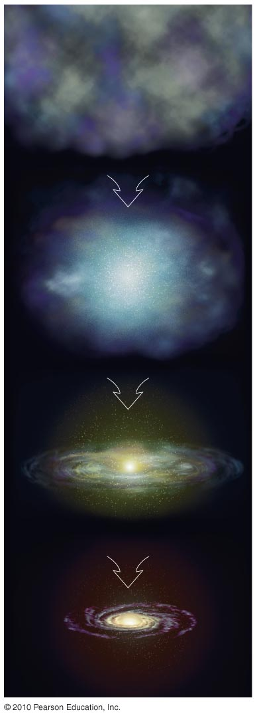
How did our galaxy form?

Slide 56
Our galaxy formed from a cloud of intergalactic gas.

Slide 57
Halo stars formed first as gravity caused gas to contract.

Slide 58
Remaining gas settled into a spinning disk.

Slide 59
Stars continuously form in disk as galaxy grows older.

Slide 60
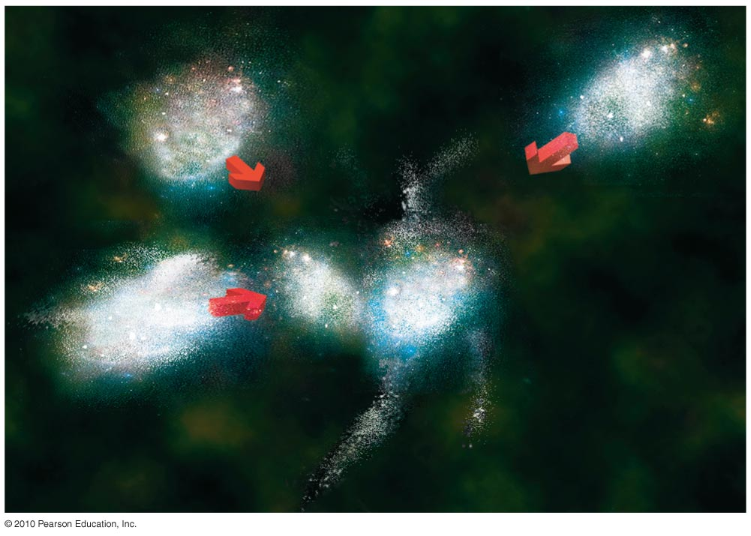
Insert TCP 6e Figure 19.19
Detailed studies show that halo stars formed in clumps that later merged.

Slide 61
What have we learned?
What clues to our galaxy's history do halo stars hold?
  Halo stars are all old, with a smaller proportion of heavy elements than disk stars, indicating that the halo formed first.
How did our galaxy form?
  Halo stars formed early in the galaxy's history; disk stars formed later, after much of the galaxy's gas settled into a spinning disk.

Slide 62
19.4 The Mysterious Galactic Center
Our goals for learning:
  What lies in the center of our galaxy?

Slide 63
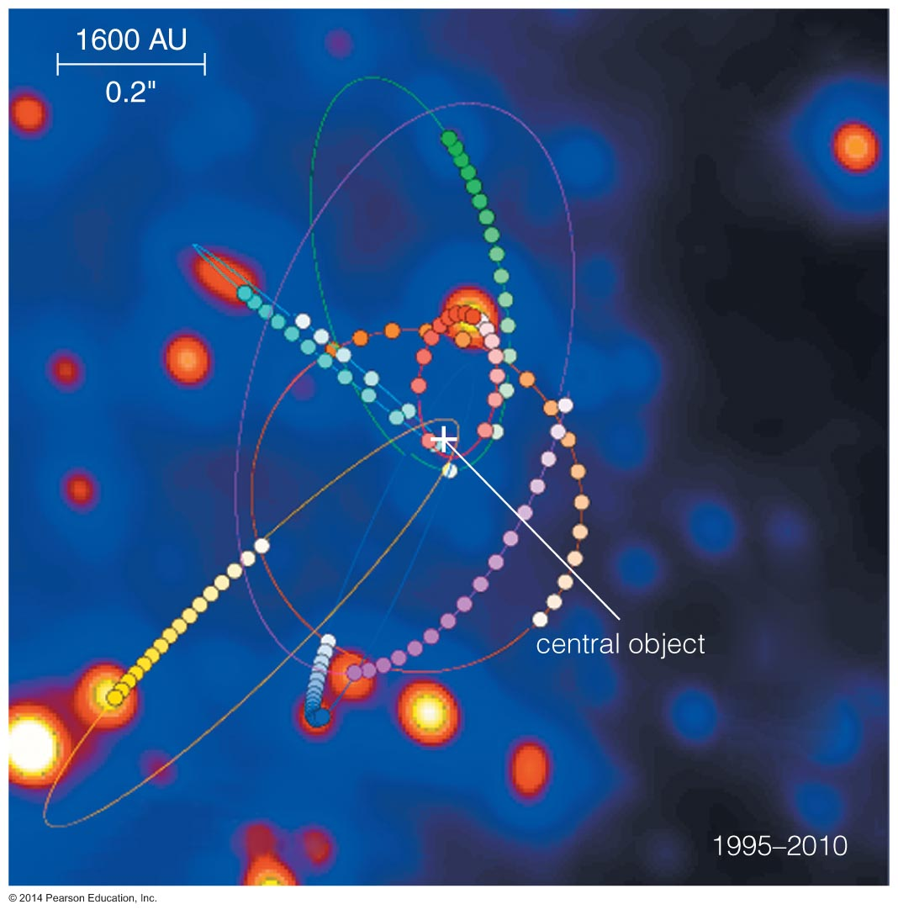
What lies in the center of our galaxy?

Slide 64
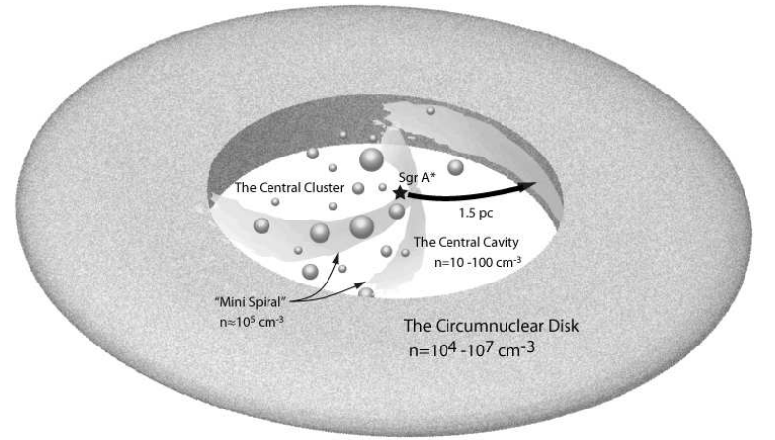
Galactic Center
Schematic view of the central few parsecs of the galaxy (central molecular zone), showing the central black hole, Sgr A*, stars in the central star cluster, and the circumnuclear disk which contains dense molecular clouds.
The ring is inclined some 20 degrees with respect to the Galactic plane and rotates at about 110 km/s. The ring has very sharp boundaries implying a recent violent event like a supernova may have recently occurred.

Slide 65
Black Holes in Hibernation
To penetrate the dust and gas near the center of our galaxy astronomers typically observe this region in the infrared.
Infrared images show that the density of stars increases dramatically near the nucleus of a galaxy.
In our galaxy the density of stars near the sun is ~ 0.006 stars per cubic light-year
Near the center of our galaxy the density is ~10⁶ stars per cubic light-year

Slide 66


Black Holes in Hibernation
To improve the spatial resolution of the IR observations of the galactic center astronomers employed adaptive optics.
With adaptive optics the distorted and flickering image of a star is compared to every few milliseconds to the point-like appearance it would have with the absence of turbulence.
The telescopes mirrors are slightly deformed in real time to compensate.
Reinhard Genzel and Andrea Ghez mapped the orbits of stars close to the galactic center and showed that it must contain a supermassive black hole with a mass of about 4 ×10⁶ M.

Slide 67
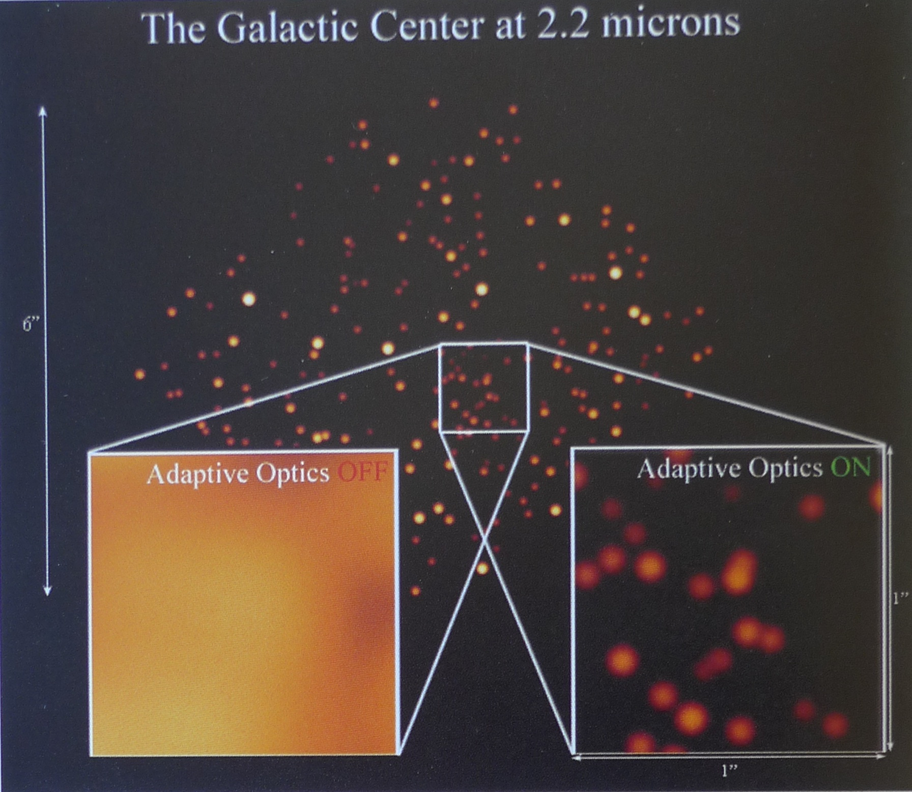
An example of the dramatic improvement of the ability of the Keck Telescopes to discern individual stars in the Galactic center when adaptive optics is used.

Slide 68
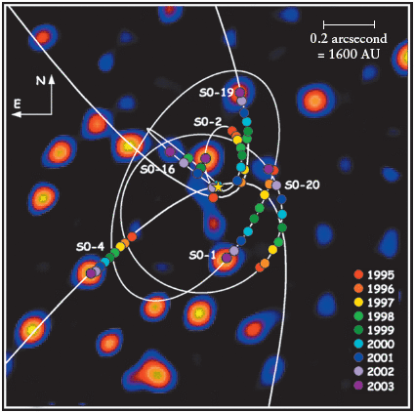
Galactic Center: Sagittarius A*
At the center of our galaxy resides a supermassive black hole named Sagittarius A*.
Because of interstellar extinction most of our information on Sgr A* comes from IR and radio observations.
Radio observations of Sgr A* indicate that it is located very close to the center of our galaxy.
Observations in the IR show many stars orbiting Sgr A*. One of these stars got as close as 45 AU to Sgr A*.
Using Kepler’s 3rd law the mass of the BH at the Galactic center has been determined to be ~4.2 ×10⁶ M.

Slide 69
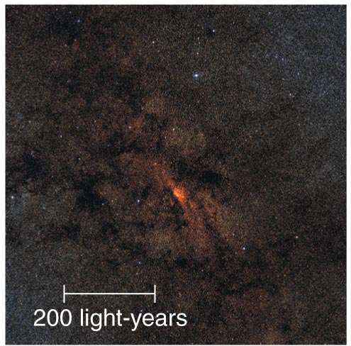
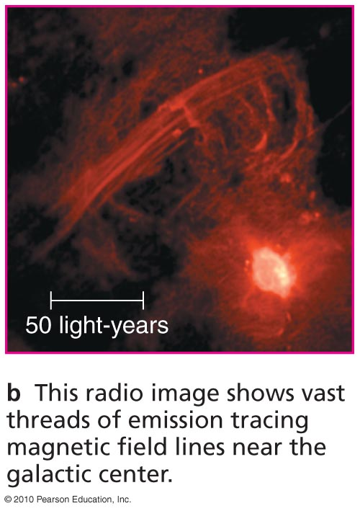
Infrared light from center
Radio emission from center

Slide 70
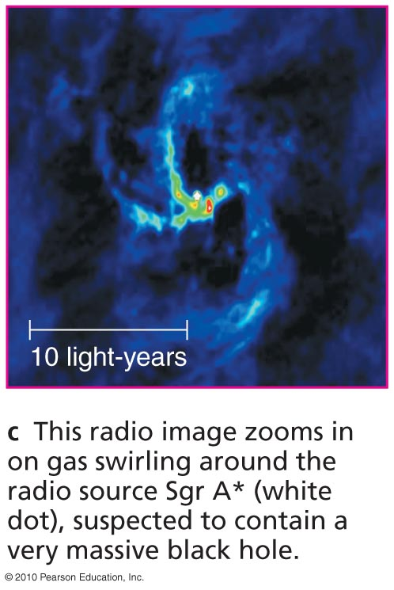
Radio emission from center
Swirling gas near center

Slide 71
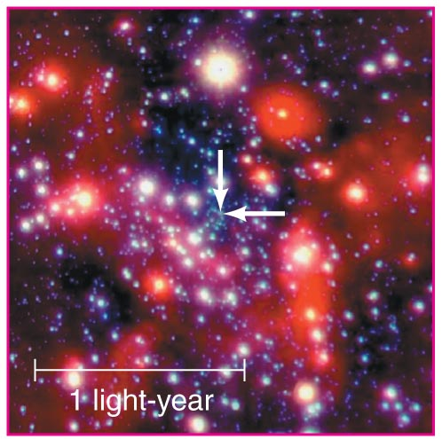
Swirling gas near center
Orbiting stars near center

Slide 72
Stars appear to be orbiting something massive but invisible … a black hole?
Orbits of stars indicate a mass of about 4 million M_{Sun.}
Notes:
Download a great movie of star motions from:
http://www.astro.ucla.edu/~jlu/gc/images/orbits_pause.gif

Slide 73


Slide 74

X-ray flares from galactic center suggest that tidal forces of suspected black hole occasionally tear apart chunks of matter about to fall in.
Insert TCP 6e Figure 19.22
Notes:
Download a great movie of star motions from:
http://www.astro.ucla.edu/~jlu/gc/images/orbits_pause.gif

Slide 75


Fueling a Black Hole by Tidal Disruption
A star is ripped apart by the tidal forces of a massive black hole (left panel). Part of the stellar debris is then accreted by the black hole (middle panel). This causes a luminous flare of radiation which fades away as more and more of the matter disappears into the black hole

Slide 76


Fueling a Black Hole by Tidal Disruption
Tidal disruption of stars is thought to be a mechanism of fueling active supermassive black holes. For this mechanism to work the star needs to be disrupted but not swallowed completely by the black hole.
A star of mass density ρ* approaching a massive body of mass density ρ_{BH} and radius R must reach at least a distance from the body of r_{R}, where r_{R} is the Roche limit for it to be tidally disturbed. The Roche limit is given by:
For a star approaching a black hole to be disrupted but not swallowed by the hole its Roche limit must be larger than the Schwarzschild radius, r_{R} > R_{s}. This then places an upper limit on the mass of the Black Hole for fueling by tidal disruption of:
ρ∗ is the density of the star in gr/cm³.

Slide 77
What have we learned?
What lies in the center of our galaxy?
  Orbits of stars near the center of our galaxy indicate that it contains a black hole with 4 million times the mass of the Sun.

