Slide 1
Galaxies and the Foundation of Modern Cosmology

Slide 2
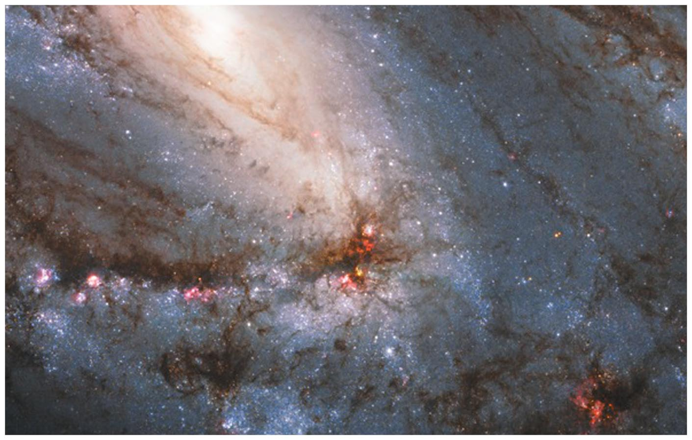
Galaxies and the Foundation of Modern Cosmology

Slide 3
20.1 Islands of Stars
Our goals for learning:
  How is the evolution of galaxies connected with the history of the universe?
  What are the three major types of galaxies?
  How are galaxies grouped together?
Notes:
3

Slide 4
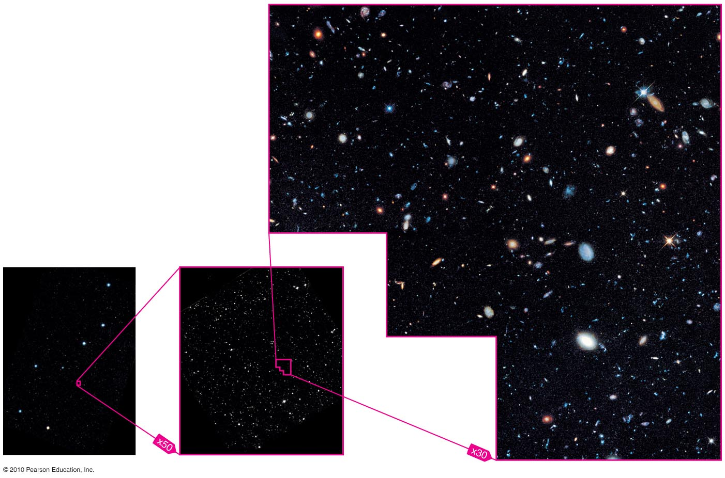
How is the evolution of galaxies connected with the history of the universe?

Slide 5
Hubble Deep Field
Our deepest images of the universe show a great variety of galaxies, some of them billions of light-years away.
Number of galaxies in the observable universe~100 billion

Slide 6
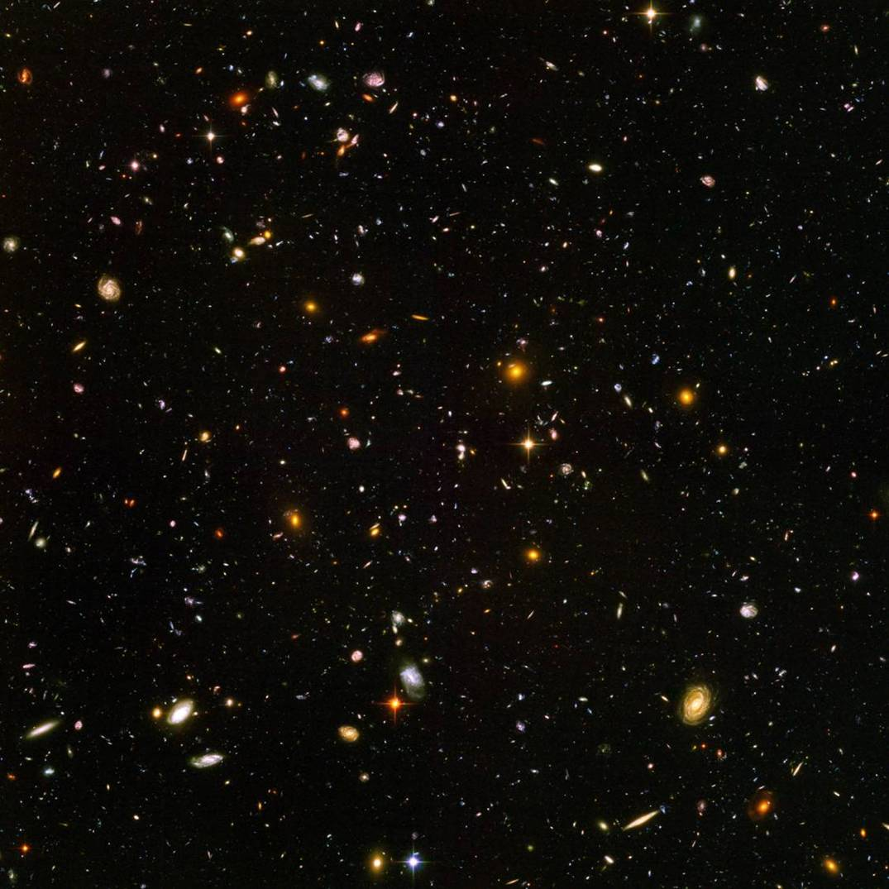
Galaxies and Cosmology
The first galaxies are thought to have formed about 13 billion years ago.
Galaxy evolution depends on their environment which changes as the Universe evolves.
We can study their evolution by measuring their properties as a function of distance which is equivalent to looking back in time.

Slide 7
What are the three major types of galaxies?

Slide 8
Insert figure, HUDF.jpg
Hubble Ultra Deep Field

Slide 9
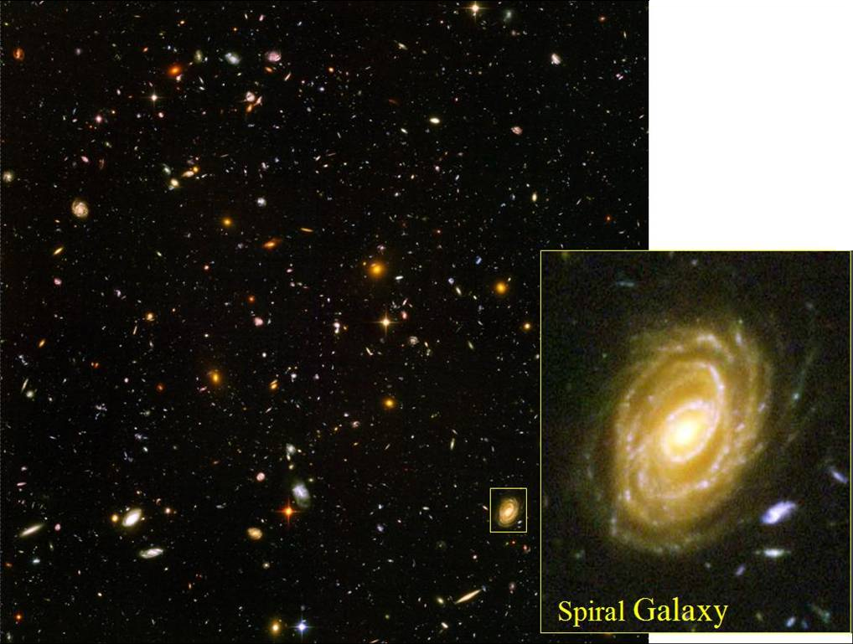
Insert figure, HUDF1.jpg
Hubble Ultra Deep Field

Slide 10
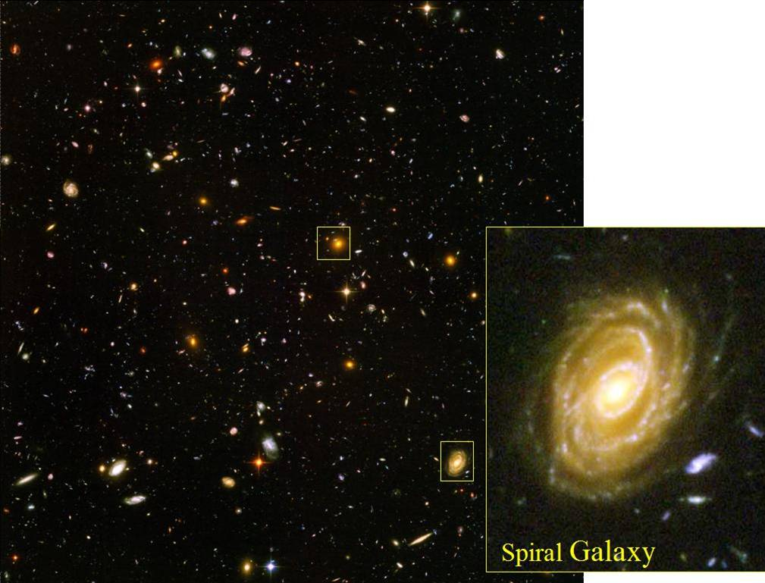
Insert figure, HUDF2.jpg
Hubble Ultra Deep Field

Slide 11
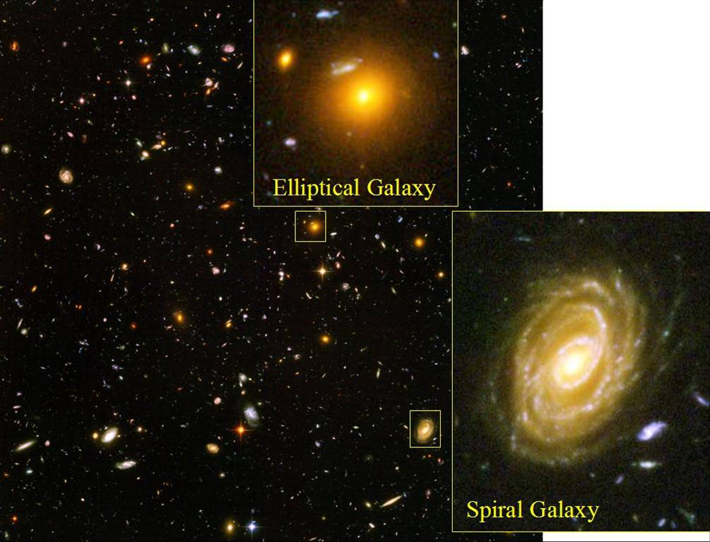
Hubble Ultra Deep Field

Slide 12

Hubble Ultra Deep Field

Slide 13
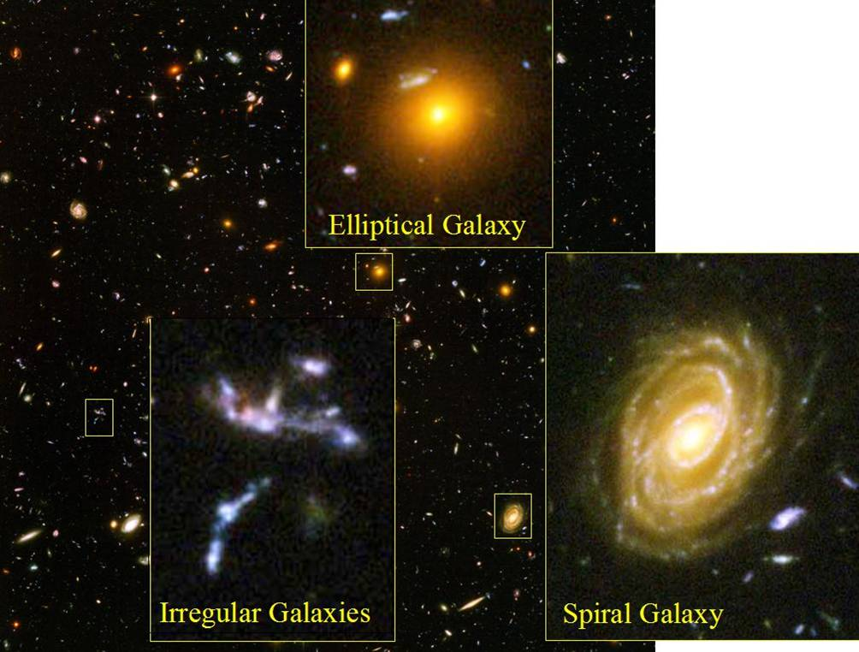
Hubble Ultra Deep Field

Slide 14
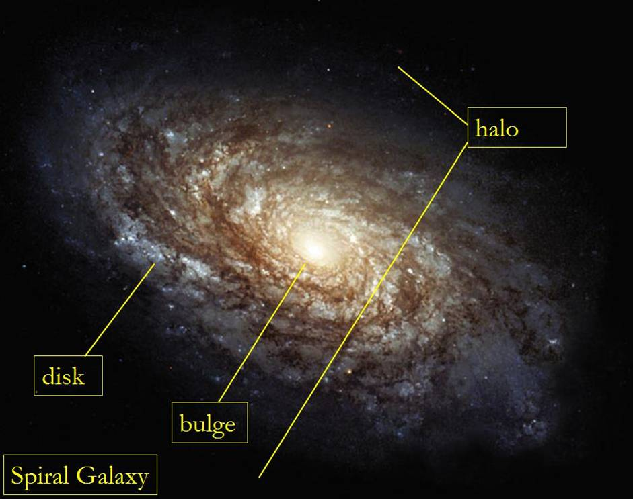

Slide 15
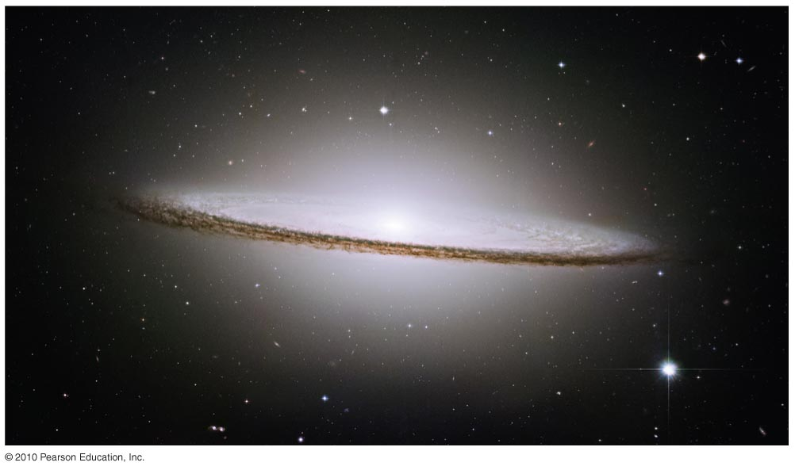
Disk component:
stars of all ages, many gas clouds
Spheroidal component:
bulge and halo, old stars, few gas clouds

Slide 16
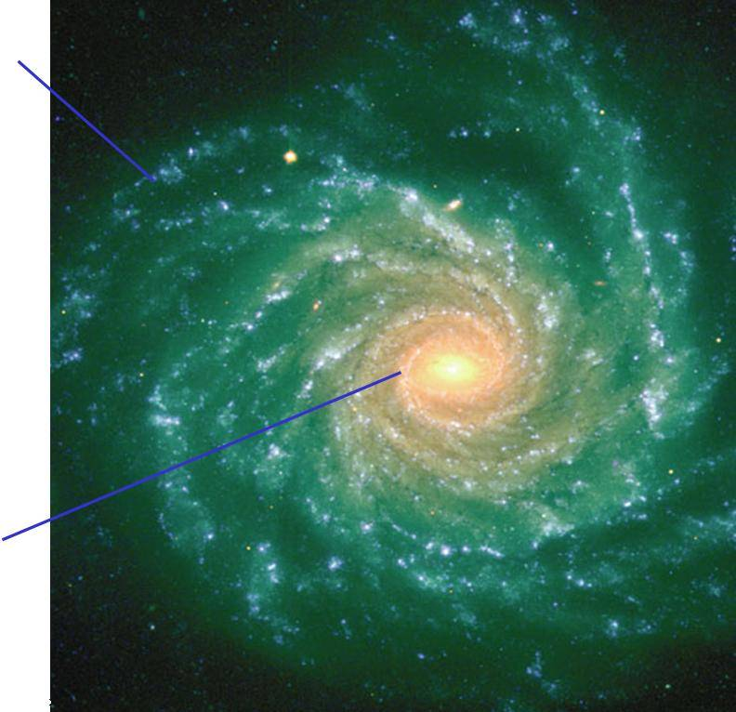
Disk component:
stars of all ages, many gas clouds
Spheroidal component:
bulge and halo, old stars, few gas clouds

Slide 17
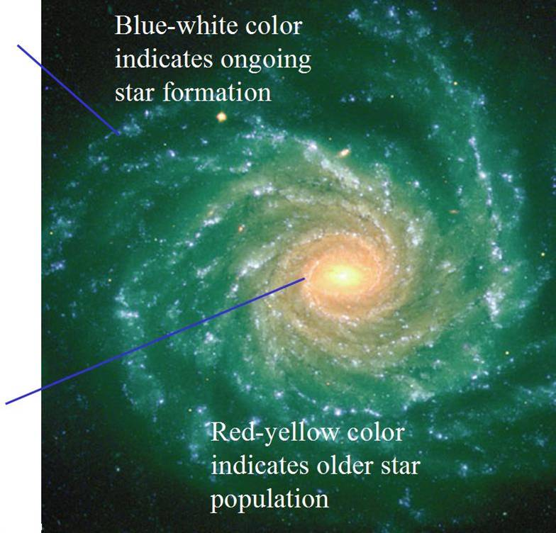
Disk component:
stars of all ages, many gas clouds
Spheroidal component:
bulge and halo, old stars, few
gas clouds

Slide 18
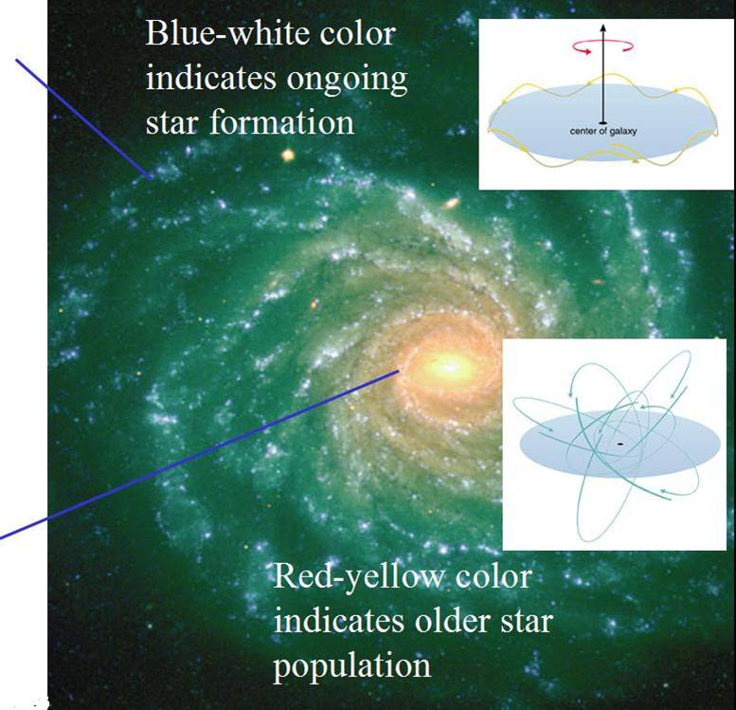
Disk component:
stars of all ages, many gas clouds
Spheroidal component:
bulge and halo, old stars, few
gas clouds

Slide 19
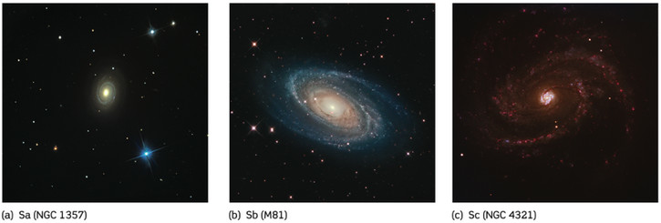
Spiral Galaxies
Hubble further classified spirals into :
Sa galaxies: smooth broad and tightly wrapped spiral arms with a large bulge (~4% of baryonic mass in dust and gas)
Sb galaxies: moderate-sized spirals and bulge (~8% of mass in dust and gas)
Sc galaxies: narrow loosely wrapped spirals and small bulge (~25% of mass in dust and gas)

Slide 20
Spiral Galaxies
Spiral galaxies are characterized by arched lanes of stars, just as is our own Milky Way Galaxy. The spiral arms contain young, hot, blue stars and their associated H II regions, indicating ongoing star formation.
As the stars in the disk evolve they enrich the interstellar medium (ISM) with metals through AGB winds and SN explosions. This metal enriched ISM will be used to form the next generation of stars that will therefore be metal rich. This is why most stars in the disks of Spirals are Population I stars.
The main difference between Sa, Sb and Sc galaxies
is the relative amounts of gas and dust in them. The proportion of dust, gas and young stars increases from Sa to Sc galaxies.

Slide 21
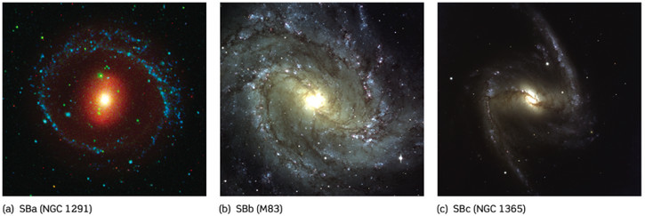
Barred Spiral Galaxies
A barred spiral galaxy is a spiral galaxy with a central bar-shaped structure composed of stars. About 20 % of the spiral galaxies in the distant past possessed bars, compared with nearly 70 % of their modern counterparts.
The bar is thought to act as a mechanism that channels gas inwards from the spiral arms, in effect funneling the flow to create new stars and feeding the central supermassive black hole.

Slide 22
Thought Question
Why does ongoing star formation lead to a blue-white appearance?
There aren't any red or yellow stars.
Short-lived blue stars outshine the others.
Gas in the disk scatters blue light.

Slide 23
Thought Question
Why does ongoing star formation lead to a blue-white appearance?
There aren't any red or yellow stars.
Short-lived blue stars outshine the others.
Gas in the disk scatters blue light.
Notes:
23

Slide 24
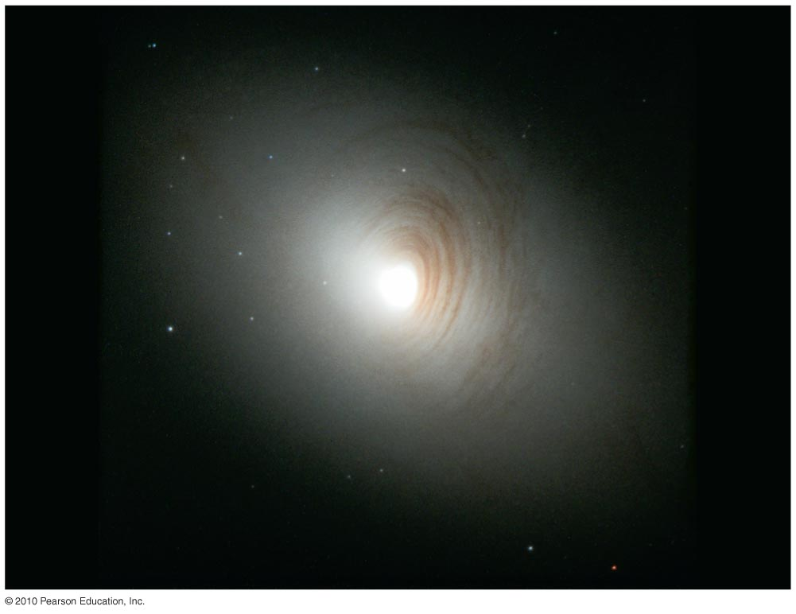
Lenticular galaxy: has a disk like a spiral galaxy but much less dusty gas (intermediate between spiral and elliptical)

Slide 25
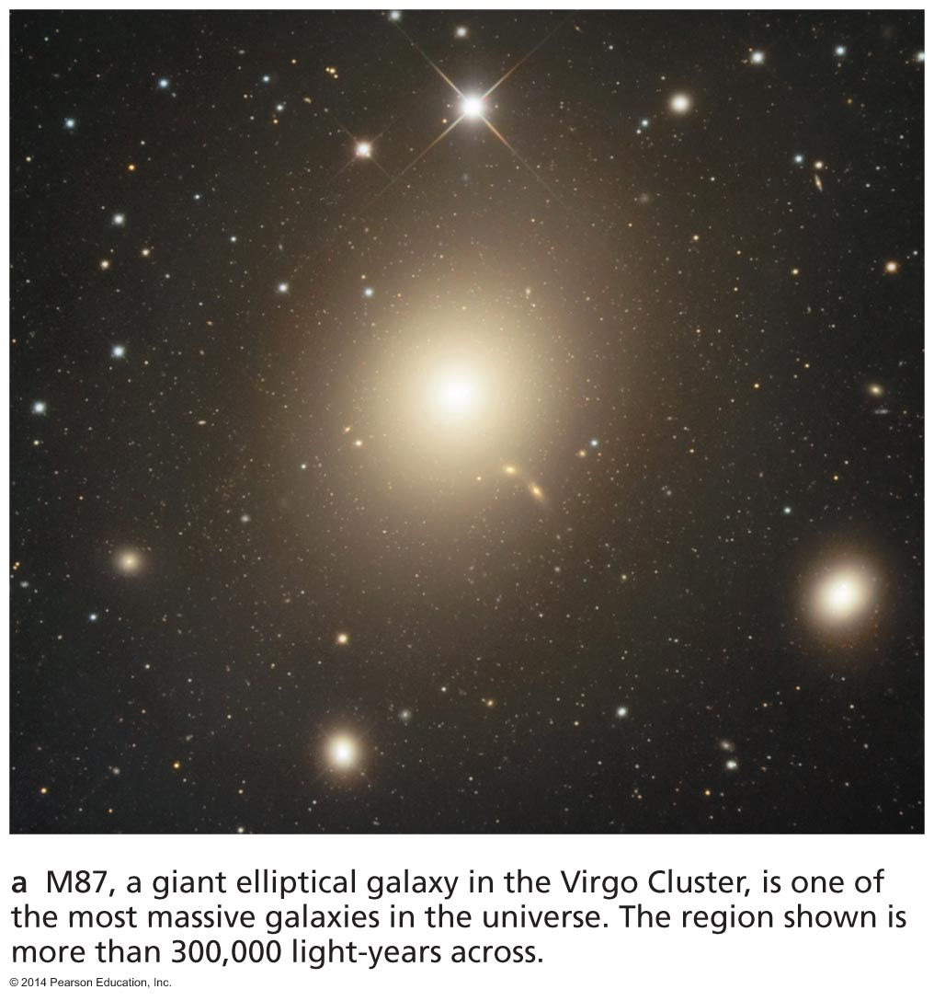
Elliptical galaxy: all spheroidal component, virtually no disk component
Red-yellow color indicates older star population.

Slide 26
Elliptical Galaxies
Elliptical galaxies contain very little amounts of gas, dust and star formation. They are composed of mostly old red Population II stars.
Giant elliptical galaxies are about 20 times larger than typical elliptical galaxies and often found in clusters of galaxies.
Dwarf elliptical galaxies contain only about a few million stars compared to 100 billion in the Milky way.
The spectrum of a galaxy consists of the sum of the spectra of all its stars. Their absorption lines are broadened because of the Doppler effect produced by orbiting stars.

Slide 27
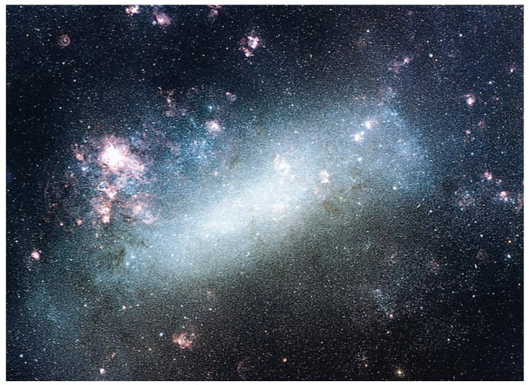
Blue-white color indicates ongoing star formation.
Irregular galaxy

Slide 28
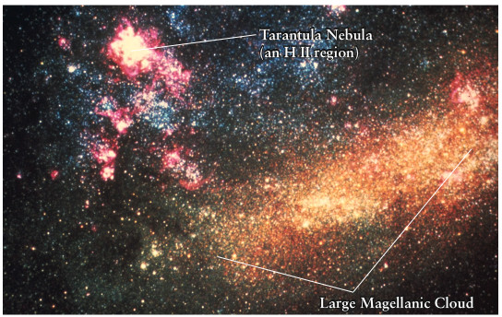
Irregular Galaxies
Galaxies that do no fit into the scheme of elliptical or spiral galaxies are referred to as irregulars. They contain old and young stars and are in general rich in gas and dust.
Two types of Irregular Galaxies:
Irr I : feature some structure and contain many OB associations and HII regions
(an OB association is a grouping of hot, young and massive stars predominately of spectral types O and B.)
Irr II : Have distorted shapes likely the result of collisions.
The Large Magellanic Cloud is a Irr I galaxy located at a distance of 179,000 ly.

Slide 29
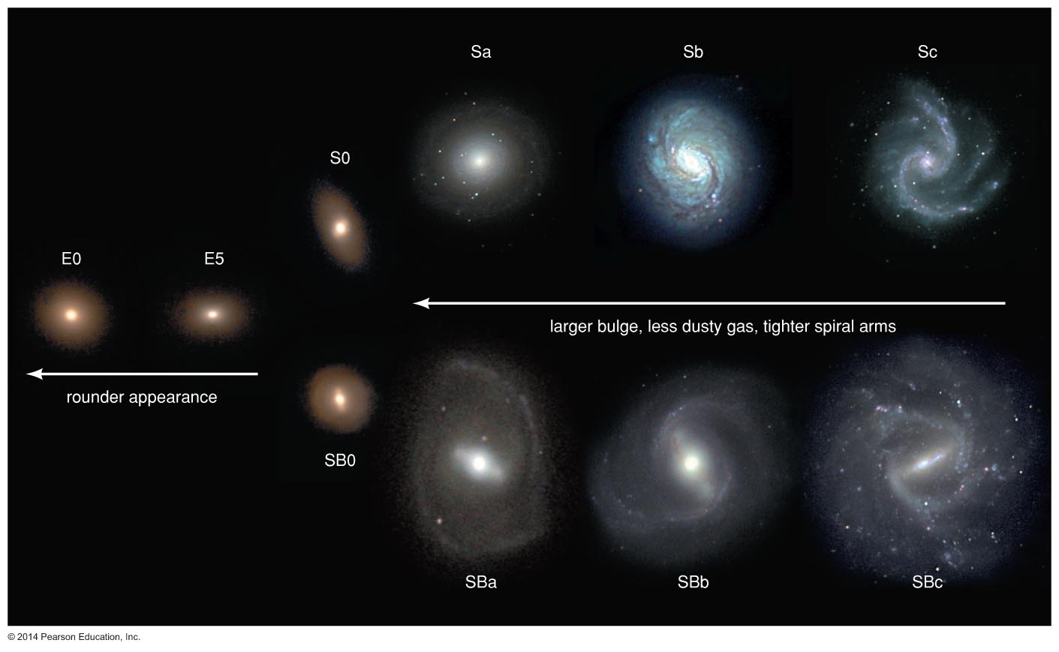
Spheroid
dominates
Hubble's galaxy classes
Disk dominates

Slide 30
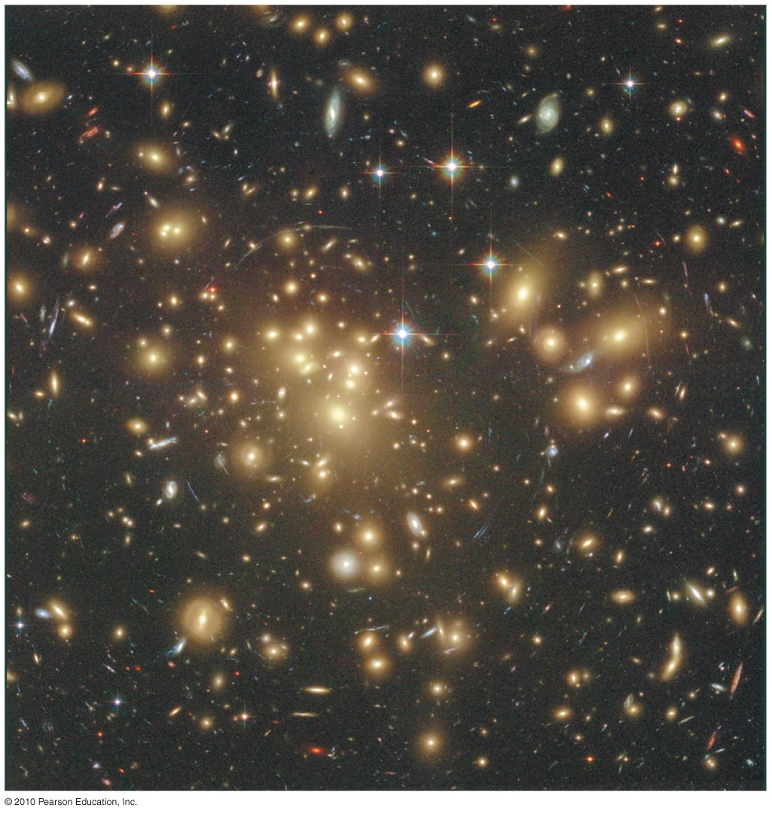
How are galaxies grouped together?

Slide 31
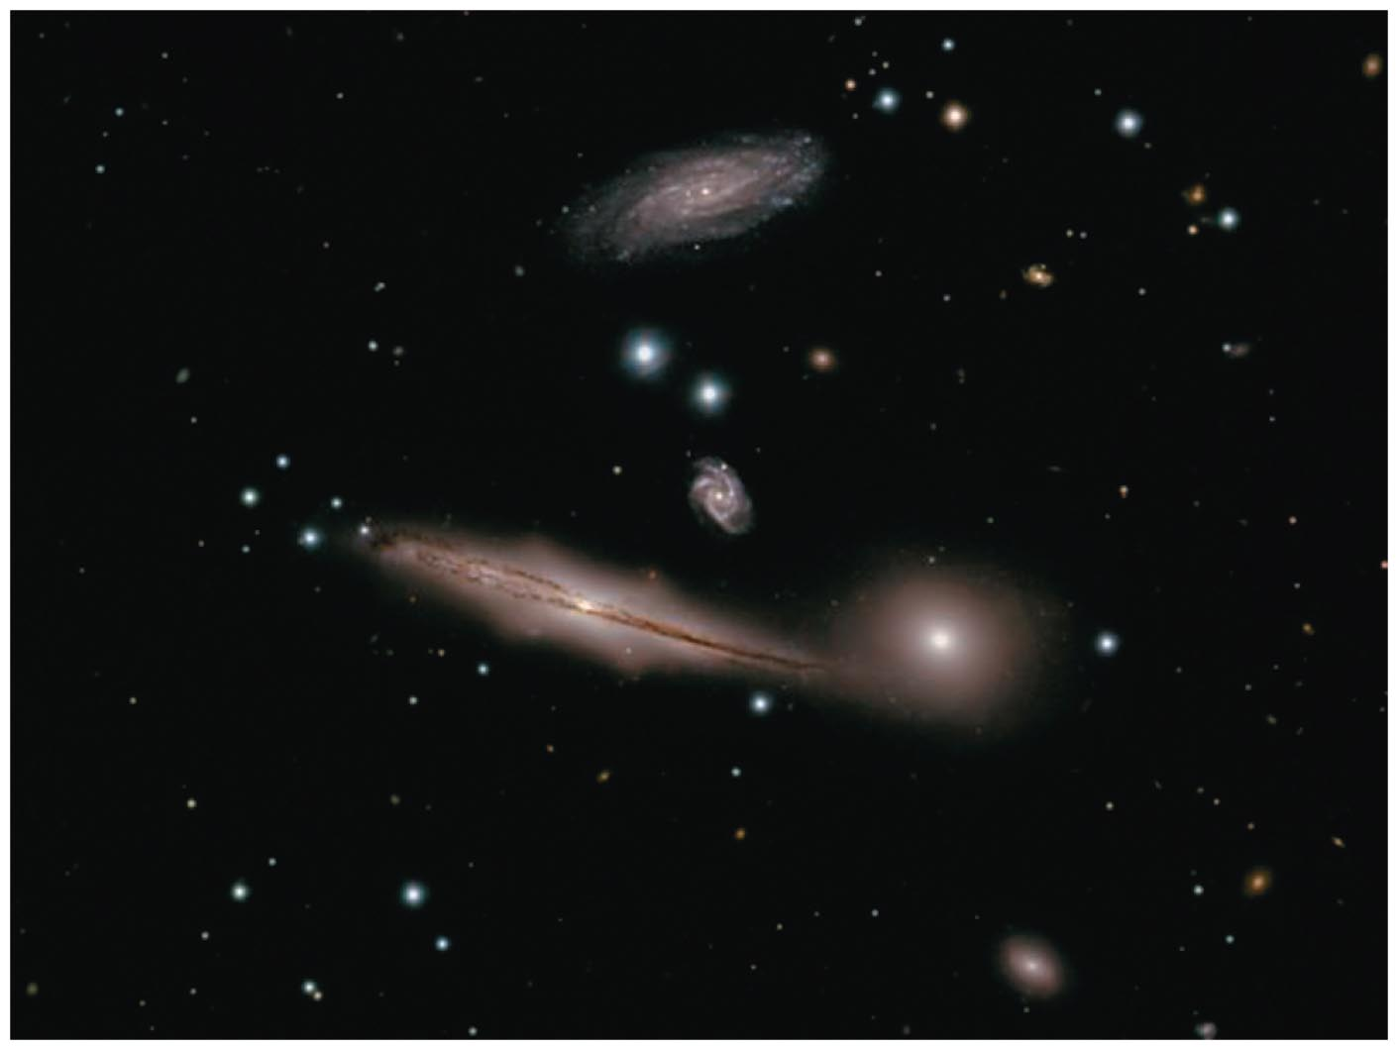
Spiral galaxies are often found in groups of galaxies (up to a few dozen galaxies).

Slide 32
Elliptical galaxies are much more common in huge clusters of galaxies (hundreds to thousands of galaxies).

Slide 33
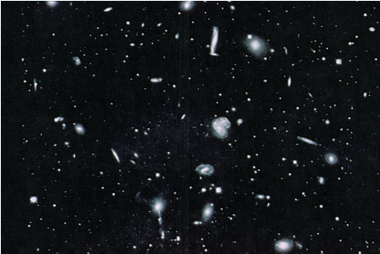
Clusters of Galaxies
The Hercules cluster of galaxies just 650 million ly away.
Clusters of galaxies are the largest gravitationally bound objects
in the Universe. Based on simulations the smallest structures collapsed first and eventually build the largest structures, such as clusters of galaxies.

Slide 34
Properties of Clusters of Galaxies
Clusters of Galaxies contain between 100 - 2000 galaxies, hot X-ray emitting gas and dark matter. Mass distribution:
~5% in galaxies, ~10% in hot gas and ~85 % in dark matter.
- Total mass ~ 10¹⁴ − 10¹⁵ M
- Diameter of 1− 2 Mpc
- Velocity dispersion (spread of galaxy velocities) of ~ 1000 km/s
Clusters are classified as rich or poor (< 100 members) depending on the number of member galaxies. Poor Clusters are also called groups. The Milky Way belongs to the Local Group.
Cluster are also classified as regular (spherical shape) and irregular (non-spherical shape).

Slide 35
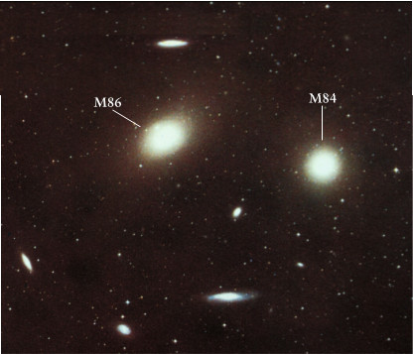
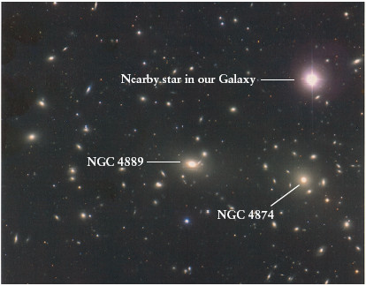
Properties of Clusters of Galaxies
Giant elliptical galaxies dominate the center of Virgo (56 million light years away).
Coma Cluster (300 million light years away)
Irregular clusters like Virgo and Hercules contain an even mixture of galaxy types.
Rich and regular clusters like Coma contain mostly elliptical and lenticular galaxies.

Slide 36
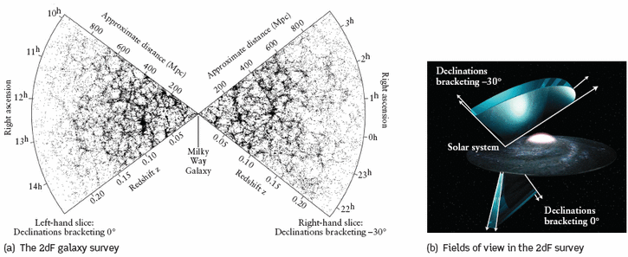
Large Scale Distribution of Galaxies: Voids and Sheets
Three dimensional maps of galaxies in the nearby Universe are now available from the Sloan Digital Sky Survey (SDSS) and the two degree field galactic redshift survey (2dFGRS).
These maps indicate that most galaxies are located on sheets several Mpc thick and separated by voids of sizes ~ 100 Mpc.

Slide 37
Large Scale Distribution of Galaxies: Voids and Sheets
This pattern is similar to that of soapsuds in a kitchen sink, with sheets of soap film (analogous to galaxies) surrounding air bubbles (analogous to voids). Voids contain very few galaxies but may contain hydrogen clouds.
On scales much larger than 100 Mpc, the distribution of galaxies in the universe appears to be roughly uniform.

Slide 38
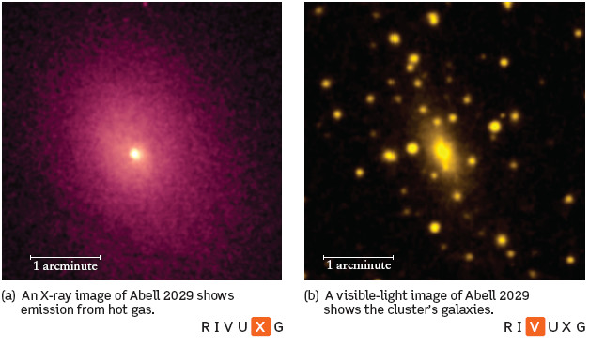
Heating of Intracluster Gas
The Intracluster Medium is heated to high temperatures primarily by the gravitational energy released during the formation of the cluster from smaller structures. Additional heating is provided by (a) winds from supernovae in the galaxies interacting with the ICM (b) by heating provided by the active galactic nucleus at the center of the cluster (c) collisions between galaxies and galaxies and the ICM.

Slide 39
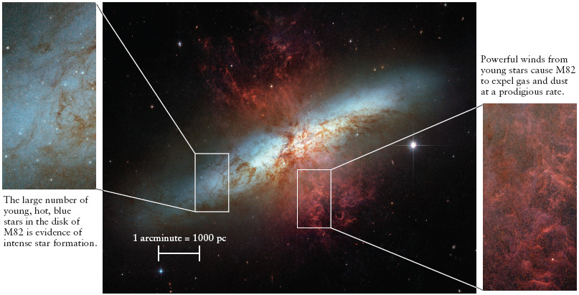
Collision of Galaxies and Starburst Galaxies
During the collision of two galaxies gas from both galaxies is brought into the central region of the merged galaxy where it is compressed and heated thus triggering star formation.
Star formation can also be triggered by less violent collisions where the galaxies pass very near each other. A galaxy with a bright center produced by vigorous star formation surrounded by clouds of warm interstellar dust is called a starburst galaxy. An example of a starburst galaxy is M82.

Slide 40
What have we learned?
How are the lives of galaxies connected with the history of the universe?
  Galaxies generally formed when the universe was young and have aged along with the universe.
What are the three major types of galaxies?
  The major types are spiral galaxies, elliptical galaxies, and irregular galaxies.
  Spirals have both disk and spheroidal components; ellipticals have no disk.

Slide 41
What have we learned?
How are galaxies grouped together?
  Spiral galaxies tend to collect into groups of up to a few dozen galaxies.
  Elliptical galaxies are more common in large clusters containing hundreds to thousands of galaxies.

Slide 42
20.2 Measuring Galactic Distances
Our goals for learning:
  How do we measure the distances to galaxies?
  How did Hubble prove that galaxies lie far beyond the Milky Way?
  What is Hubble's law?
Notes:
(edited)

Slide 43
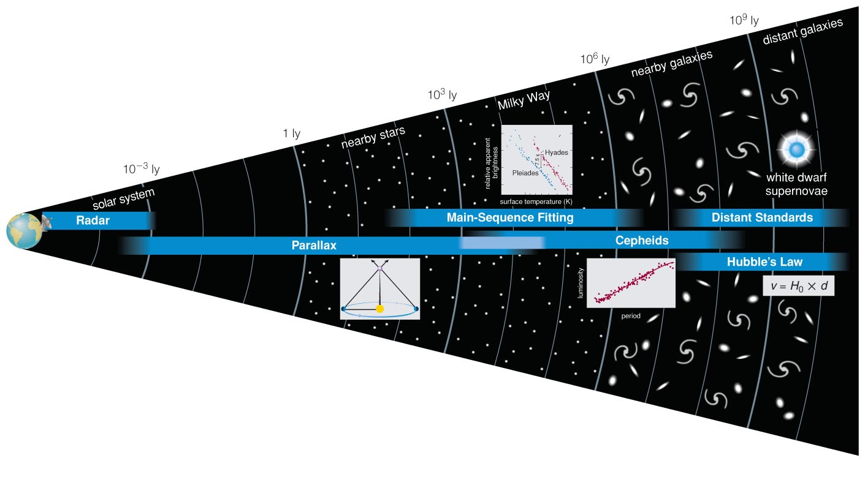
How do we measure the distances to galaxies?

Slide 44
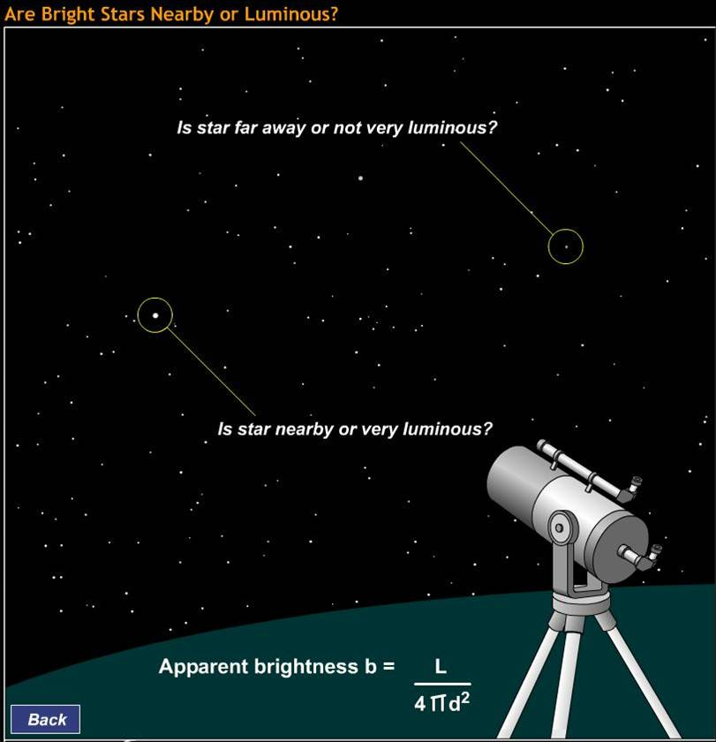

Brightness alone does not provide enough information to measure the distance to an object.

Slide 45
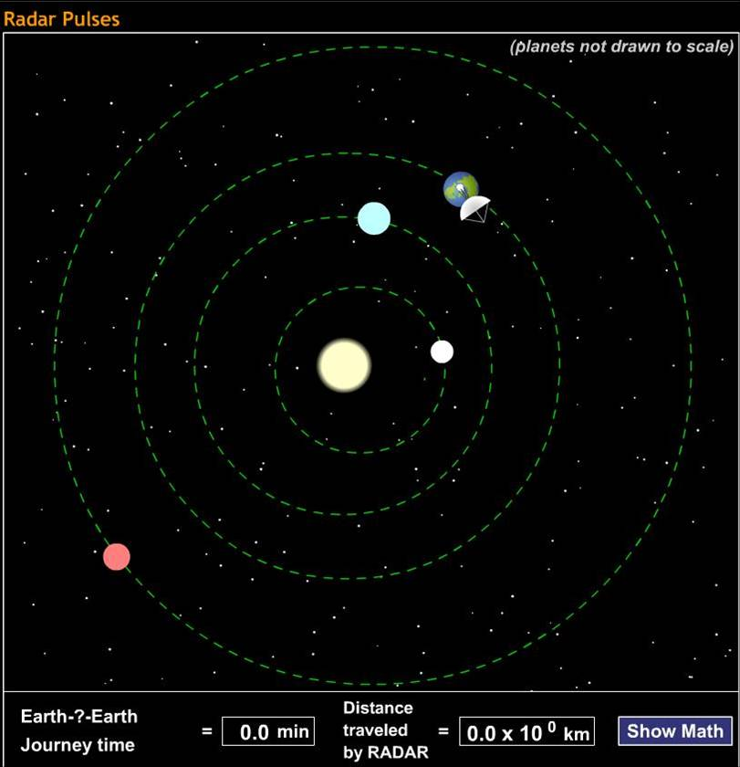
Step 1
Determine size of the solar system using radar.

Slide 46
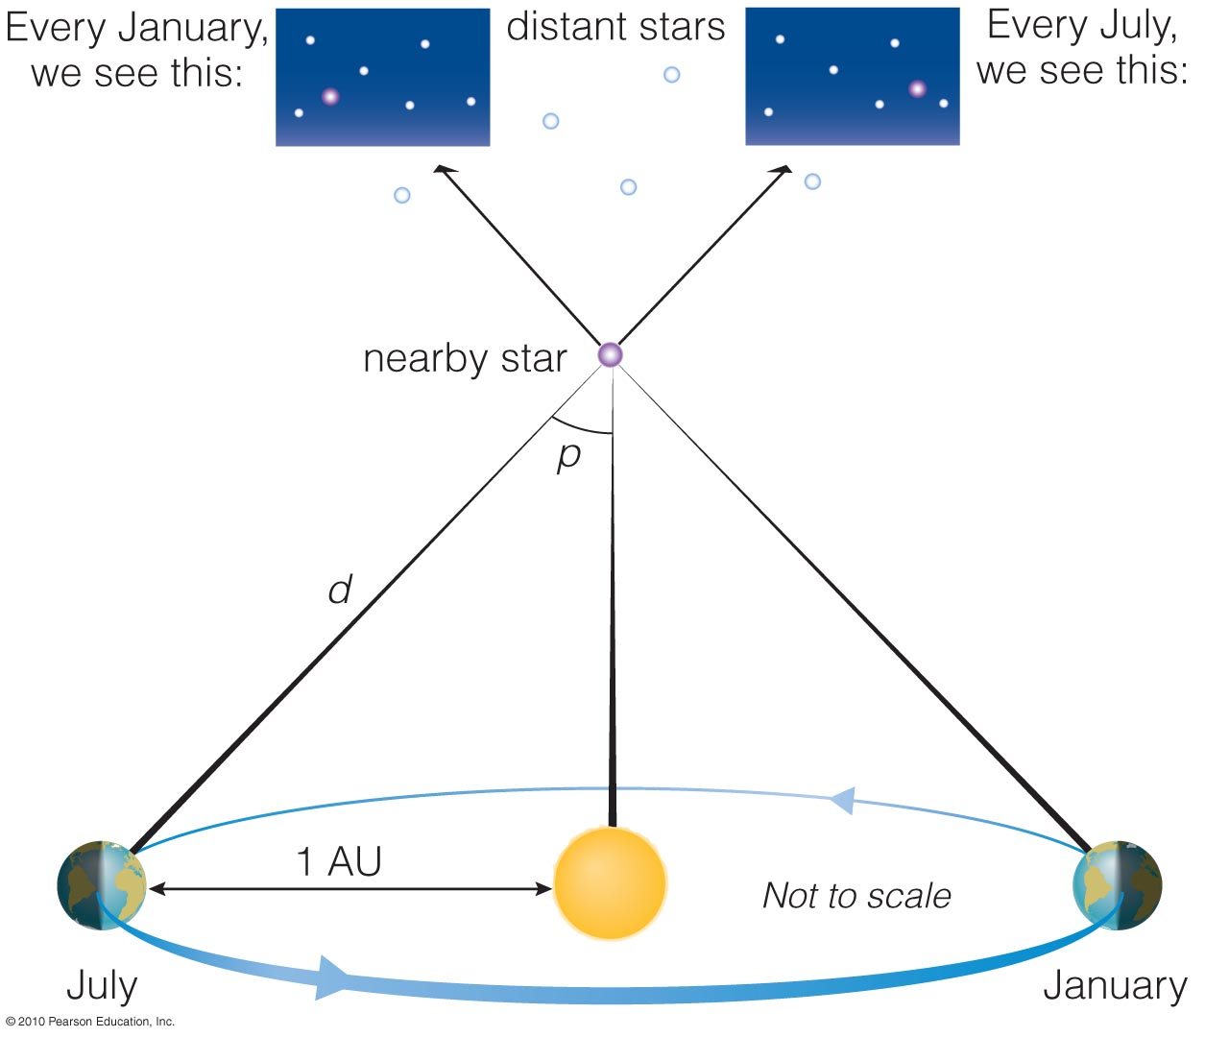
Step 2
Determine the distances of stars out to a few hundred light-years using parallax.
d = (1/p) parsec,
p in arcsec.

Slide 47
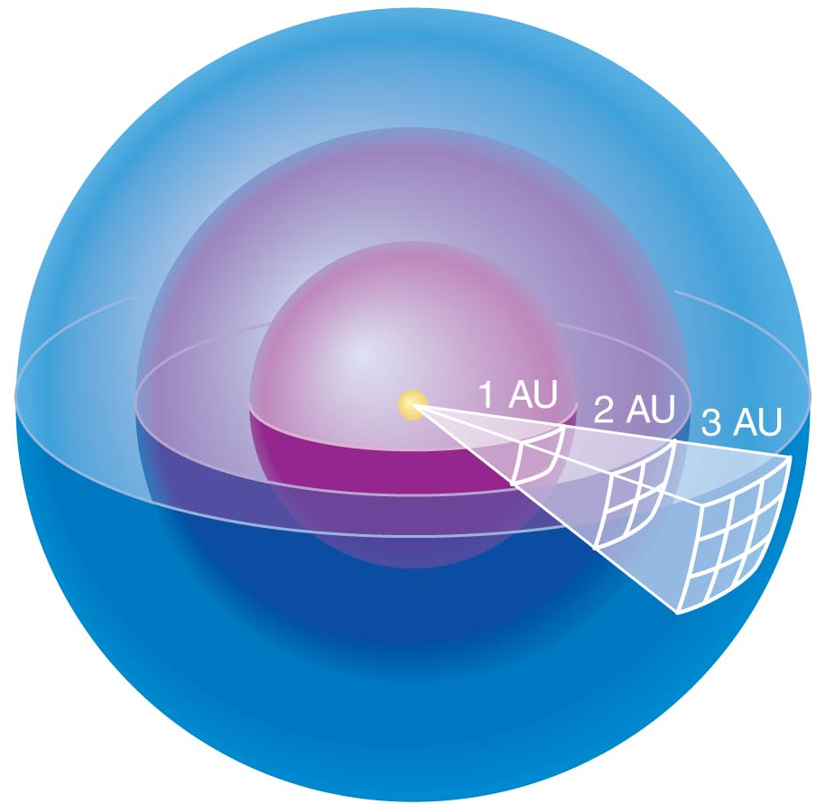
Luminosity passing through each sphere is the same.
Area of sphere:
4π (radius)²
Divide luminosity by area to get brightness.

Slide 48
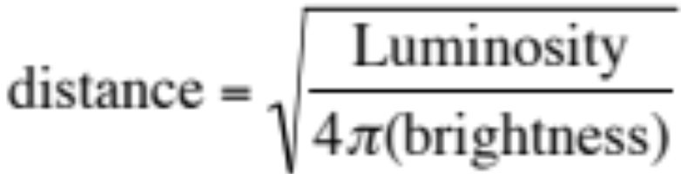
The relationship between apparent brightness and luminosity depends on distance:
Luminosity
Brightness =
4π (distance)²
We can determine a star's distance if we know its luminosity and can measure its apparent brightness
A standard candle is an object whose luminosity we can determine without measuring its distance.

Slide 49
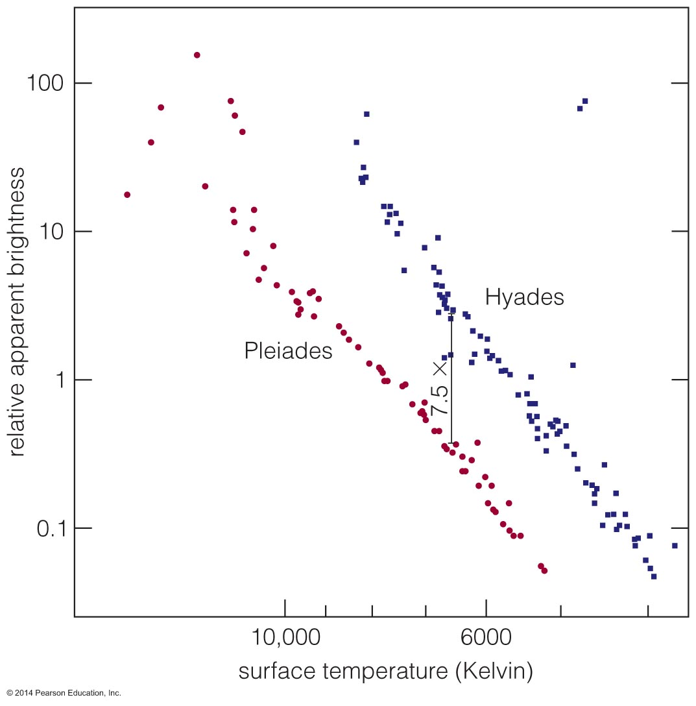
Step 3
The apparent brightness of a star cluster's main sequence tells us its distance.

Slide 50
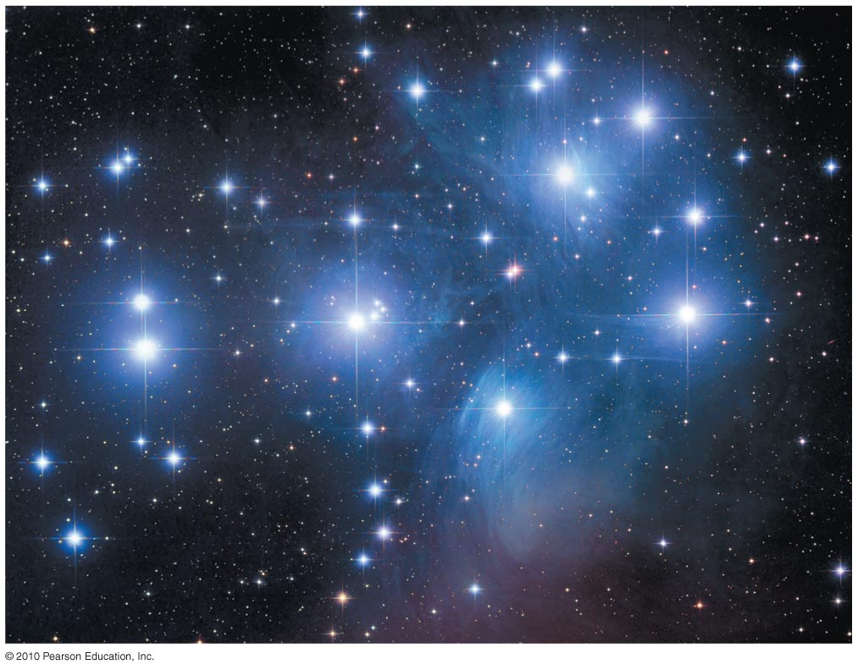
Insert TCP 6e Figure 15.16
Knowing a star cluster's distance, we can determine the luminosity of each type of star within it.

Slide 51
Thought Question
Which kind of stars are best for measuring large distances?
high-luminosity stars
low-luminosity stars

Slide 52
Thought Question
Which kind of stars are best for measuring large distances?
high-luminosity stars
low-luminosity stars
Notes:
52

Slide 53
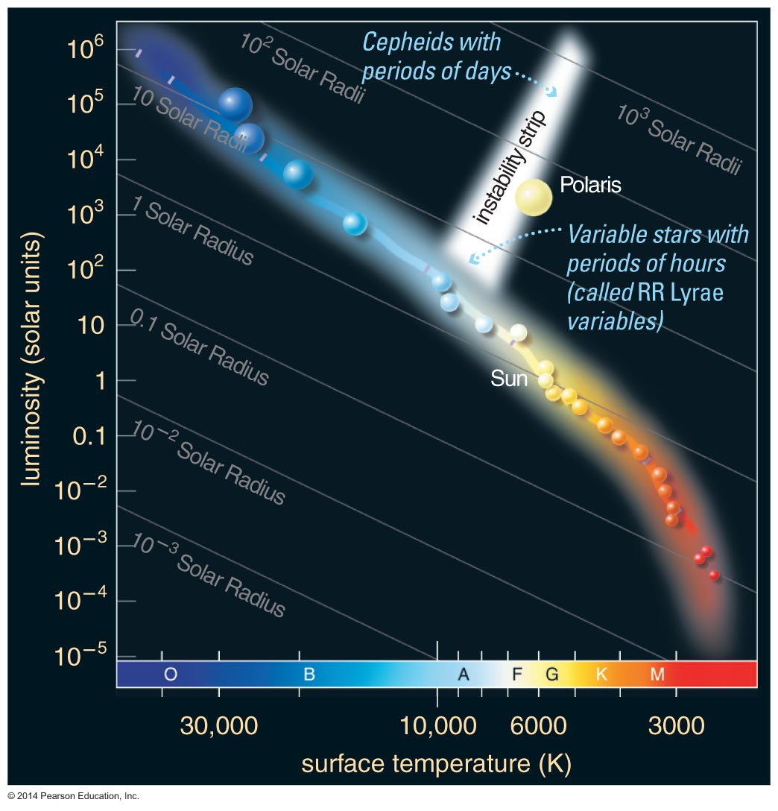
Cepheid variable supergiant stars are very luminous.

Slide 54
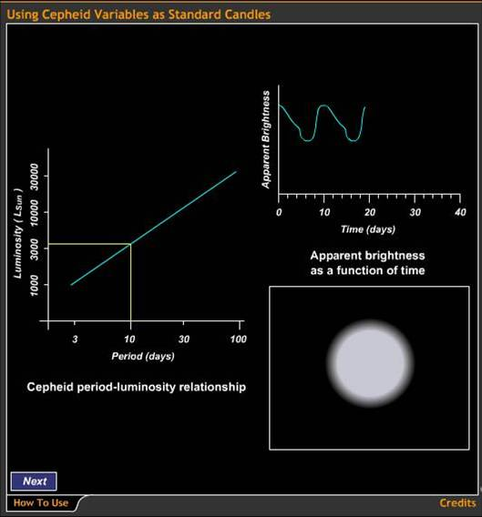
Step 4
Because the period of Cepheid variable stars tells us their luminosities, we can use them as standard candles.

Slide 55
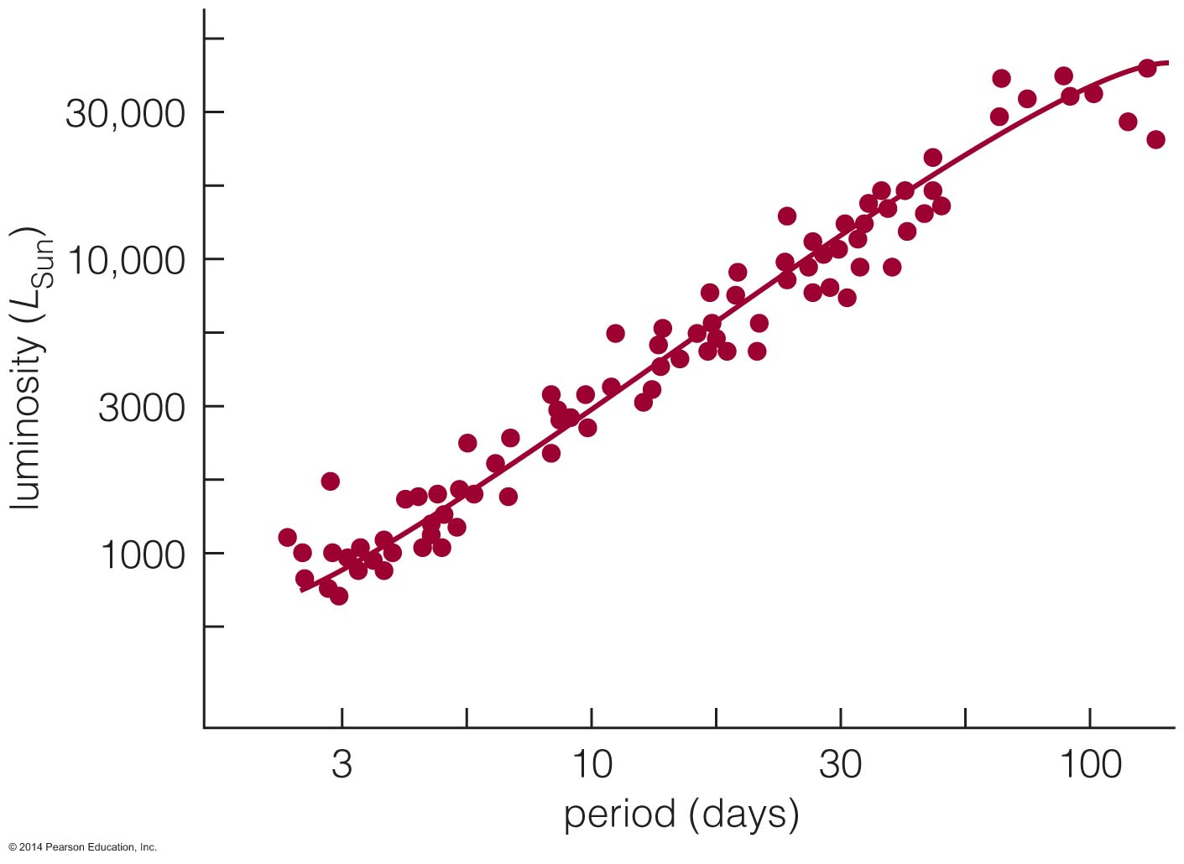
Cepheid variable stars with longer periods have greater luminosities. Can be used to determine distances up to 100 Mly.

Slide 56
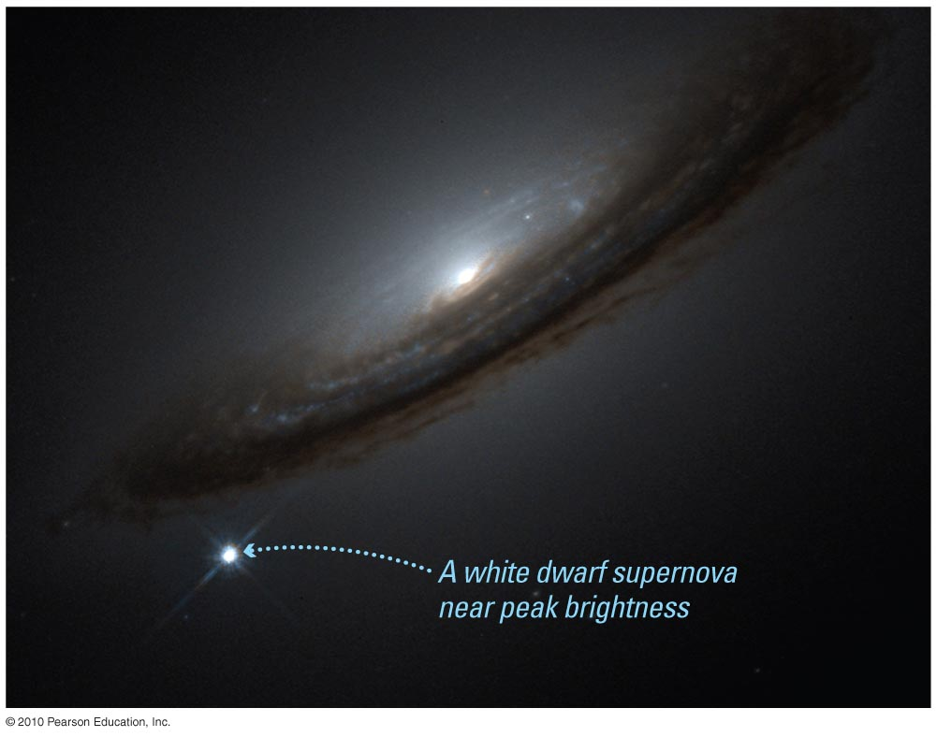
White-dwarf supernovae can also be used as standard candles.
These supernovae occur when a white dwarf in a close binary system accretes enough matter from its companion to blow itself apart when M > 1.4 M

Slide 57
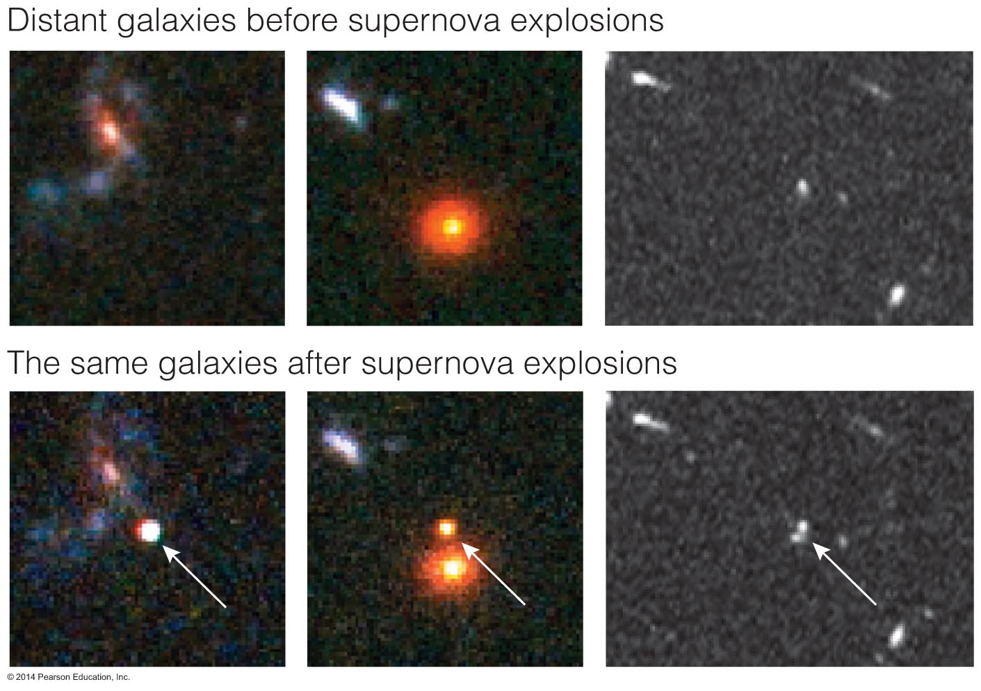
Step 5
The apparent brightness of a white dwarf supernova tells us the distance to its galaxy (up to 10 billion light-years).

Slide 58
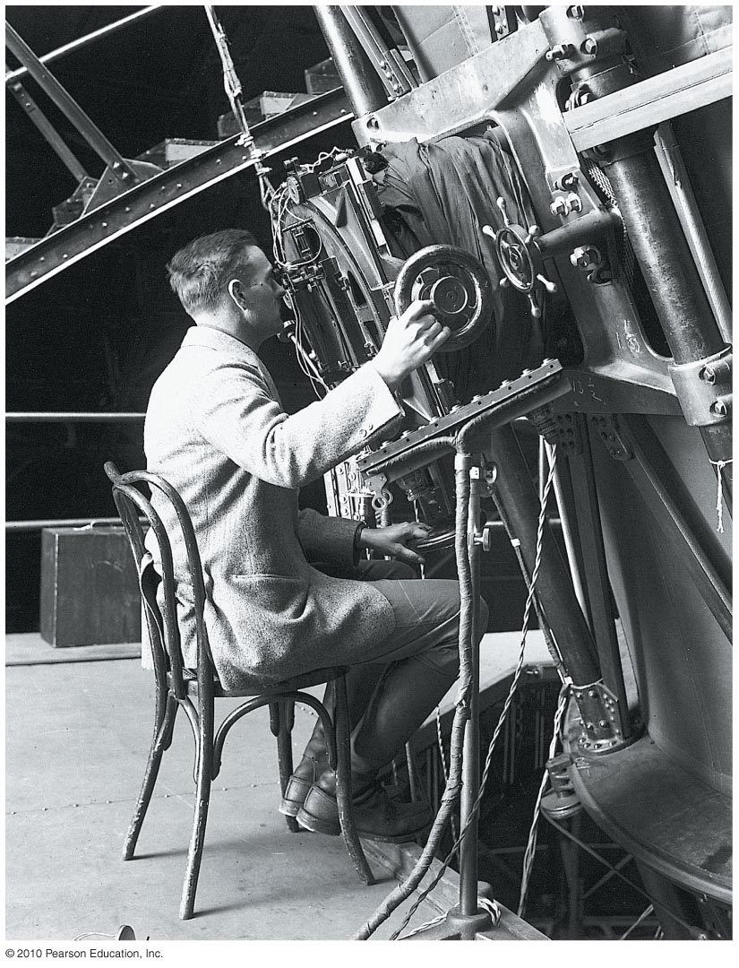
How did Hubble prove that galaxies lie far beyond the Milky Way?

Slide 59
The Puzzle of "Spiral Nebulae"
Before Hubble, some scientists argued that "spiral nebulae" were entire galaxies like our Milky Way, while others maintained they were smaller collections of stars within the Milky Way.
The debate remained unsettled until Edwin Hubble finally measured their distances.

Slide 60
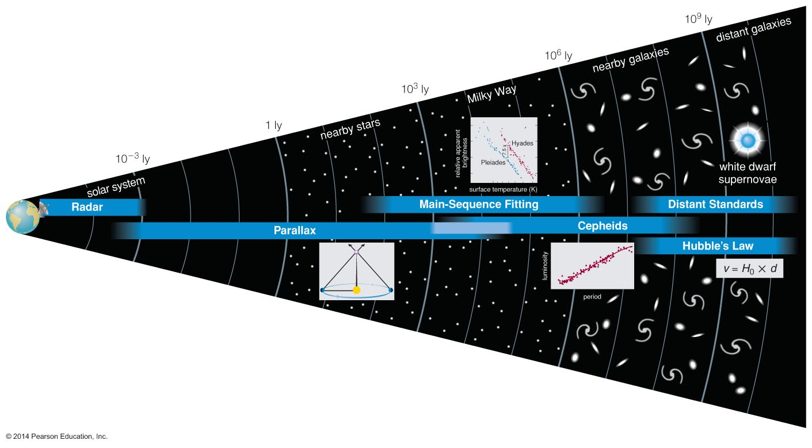
Hubble settled the debate by measuring the distance to the Andromeda Galaxy using Cepheid variables as standard candles.

Slide 61
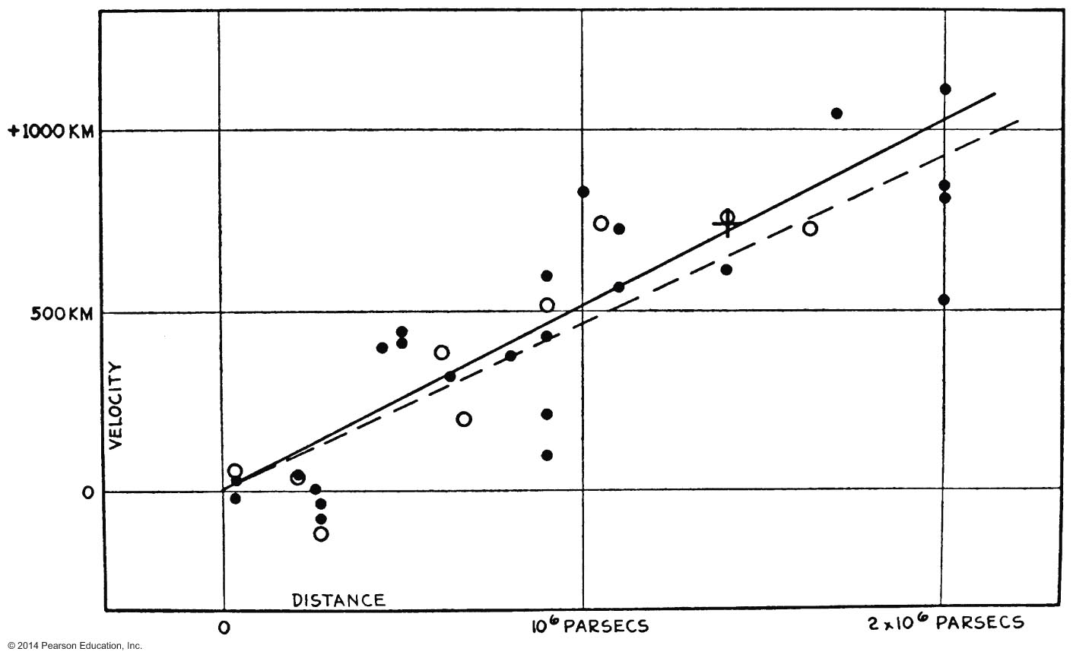
What is Hubble's law?

Slide 62
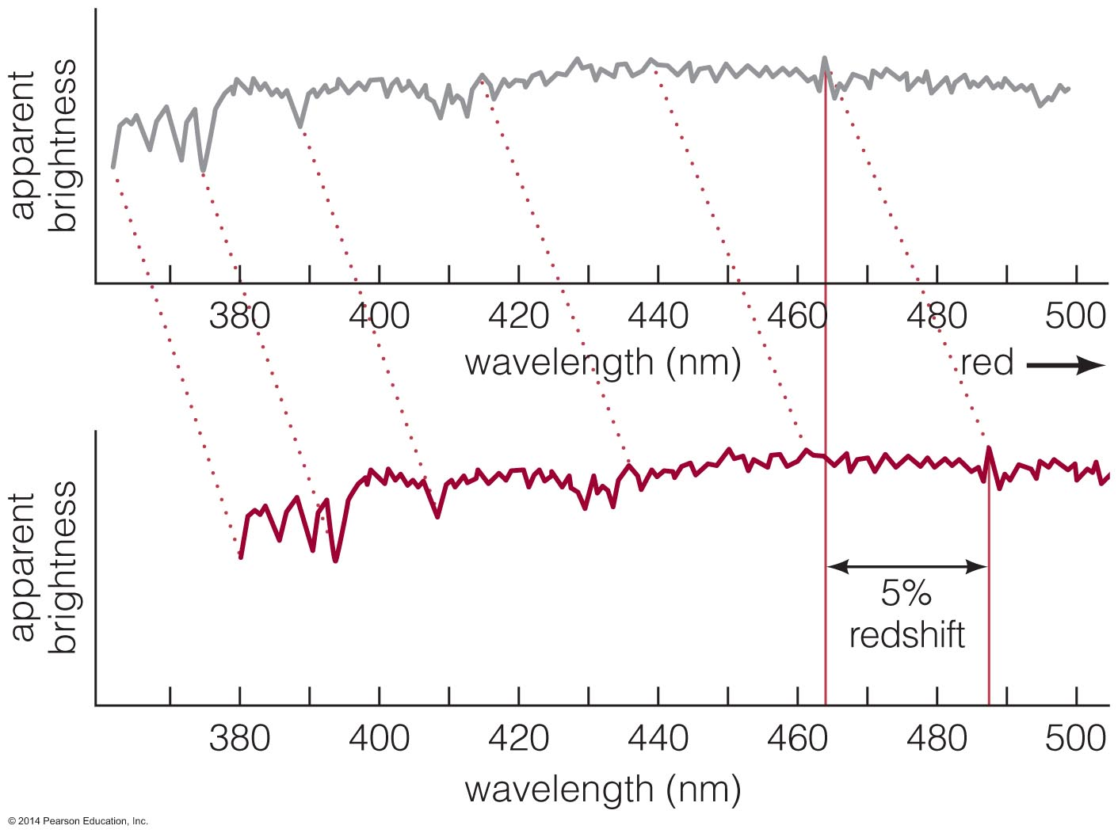
The spectral features of virtually all galaxies are redshifted, which means that they're all moving away from us.

Slide 63
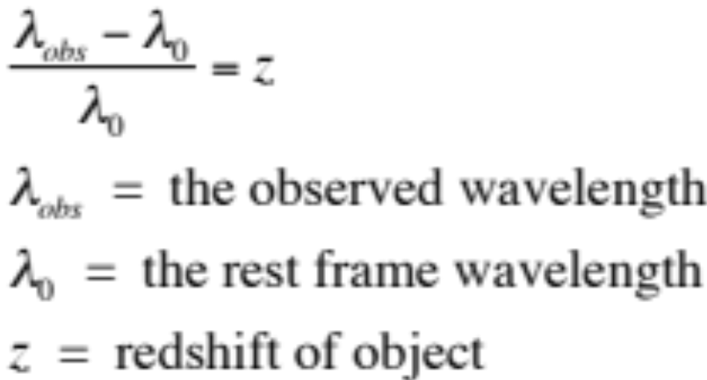
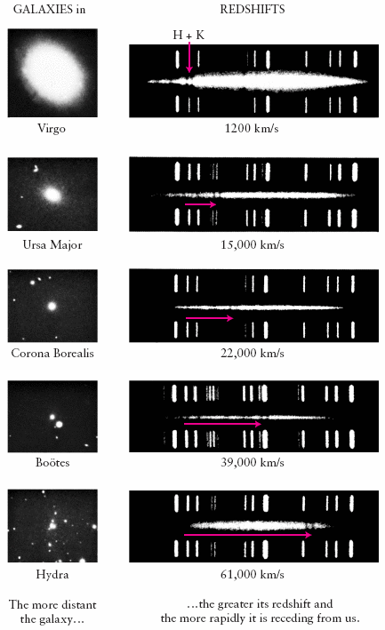
Cosmological Redshift
Figure: Each galaxy’s spectrum is a bright band with dark absorption lines.
The bright lines above and below it are a comparison spectrum taken on Earth. The horizontal red arrows show how much the H and K lines of singly ionized calcium are redshifted in each galaxy’s spectrum. Below each spectrum is the recessional velocity calculated from the redshift.

Slide 64
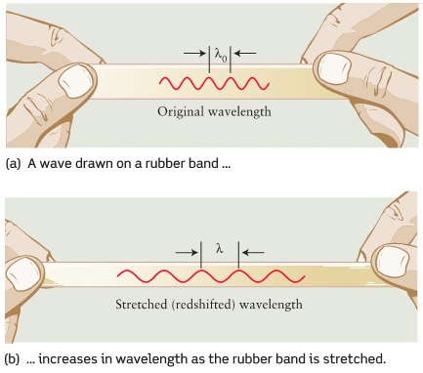
Cosmological Redshift
We can easily calculate the factor by which the Universe has expanded from some previous time as follows:
z = (λ_{obs} - λ₀)/λ₀ → λ_{obs}/λ₀ = (1+z)
This means that if you observe an object to have a redshift of z = 1
the distance between us and the object has increased by a factor of 2 from the time the photon left that object and arrived to Earth.
How does the volume and density change?

Slide 65
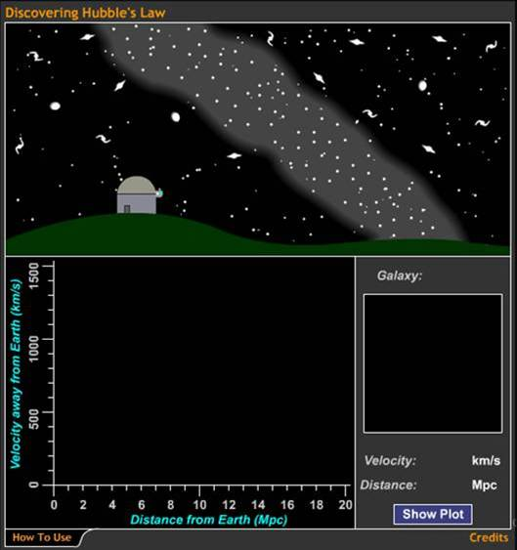
By measuring distances to galaxies, Hubble found that redshift and distance are related in a special way.

Slide 66
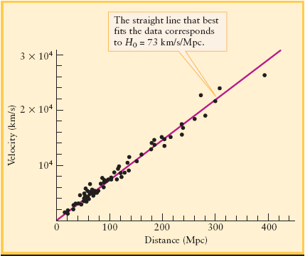
Hubble’s Law
The Hubble Law:
v = H₀ d
v = recessional velocity of a galaxy, H₀ = Hubble constant
d = distance to the galaxy
H₀ = 68 km/s/Mpc (updated value)
Note that this is not a real velocity as in the Doppler effect but the apparent velocity due to the expansion of space. For low redshift (z < 0.1) z ~ v/c
Hubble measured the recession velocities (from redshifts) and distances to galaxies (using Cepheid variable stars) and found that the more distant the galaxy the greater its recession velocity.

Slide 67
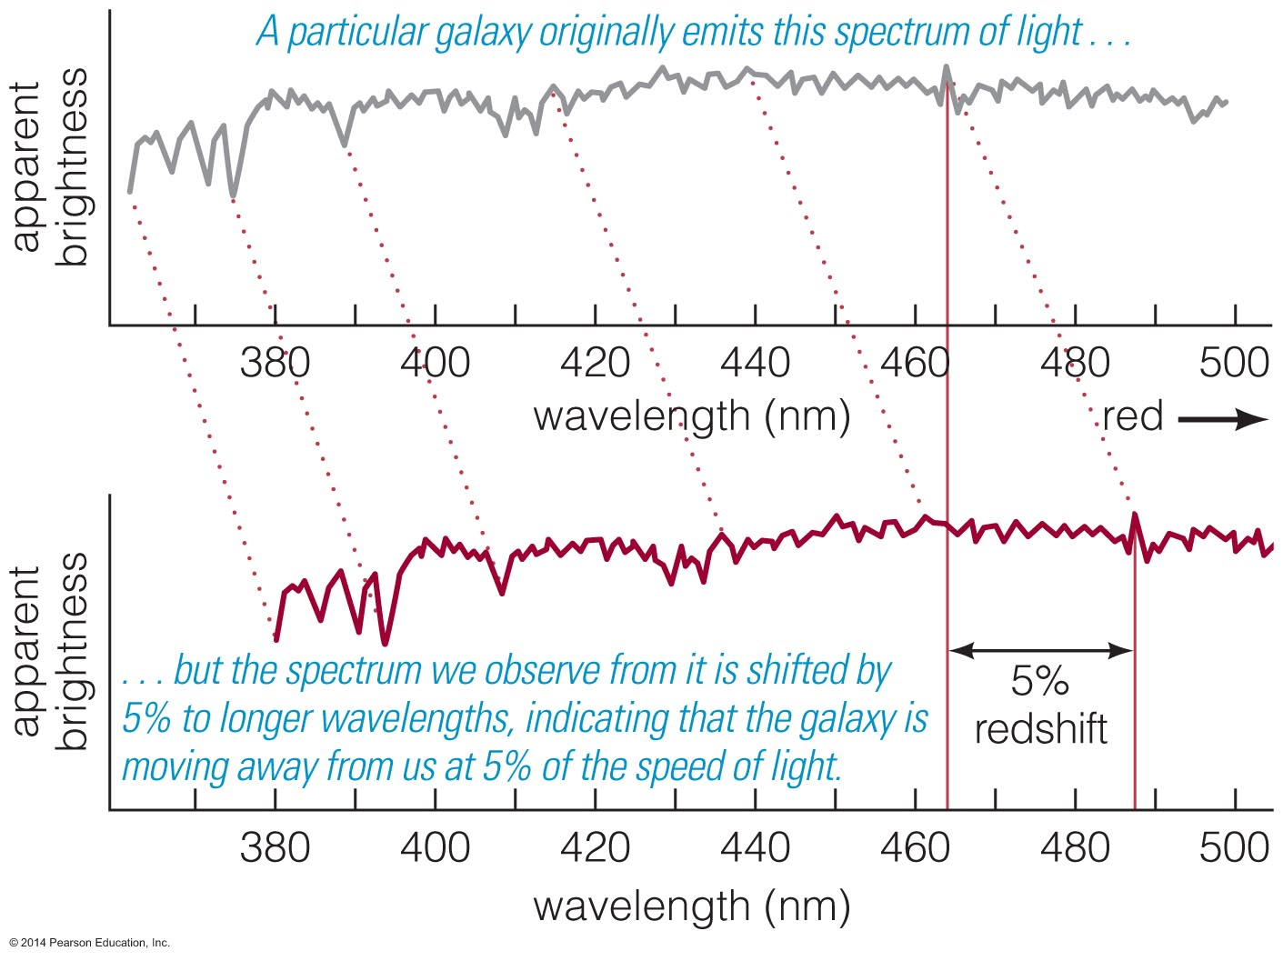
Redshift of a galaxy tells us its distance through Hubble's law:
Distance =
velocity
H₀

Slide 68
Distances of the farthest galaxies are measured from their redshifts.

Slide 69
We measure galaxy distances using a chain of interdependent techniques.

Slide 70
Distances
lookback time (or light travel time) indicates how far into the past we are looking when we see a particular object.
comoving radial distance: d(which goes into the Hubble law :
v = H₀d) is the distance now between the object and us. During the time that it takes a photon to reach us from a distant object, that object has moved farther away due to the expansion of the universe.
luminosity distance (which goes into the inverse square law)
Several online cosmology calculators can be found at:
http://lambda.gsfc.nasa.gov/toolbox/tb_calclinks.cfm

Slide 71
What have we learned?
How do we measure the distances to galaxies?
  The distance measurement chain begins with parallax measurements that build on radar ranging in our solar system.
  Using parallax and the relationship between luminosity, distance, and brightness, we can calibrate a series of standard candles.
  We can measure distances greater than 10 billion light-years using white dwarf supernovae as standard candles.

Slide 72
What have we learned?
How did Hubble prove that galaxies lie far beyond the Milky Way?
  He measured the distance to the Andromeda Galaxy using Cepheid variable stars as standard candles.
What is Hubble's law?
  The faster a galaxy is moving away from us, the greater its distance:
    Velocity = H₀ × distance

Slide 73
20.3 The Age of the Universe
Our goals for learning
  How does Hubble's Law tell us the age of the universe?
  How does expansion affect distance measurements?
  Why does the observable universe have a horizon?

Slide 74

How does Hubble's Law tell us the age of the universe?

Slide 75

The expansion rate appears to be the same everywhere in space.
The universe has no center and no edge (as far as we can tell).

Slide 76

One example of something that expands but has no center or edge is the surface of a balloon.

Slide 77
Cosmological Principle
The universe looks about the same no matter where you are within it.
Matter is evenly distributed on very large scales in the universe.
It has no center or edges.
The cosmological principle has not been proven beyond a doubt, but it is consistent with all observations to date.
The Universe is homogeneous and isotropic.

Slide 78

Cosmological Principle

Slide 79

Age of the Universe
The expansion of the Universe is an expansion of space. As we go back in time we find the density of the Universe increasing. About 13.8 billion years ago all matter was concentrated in a singularity of infinite density. Space and time were created 13.8 billion years ago in an event that is called the Big Bang.
How long ago did the Big Bang take place?
T₀ = d/v = d / H₀d = 1 / H₀ = 1 / 70 km s⁻¹ Mpc⁻¹ → T₀ ~ 14 billion years1(1 Mpc = 3.09 ×10¹⁹ km)
We have assumed that the Universe expands at a constant rate which is not true. Doing the calculations assuming a ΛCDM cosmology gives: T₀ = 13.8 Billion years
According to the Big Bang Model the Universe expanded from an extremely dense and hot state and continues to expand today.
Notes:
79

Slide 80

How does expansion affect distance measurements?

Slide 81
Distances between faraway galaxies change while light travels. The distance now between us and a galaxy is larger than the distance during the time the photon left the galaxy.
Astronomers use the term lookback time that indicates how far into the past we are looking when we see a particular object.

Slide 82
Why does the observable universe have a horizon?

Slide 83
The Cosmological Horizon marks the limits of the observable universe.
We can only observe the parts of the Universe where the lookback time is less than the age of the Universe.

Slide 84

The Observable Universe

Slide 85
What have we learned?
How do distance measurements tell us the age of the universe?
  Measuring a galaxy's distance and speed allows us to figure out how long the galaxy took to reach its current distance.
  Measuring Hubble's constant tells us that amount of time: about 14 billion years.
How does the universe's expansion affect our distance measurements?
  Lookback time is easier to define than distance for objects whose distances grow while their light travels to Earth.

Slide 86
What have we learned?
Why does the observable universe have a horizon?
  We cannot see back to a time before the beginning of the universe!

