Slide 1
Galaxy Evolution

Slide 2
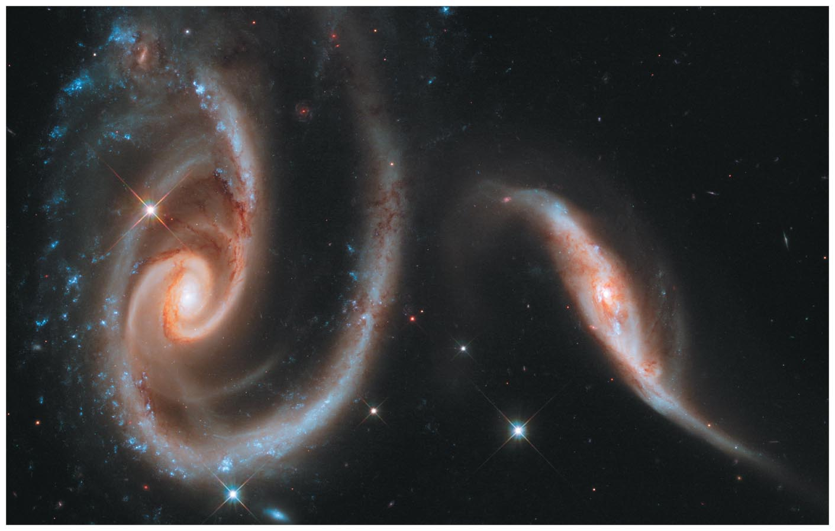
Galaxy Evolution

Slide 3
21.1 Looking Back Through Time
Our goals for learning:
  How do we observe the life histories of galaxies?
  How do we study galaxy formation?
Notes:
3

Slide 4
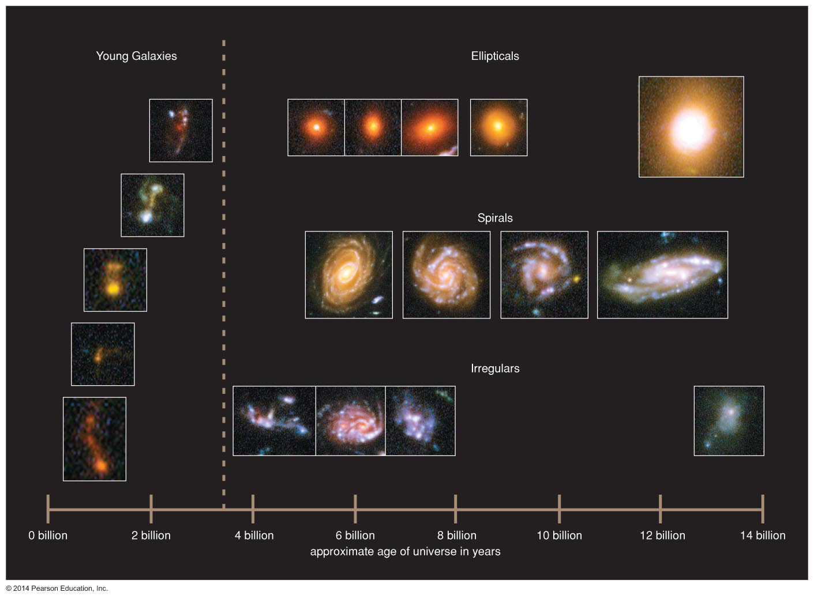
By looking back through time we can study how galaxies first formed and how they evolved and why there is such a variety of galaxy types.

Slide 5
Based on Hubble observations we find that the first galaxies formed at about 1 billion years after the Big Bang. Our galaxy also probably started forming during this time. Several stars in the halo of our galaxy are about 13 billion years old.

Slide 6
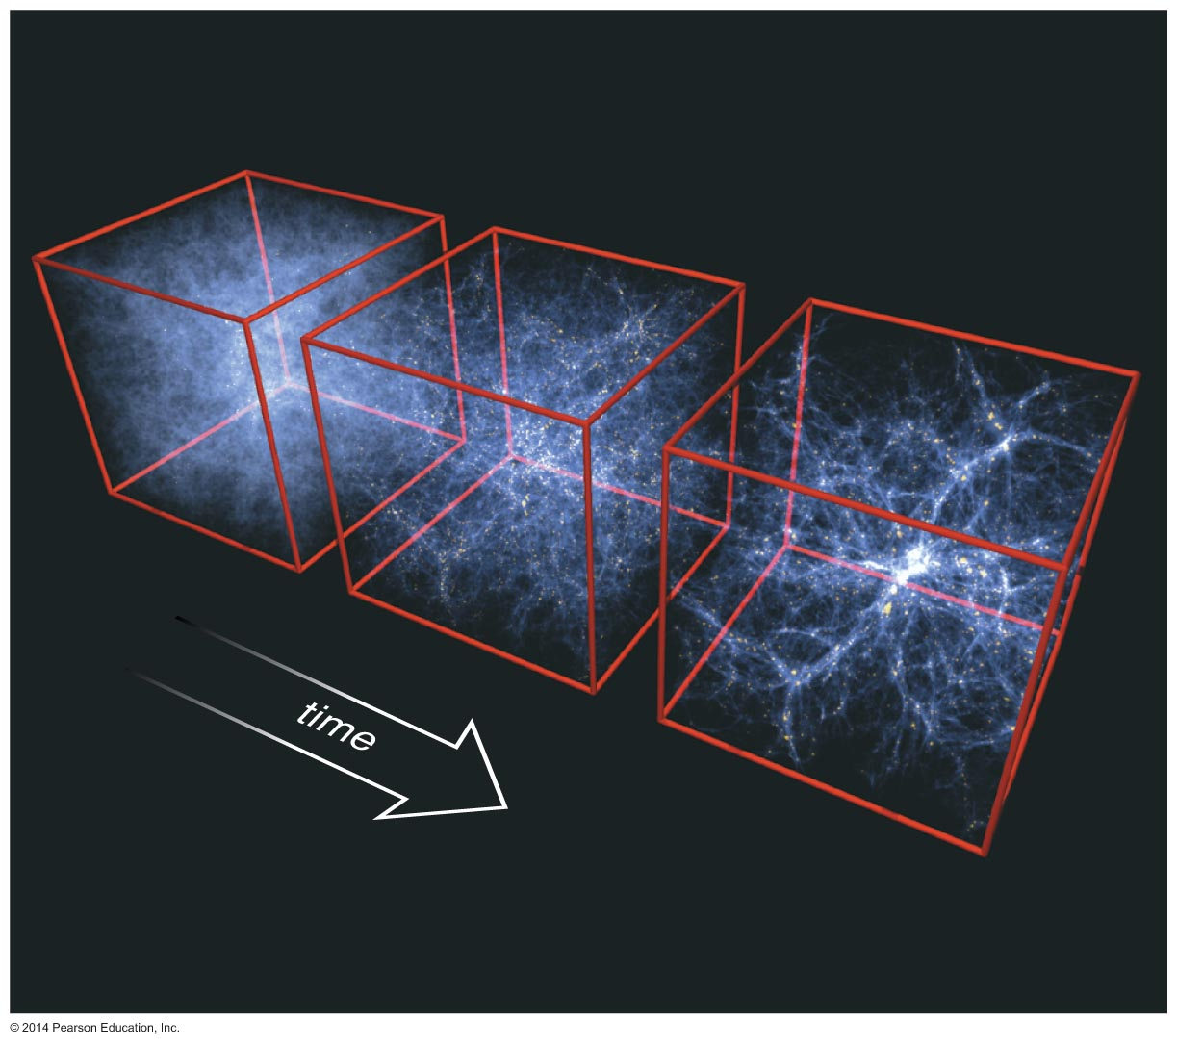

We can study galaxy formation with numerical simulations
Our best models for galaxy formation assume:
  Matter originally filled all of space almost uniformly.
  Gravity of denser regions pulled in surrounding matter.

Slide 7
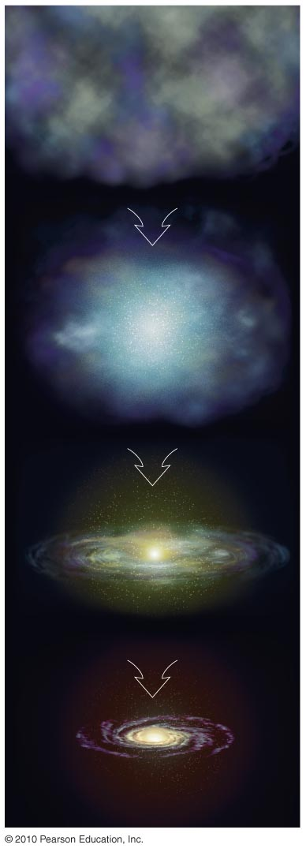
Denser regions contracted, forming protogalactic clouds.
Hydrogen and helium gas in these clouds formed the first stars.

Slide 8
Supernova explosions from the first stars kept much of the gas from forming stars.
Leftover gas settled into a spinning disk due to the conservation of angular momentum.

Slide 9
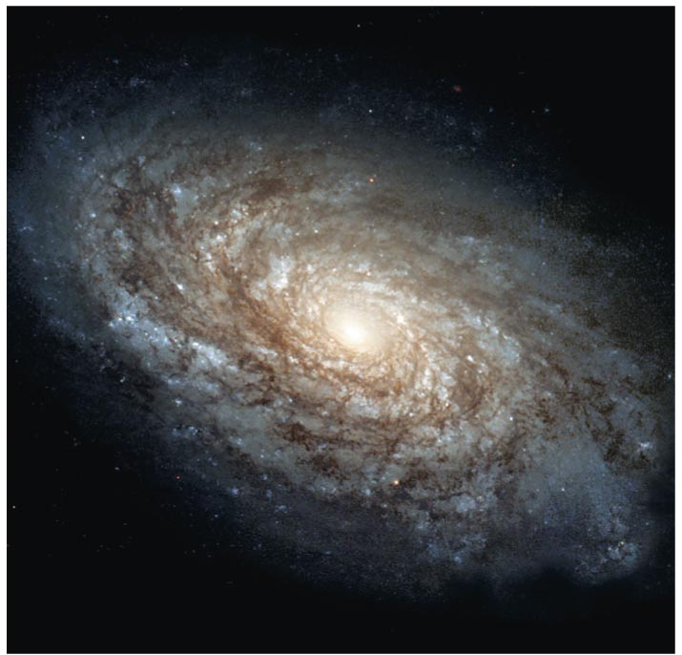
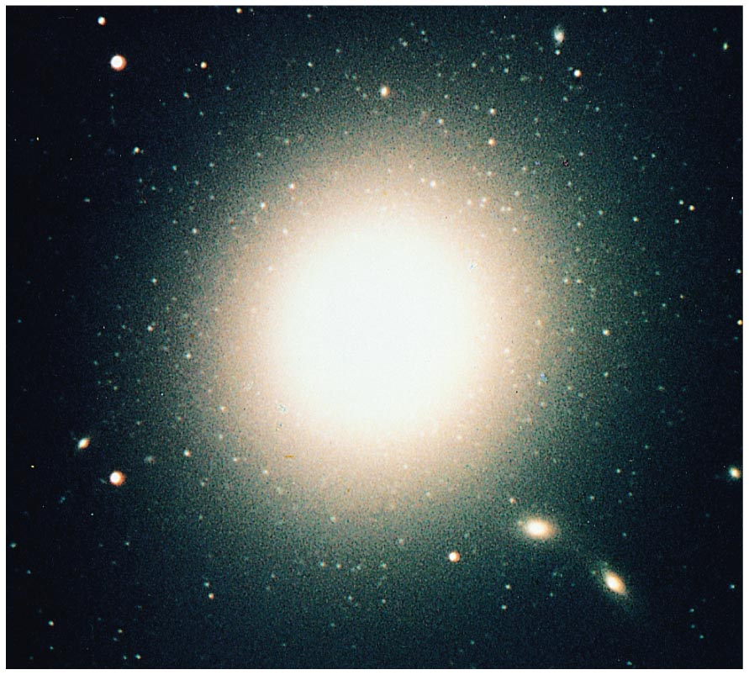
NGC 4414
M87
But why do some galaxies end up looking so different?

Slide 10
What have we learned?
How do we observe the life histories of galaxies?
  Deep observations of the universe show us the history of galaxies because we are seeing galaxies as they were at different ages.
How do we study galaxy formation?
  Our best models for galaxy formation assume that gravity made galaxies out of regions in the early universe that were slightly denser than their surroundings.

Slide 11
21.2 The Lives of Galaxies
Our goals for learning:
  Why do galaxies differ?
  What are starbursts?

Slide 12
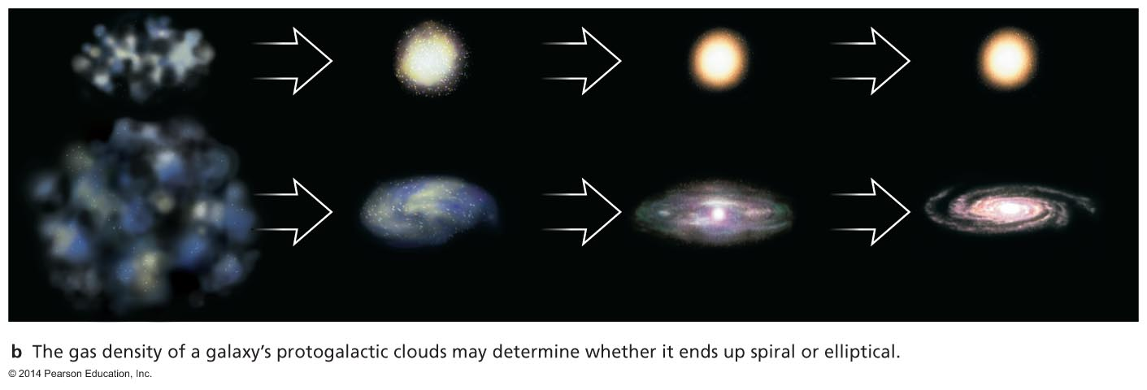
Why do galaxies differ?
Birth Conditions (rotation, density)
Mergers

Slide 13
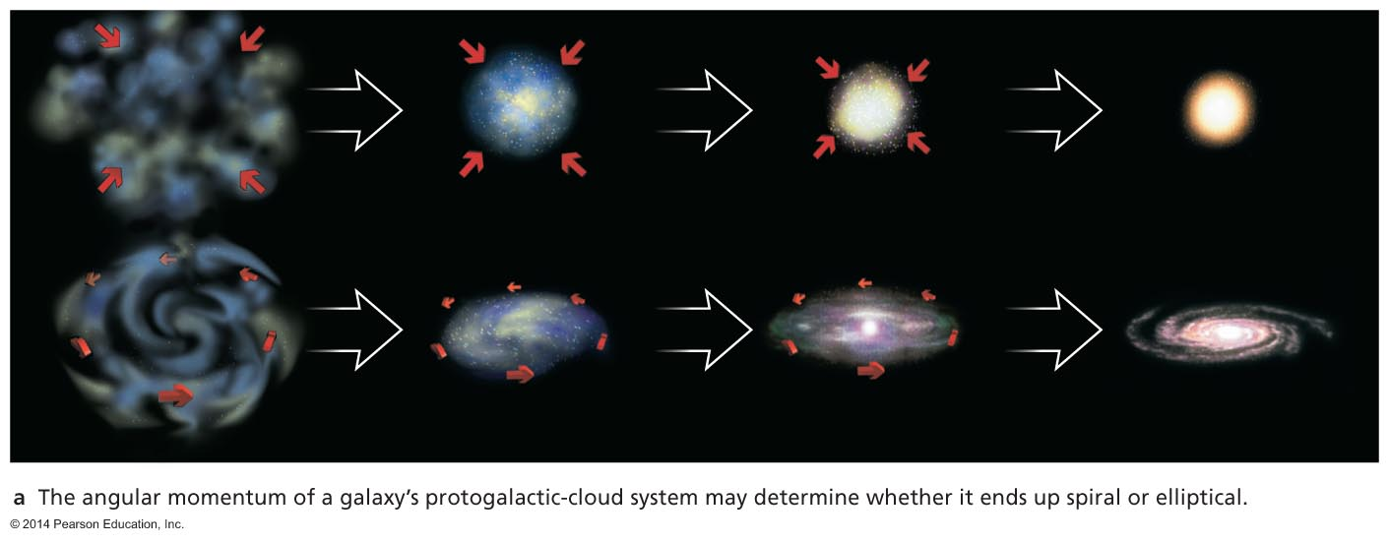
Conditions in Protogalactic Cloud?
Spin: The initial angular momentum of the protogalactic cloud could determine the size of the resulting disk. Protogalactic clouds with large spin are likely to form a disk and the resulting galaxy will be spiral.

Slide 14
Conditions in Protogalactic Cloud?
Density: Elliptical galaxies could come from dense protogalactic clouds that were able to cool and form stars before gas settled into a disk.

Slide 15
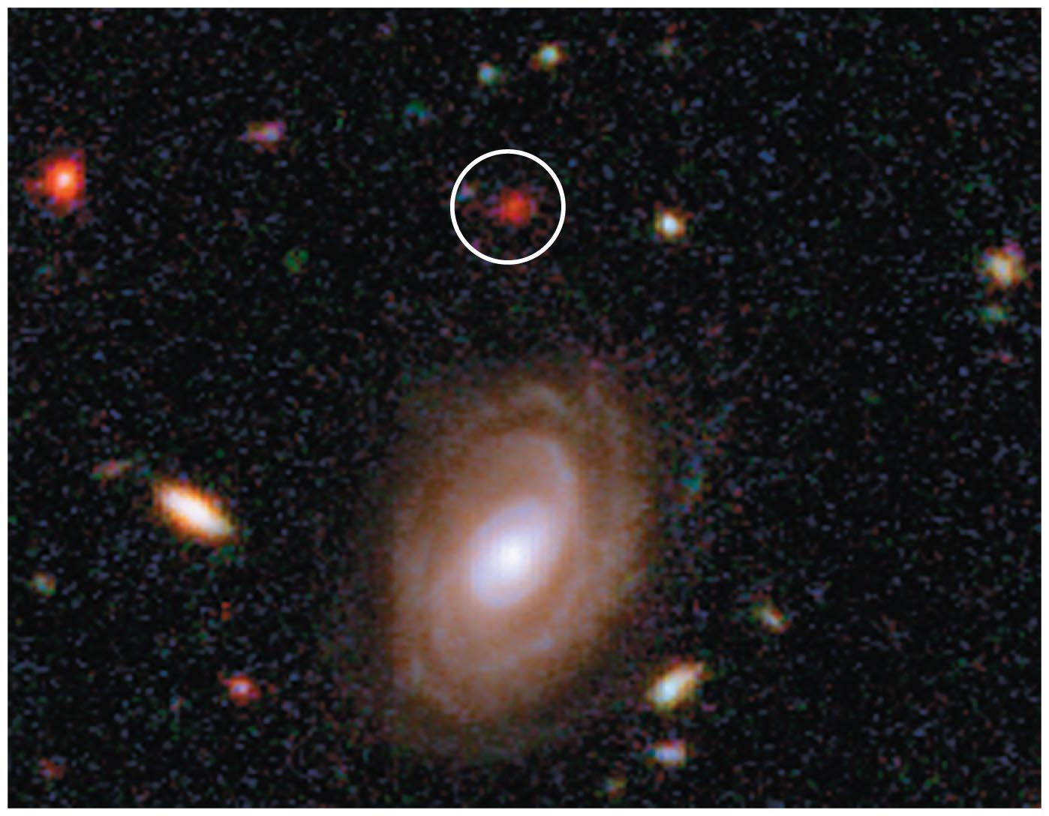
Distant Red Ellipticals
Observations of some distant red elliptical galaxies support the idea that most of their stars formed very early in the history of the universe.

Slide 16
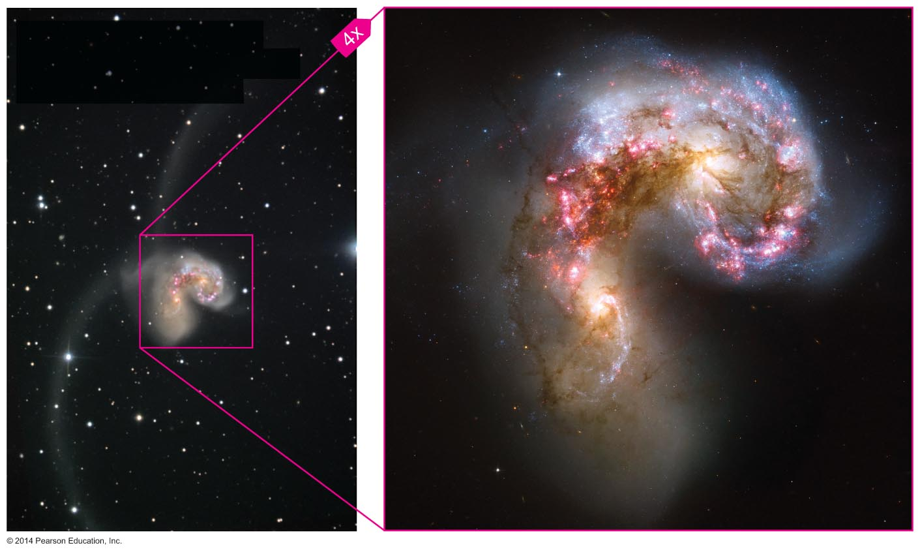
We must also consider the effects of collisions.

Slide 17
Collisions were much more likely early in time because galaxies were closer together.

Slide 18
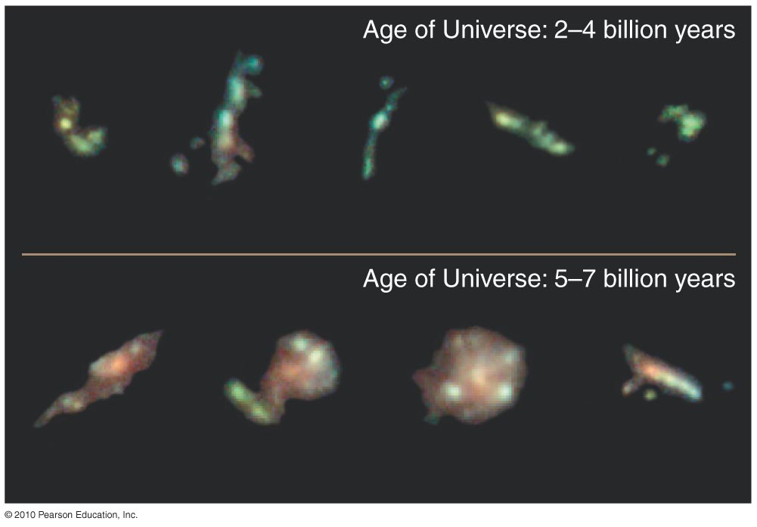
Many of the galaxies we see at great distances (and early times) do look violently disturbed.

Slide 19
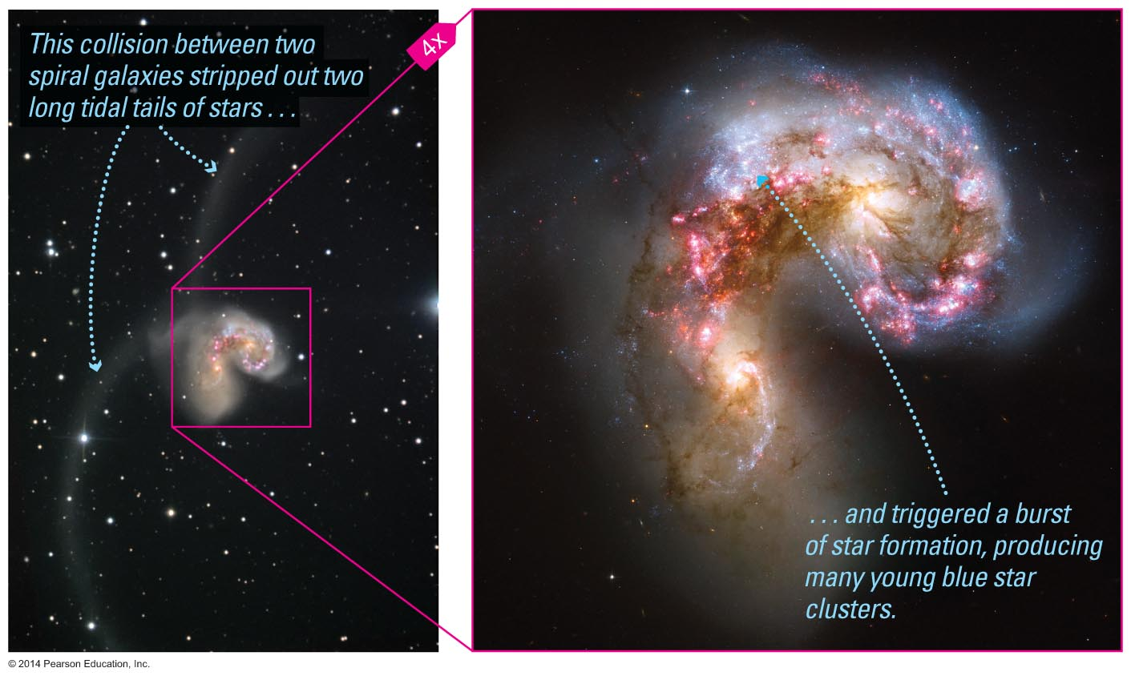
The collisions we observe nearby trigger bursts of star formation.

Slide 20
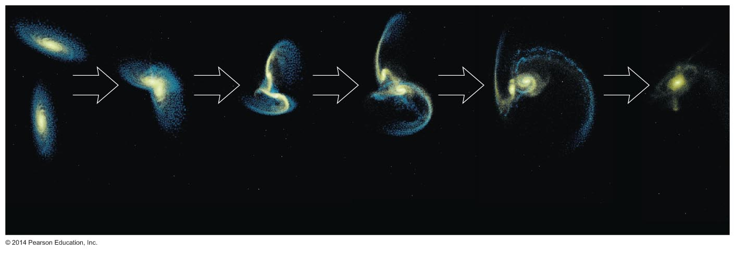
Modeling such collisions on a computer shows that two spiral galaxies can merge to make an elliptical.

Slide 21
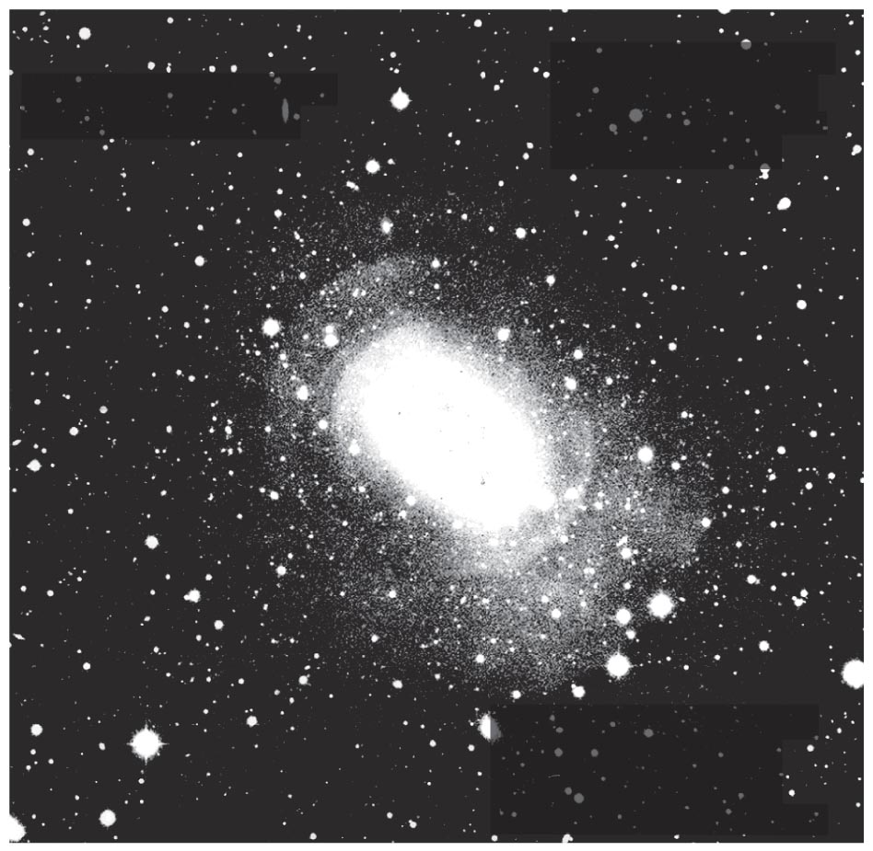
Shells of stars observed around some elliptical galaxies are probably the remains of past collisions.
Notes:
There is a different version of this image in the 7th edition of the text, but this one actually shows the shells better!

Slide 22
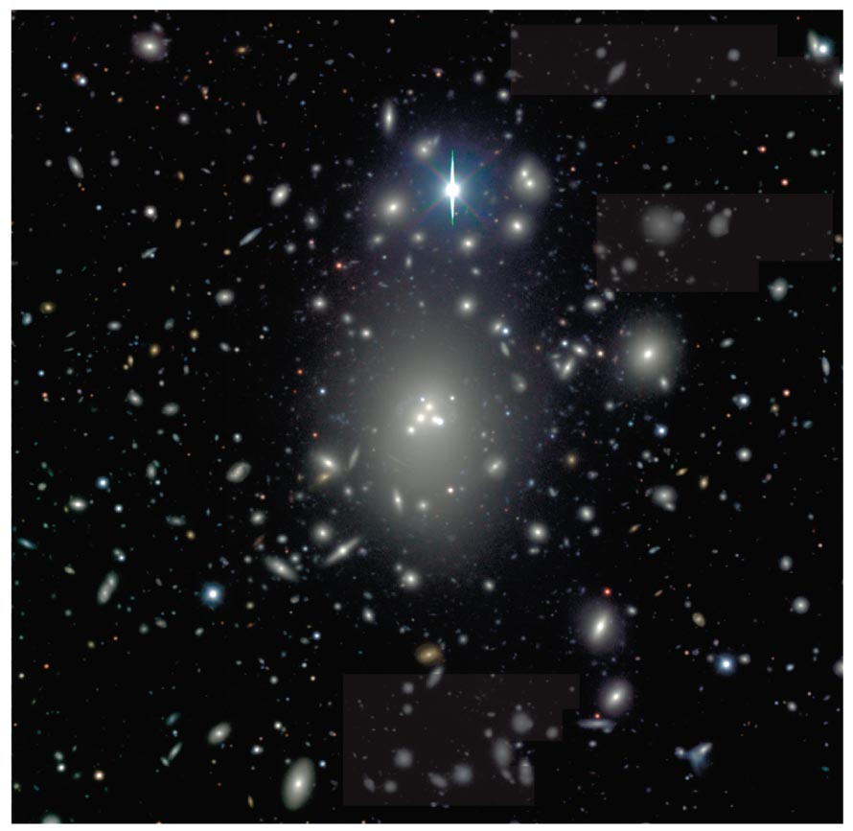
A large fraction of elliptical galaxies is found near the centers of clusters of galaxies where we expect the merger rate to be higher higher due to the larger density of galaxies.

Slide 23
Giant elliptical galaxies at the centers of clusters seem to have consumed a number of smaller galaxies. This is because of multiple mergers near the center of the cluster.
Notes:
(new figure)

Slide 24
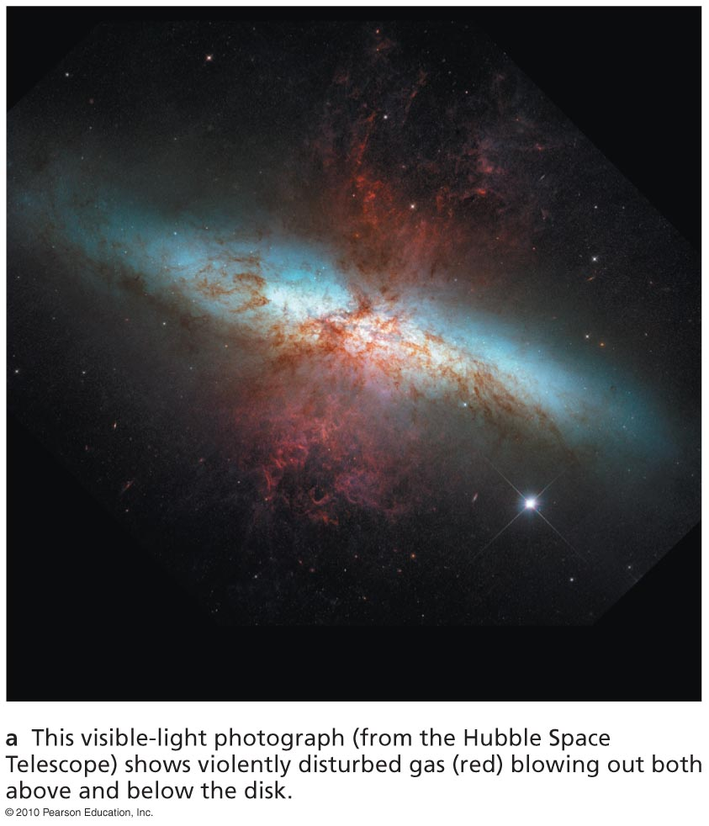
Starburst galaxies are galaxies with large star formation rates (~ 100 M/year)

Slide 25
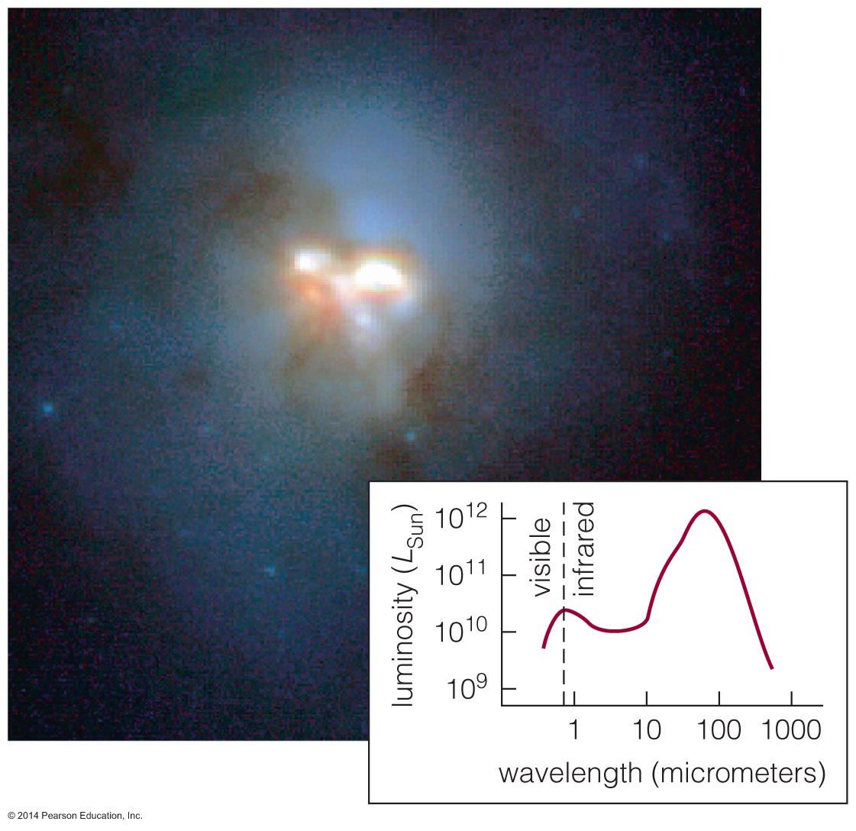
Starburst galaxies are forming stars so quickly that they would use up all their gas in less than a billion years.

Slide 26
Visible-light
image
Intensity of supernova explosions in starburst galaxies can drive galactic winds.

Slide 27
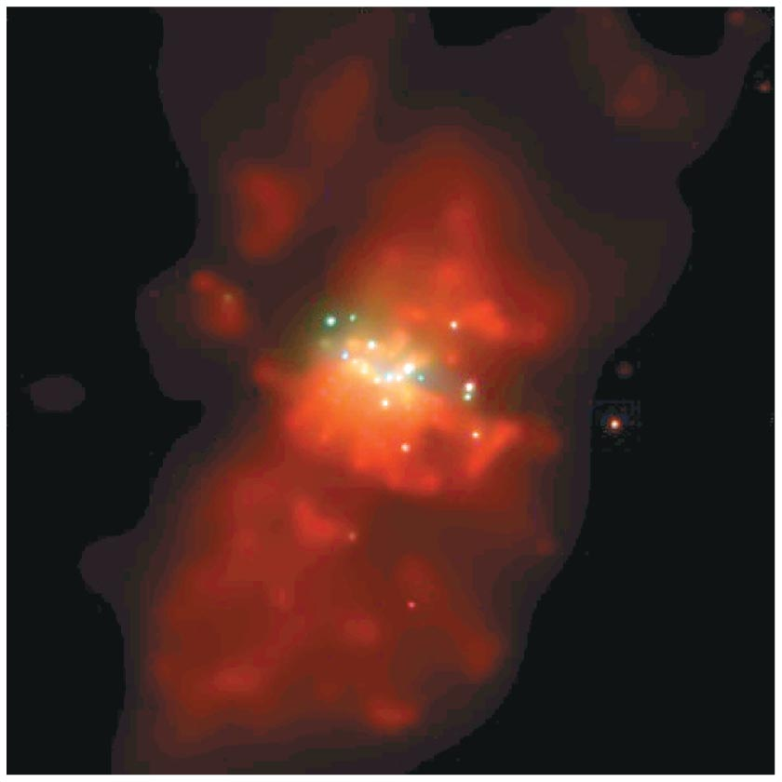
X-ray
image
Intensity of supernova explosions in starburst galaxies can drive galactic winds.

Slide 28
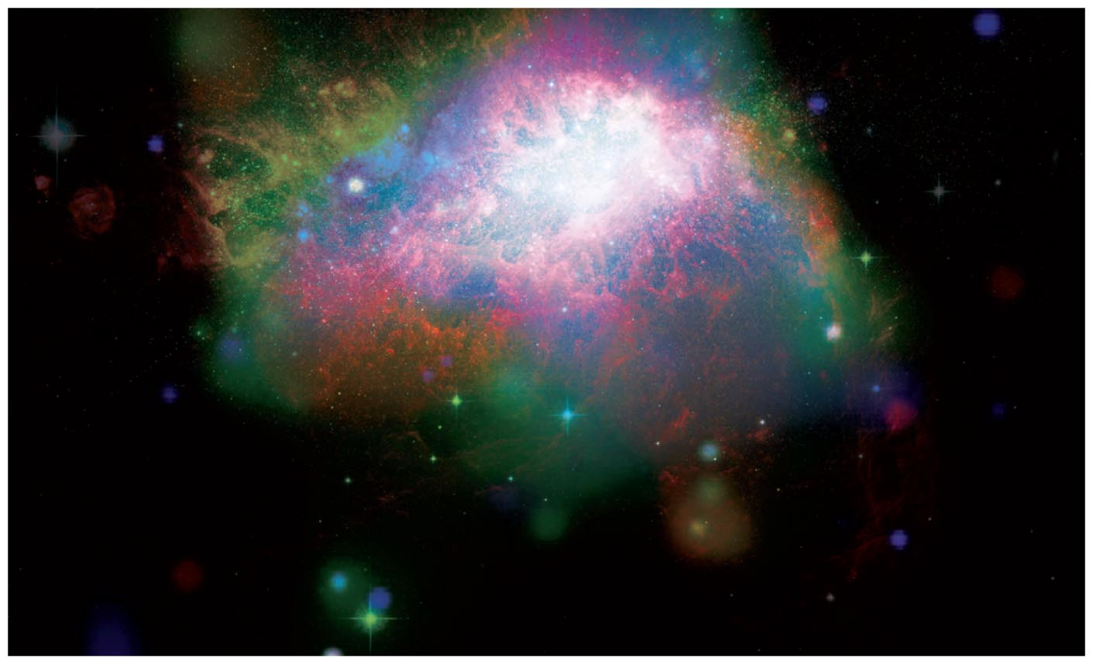
A galactic wind in a small galaxy can drive away most of its gas.

Slide 29
What have we learned?
Why do galaxies differ?
  Some of the differences between galaxies may arise from the conditions in their protogalactic clouds.
  Collisions can play a major role because they can transform two spiral galaxies into an elliptical galaxy.
What are starbursts?
  A starburst galaxy is transforming its gas into stars much more rapidly than a normal galaxy.

Slide 30
21.3 Quasars and Other Active Galactic Nuclei
Our goals for learning:
  How are quasars powered?
  Do supermassive black holes really exist?
  How do quasars let us study gas between the galaxies?

Slide 31
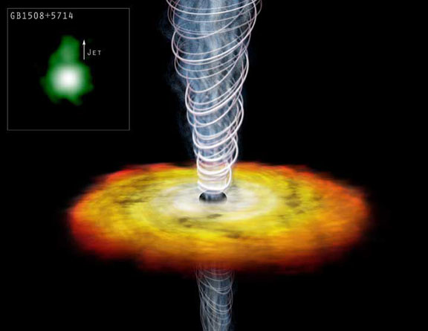
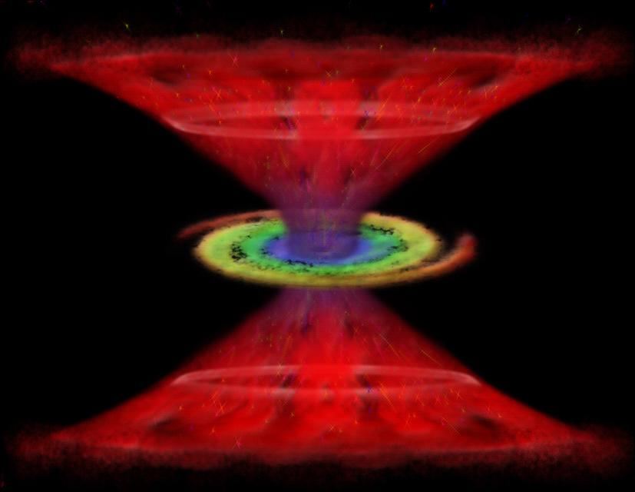
Quasars and Active Galaxies

Slide 32
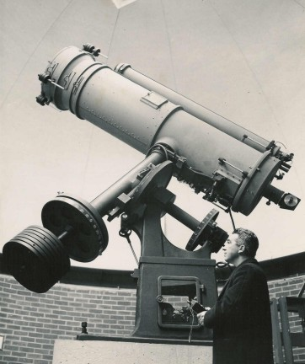
The Discovery of Active Galactic Nuclei
Carl Seyfert at the Mount Wilson observatory in California first observed that a few percent of spiral galaxies contain intense blue nuclei. Such spiral galaxies are now called Seyfert galaxies.
The spectra of Seyfert galaxies show strong emission lines of the type typically produced by ionized gas.

Slide 33
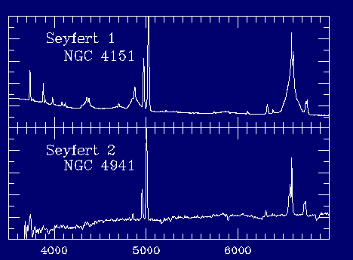
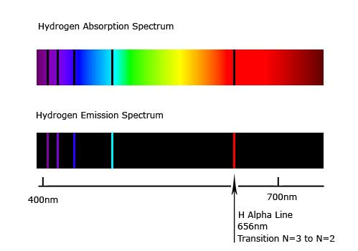
The Discovery of Active Galactic Nuclei
Seyfert galaxies are observationally grouped into ones that show broad and narrow emission lines (Type I Seyferts) and ones that show only narrow emission lines (Type II Seyferts)
The narrow lines are thought to be produced by low density ionized gas with n_{e} ~10³ - 10⁶cm⁻³ producing forbidden narrow lines with widths of ~100 km/s
The broad lines are thought to come from higher density ionized gas with n_{e} > 10⁹ cm⁻³ producing permitted lines with widths of up to 10⁴ km/s

Slide 34
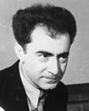
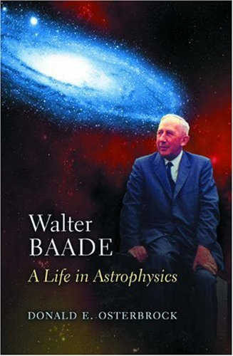
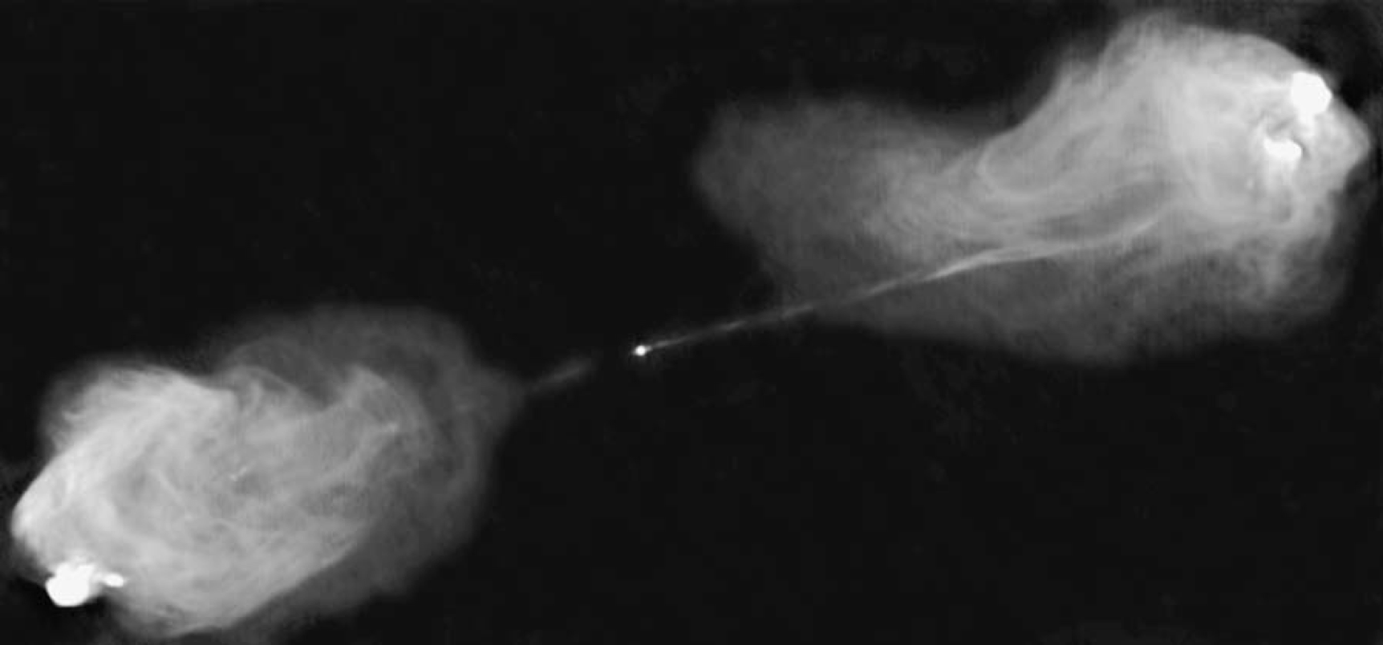
The Discovery of Active Galactic Nuclei
The Armenian astronomer Markarian discovered that some elliptical galaxies also harbor bright blue nuclei.
In 1954 Walter Baade of the Mount Wilson and Palomar Observatories was able to identify that a faint galaxy at a redshift of 0.05 was associated with the bright radio source Cygnus A.
Soon after Baade’s discovery radio observations showed that the radio emission was emanating from two distinct patches placed symmetrically about the galaxy at ¼ million light-years on each-side.

Slide 35
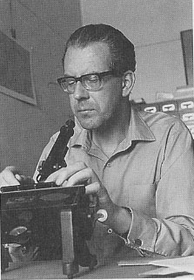
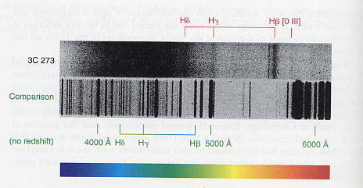
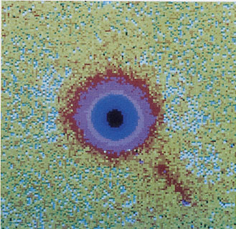
The Discovery of Quasars
In 1963 Hazard using the Parkes Radio Telescope obtained an accurate position of the radio source 3C 273.
The accurate position of 3C 273 allowed Maarten Schmidt to locate the optical counterpart of 3C 273 and obtain its optical spectrum.
The first breakthrough that lead to the understanding of quasars was the realization by Maarten Schmidt that the emission lines detected in 3C 273 were significantly redshifted Balmer lines.
3C 273

Slide 36
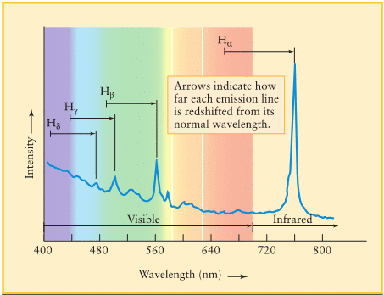
The Discovery of Quasars
The large distances of quasars was revealed by their redshifts.
Caution: When a photon travels from a distant object to us the Universe is expanding during its travel so the distance between the object and us has increased by the time the photon gets to us.
The relationship between redshift and distance depends on the cosmological model assumed for the expansion of the Universe!
Maarten Schmidt from Caltech first realized that the emissions lines in 3C 273 were significantly redshifted Balmer lines.
Schmidt determined that 3C 273 has a
redshift of z = 0.158 which corresponds to a comoving distance of ~ 2 ×10⁹ ly.

Slide 37
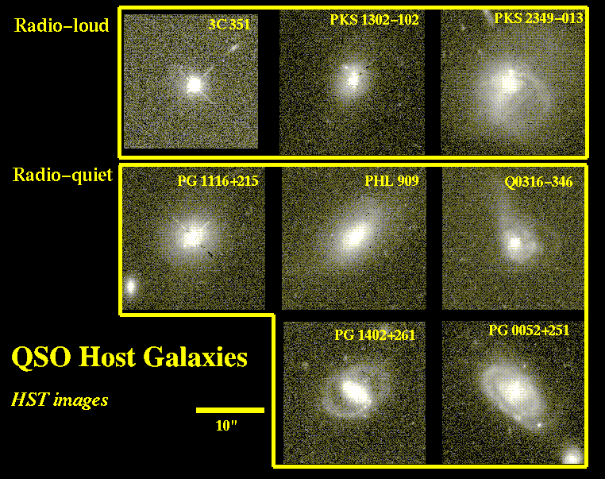
The Discovery of Quasars
Quasars are more luminous versions of Seyfert galaxies. HST observations found that quasars reside in galaxies.
About 10% of quasars are radio loud and ~90% radio quiet.
Quasar luminosities are calculated from distances inferred from redshifts, the apparent brightnesses and using the inverse square law.
The average luminosity of 3C 273 is about 10⁴⁰ watts (L~3.9×10²⁶ watts and L_{Milky Way} ~ 10³⁷ watts)
Most radio-loud quasars reside in the centers of elliptical galaxies. Nearby (z < 0.2) radio-quiet quasars reside mostly in spiral galaxies and distant (z > 0.2) radio-quiet quasars reside in either spiral or elliptical galaxies.

Slide 38
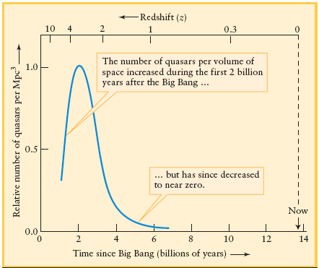
Evolution of Quasars
There are no quasars nearby. The nearest quasar known is ~ 800 million ly away. The number density of quasars peaked around redshift of 3-4 corresponding to a look back time of about 10 billion years.

Slide 39
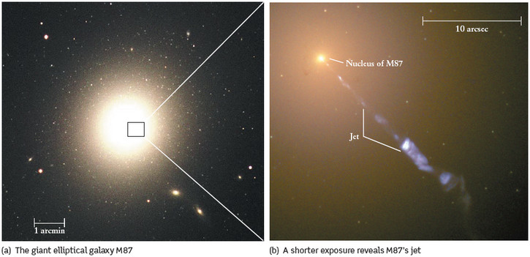
Radio Galaxies
Certain galaxies (especially elliptical ones) have strong radio sources in their centers and resemble dim radio-loud quasars. Such galaxies that emit large amounts of radio waves are called radio galaxies. In the center of elliptical galaxy M87 lies a strong compact radio (~ 7 ly) source. A jet extends outwards some 1000 ly.

Slide 40
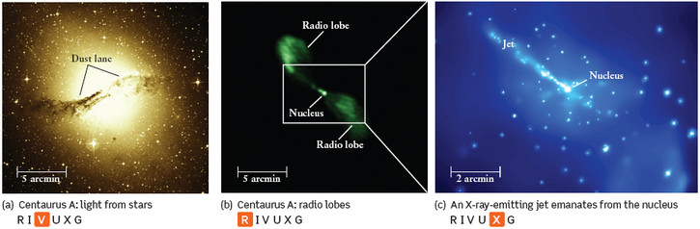
Jets and Radio Lobes in Radio Galaxies
Images of Centaurus A. Jets of charged particles are often ejected from the centers of radio galaxies. When these jets collide with dense clouds in the intergalactic medium they convert their kinetic energy into electromagnetic radiation that appears as bright lobes on either side of the galaxy.
The emission from the jets and lobes is partially polarized supporting the model of relativistic charged particles being accelerated in these jets. The distance between the lobes can be >10 times larger than the size of the galaxy.

Slide 41
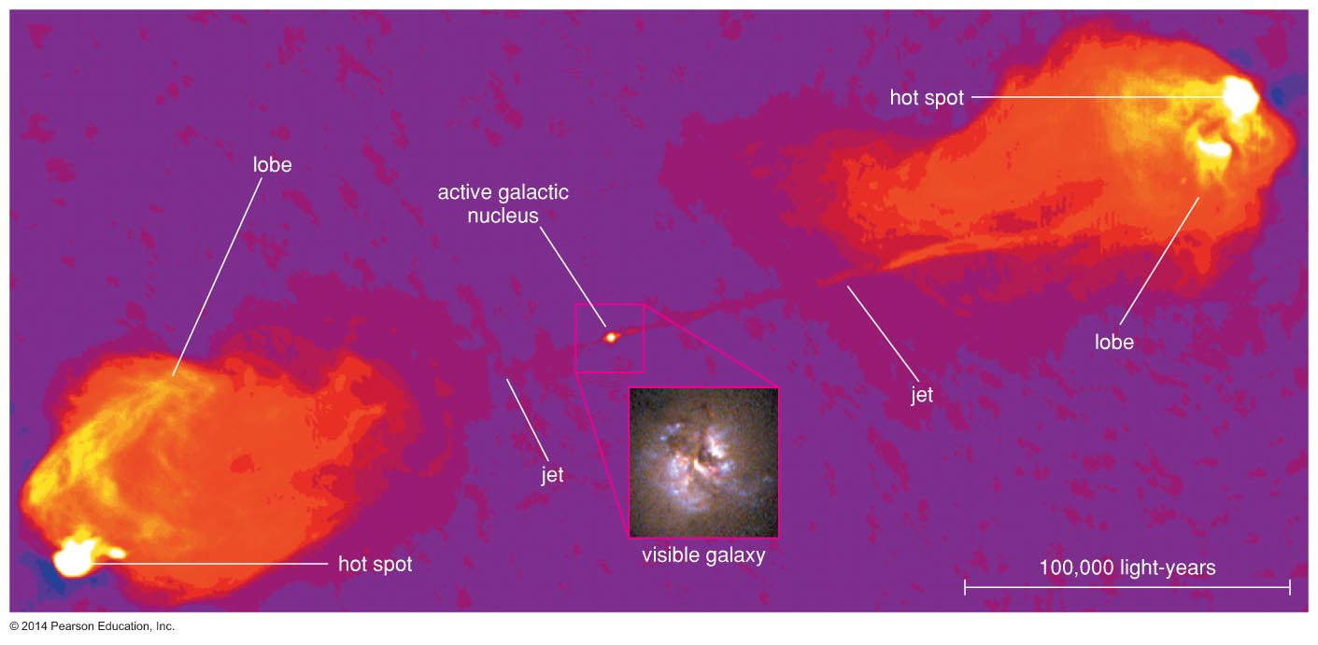
Radio galaxies contain active nuclei shooting out vast jets of plasma that emits radio waves coming from electrons that move at near light speed.

Slide 42
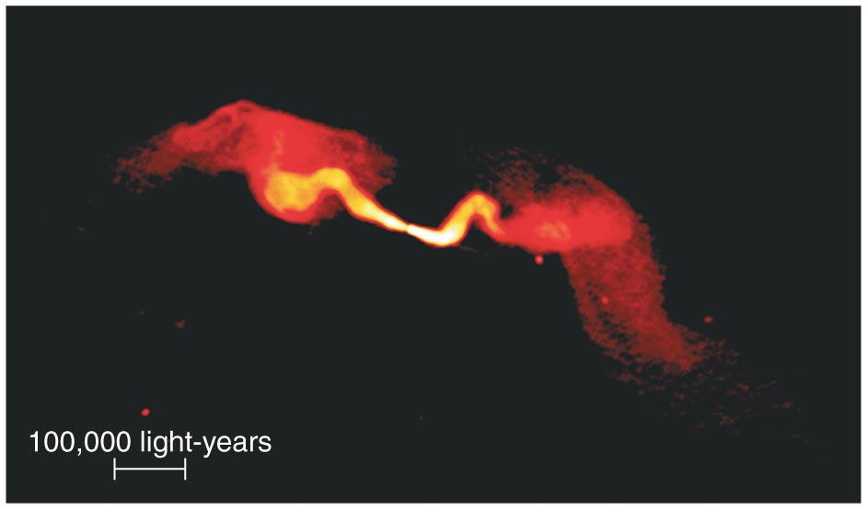
The lobes of radio galaxies can extend over hundreds of thousands of light-years.

Slide 43
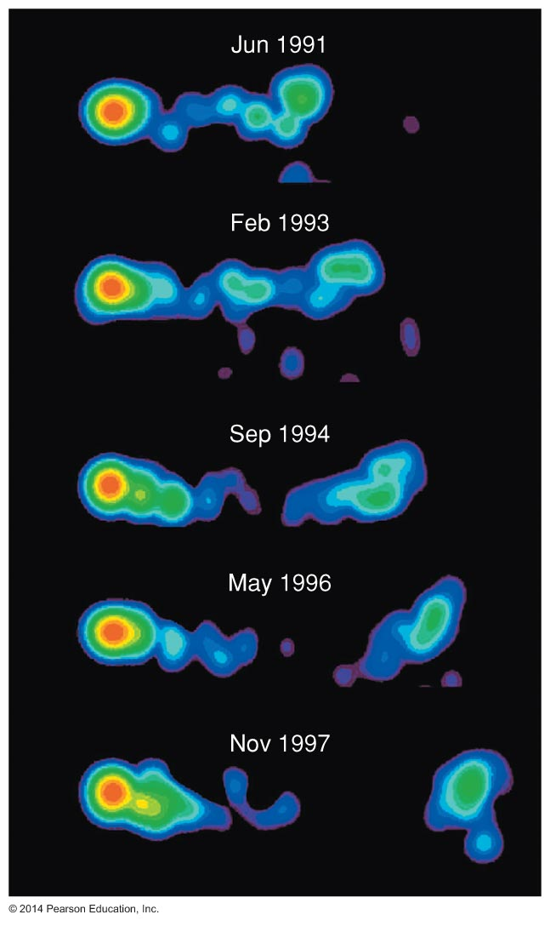
An active galactic nucleus can shoot out blobs of plasma moving at nearly the speed of light.
These ejection speeds suggests the presence of a black hole.

Slide 44
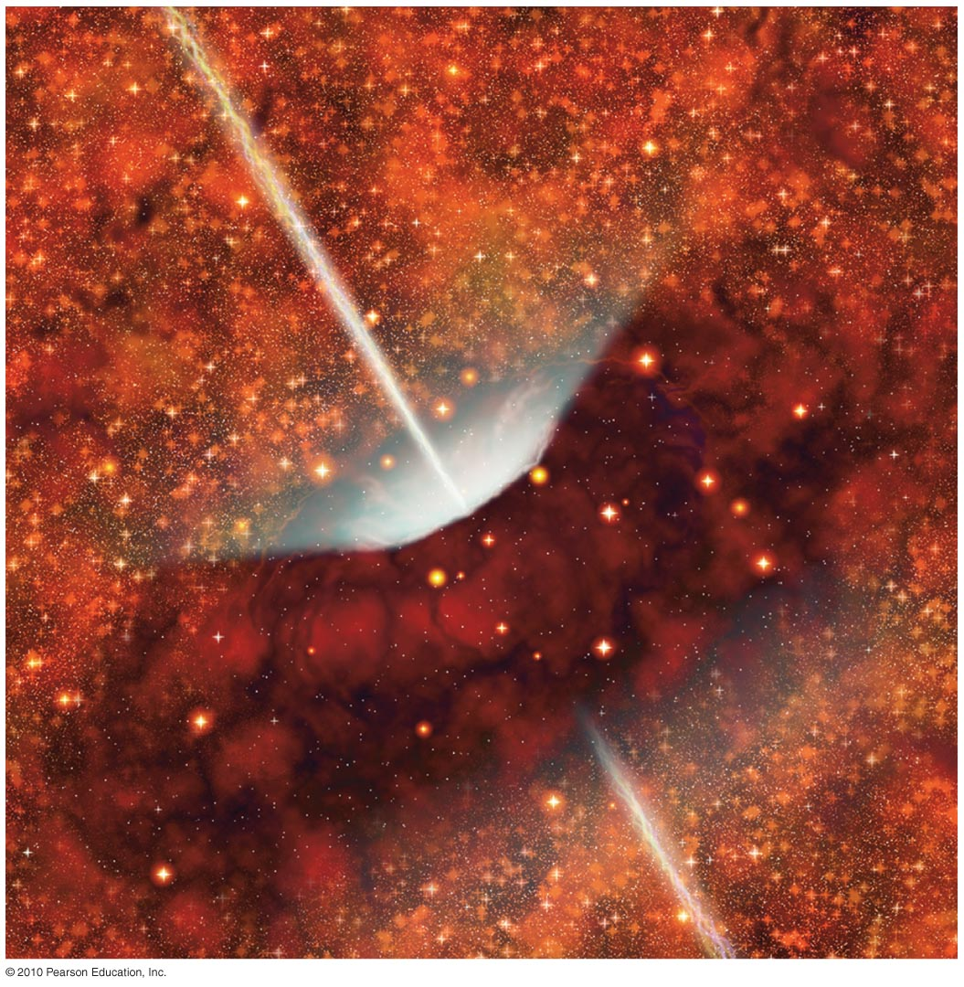
Radio galaxies don't appear as quasars because dusty gas clouds block our view of the accretion disk.

Slide 45
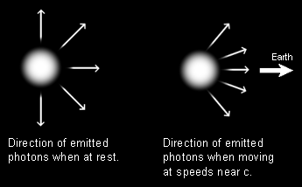
Beaming
The luminosity of a jet is increased due to various relativistic effects including beaming and time dilation.
Beaming Angle:
Half of the opening angle
is θ = 1/γ,
A sphere at rest emits photons in all directions (not all are shown). If the sphere is moving at relativistic speeds then we would observe these same photons to be emitted from a cone centered around the direction of motion.

Slide 46
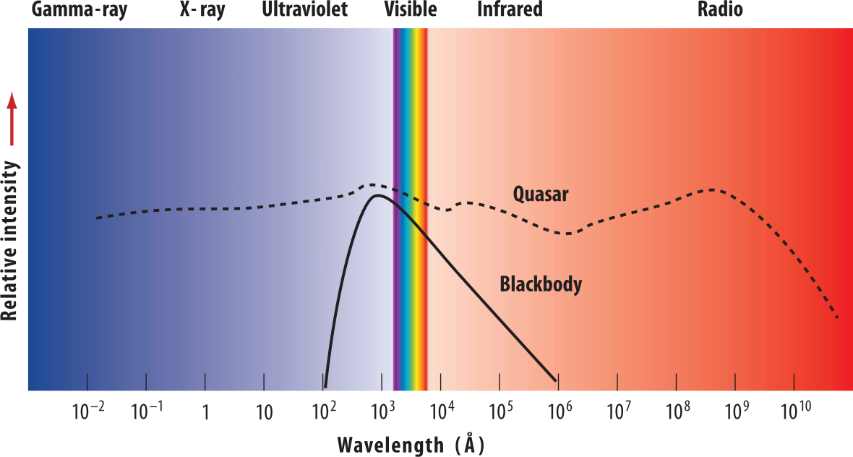
Properties of AGN
The surface of stars emit approximately blackbody radiation whose spectrum has a characteristic shape and peaks at shorter wavelengths for hotter bodies.
A spectrum of a quasar, however, shows that energy is distributed over a much broader range of wavelengths. This is because several regions of different temperature contribute to the total spectrum and also because some of the emission comes from processes (such as synchrotron radiation) that do not have a well defined temperature.

Slide 47
Properties of AGN
Thermal radiation is caused by the random thermal motion of the atoms
and molecules that make up the emitting object. Any body with some temperature emits thermal radiation. The wavelength of the peak of the spectrum decreases with increasing temperature.
The spectra of stars resemble that of a blackbody spectrum. Superimposed on this are usually absorption lines. The spectrum of a normal galaxy is just the sum of the spectra of the stars in the galaxy smeared by the Doppler effect.
Non thermal radiation is radiation other than that emitted by a heated body
One type of non thermal radiation is called synchrotron and is produced by relativistic electric charges accelerating in a strong magnetic field.
Relativistic means anything traveling close to the speed of light.

Slide 48
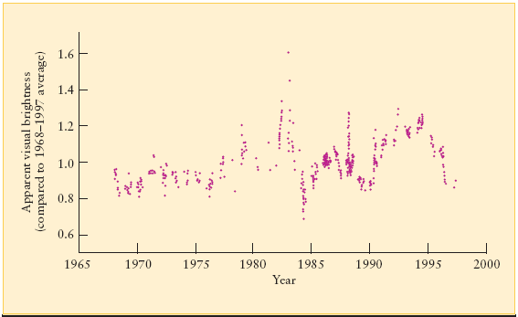
Variability of AGN
This graph shows variations over a 29-year period in the apparent brightness of the quasar 3C 273. One property that is common in most types of AGN is variability. If a source of size D_{source} varies significantly over a time interval t_{var} (rest frame) then the size of the source is smaller than the distance light travels in that time interval.
D_{source} < c t_{var} = ct_{obs}/(1+z), were t_{var} and t_{obs} are in the objects rest frame and observed frame, respectively.

Slide 49
Eddington Limit
A quasar consists of a supermassive black hole that accretes material through an accretion disk. The accretion disk radiates as it is heated up. The amount a disk can radiate is limited to a maximum luminosity called the Eddington Luminosity.
If the disk radiates above the Eddington limit, radiation pressure produced by outgoing photons in the disk will overcome the pressure produced by gravity as material is accreted onto the black hole.
Example: Estimate the black hole mass of 3C 273. L_{3C273} = 10¹³L
Since the true luminosity of 3C 273 (L_{3C273}) must be less than L_{Edd} its black hole mass (M_{3C273}) is greater than :
M_{3C273} > L_{3C273} M/(30,000L).

Slide 50
Characteristics of Active Galaxies
Their luminosities can be enormous (>10¹² L_{Sun}).
Their luminosities can rapidly vary (come from a space smaller than solar system).
They emit energy over a wide range of wavelengths (contain matter with a wide temperature range).
Some galaxies drive jets of plasma at near light speed.

Slide 51
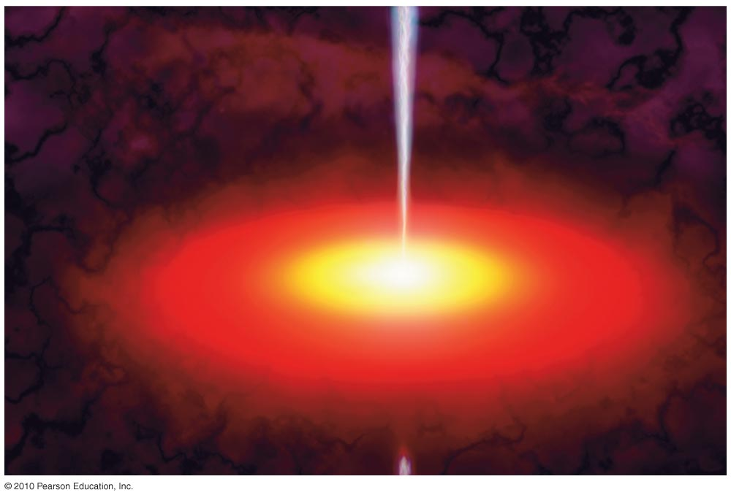
Accretion of gas onto a supermassive black hole appears to be the only way to explain all the properties of quasars.

Slide 52
Energy from a Black Hole
Gravitational potential energy of matter falling into black hole turns into kinetic energy.
Friction in an accretion disk turns kinetic energy into thermal energy (heat).
Heat produces thermal radiation (photons).
This process can convert 10 to 40% of
E = mc² into radiation.

Slide 53
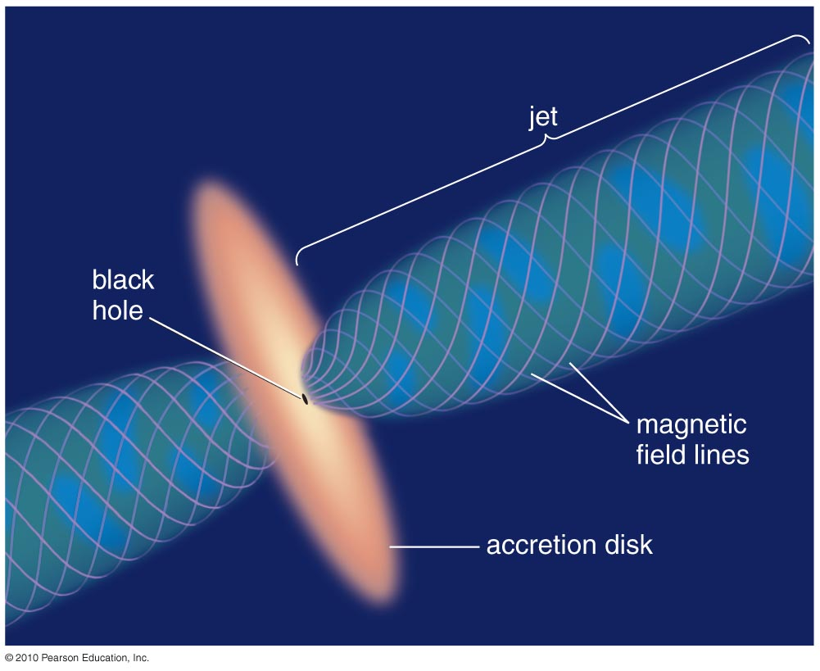
Jets are thought to come from twisting of magnetic field in the inner part of accretion disk.

Slide 54
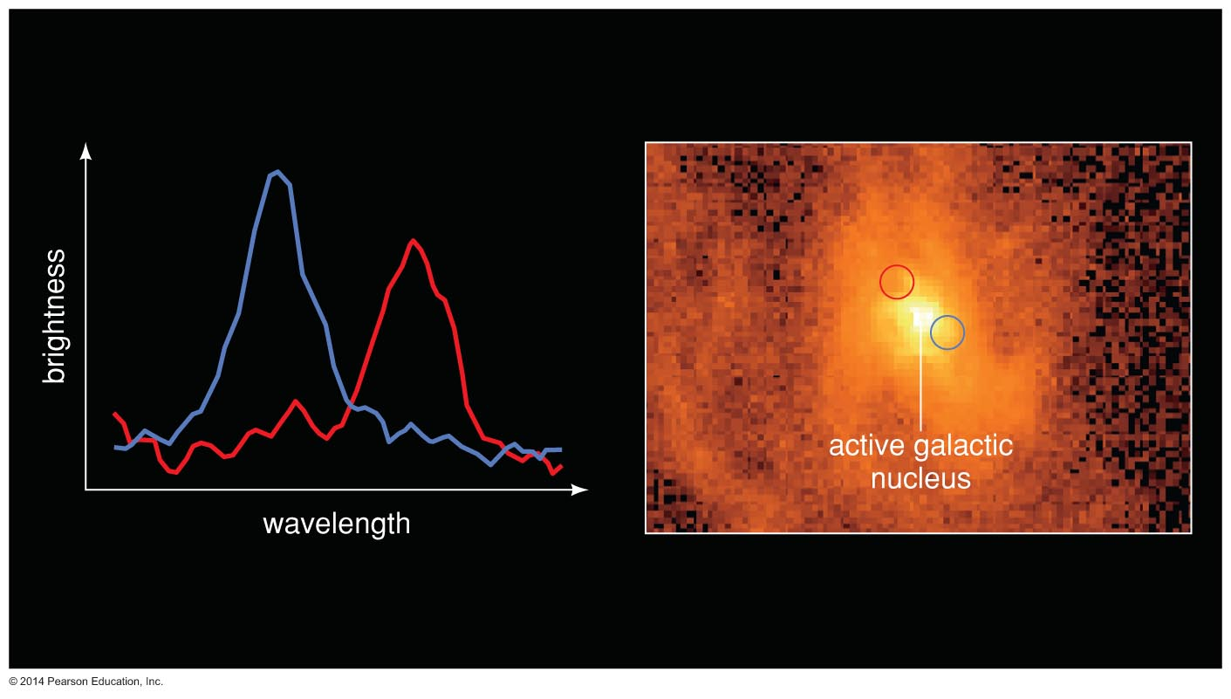
Do supermassive black holes really exist?

Slide 55
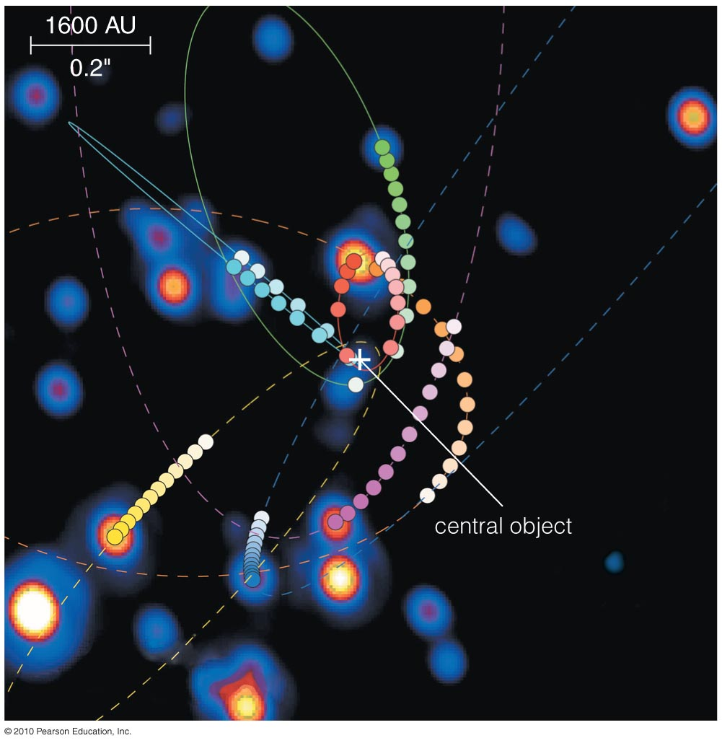
Orbits of stars at center of Milky Way stars indicate a black hole with mass of 4 million M_{Sun}.

Slide 56
The orbital speed and distance of gas orbiting the center of Galaxy M87 indicate a black hole with mass of 3 billion M_{Sun}.

Slide 57
Black Holes in Galaxies
Many nearby galaxies—perhaps all of them—have supermassive black holes at their centers.
These black holes seem to be dormant active galactic nuclei.
All galaxies may have passed through a quasar-like stage earlier in time.

Slide 58
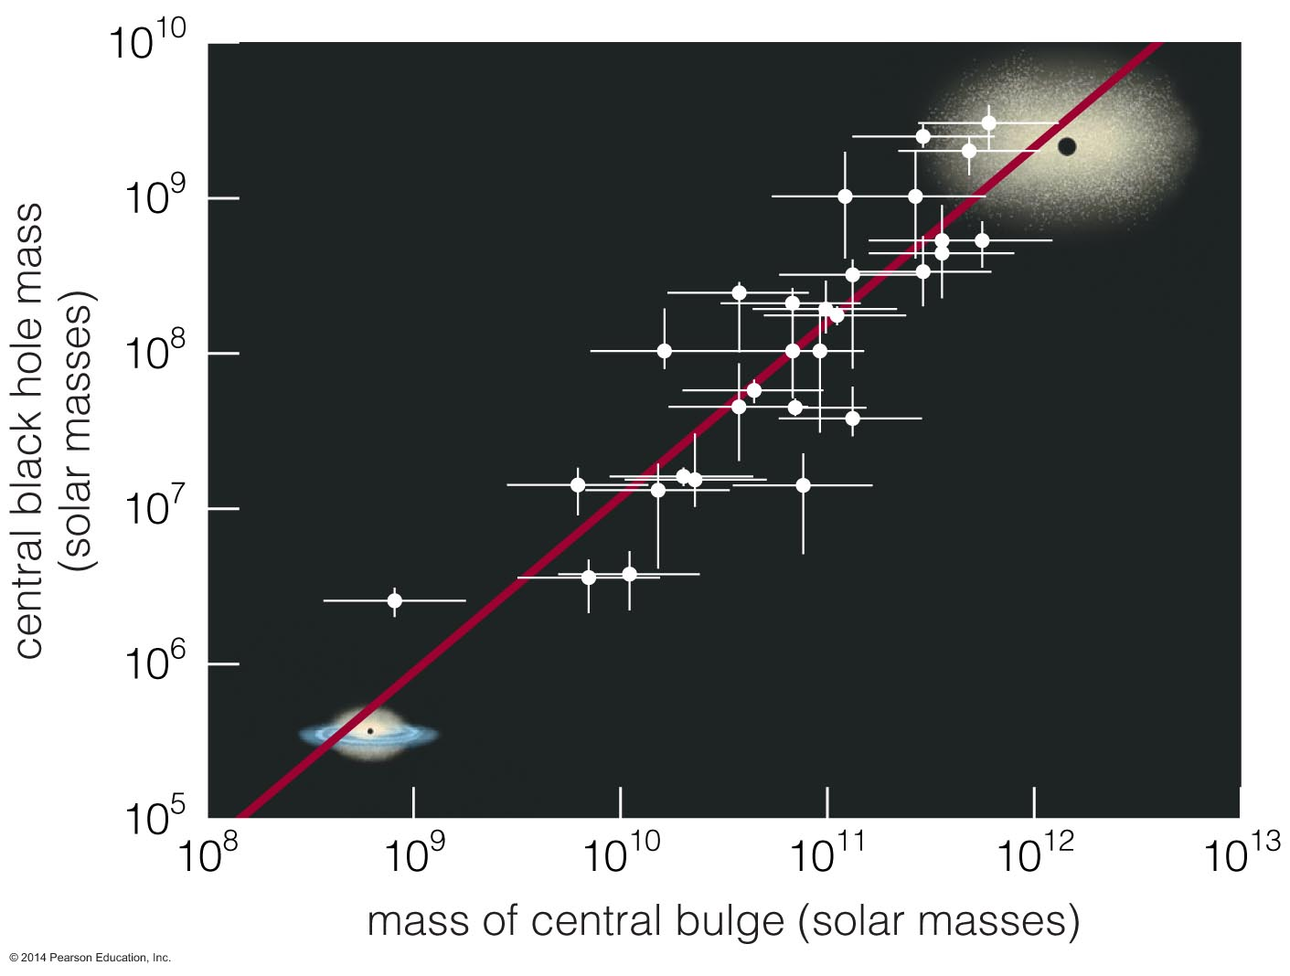
Galaxies and Black Holes
The mass of a galaxy's central black hole is closely related to the mass of its bulge.

Slide 59
Galaxies and Black Holes
The development of the central black hole must be somehow related to galaxy evolution.

Slide 60
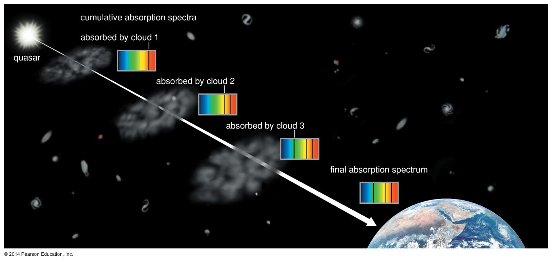
How do quasars let us study gas between the galaxies?

Slide 61
Gas clouds between a quasar and Earth absorb some of the quasar's light.
We can learn about protogalactic clouds by studying the absorption lines they produce in quasar spectra.

Slide 62
What have we learned?
How are quasars powered?
  Active galactic nuclei are very bright objects seen in the centers of some galaxies, and quasars are the most luminous type.
  The only model that adequately explains the observations holds that supermassive black holes are the power source.

Slide 63
What have we learned?
Do supermassive black holes really exist?
  Observations of stars and gas clouds orbiting at the centers of galaxies indicate that many galaxies, and perhaps all of them, have supermassive black holes.
How do quasars let us study gas between the galaxies?
  Absorption lines in the spectra of quasars tell us about intergalactic clouds between those quasars and Earth.

